Slide 1
Getting Data in the Lab
LabVIEW, Data Acquisition,
and Instrument Control
Dr. Jason D. Sommerville
President, UPVI, LLC.
jason.sommerville@upvi.net
www.upvi.net
Copyright © 2015 UPVI, LLC. Redistribution is prohibited.

Slide 2
Getting Data in the Lab
Part 2: Data Acquisition
Copyright © 2015 UPVI, LLC. Redistribution is prohibited.

Slide 3
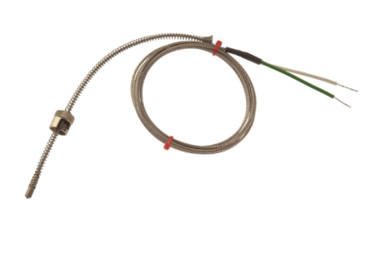
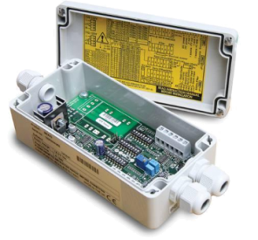
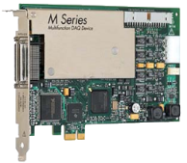
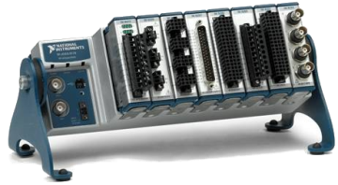

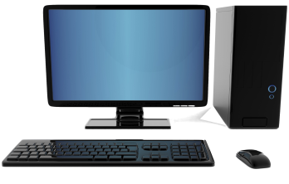

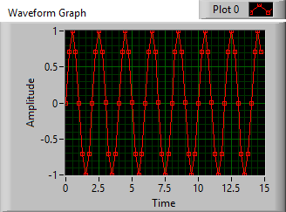

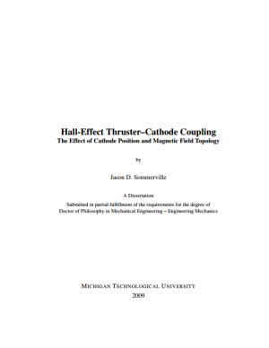




Transducer
Signal Conditioner
DAQ Hardware
Thermocouple
Amplifier, Low pass filter
NI CompactDAQ
Computer
Brought to you by IT
Phenomenon
Plotting
Software Basics
Cooling of Tea
Thesis/
Dissertation
Graduate!
Analysis
Curve fitting
DAQ
Storing Data
Analog Input
HDF5 Files

Slide 4
Data Acquisition
Data Acquisition or DAQ is the process of converting real-world measurements into digital computer data
Signal measurement
Signal digitization
Moving the data to computer memory and/or disk
DAQ may also encompass signal generation
Waveform generation
Triggering
Control systems
All the components must be compatible with each other!
But we have to break it down in the lecture and handle one thing at a time
In 2016, if you’re writing data down by hand, you’re probably doing it wrong

Slide 5
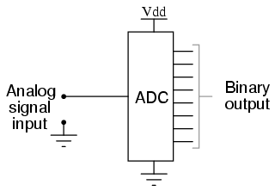
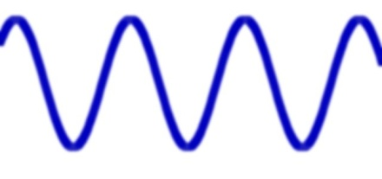
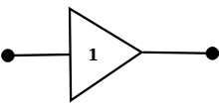

Types of DAQ: Signal Acquisition
Analog Input
Convert analog voltage signals into digital data
Single-shot or timed measurements
Use an analog-to-digital converter
Examples: temperature, sounds, voltage
101110110100 101110100101 011001100101
110011000101 011100101010 110110001000
Digital Input
Counter/Timers
Single-shot or timed
Single bit or bus
Example: proximity sensor, photointerrupter
Count events
Time events
Examples: encoders, pulse train timing, delay timing, delay generation
555
4, 5, 6, …
1 or 0
10 ms
Buffer
Counter/Timer
10 ms

Slide 6
Types of DAQ: Generation
Analog Output
Convert digital data into analog waveforms
Single-shot or timed generation
Use a digital-to-analog converter
Examples: sound, system excitation, motor control
101110110100 101110100101 011001100101
110011000101 011100101010 110110001000
Digital Output
Counter/Timers
Single-shot or timed
Single bit or bus
Generating a slow trigger, controlling an LED, controlling a bus
Control timing
Examples: Pulse train generation, delay generation
555
4, 5, 6, …
1 or 0
10 ms
Counter/Timer
10 ms
Buffer

Slide 7
Transducer
Signal Conditioner
DAQ Hardware
Transducer
Thermocouple
Amplifier, Low pass filter
NI CompactDAQ
Thermocouple
Computer
Brought to you by IT
Phenomenon
Plotting
Software Basics
Cooling of Tea
Thesis/
Dissertation
Graduate!
Analysis
Curve fitting
DAQ
Storing Data
Analog Input
HDF5 Files

Slide 8
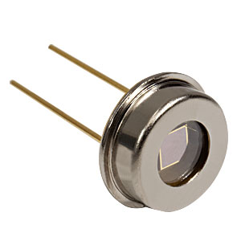
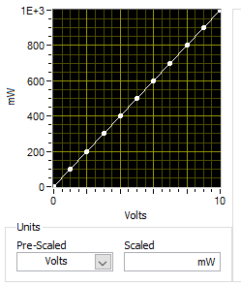
Transducers
Convert real world data into something that can be measured by a data acquisition device
Voltage
Current
Resistance
Input is related to output by a calibration curve or scale
(for analog transducers)
Also called sensors
A calibration curve for a photodiode

Slide 9
Transducer Menagerie
Temperature | Pressure | Flow
Thermocouple Thermistor RTD IC Temp Sensor IR Sensor Fiber Bragg Grating (FBG) | Piezo-resistive strain gauge Capacitive Electromagnetic Piezoelectric Microphone FBG Ion gauge | Differential Pressure Pitot tube Calorimetric Turbine Electromagnetic Ultrasonic
Light | Position/Velocity | Strain, weight, etc
Photodiode Phototransistor Photomultiplier Single-photon avalanche diode CCD/CMOS array | Optical Encoders (A,L) LVDT (L) Resolver (A) Potentiometer (A) String Pot (L) Radar (L) Laser interferometry (L) | Strain gauge Load cell Piezoelectrics

Slide 10
How to chose a transducer
What type of measurement do you need to make?
Calibration Curve
Range
Input range (25 – 300 ºC, 1 – 100 mN, etc.)
Output range (0 to 10V, -5 to 5 V, 4 to 20 mA, etc.)
Sensitivity—How well can change be detected?
How good is the measurement?
Accuracy (±1 ºC, ±0.1 mN, etc.)
Precision (repeatability)
Linearity—can be handled in software
Drift—Change in calibration over time
Hysteresis—is it the same going up as coming back down?
Timing
Response time
Bandwidth (1 Hz, 100 kHz – 1 MHz, etc.)
Other considerations
Analog or digital
Analog: voltage, current, impedance, etc.
What signal conditioning or excitation/power does it require?
How will I connect it to my DAQ system?
Environmental isolation
Voltage, temperature, noise, vacuum, water, etc.
Ruggedness
Cost
Q: Where do I find this stuff?
A: All this info should be on the transducer’s specification sheet
(which should be available from the manufacturer’s website)

Slide 11
Range
Range specifies the maximum and minimum values a transducer can accurately handle
Input range (or just “range”) is the values of the real world signals that can be accurately measured
0 – 100 degrees C
0 – 10 mN
-500 – 500 mm
Should cover the expected range of your physical system!
Output range is the corresponding range of output:
0 – 10 V
-2 – 5 V
4 – 20 mA
0 – 100 kΩ
Must work with your DAQ system!

Slide 12
Sensitivity
How much does the output change for a given change in input?
That is, the slope of the calibration curve
Units of output unit/physical unit
V / deg C
V / N
mV / mrad
mA / (L/s)
Tradeoff between sensitivity and range
Sensor may not be equally sensitive across its full range
I.e., calibration curve may not be linear

Slide 13
Example
Thermocouples measure the difference in temperature between the hot junction and the cold junction
There are different types of thermocouples for different temperature ranges
More reading: http://www.ni.com/white-paper/4218/en/

Slide 14
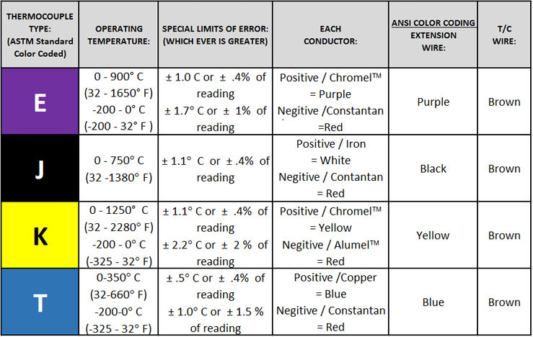
Range: Choosing a thermocouple
http://www.temprel.com/support/how-to-choose-thermocouple.aspx

Slide 15
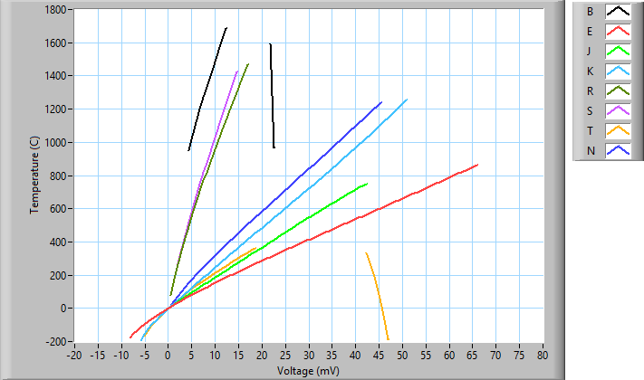
Linearity and Sensitivity: Ex: Choosing a thermocouple

Slide 16
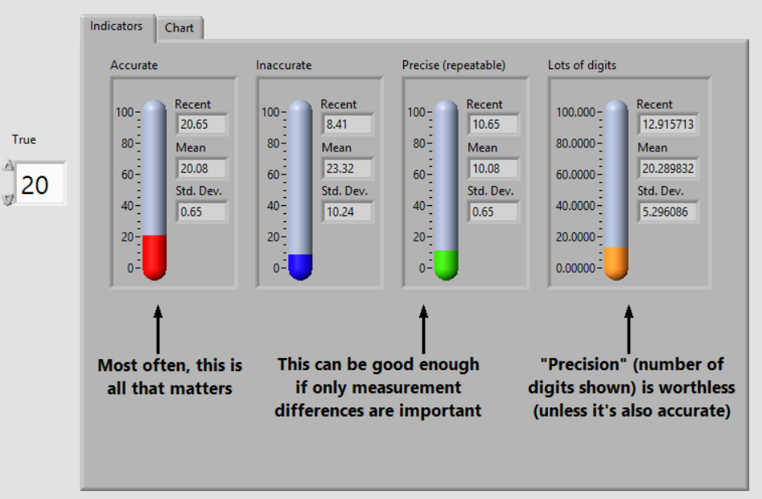
How well does it measure?

Slide 17
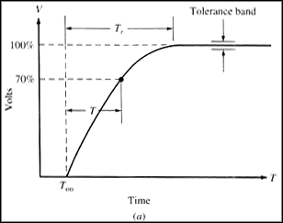
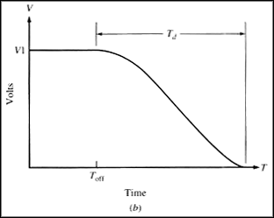
Response/Rise/Fall Time
How fast can the sensor respond to changes in the measured property?
Hall sensor
Rise Time
Fall Time

Slide 18

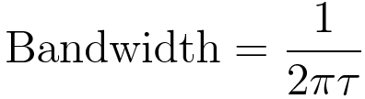
Bandwidth
Usually another way of specifying the response time
Note: Response time is typically given as 10% to 90% rise/fall

Slide 19
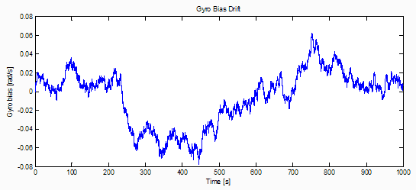
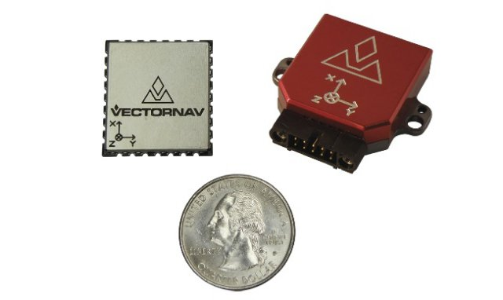
Drift
The calibration of a sensor may change over “long” periods of time
Temperature effects
Humidity effects
Aging effects
What is long? Depends on your measurement.
Source: http://www.vectornav.com/support/library/calibration

Slide 20
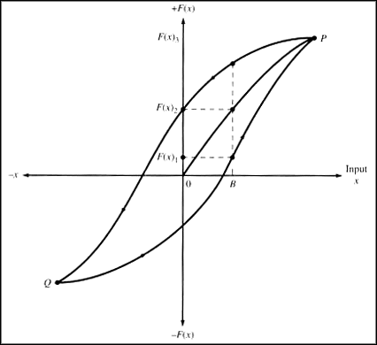
Hysteresis
Is it the same going up as coming down?
Image: http://www.ni.com/white-paper/14860/en/#toc8

Slide 21
Analog vs. Digital
Nearly all transducers are analog internally
However, some are packaged with dedicated ADCs, signal conditioners and may provide digital communication outputs
Analog
Digital
Voltage, current, impedance, etc.
Requires DAQ device
Typically faster
Sensor response time limits update speed
Typically cheaper
Transmission lines susceptible to noise
More difficult/expensive to isolate
Communicates via GPIB, RS-232, USB, Ethernet, etc.
May require interface card, or may be built into system
Typically slower and more expensive
Comm limits update speed
Typically more expensive
Less susceptible to noise
Easier to isolate

Slide 22
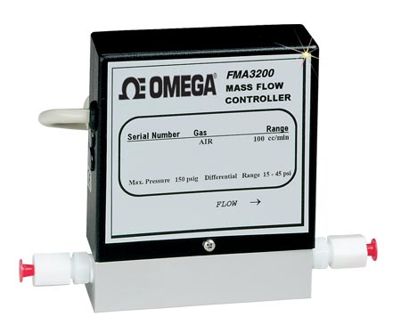
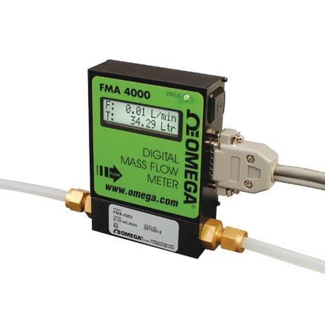
Example: Gas Flow Meter
Analog: Omega FMA-3103
Digital: Omega FMA-4102
No internal calibration curve
Analog output only
Output is linearized
=> internal signal conditioning
Update rate of 0.5 Hz
Cost: $375
Internal, programmable gas calibration curves
Interface: RS-232 or RS-485
Unspecified, probably about 2 Hz
Cost: $730
http://www.omega.com/pptst/FMA3100_3200_3300.html
http://www.omega.com/pptst/FMA4100_4300.html

Slide 23
Transducers: Other Considerations
What signal conditioning or excitation/power does it require?
How will I connect it to my DAQ system?
Cabling
Isolation (see next bullet)
Environmental isolation
Voltage, temperature, noise, vacuum, water, etc.
Ruggedness
Cost

Slide 24
How to chose a transducer
What type of measurement do you need to make?
Calibration Curve
Range
Input range (25 – 300 ºC, 1 – 100 mN, etc.)
Output range (0 to 10V, -5 to 5 V, 4 to 20 mA, etc.)
Sensitivity—How well can change be detected?
How good is the measurement?
Accuracy (±1 ºC, ±0.1 mN, etc.)
Precision (repeatability)
Linearity—can be handled in software
Drift—Change in calibration over time
Hysteresis—is it the same going up as coming back down?
Timing
Response time
Bandwidth (1 Hz, 100 kHz – 1 MHz, etc.)
Other considerations
Analog or digital
Analog: voltage, current, impedance, etc.
What signal conditioning or excitation/power does it require?
How will I connect it to my DAQ system?
Environmental isolation
Voltage, temperature, noise, vacuum, water, etc.
Ruggedness
Cost

Slide 25
Signal Conditioner
Transducer
Signal Conditioner
DAQ Hardware
Transducer
Amplifier, Low pass filter
Thermocouple
Amplifier, Low pass filter
NI CompactDAQ
Thermocouple
Computer
Brought to you by IT
Phenomenon
Plotting
Software Basics
Cooling of Tea
Thesis/
Dissertation
Graduate!
Analysis
Curve fitting
DAQ
Storing Data
Analog Input
HDF5 Files

Slide 26
Signal Conditioning
Modify the transducer output so that it can be accurately measured by the DAQ system
Some basic signal conditioning is often included with some transducers and some DAQ systems
X -> Voltage conversion
Amplification
Anti-aliasing filters
Amplification/Attenuation
Small signals (typ. <100 mV) should be amplified to a range readable by the ADC
Large signals (>5 – 10 V) voltage signals need to be attenuated
Filtering
Noise: use low-pass or notch filters to remove known noise sources
Anti-aliasing filter: a low-pass filter designed to prevent high-frequency components from being digitized and aliased by the DAQ system

Slide 27
Signal Conditioning (cont.)
Voltage Isolation
Allows signals at high potential differences to be safely connected to a DAQ system
Linearization
Corrects for non-linearities in the transducer
In modern systems this is usually done in software
Transconductance, etc.
Convert current signals to voltage signals
Other conversions possible as well (i.e. resistance to voltage, pulse-train to voltage, etc.)
Excitation
Some sensors, e.g. RTDs and strain gauges, require a power source to excite them
Not strictly signal conditioning

Slide 28
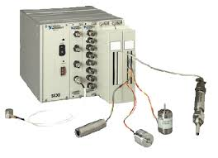
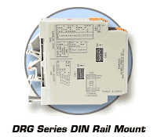
Signal Conditioning—Hardware
Amplifiers and filters often build into DAQ hardware
Rack and rail systems
NI SCXI
Omega DRG or OM7
Custom solutions
Build it yourself
NI SCXI
Omega DRG Module

Slide 29
Signal Conditioner
Signal Conditioner
DAQ Hardware
Transducer
DAQ Hardware
Amplifier, Low pass filter
Amplifier, Low pass filter
NI CompactDAQ
Thermocouple
NI CompactDAQ
Computer
Brought to you by IT
Phenomenon
Plotting
Software Basics
Cooling of Tea
Thesis/
Dissertation
Graduate!
Analysis
Curve fitting
DAQ
Storing Data
Analog Input
HDF5 Files

Slide 30
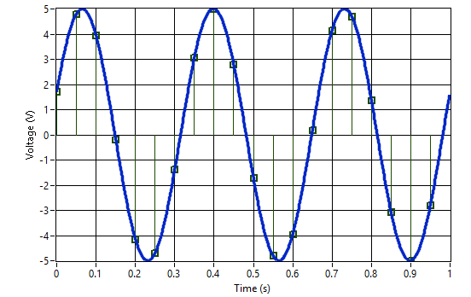
Analog Input Digitization
Digitized Samples
Sample Index | Time (s) | Voltage (V)
0 | 0.00 | 1.7101
1 | 0.05 | 4.80631
2 | 0.10 | 3.94005
3 | 0.15 | -0.174497
4 | 0.20 | -4.14519
5 | 0.25 | -4.69846
6 | 0.30 | -1.37819
7 | 0.35 | 3.07831
8 | 0.40 | 4.99695
9 | 0.45 | 2.79596
10 | 0.50 | -1.7101
11 | 0.55 | -4.80631
12 | 0.60 | -3.94005
13 | 0.65 | 0.174497
14 | 0.70 | 4.14519
15 | 0.75 | 4.69846
16 | 0.80 | 1.37819
17 | 0.85 | -3.07831
18 | 0.90 | -4.99695
19 | 0.95 | -2.79596
Analog signal: 3 Hz Sine
Sampling Period: 50 ms (20 Hz)

Slide 31
DAQ: Analog Input
Central component is the Analog-to-Digital (ADC) converter
Digitizes the analog signal and making a digital measurement available for storage in memory
ADC must be supported by amplifiers, clocks, multiplexers, and other items
Typical DAQ-AI system has the following parameters:
Differential vs. Single-ended inputs
Voltage range and polarity (bipolar or unipolar)
Gain settings
ADC resolution
Sampling speed and bandwidth
Multi-channel multiplexing

Slide 32
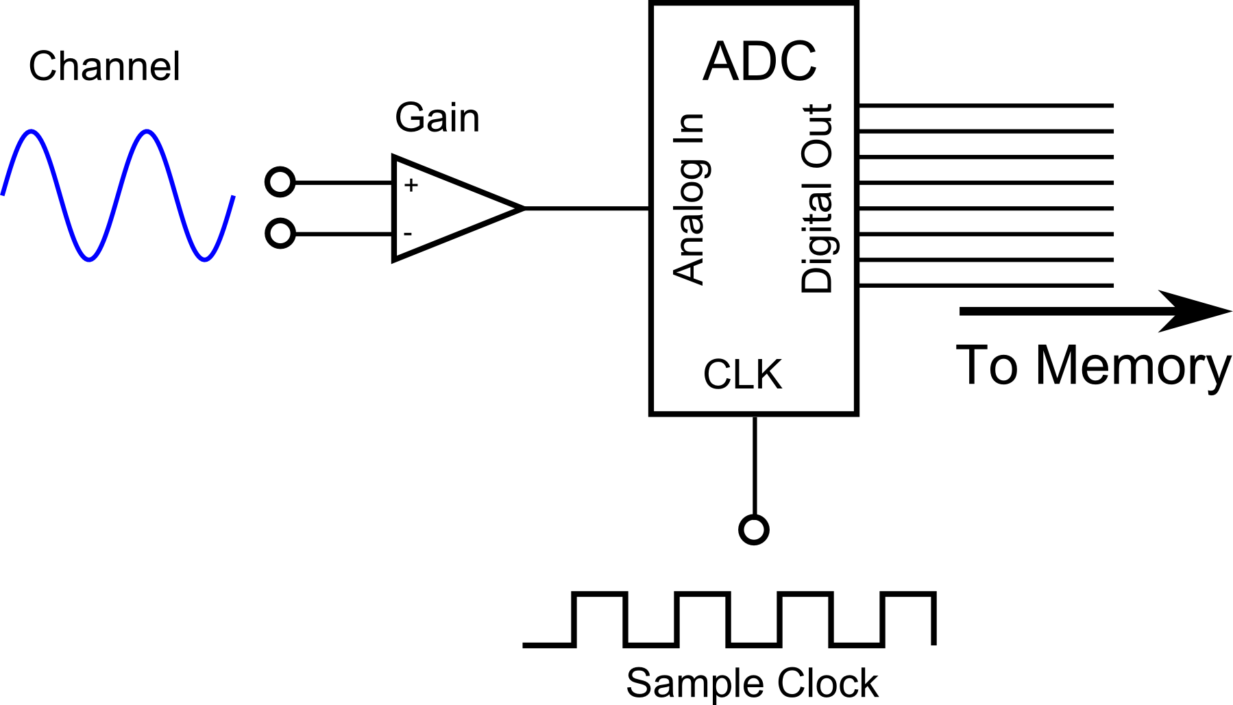
Analog Input
Differential Input (DI)

Slide 33
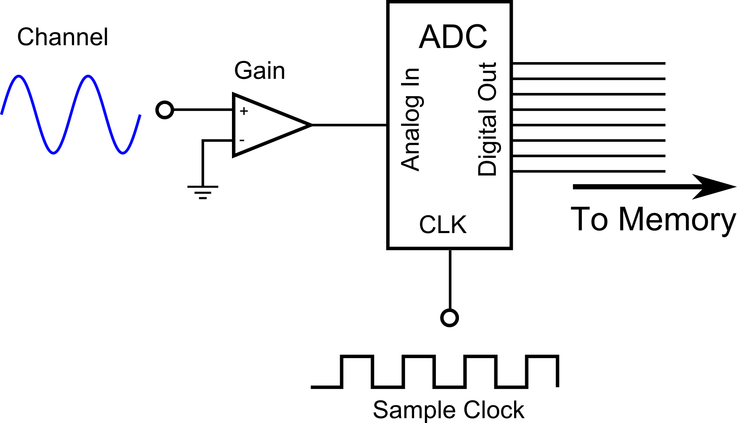
Analog Input
Single-ended Input (SE)

Slide 34
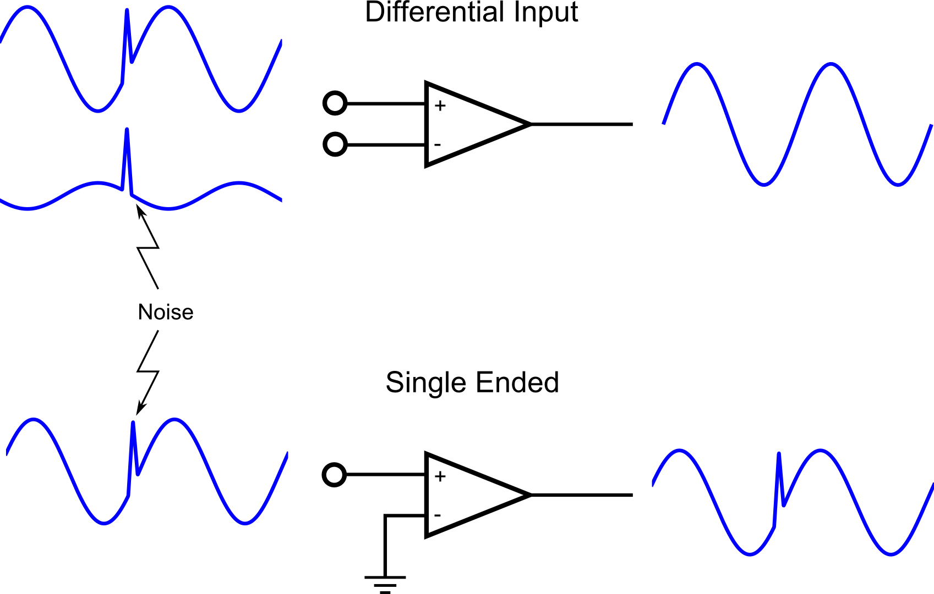
Analog Input: DI vs. SE

Slide 35
Analog Input: DI vs. SE
Differential Input
Single-Ended
Used with balanced signal lines
Less susceptible to noise
Less likelihood of ground loops
Lower channel count
Used with unbalanced signals
Increased susceptibility to noise
Increased likelihood of ground loops
Higher channel count
Differential Input Caveats
Voltage difference must be within DAQ range
Neither side must float too far from DAQ ground

Slide 36
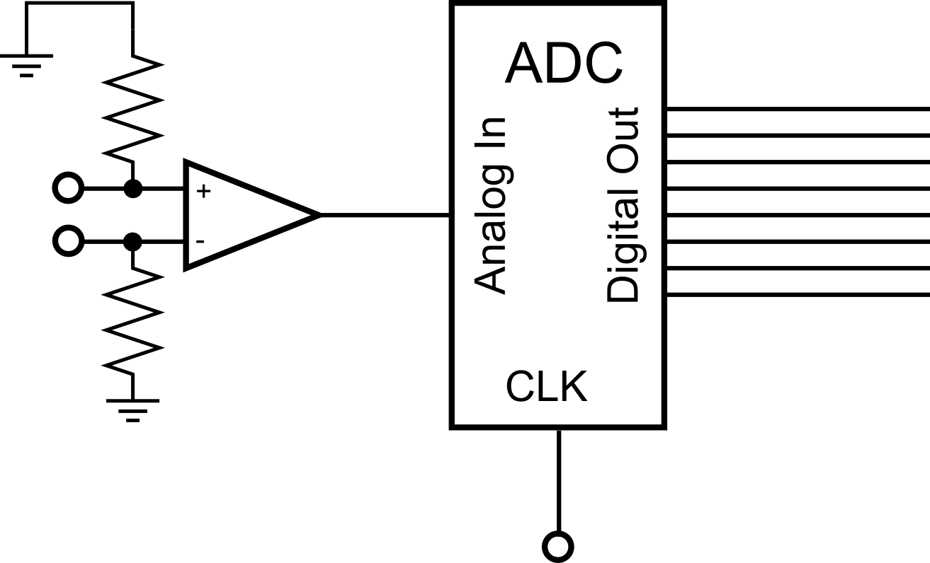
Bias resistors
Differential signals may float outside of the operating range of the ADC
Floating source: powered by batteries or isolated supply
Bias resistors can hold the voltages in range by preventing the source from floating
Make sure source is actually floating!
Value R should be such that:
Output impedance < R < Input impedance
Typically 10 kΩ – 100 kΩ
Further reading: http://www.ni.com/white-paper/3344/en/#toc3

Slide 37
Analog Input
Digitized Samples
Resolution: 16 bits across the range
Bi-polar, Range: ±5 V
Analog signal: 3 Hz Sine
Sampling Period: 50 ms (Rate is 20 Hz)

Slide 38
ADC Range and Polarity
Range: the maximum and minimum voltage that may be read
Unipolar: only read signals >= 0 V (or only <= 0, sometimes)
Bipolar: may read positive and negative signals
Most Common Ranges:
±5 V, ±10 V
Bi-polar, Range: ±5 V

Slide 39
Gain Settings
Configurable gain settings allow ADC to make more use of available ADC resolution
Note that noise is also amplified—better to amplify at source, if possible
Signal here must be (e.g.) ±5 V to make full use of ADC resolution
Gain is software-configurable

Slide 40
ADC Resolution
The resolution with which a signal can be measured, specified in bits
Resolution in volts is given by ADC Range, Gain setting, and ADC resolution
Note that sometimes the specified “range” will be the product of the smallest gain and range, or all range-gain products will be specified.
Most Common Resolutions:
8, 12, 16, 24
Example:

Slide 41
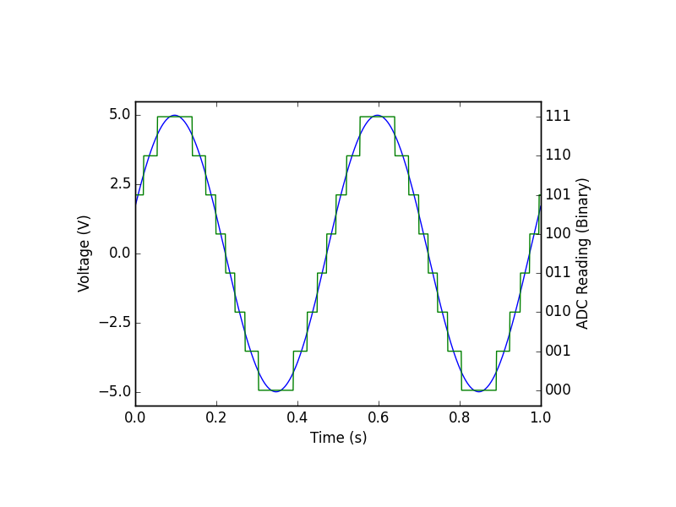
ADC Resolution: 3 bits

Slide 42
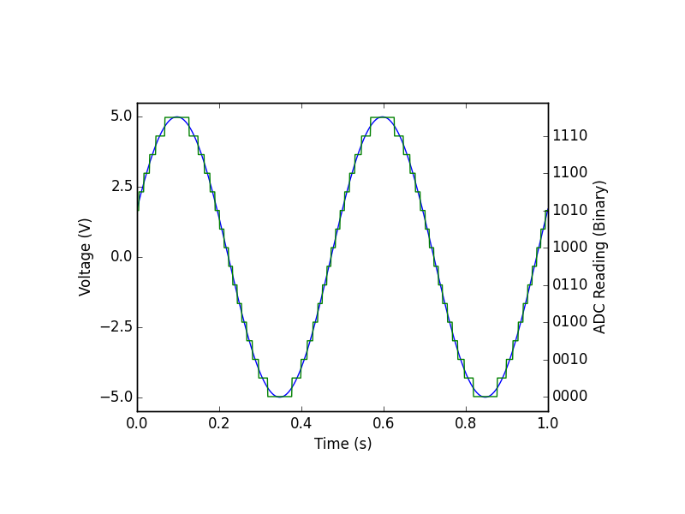
ADC Resolution: 4 bits

Slide 43
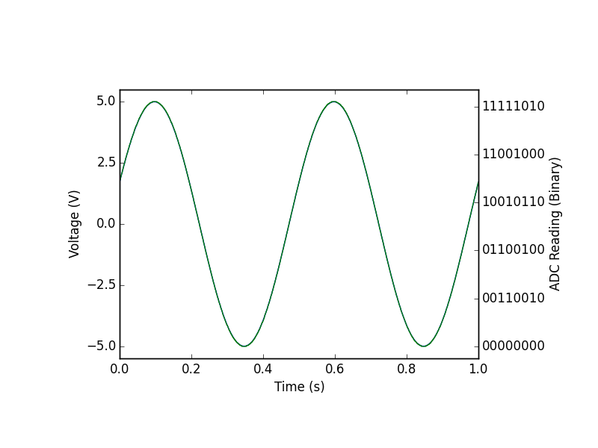
ADC Resolution: 8 bits

Slide 44
Sampling Speed
The maximum rate that the hardware can make ADC conversions
In samples per second
E.g. 250 S/s, 350 kS/S, 10 MS/s
Hardware or software controlled?
Low-end hardware must be clocked by software—very unreliable timing on modern OSes
Lab-quality software will use hardware timing
What about bandwidth?
A system may be able to sample above its bandwidth
Imagine putting a 10 Hz low-pass filter ahead of your 10 MS/s ADC
Bandwidth is set by the analog characteristics of the electronics
Bandwidth may be affected by your setup, esp. cabling.
Usually not a concern until you get to 10s – 100s of MHz

Slide 45
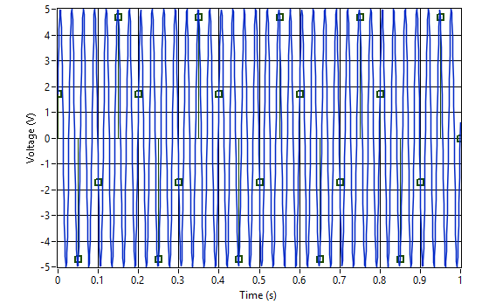
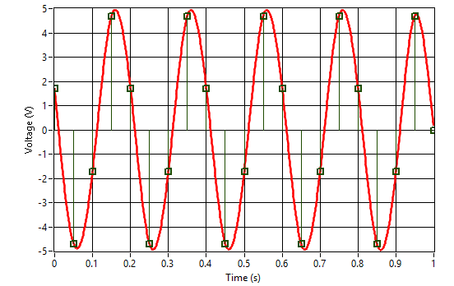
Undersampling
Digitized Samples
Undersampled data causes aliasing
The alias looks like a lower frequency signal
Analog signal: 35 Hz Sine
Sampling Period: 50 ms (20 Hz)
Alias Period: 200 ms (5 Hz)

Slide 46
Nyquist-Shannon Sampling Theory
“The sampling frequency must be greater than or equal to twice the bandwidth of the signal sampled to determine the frequency content of the sample.”
If bandwidth starts at 0 Hz (usual), BW is simply the maximum frequency component in our sample.
If you need to determine the non-sinusoidal shape of a signal repeating at X Hz

Slide 47
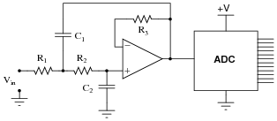
Anti-alias Filters
If you know you have frequency components which are not interesting, use an anti-alias filter.
Prevents aliasing by preventing the signal!

Slide 48
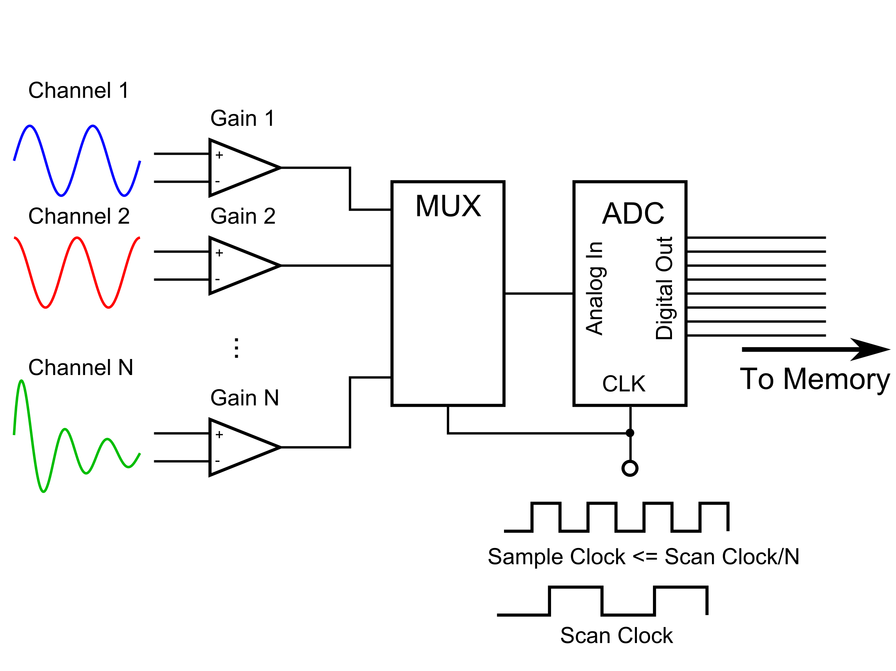
Analog Input: Multiplexing
Scan Clock: Acquire one data point from every channel
Sample Clock: Acquire one data point from any channel

Slide 49
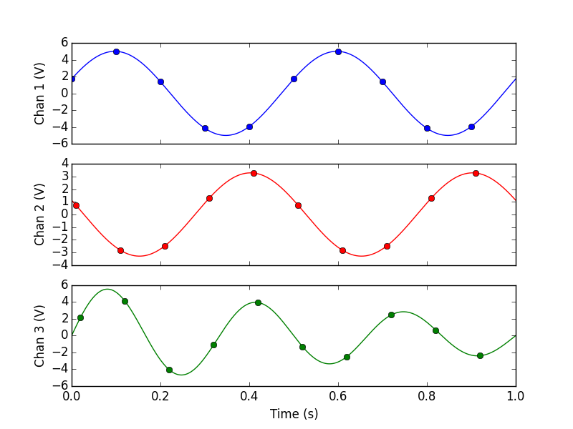
Analog Input: Time Skew
Sample Clock
100 Hz
Scan Clock
10 Hz

Slide 50
Dealing with Time Skew
Live with it
Does it really matter for your data?
Make sure you understand the effect it will have on your data
By far the most common solution
Sample-and-hold circuitry
An analog circuit which captures all channels’ voltages simultaneously
Allows ADC and MUX to cycle through sampled voltages at scan clock rate
Multiple ADCs

Slide 51
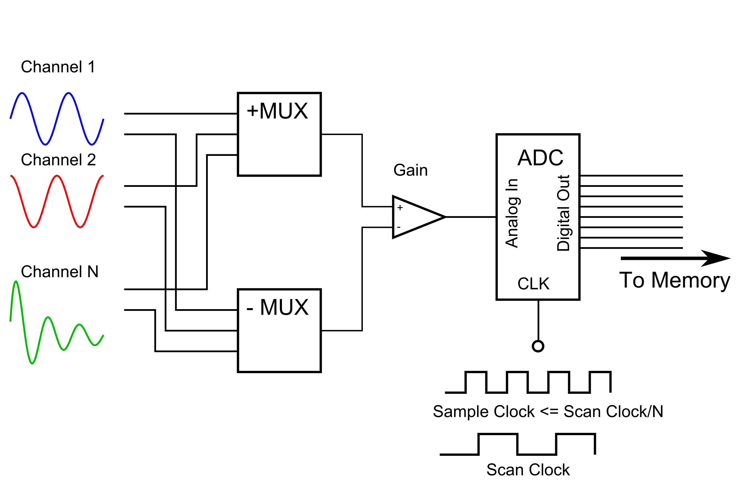
Analog Input: Full Disclosure
Gain circuitry actually comes after the MUXs in most designs.
This explains the tradeoff between DI/SE and channel count

Slide 52
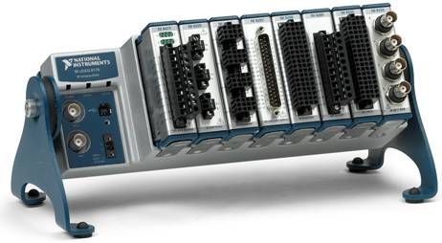
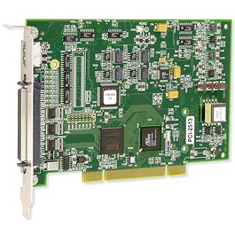
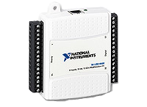
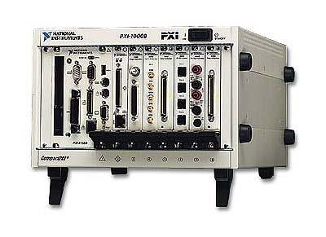
Some Examples
NI CompactDAQ Platform
USB connectivity or embedded controller
Modules support AI, AO, DIO Counter/timers, some signal conditioning
$800+
Meas. Computing PCI-2513
PCI card
16-bit AI 16 SE/8 DI
1 MS/s
DIO, counter/timers
$909
NI USB-6008
USB connectivity
12-bit AI 8 SE/4 DI
10 kS/s
2 AO
$189
NI PXIe Platform
Embedded controller or PCIe bridge
Modules support everything
$2000+

Slide 53
How to choose DAQ hardware
What type of signals do you need to acquire/generate?
How many channels of each type?
After external conditioning, what will the polarity and range of your signal be?
DI/SE?
What resolution do you need across that range?
What bandwidth do you need?
At what rate do you need to acquire/generate the data?
Note that bandwidth ≠ sampling frequency, but related
How precise are you timing requirements? Can you use software timing?
How much time-skew is acceptable?
Memory depth if signals cannot be transferred to system memory
Connectors
Form factor
Software interface
Front panel
Cost

Slide 54
Put some example systems here!

Slide 55
Signal Conditioner
Signal Conditioner
DAQ Hardware
Transducer
DAQ Hardware
Transducer
Amplifier, Low pass filter
Amplifier, Low pass filter
NI CompactDAQ
Thermocouple
NI CompactDAQ
Thermocouple
Computer
Computer
Brought to you by IT
Brought to you by IT
Phenomenon
Phenomenon
Software Basics
Plotting
Software Basics
Cooling of Tea
Plotting
Cooling of Tea
Thesis/
Dissertation
Thesis/
Dissertation
Analysis
Graduate!
Analysis
Graduate!
Curve fitting
Curve fitting
DAQ
DAQ
Analog Input
Storing Data
Analog Input
Storing Data
HDF5 Files
HDF5 Files

Slide 56
Analog Input Software
Making your hardware work for you
Hardware Driver
Provides the a software interface to the hardware
For NI it’s NI-DAQmx
NI-DAQmx terminology:
Channel: a single interface, e.g. one AI channel, one counter-timer, etc.
Task: A acquisition or generation of one or more data points on one or more channels of the same type.

Slide 57
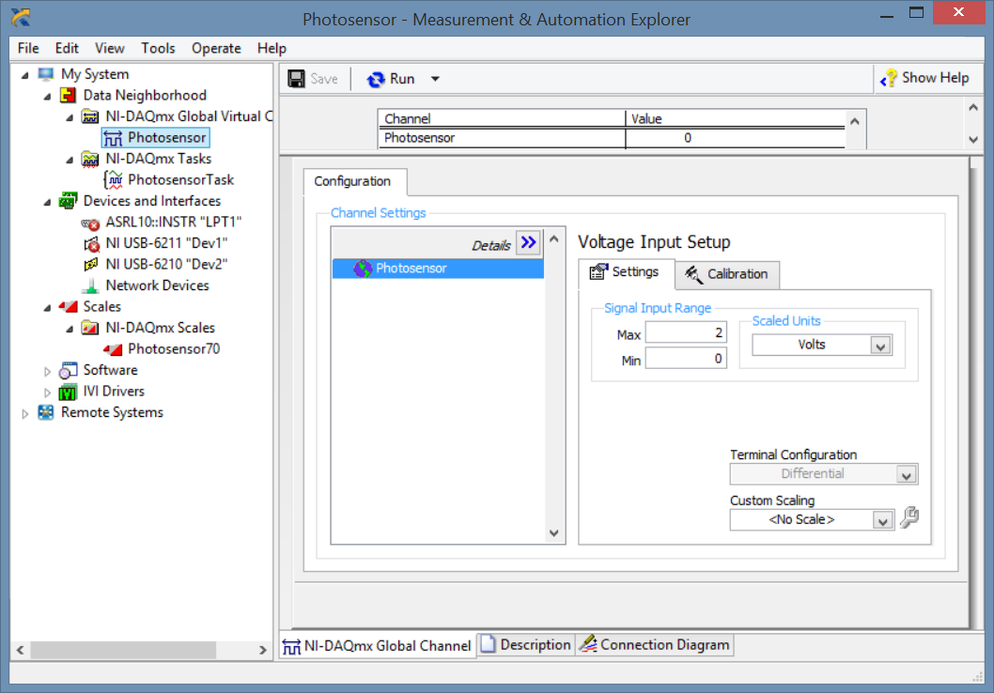
A Word about MAX
NI Measurement and Automation Explorer (MAX)
Central location for investigating NI Hardware and Software
Allows for global (i.e. system-wide) channel and task creation
Useful for fixed or infrequently-changed installations

Slide 58
The Mantra
Open, Configure, Start, Read/Write, Stop, Close
Open: Open a device for further access
Configure: setup the task, including channel(s), range(s), timing, triggering, etc. for the task
Start: Begin the acquisition (or generation) process
Read/Write: read acquired data (or write data to be generated), typically repeatedly, until the task is complete
Stop: stop the acquisition but do not close the device and free the resources associated with it
Close: okay, now close the device and free the resources

Slide 59
The Mantra
A note about NI-DAQmx
NI-DAQmx is “smart” and will attempt to do steps in the mantra that you “forget.”
If you don’t configure the task, defaults are chosen
If you don’t start the task before reading, it starts it when you attempt to perform the read
If you don’t stop the task before closing it, it stops it for you
For learners, especially, don’t “forget” to do any of the steps.
Leads to muddled thinking
May have unexpected results because the coder doesn’t understand what NI-DAQmx is doing under the hood.
Open, Configure, Start, Read/Write, Stop, Close

Slide 60
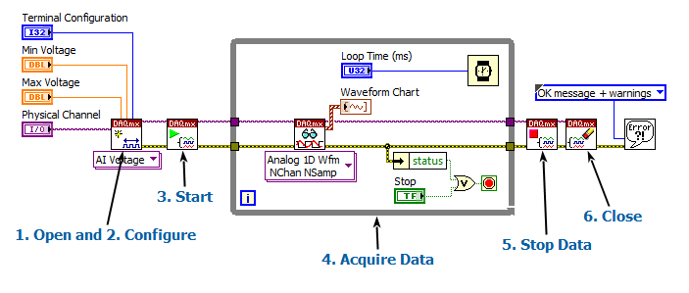
Software Timed Analog Input
Uses system clock
Best timing ~ 1 ms period on modern, non-RT OSes
Subject to jitter due to processor multitasking
Must be used for process control systems
Maybe you should consider an RT system?
NI Example: Voltage - SW timed Input.vi

Slide 61
Software Timing: Jitter
Show jitter example

Slide 62
Finite Samples, Hardware Timed
To relieve jitter and free up the process, let the DAQ card handle the timing
We must now configure the channel timing
Use DAQmx Timing.vi
Specify:
Timing type (Finite samples in this case)
Frequency
Number of samples
Timing source*
*Timing source allows one to use an external clock rather than an internal clock. This is useful for clocking in data based on external events signals, e.g. an encoder pulse, a clock from another DAQ task (e.g. analog output) or an external instrument.

Slide 63
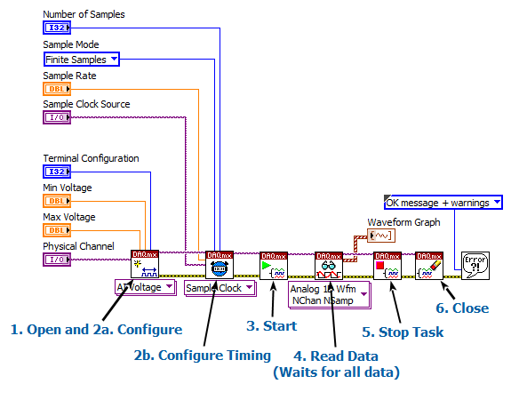
Finite Samples, Hardware Timed

Slide 64
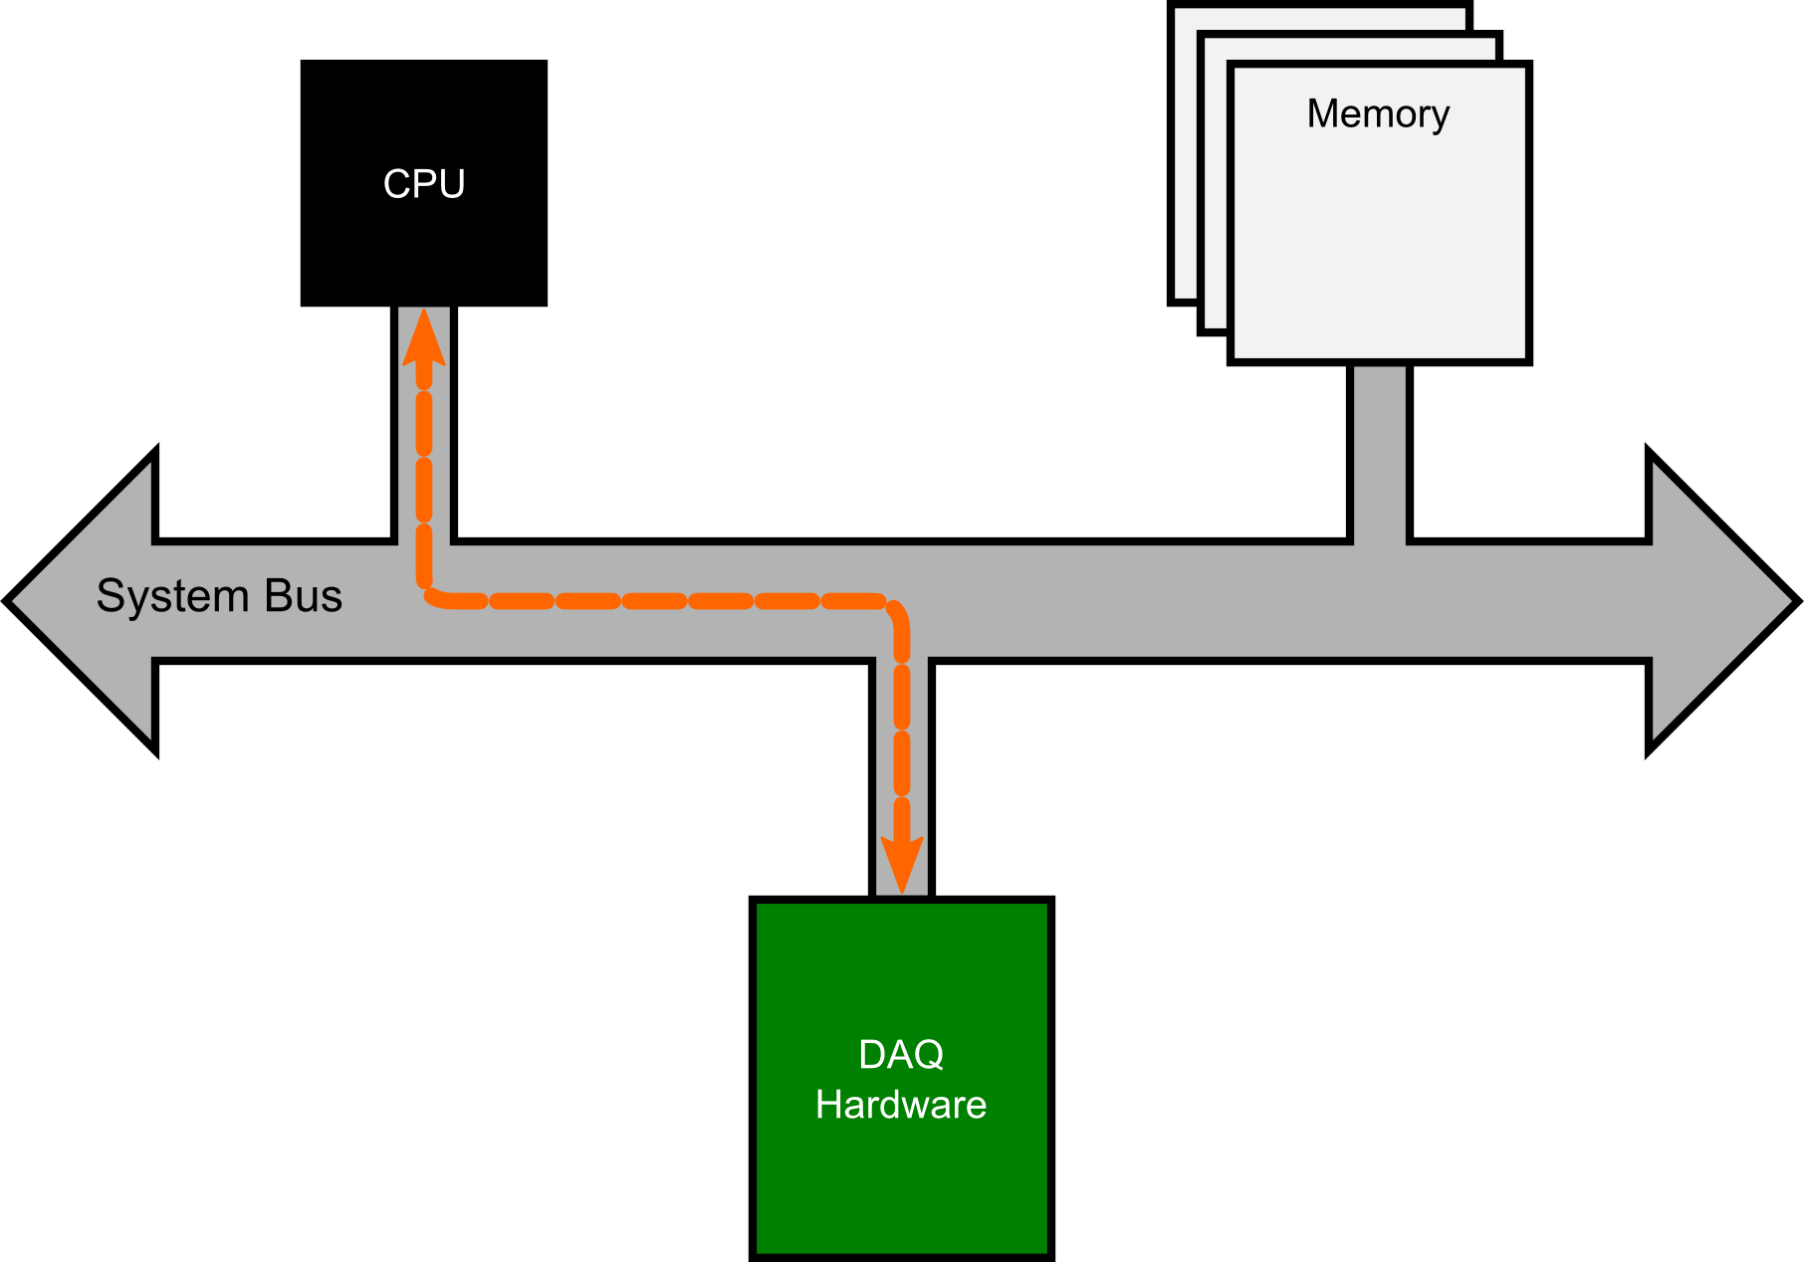
What’s really happening?*
1 Configuration Step
*This is still a simplification of the real architecture. Sorry.

Slide 65
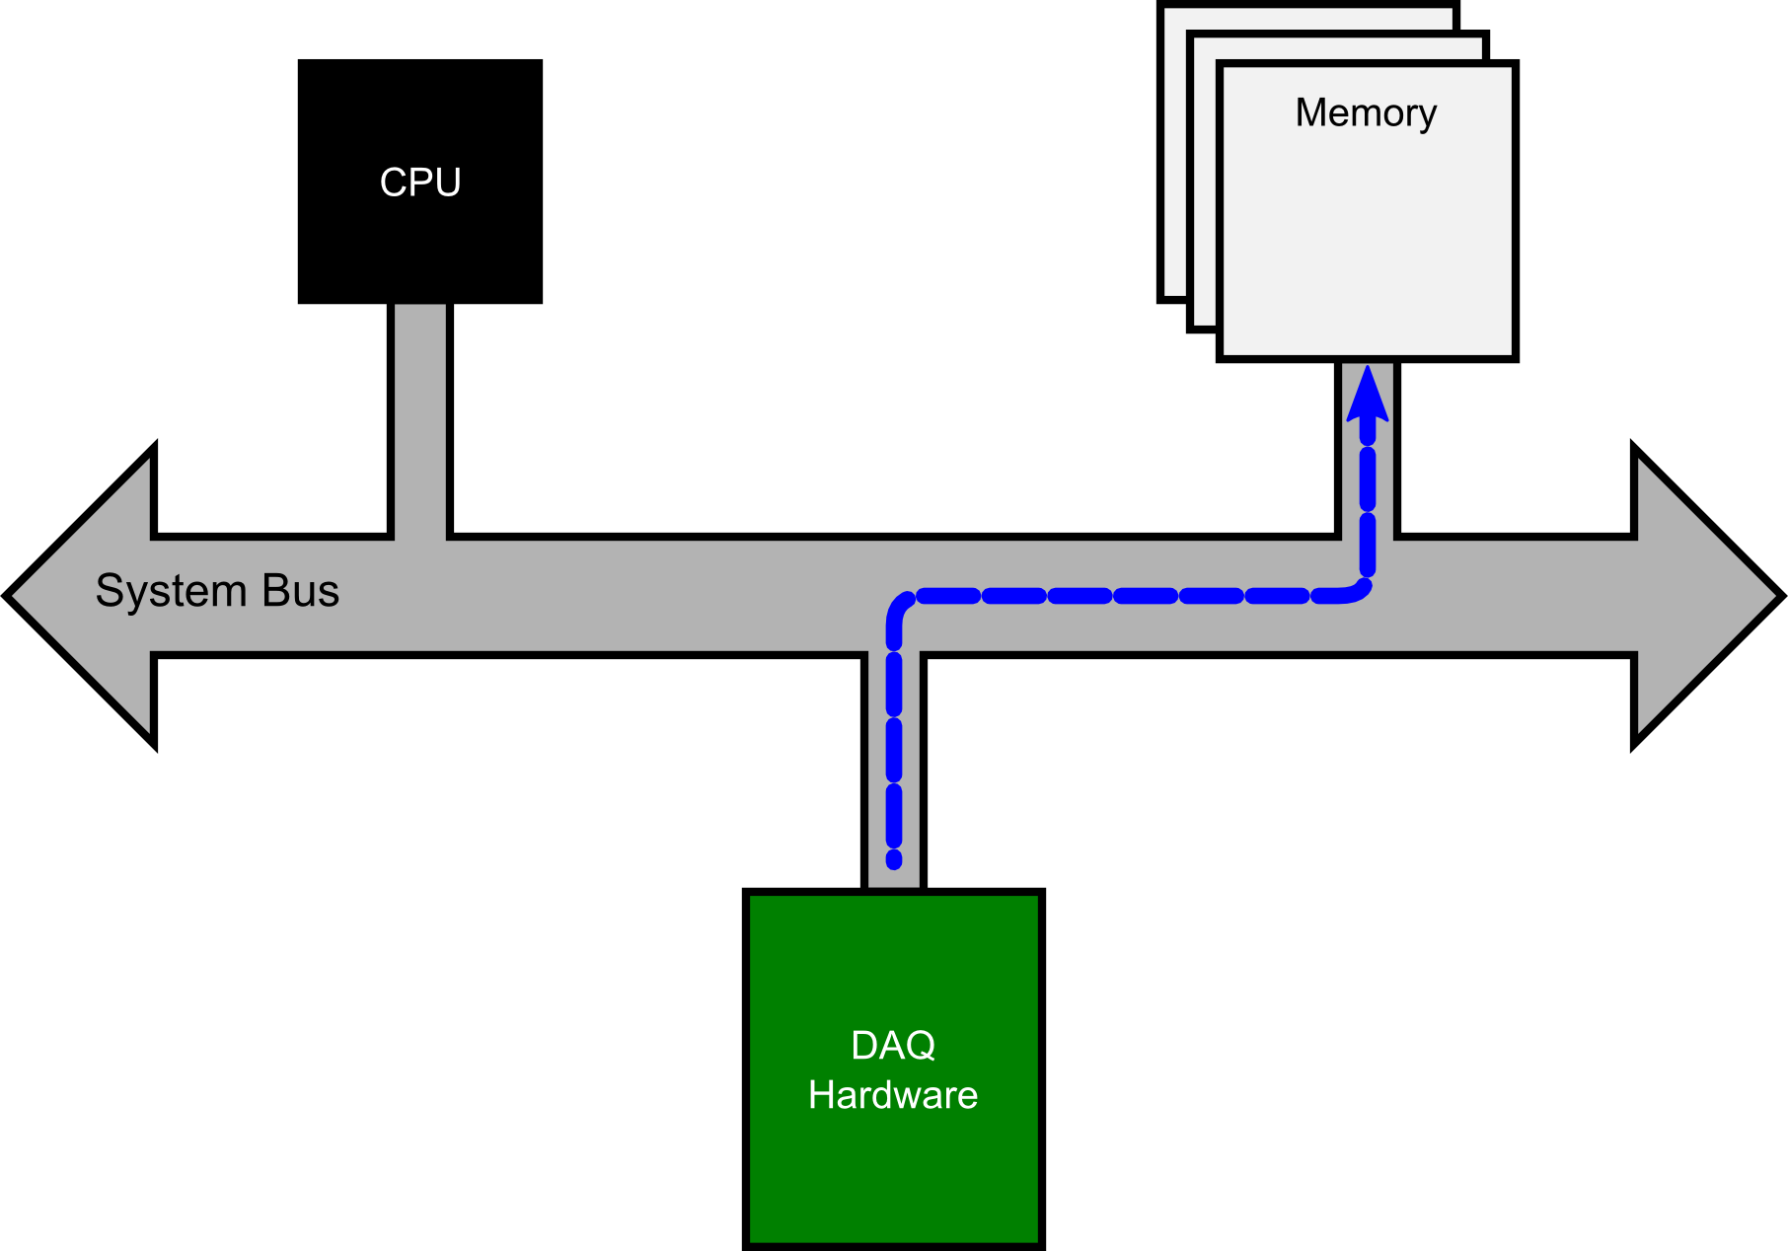
What’s really happening?*
1 Configuration Step
N Reads w/o CPU

Slide 66
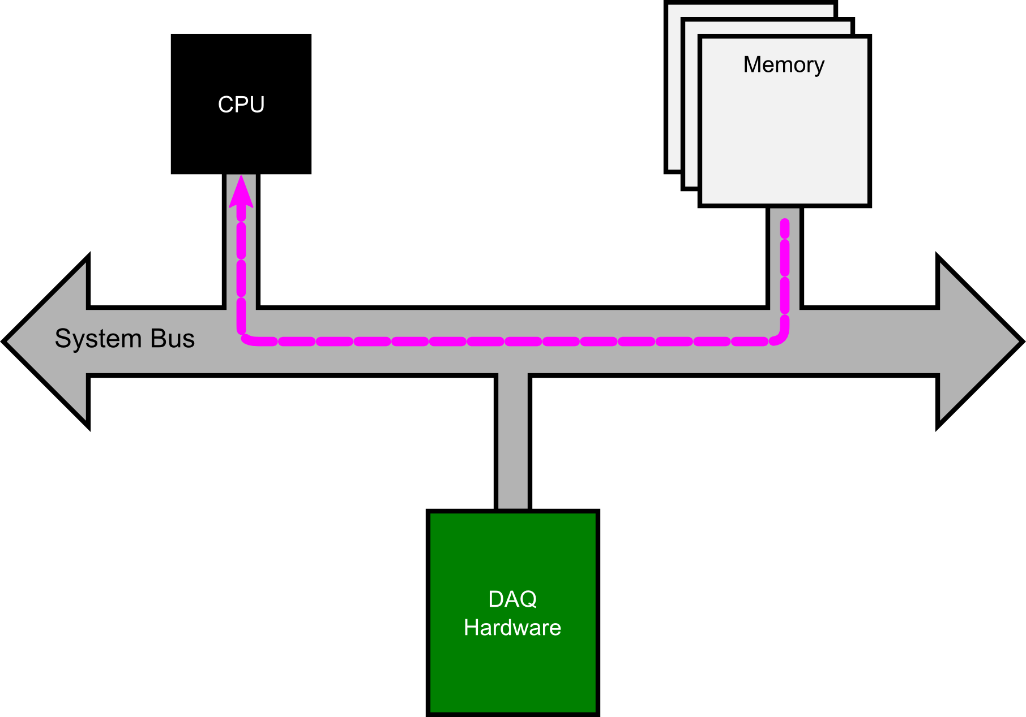
What’s really happening?*
1 Configuration Step
N Reads w/o CPU
N Reads w/ CPU at our leisure

Slide 67
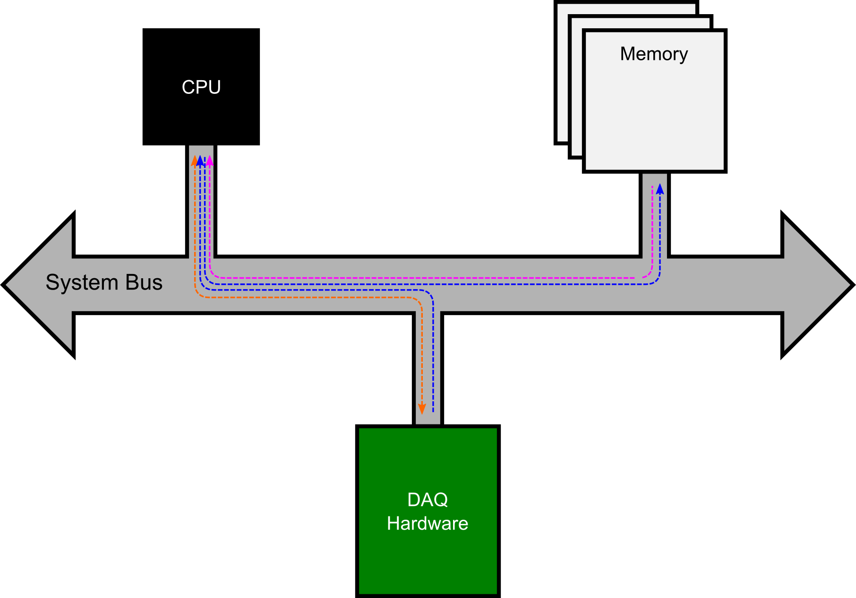
Why is DMA better than PIO?
1 Configuration Step
N Reads w/ CPU
N Writes w/ CPU
N Reads w/ CPU
All must be on time!

Slide 68

Continuous Sampling
Acquiring data forever
But how will I graduate?
Specify number of samples to read.
Defaults to “all available.”
Notes:
Modify Finite into Continuous

Slide 69

What’s really happening?
Circular Buffering
Notes:
Modify Finite into Continuous

Slide 70

What’s really happening?
Circular Buffering
Notes:
Modify Finite into Continuous

Slide 71

What’s really happening?
Circular Buffering
Notes:
Modify Finite into Continuous

Slide 72

What’s really happening?
Circular Buffering
Notes:
Modify Finite into Continuous

Slide 73

What’s really happening?
Circular Buffering
Notes:
Modify Finite into Continuous

Slide 74

What’s really happening?
Circular buffer overflows
Notes:
Modify Finite into Continuous

Slide 75

Buffer Overflows

Slide 76
Triggering
Use triggering to delay the start of acquisition until a certain event occurs
Common Types:
Digital start trigger: start when a rising or falling edge of a TTL (0-5 V) signal is detected
Analog start trigger: start when a signal’s voltage rises above or falls below a certain level
Digital reference trigger: similar to digital start, but may acquire pre-trigger samples
Analog reference trigger: similar to analog start, but with pre-trigger samples

Slide 77




Triggering

Slide 78

Digital Start Triggering
Show Digital – Finite Input Example

Slide 79
Problems with Digital Triggers
Wrong polarity
Triggers look for rising or falling edges (or sometimes either)
Wrong voltage
Digital logic operates on specific voltage levels
Glitches

Slide 80

Problems with Digital Triggers
TTL Logic Levels
Voltage | Description | TTL | LVTTL
V_{cc} | Supply voltage | 5.0 | 3.3
V_{OH} | Logic-high output voltage minimum | 2.7 | 2.4
V_{IH} | Logic-high input voltage minimum | 2.0 | 2.0
V_{IL} | Logic-low input voltage maximum | 0.8 | 0.8
V_{OL} | Logic-low output voltage maximum | 0.4 | 0.4
Figure from https://learn.sparkfun.com/tutorials/logic-levels/ttl-logic-levels

Slide 81

Problems with Digital Triggers
More logic levels
Figure from http://www.interfacebus.com/voltage_LV_threshold.html

Slide 82


Problems with Digital Triggers
How to solve level problems
Ignore it
Some voltage levels are cross-compatible, e.g. most TTL and LVTTL
However—if at all possible, check all output levels before connecting to the input
Use level-shifter circuit (voltage level translation)
e.g. SN74LV4T125
Figures from Texas Instruments SN74LV4T125 Datasheet

Slide 83
Problems with Digital Triggers
Glitches
Figure from http://www.interfacebus.com/voltage_LV_threshold.html

Slide 84






Review
Open
Configure
Start
Read/Write
Stop
Close

Slide 85
Signal Conditioner
Signal Conditioner
DAQ Hardware
Transducer
DAQ Hardware
Transducer
Amplifier, Low pass filter
Amplifier, Low pass filter
NI CompactDAQ
Thermocouple
NI CompactDAQ
Thermocouple
Computer
Computer
Brought to you by IT
Brought to you by IT
Phenomenon
Phenomenon
Software Basics
Plotting
Software Basics
Cooling of Tea
Plotting
Cooling of Tea
Thesis/
Dissertation
Thesis/
Dissertation
Analysis
Graduate!
Analysis
Graduate!
Curve fitting
Curve fitting
DAQ
DAQ
Analog Input
Storing Data
Analog Input
Storing Data
HDF5 Files
HDF5 Files

