Slide 1
Analysis of Time Aware and Semantic Feature Based Music Recommender System Project By -:
Ronish KALIA (IIT2012139)
Dhruv Kumar (IIT2012171)
SHubham Mehrotra (IIT2012156)

Slide 2
Introduction
Recommender systems or recommendation systems are a subclass of information filtering system that seek to predict the 'rating' or 'preference' that a user would give to an item.
The goal of recommender systems is to make personalized product recommendations based on users’ taste.
Recommender systems work on explicit and implicit feedback.

Slide 3
Work Flow
Extracting Relevant Dataset
Calculate Scores based on Implicit Factors
Considering Data from Semantic Web
Including Temporal Factors
Compare Results

Slide 4

Including Semantic Information
The semantic information includes features like regions, social network, tagging, etc.
After including the semantic information the equation becomes
C is latent factor x category and S denotes artist x category.
α controls the importance that needs to be given to semantic information.

Slide 5
Including Tag Information
To improve recommendation quality, metadata such as content information of items has typically been used as additional knowledge. With the increasing popularity of the collaborative tagging systems, tags could be interesting and useful information to enhance RS algorithms. Unlike attributes which are “global” descriptions of items, tags are “local” descriptions of items given by the users.
In our case each tag is divided into K latent factors. Its effects can be defined by the following formulas:

Slide 6
e_{ij =} e_{ij} + 2γ(T – p_{j}.g_{k}^{T})
g_{k} denotes Tag X Latent Factor
p_{J} denotes Artist X LatentFactor
t_{j,k} = (1/ a)*log((N * b))
a = no. of times users gave this tags.
N = total no. of tags presents in the dataset
b = no. of users who gave this tag k^{th} tag to this artist.

Slide 7
Including Temporal Factors
Including temporal factor
The first major effect addresses the fact that an item’s popularity may change over time.
The second major temporal effect allows users to change their baseline ratings over time.
Following the intuition that tags can get outdated over the years, and, thus, older assigned tags should be weighted less for recommendation, we introduced a time decaying function of posts. Scores are assigned to posts based on the time when they have been issued compared to the time the latest test post has been issued. The time decaying function and its effects can be defined by the following formulas:

Slide 8
postScore_{i,j} = postScore_{i,j} + λ^{ΔTime}
tagSpeceficity_{i} = log(50 + tagCount_{i})
TagScore or c_{i,j} = (PostScore_{i,j}) / tagSpecificity_{i}
e_{ij =} e_{ij} + 2γc_{ij}(T – p_{j}.g_{k})

Slide 9
Problems Faced and Optimizations
Data was too large to be accommodated into the memory
Instead of using matrix, we implemented it using lists.
All the tag and time related information was pre-computed.
There were huge differences in errors between training and testing data
Implemented regularization on matrix factorization.
Values of α, β, γ, Δ were analyzed and their optimum values were selected.
Rate of learning for temporal factors should be less than semantic factors.

Slide 10
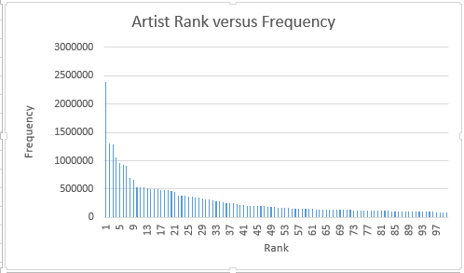
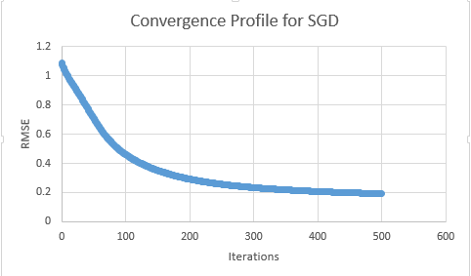
RESULTS

Slide 11
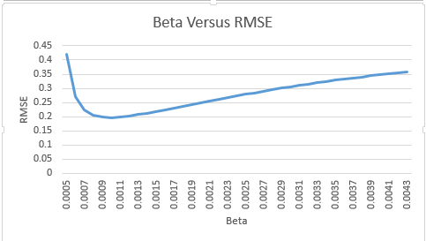
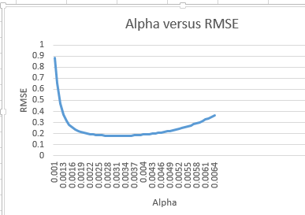
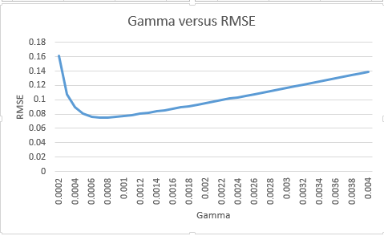
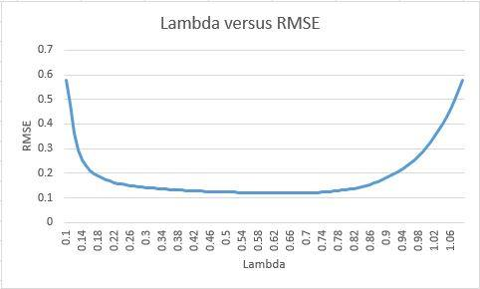

Slide 12
TAG_TIME
Training Size | Test Size | Train Error | Test Error
8156 (20%) | 33132 | 0.384579322934 | 0.486217337033
16611 (40%) | 24677 | 0.34319899727 | 0.394204147192
24854 (60%) | 16434 | 0.336208159975 | 0.384122427242
33005 (80%) | 8283 | 0.323183635267 | 0.378329296078
SEMANTIC
Training Size | Test Size | Train Error | Test Error
8198 (20%) | 33090 | 0.291794410351 | 0.455146682153
16683(40%) | 24605 | 0.270813517029 | 0.383589007124
24721 (60%) | 16567 | 0.252987018573 | 0.335888042357
33061 (80%) | 8227 | 0.240566742213 | 0.294084896122

Slide 13
SEMANTIC, TAG AND TIME
Training Size | Test Size | Train Error | Test Error
8301 (20%) | 32987 | 0.299473772339 | 0.369949341672
16611 (40%) | 24677 | 0.274483475109 | 0.292670808659
24838 (60%) | 16450 | 0.259931881909 | 0.244602200161
33100 (80%) | 8188 | 0.250994254996 | 0.234908290027

Slide 14
THANK YOU

