Slide 1
Chess Helper by
Ctrl Alt Elite
Chris Kazenske
Deandra Diedrick

Slide 2
Requirements
We want to create a website to teach people to play chess. The website should show the user:
A visual creation of a chess board with animated pieces.
What pieces are on a chessboard and how they can move.
Instructions on how to play and win chess.
Common strategies for playing chess.
Answers to frequently asked questions.

Slide 3
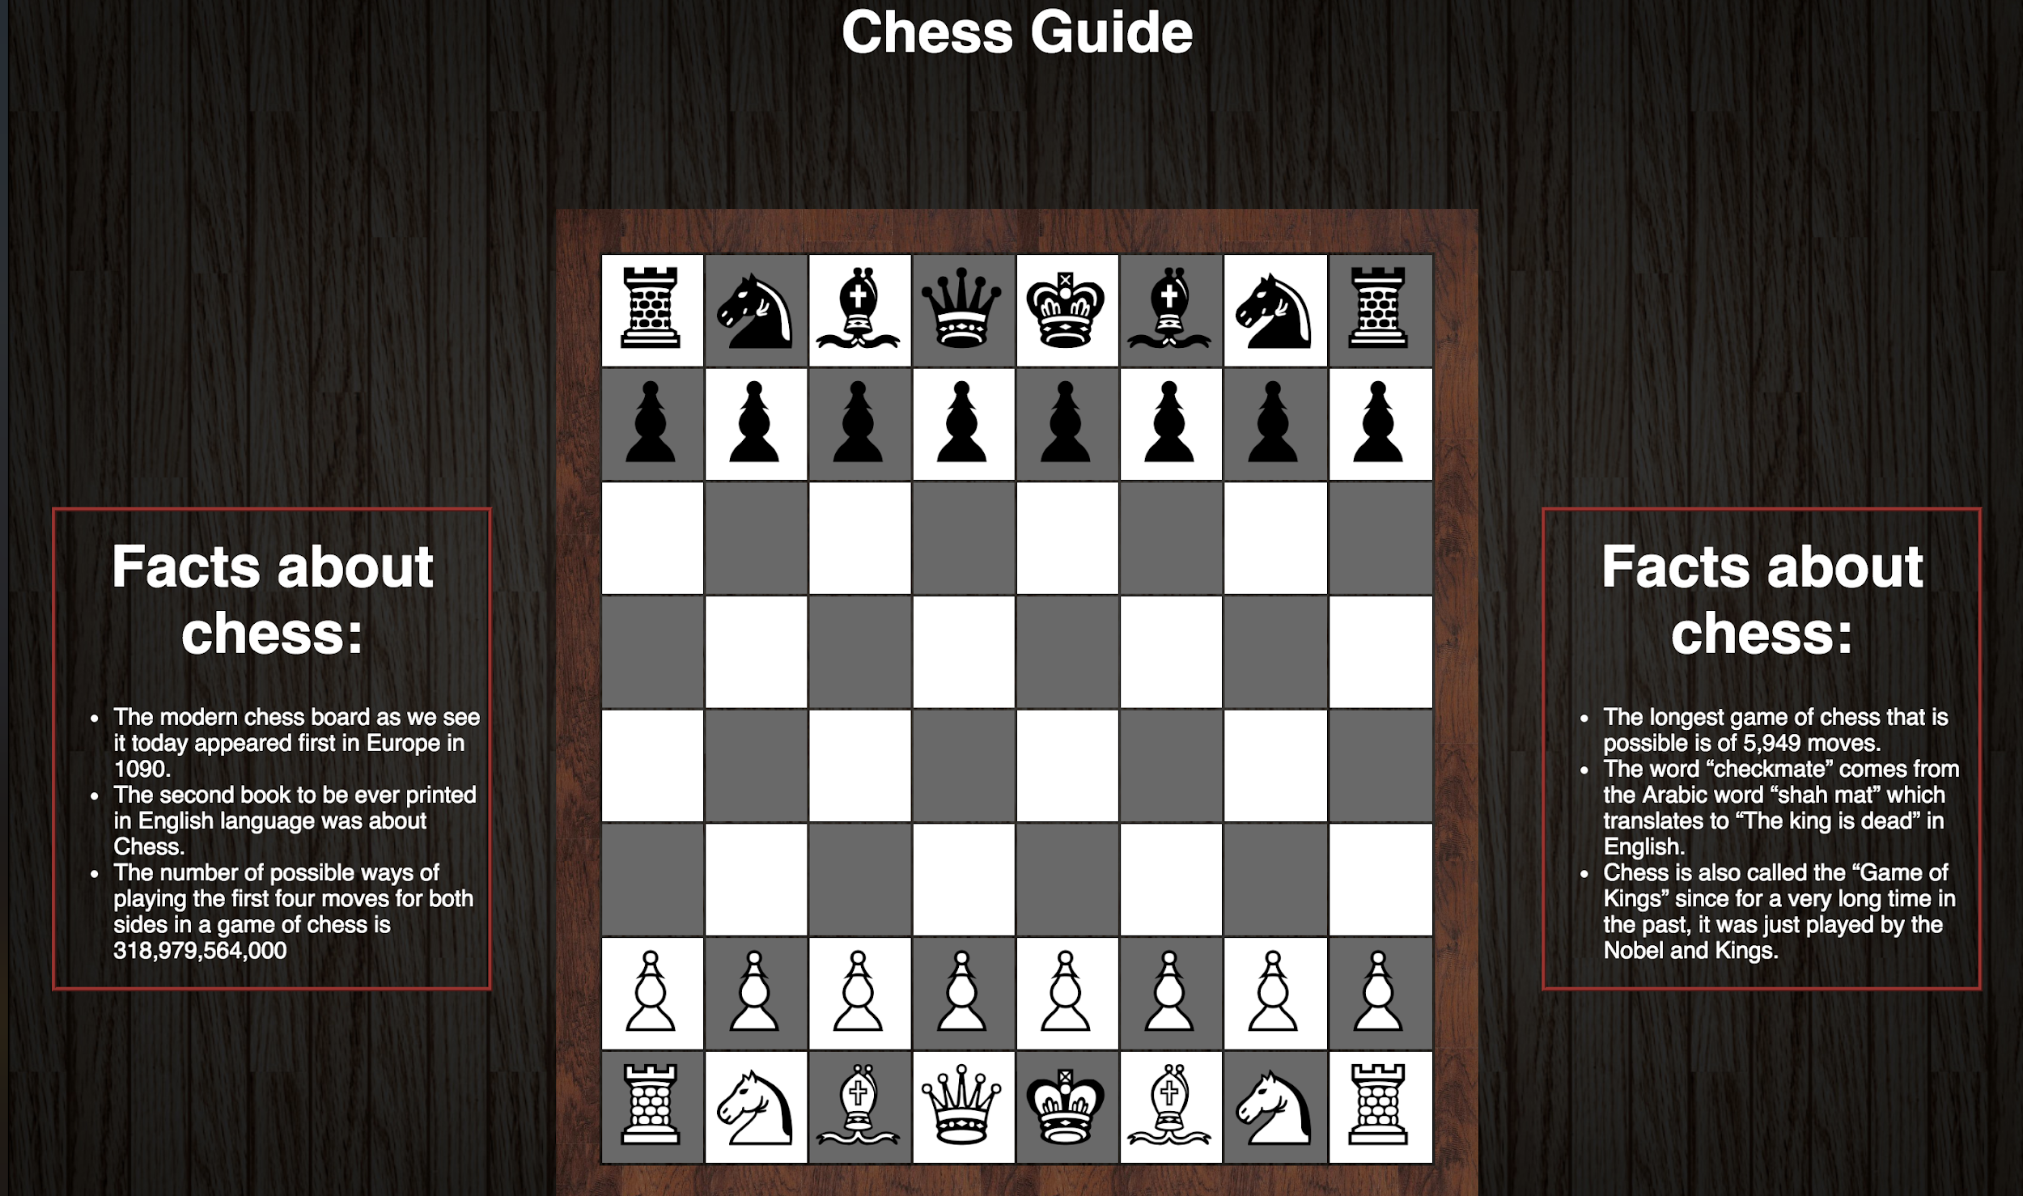
User Interface
This is the main page. On this page users can hover over any piece and the piece will glide to an valid place on the board.
This teaches the user what first move each piece is allowed to make.

Slide 4
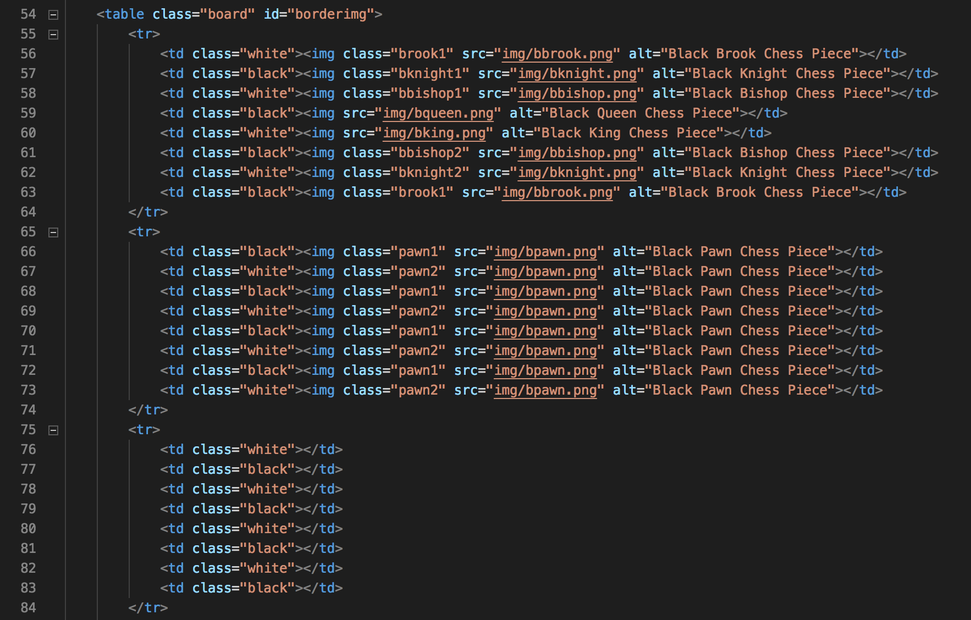
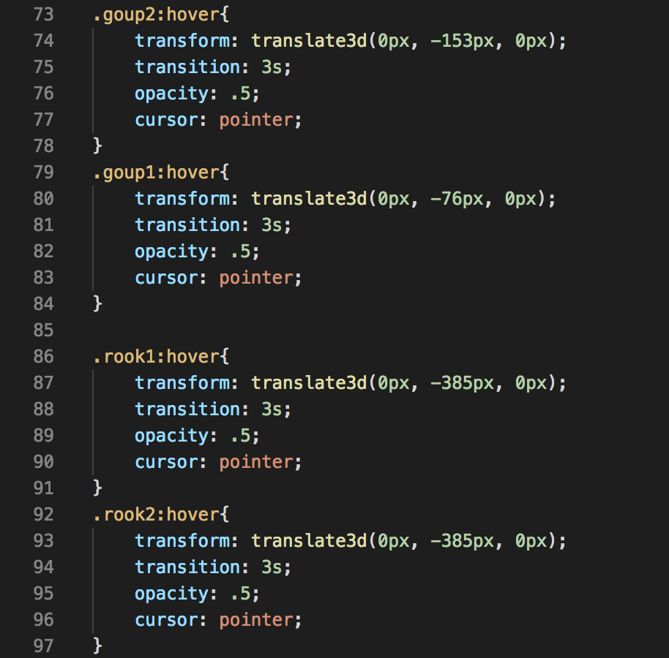
Code Snippets
Partial code for the chess board
Css code to create the transitions

Slide 5
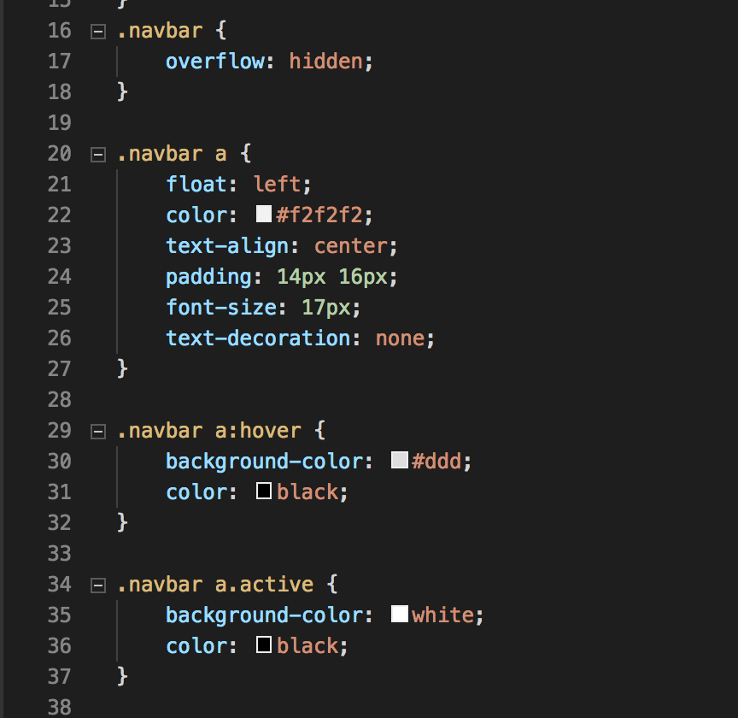
Problems & Solutions
We had some issues getting the navigation bar exactly how we wanted it but eventually got the right css code to get it right.

Slide 6
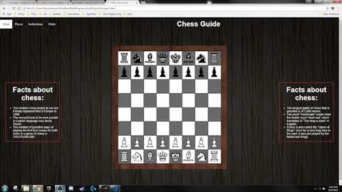
Development Video

Slide 7
Any Questions?

