Slide 1
Final Project
Ian Keane, Calcium Williams, Dylan Diener, Juweek Adolphe

Slide 2
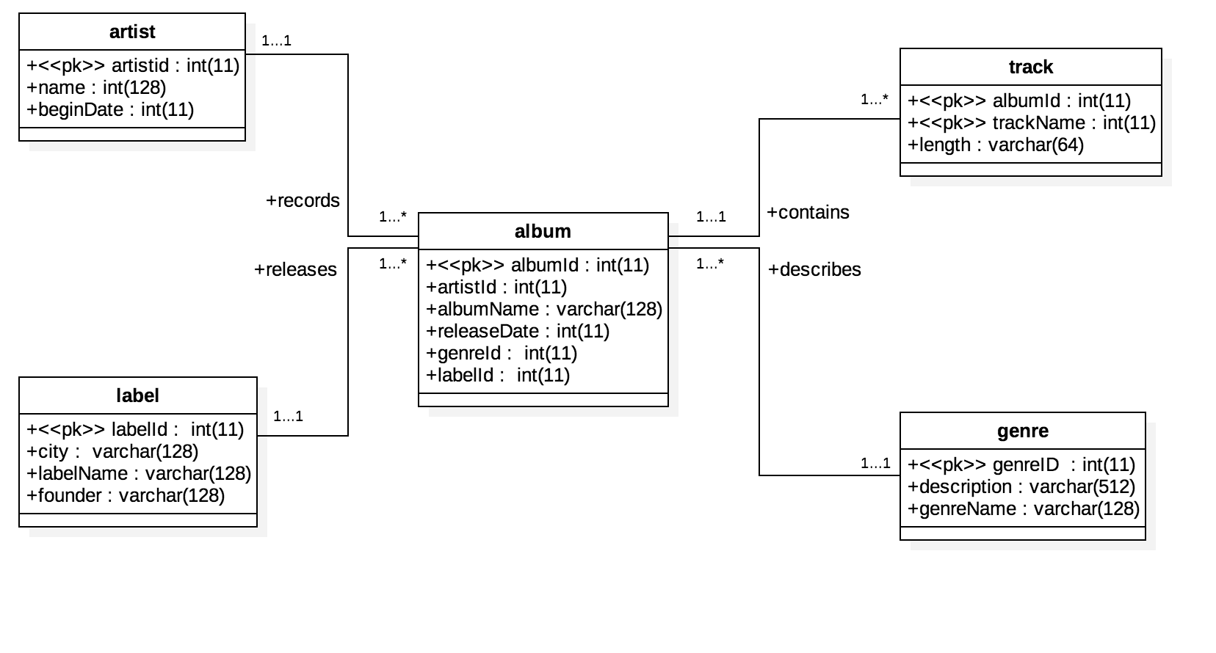
UML Diagram

Slide 3
Creating P1: UML DB Diagram
1. Identify Strong Entities
2. Identify Weak Entities
3. Identify 1:1 Relationships

Slide 4
Creating P1: UML DB Diagram
4. Identify m:1 Relationship

Slide 5
Creating P1: UML DB Diagram
5. Identify m:m Relationship
6. IS -A Hierarchy
7. Higher Arity Relationship (ternary)

Slide 6
Relational Model
Relational Model Table for BCNF go here

Slide 7
P2: Use BCNF Decomposition Algorithm
1. Identify Attributes in Schema:
2. Functional Dependencies

Slide 8
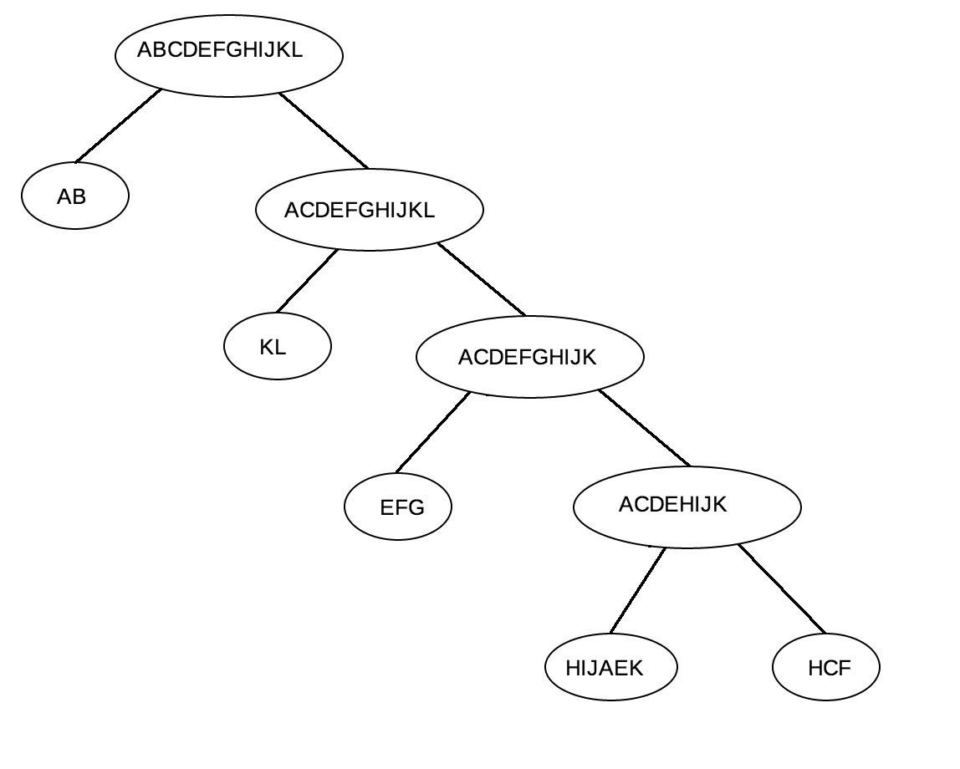
P2: Use BCNF Decomposition Algorithm

Slide 9
P3: Use 3NF Synthesis Algorithm
1. Compute Minimal Cover
2. Functional Dependencies:

Slide 10
P3: Use 3NF Synthesis Algorithm
3. Make RHS Singleton

Slide 11
Use 3NF Synthesis Algorithm
4. Remove extraneous left-hand side
5. Eliminate redundant FD’s
6. Remove subset tables
7. Check if lossless

Slide 12
Relational Model
Relational Model Table for 3NF Go Here

Slide 13
P1, P2, P3 Comparison
compare/contrast them

Slide 14
Shema.sql
Post sql schema

Slide 15
Insert.sql
Post insert sql

Slide 16
System Architecture and Components
and such

