Slide 1

RS-INS-GLB-R-001116-V001 IICRA RSR (R)
Derek Ding
Sr Director
FS Methodologies
[TBD]
[TBD]
AQV
July 16, 2026
Copyright © 2016 by S&P Global. All rights reserved.
Last update – 09/24/2024

Slide 2
Agenda
Executive Summary & Project Background (ProjFin Models Only)
Relevant Criteria Articles
Development Information
Access & Version Controls for Model Deployment
Key Model Assumptions
Limitations/Restrictions for the Model
Model Changes since last CMGC/Board Approved Version
Testing
Back-Testing
Model Validation Summary
Model Training
Model Retirement Request

Slide 3
1. Executive Summary:
Model Name & ID: IICRA RSR (R) RS-INS-GLB-R-001116-V001
Last version approved by the CMGC/Board of Managers: RS-INS-GLB-R-000463-V007 IICRA RSR (Excel)
Version this new Model is expected to replace: RS-INS-GLB-R-000463-V007 IICRA RSR (Excel)
Covered Model Type: Ratings Model
Purpose of the Model: This model is used to determine and document IICRAs (Insurance Industry and Country Risk Assessments), which are a step in the analytical process for rating insurance companies. Although the model does not produce a rating outcome, it facilitates the derivation of, and rating summary record-keeping for, IICRA assessments that feed into the derivation of the business risk profile for an insurance company. The model produces a final IICRA score based on the corresponding country risk and industry risk profile, ranging from 1 (strongest – very low risk) to 6 (weakest – very high risk). It is recoded in R from the IICRA RSR Excel model.
Region: Global
Business: Insurance
Model cross reference to other models: N/A
Actual or expected usage: This model will be used to conduct industry and country risk assessments for insurance companies.
Time frame during which model is expected to remain valid: The Model is expected to remain valid until there are changes requiring a new version or changes to the applicable criteria.
Squad: Model working group:
Developer: Derek Ding
Tester (must be different than Developer): Anoop Garg
Squad Leader/Model Owner: Derek Ding
Model Coordinator/Approver:

Slide 4
1. Project Background: For ProjFin Models Only, Include Project Name
Purpose: N/A – IICRA RSR (R) is not a Project Finance model.
Debt: N/A
Transaction Background: N/A
Revenue Sources: N/A
Performance Risk: N/A

Slide 5
2. Relevant Criteria Articles
 | Criteria ID (CUID) | Date Criteria Published | Criteria Title
1 | C-EN-11017264-10 | Jul 01, 2019 | Insurers Rating Methodology
2
3
4
5

Slide 6
3. Development Information:
Lead Model Developer: Derek Ding
Platform for model deployment: R
Start/Completion Dates of Model Development: [TBD]
Type & Source of Inputs:
Type of Inputs: country risk assessment; industry risk assessment; and adjustment, if applicable.
Additional inputs to assist the assessment of industry risk: profitability, product risk, barriers to entry, market growth prospects, and institutional framework.
Source of Inputs: user input / analyst assessment.
Model performance measures: unit testing, UI testing, integration testing (within the Analytical Desktop workflow system), and Criteria Validation Report.
Date of model validation report (if any): [TBD]

Slide 7
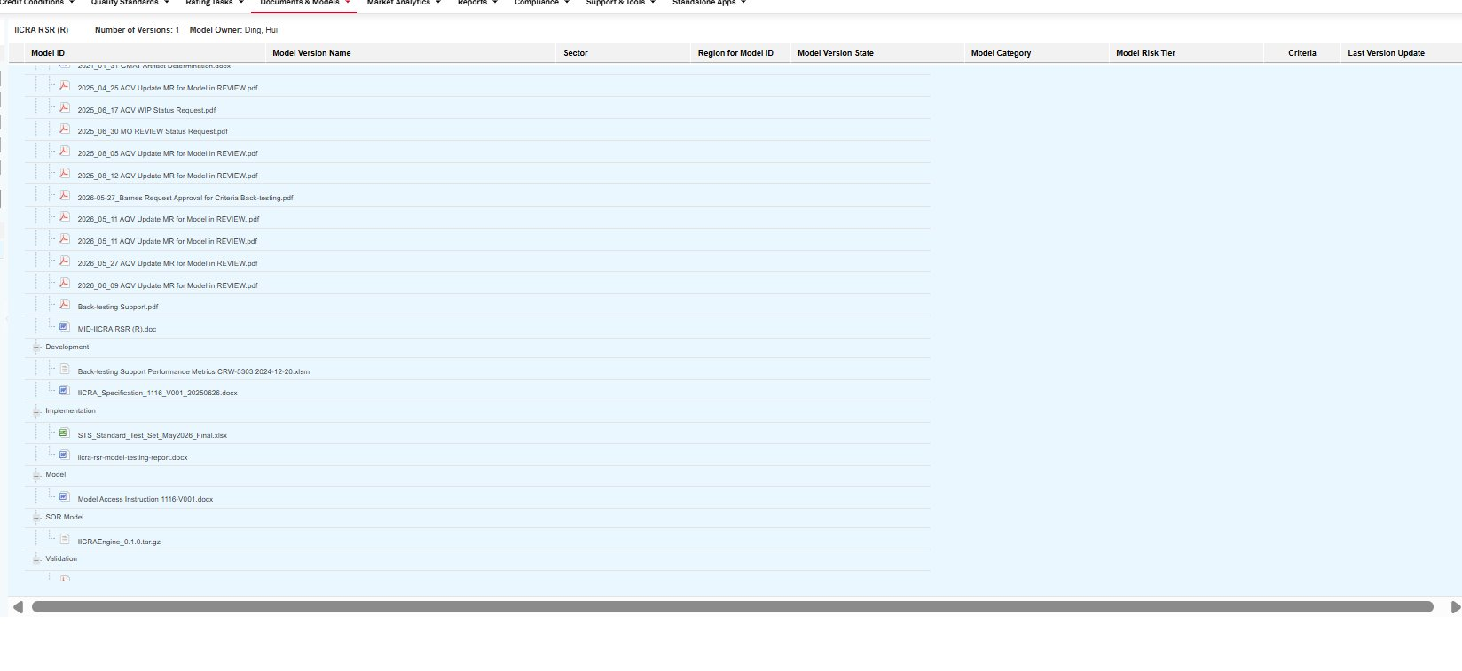
4. Access & Version Controls for Model Deployment:
The instructions to access the model are stored in the Model Repository (MDTS). Only approved users can gain access to the model using their intranet username and password.
Only the development team can make changes to the model.

Slide 8
5. Key Model Assumptions:
Description of Assumption | Criteria |  | Ratings Committee or Analyst |  | Model Development
 | Concept | Value | Concept | Value | Concept | Value
The model assumes that the final IICRA score is solely derived from assumptions relating to industry and country risk factors. | X |  |  | X
The model assumes that analytical judgement is applicable in cases where it is determined that the balance of industry and country risks materially understates or overstates the risks for the insurance sector of operating in a given country. In such cases, the IICRA score can be adjusted by one category. | X |  |  | X

Slide 9
5. Key Model Assumptions (continued)
Description of Assumption | Assumption deployment in model
 | User Input | Embedded | Override Capability
The model assumes that the final IICRA score is solely derived from assumptions relating to industry and country risk factors. | X
The model assumes that analytical judgement is applicable in cases where it is determined that the balance of industry and country risks materially understates or overstates the risks for the insurance sector of operating in a given country. In such cases, the IICRA score can be adjusted by one category. | X

Slide 10
6. Limitations/Restrictions for the Model
The model applies exclusively to the insurance industry. It should only be used to derive the IICRAs for a designated combination of industry and country risks.

Slide 11
7. Model Changes since last CMGC/Board Approved Version
Effective Date of the Changes: Effective July 2026
Summary Description of changes since last version approved by CMGC/Board of Managers:
RS-INS-GLB-R-001116-V001 IICRA RSR (R) is a recode of the previously approved Excel model RS-INS-GLB-R-000463-V007 IICRA RSR into R. The model is now deployed within the Analytical Desktop workflow system.
The recode reproduces the existing model logic; no analytical methodology, assumptions, or calculations were changed. Approval is being sought for the R version (V001) to replace the Excel version (V007) currently in Business Use.
The changes to the Model are not anticipated to have any impact on current credit ratings.

Slide 12
8. Testing
The model has been tested by means of unit testing, UI testing, and integration testing within the Analytical Desktop workflow system.
Unit testing involves independently testing individual components of a model to ensure they behave as expected.
A total number of 132 unit test cases were created.
The unit test coverage for all components comprising the model was 100 %.
UI testing verified that the model’s user interface within the Analytical Desktop workflow system correctly captures user inputs and displays the expected outputs.
Integration tests complements unit testing, it ensures that components of a model work correctly to produce the accurate and expected ultimate results.
11 integration test scenarios were created to ensure end-to-end calculations behave as expected.
All integration test scenarios passed and met expectations.
End User Testing – The model was tested end to end using actual data, user inputs and outputs verified.
There were no issues reported during the unit, UI, and integration test runs.

Slide 13
8. Testing
Not applicable. This model was recoded in R under the new architectural design and follows the unit, UI, and integration testing framework described on the preceding Testing slide.

Slide 14
9. Back-Testing: This Covered Model solely implements analytical considerations that are set out in the applicable Criteria. The Criteria performance metrics are therefore used to confirm acceptable model performance. As the model relies solely on Criteria Validation back-testing, this slide will be completed by AQV at the same time the Model Validation Report is issued, summarizing the performance metrics for the model’s applicable Criteria.

Slide 15
10. Model Validation Summary
To be completed by AQV at the same time the Model Validation Report is issued.
Validation Team:
Lead Validator: [TBD]
Support Validator: [TBD]
Designated Approver: [TBD]
Summary of Validation Fieldwork: [To be completed by AQV]
Comments/Findings: [To be completed by AQV]
All identified issues have been fixed before the report was issued, and all Comments have been Resolved. AQV’s overall assessment of the model is Satisfactory.
All the necessary documents and files for model development, governance and validation have been appropriately stored in the Model Repository (MDTS).

Slide 16
11. Model Training
Is this a new Model or material change to a Model? Material change
Is training required? Yes
Has training been completed? No*
Date of completed Model training – N/A*
*Model training will follow the Analytical Desktop rollout timeline.

Slide 17
12. Model Retirement Request
Reason for Retirement Request:
RS-INS-GLB-R-001116-V001 IICRA RSR (R) is the R recode of, and fully supersedes, the Excel IICRA RSR model. We request that RS-INS-GLB-R-000463-V007 IICRA RSR (Excel) be retired upon completion of the analyst transition to the Analytical Desktop (AD) application, once RS-INS-GLB-R-001116-V001 is in Business Use.
Requested retirement date of the current Excel model (RS-INS-GLB-R-000463-V007): [TBD], following the full analyst transition to the Analytical Desktop application.
This model is used in Mexico.

Slide 18
Thank You INTERNAL COMMUNICATION ONLY / NOT FOR EXTERNAL DISTRIBUTION This document is the property of S&P Global Ratings. It contains proprietary and confidential information and is for internal use only by S&P Global Ratings employees. This document shall not be shown or provided to anyone other than S&P Global Ratings employees

