Slide 1


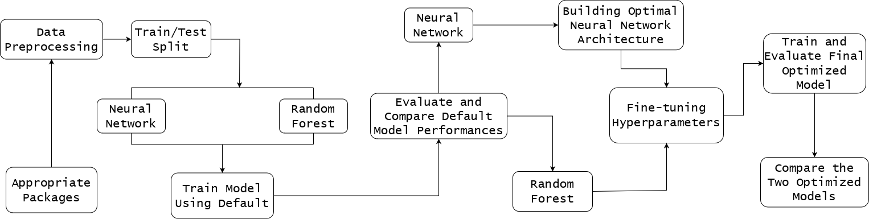
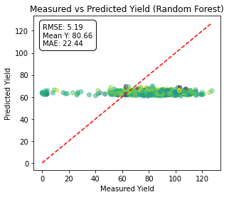
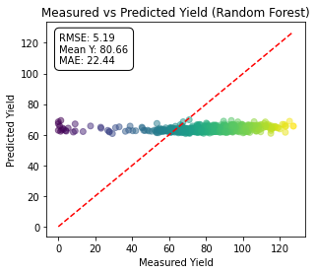
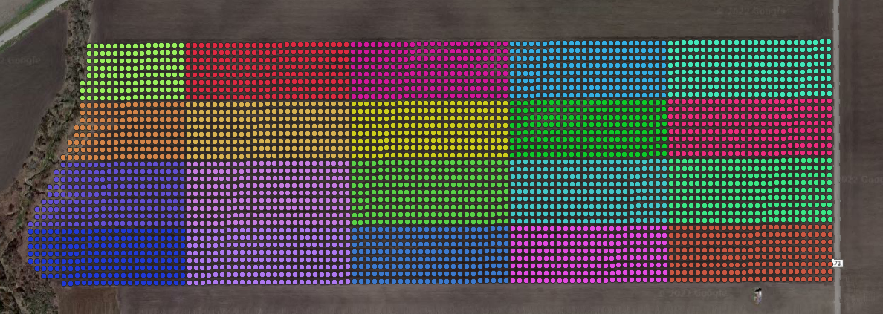
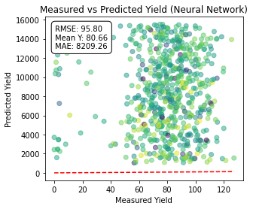
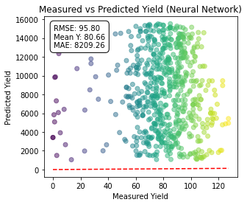
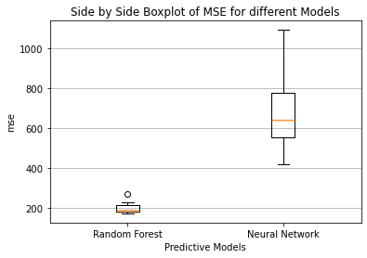
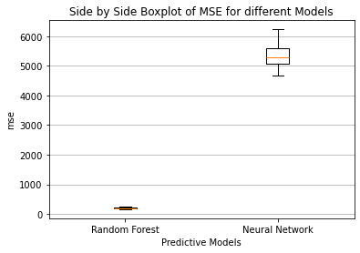
Optimizing Crop Yield Prediction: A Comparative Analysis of Machine Learning Methods
Dina Dinh¹, Leticia Santos², Yinan Yang¹, Phillip Lanza⁴, Tri Setiyono³, Maria Bampasidou⁵, Thanos Gentimis¹
¹Experimental Statistics LSU, ²North Carolina State University, ³School of Plant Environmental and Soil Sciences LSU, ⁴Cornell University, ⁵ Agricultural Economics and Agribusiness LSU
Introduction
Process Flow
Methodology
Agriculture is embracing AI-driven big data fueled decision support algorithms. The surge in data generated by precision agriculture has surpassed traditional scientific methods, leading to a need for AI-driven analytics to manage this data saturation. Among AI analytics tools, Machine Learning techniques like Neural Networks, Random Forests, and XGBOOST are widely used.
A critical aspect of Machine Learning is hyperparameter tuning, especially when using pre-built Neural Networks or Random Forests. Default hyperparameters and pre-defined architectures often fall short in achieving high prediction accuracies. Hence, the choice of specific hyperparameter ranges is crucial, especially for practical Machine Learning applications.
The dataset was divided into 20 unique Grid IDs using QGIS. For the model training and testing, an 80-20 split was employed, with 16 grids allocated for training and 4 grids reserved for testing.
In our study, we began by comparing the default settings of a neural network and random forest models based on prediction accuracy using mean squared error. This comparison was conducted over multiple iterations to ensure the reliability and robustness of the results.
To optimize the neural network, we developed a custom algorithm in Python using Keras. This algorithm focused on two main phases: architecture determination and hyperparameter tuning.
In the architecture determination phase, we started with an empty Sequential model and gradually added layers while optimizing the number of neurons to minimize the Mean Squared Error (MSE) in yield predictions.
Statistical analysis guided us to identify the optimal architecture that balances model complexity and accuracy. Subsequently, in the hyperparameter tuning phase, we systematically varied epochs and batch sizes to optimize model training.
For the optimization of the random forest model, we employed a grid search technique combined with cross-validation. This involved tuning key hyperparameters:
tree depth
maximum features
number of trees
After training and optimizing both the neural network and random forest models, we compared their performance by evaluating prediction accuracy across multiple iterations using mean squared error as the evaluation metric.
Results
Optimized
Un-optimized
Data Description
Figure: Grid IDs created using QGIS.
Variable | Description
x | longitude coordinate
y | latitude coordinate
VRYieldVOI | volumetric yield
Row & Column | location within 10ft x 10ft data point sample grid
Relative_Elevation1 | standardized elevation value relative to the mean elevation
Slope1 | slope value present in the 10ft x 10ft cell
TRI1 | terrain ruggedness index value
TPI1 | topographic position index
Elevation1 | absolute elevation value
Application_<#>_<N_Rate | application rates of nitrogen
ph_mean_30_60 | mean soil pH value
Clay_mean_30, 60, silt_mean_30_60, and sand_mean_30_60 | percentages of clay, silt, and sand, respectively
ksat_mean_30_60 | mean saturated hydraulic conductivity of soil
om_mean_30_60 | mean organic matter (OM) percentage
References
Thanos Gentimis, Yinan Yang, Phillip Lanza, Tri Setiyono, Maria Bampasidou. Hyperparameter Estimation for Neural Network Architectures in Agriculture-Based Structured Data Sets for Yield Prediction.
Letícia Bernabé Santos, Donna Gentry, Alex Tryforos, Lisa Fultz, Jeffrey Beasley, Thanos Gentimis, Soybean yield prediction using machine learning algorithms under a cover crop management system, Smart Agricultural Technology, 2024, https://doi.org/10.1016/j.atech.2024.100442.
Github link

