Slide 1
E-Commerce Website SHOPPING TIME
Introduction to Software Engineering Project
GROUP 4
20127347 – Nguyễn đình thuận
20127348 – NGUYỄN MINH THUẬN
20127401 – QUÁCH ĐỖ GIA HUY
20127217 – NGUYỄN TRUNG KIÊN
20127652 – HOÀNG MINH TRIẾT

Slide 2
PROBLEM STATEMENT
Create an e-commerce website for all users. The website contains many functions like mostly e-commerce website such as Tiki, Shopee, Lazada,…
Key features: Login, register, shopping cart, pay up, feedback, search product, share product, approve product,…

Slide 3
product position statement
For everyone who didn’t have time to go shopping and looking for a way to buy everything they need in just a minute. Shopping Time an e-commerce website that provides you all the best product (shirts, pants, shoe,…) with very few simple steps in just a minute.

Slide 4
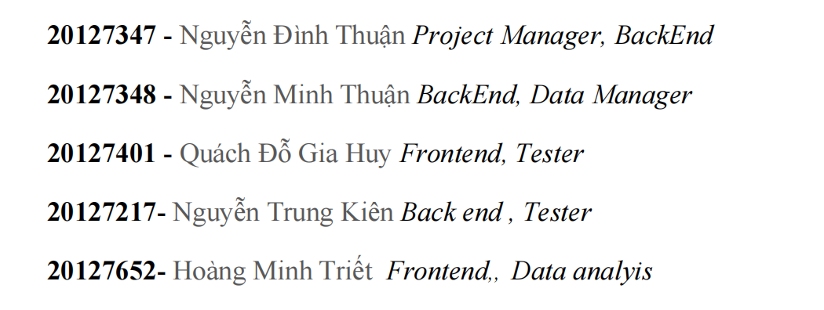
team structure and responsibilities of team members :

Slide 5
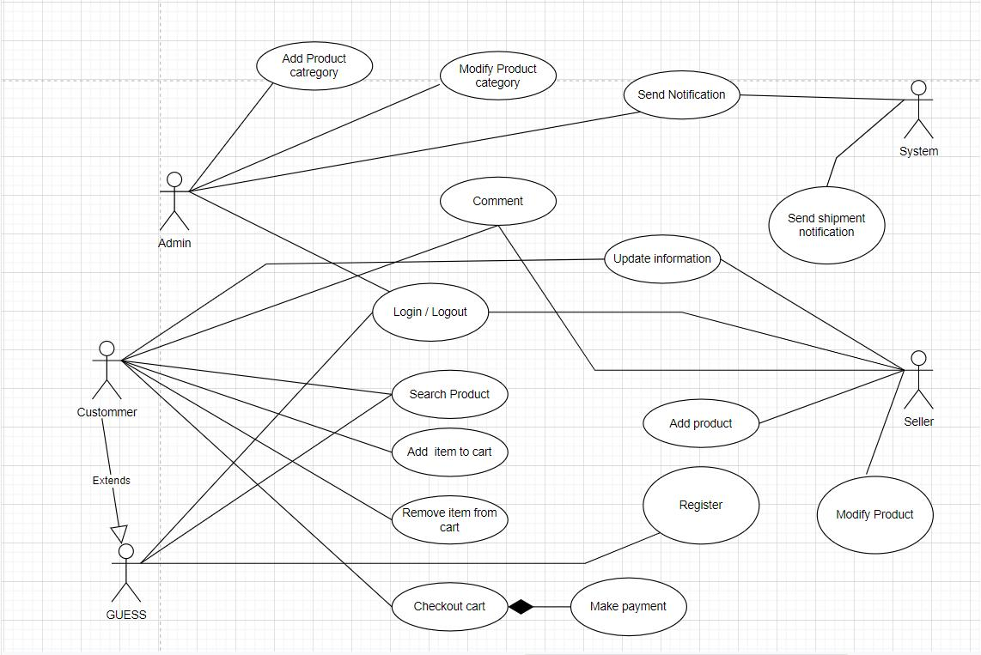
USE-CASE MODEL

Slide 6
non-functional requirements
Usability
A customer should easily find the right product for them, understand what problems it solves, and make a purchase without contacting us.
Security
Only the system data administrator can assign roles and change access permissions to the system.
Performance
The website’s homepage should load in less than 4 seconds
Maintainability
Our main goal for the next two years is internationalization, so the website shall have multiple storeviews for each country we’re selling to.

Slide 7
architecture and technologies used
Architechture: use MVC design pattern
Technologies:
Node.js
Database: mongo database
Main library include:
Passportjs
Expressjs
Bcryptsjs
Body-parser
Dotenv

