Slide 1

ALPACA AI TRADING AGENTS HACKATHON — SEPTEMBER 2026
BUSHWOOD STRATTON
CAPITAL PARTNERS, AP
A Darwinian multi-agent hedge fund:
ten autonomous traders, fired nightly, cloned from winners.
Team Bushwood Stratton — Doug Jenkins, PM Systems · Powered by Alpaca Paper Trading API
Notes:
Bushwood Stratton Capital Partners AP — submission deck for the Alpaca AI Trading Agents Hackathon. One-liner: a Darwinian multi-agent fund where ten autonomous agents compete for capital every day; the bottom seven are fired, the top three are cloned, and every generation inherits lessons from the fallen.

Slide 2
ONE-PAGE WRITE-UP
BUSHWOOD STRATTON CAPITAL PARTNERS, AP
We built a Darwinian multi-agent hedge fund on Alpaca's paper trading API: ten autonomous trading agents, each with a persistent persona, a strategy family (covered calls, cash-secured puts, credit spreads, crypto momentum), and one rule — finish the day in the top three by P&L or lose your seat. Every evening the bottom seven are fired and their books are liquidated; the top three survive with their portfolios intact; and the desk respawns overnight with six clones (two per survivor, inheriting surnames and lessons) plus one blank-slate mutant trying a new strategy. A surviving mutant founds an entirely new family line. Agents that win therefore breed; agents that fail are documented, quoted, and replaced.
No agent improvises. Every trade goes through a nightly Options Gauntlet: macro wire from the fund economist, option-chain analysis, strategy selection, six-month historical backtest validation (a custom engine for covered calls, CSPs, and credit spreads), a risk-officer gate with hard exposure limits, and a nine-point compliance review. Only then does a trade plan get filed and executed at the open through Alpaca — every order tagged with an agent-attributable client_order_id, so every position and every dollar of P&L traces to a named agent.
The result is a fund that runs itself end-to-end on a cron-driven operating cadence (macro briefing at 7:00 AM, execution at the open, hourly dashboards, 4:30 PM firings, 5:30 PM exit interviews, 6:00 PM respawns, nightly gauntlets) with a live public dashboard, portfolio holdings attribution, and a full editorial record. Over the official measurement window the fund executed 51 fills across 23 distinct agent lineages, with maximum end-of-day drawdown of 0.17% — a fully autonomous, self-correcting trading organization, not a single model with a prompt.
Tech stack (all execution and market data via Alpaca): Alpaca Trading API (REST), Alpaca Market Data API (IEX feed; indicative options chains), Python, Astro/Cloudflare (public site), SQLite/JSON state, cron-orchestrated autonomous agents.
Notes:
The one-page write-up. Emphasis for judges: (1) Darwinian selection is the core idea — agents compete daily and capital flows to proven books. (2) Autonomy with process: nightly backtest-gated gauntlet, compliance strikes, risk caps. (3) Full auditability: every order carries an agent-attributable client_order_id. (4) All trading and market data through Alpaca.

Slide 3
ARCHITECTURE — ALPACA AT THE CENTER
TECHNOLOGY STACK
[Alpaca] Trading API — REST order execution
(equities, options L3, crypto, client_order_id attribution)
[Alpaca] Market Data API — IEX equity feed,
indicative option chains, crypto quotes, portfolio history
[Alpaca] Paper Account — $100,000 starting balance,
official competition account PA3GWO1FKED0
Python — backtest engine (covered calls, CSPs, credit
spreads, 6-month bar validation), market data CLI, risk math
Astro + Cloudflare Workers — live public site & dashboard
SQLite/JSON — state, message board, HR log, audit trail
Cron orchestration — 9 scheduled jobs run the whole fund
DAILY OPERATING LOOP (fully autonomous)
07:00 Economist files the macro Wire; published to site
09:35 Gap-checked trade plans execute at the open
12:00 Mid-day risk & compliance audit
16:30 THE FIRING — bottom 7 by P&L are terminated
16:45 Fired books liquidated to cash (audit-tagged)
17:30 Exit interviews; lessons filed for inheritance
18:00 Respawn: 6 clones + 1 mutant; capital reallocated
19:00 Options Gauntlet: backtest → risk → compliance
Every order: client_order_id = agent-NN-date-leg-seq
Every position traces to a named, accountable agent.
GitHub repository: <YOUR-REPO-URL-HERE>
Notes:
Tech stack slide. Every external capability is Alpaca: execution via Trading API, data via Market Data API, the competition account itself. Python does strategy/backtesting; Astro+Cloudflare publishes the public dashboard; cron orchestrates the fund's day. Remember to replace the GitHub placeholder URL before submitting.

Slide 4
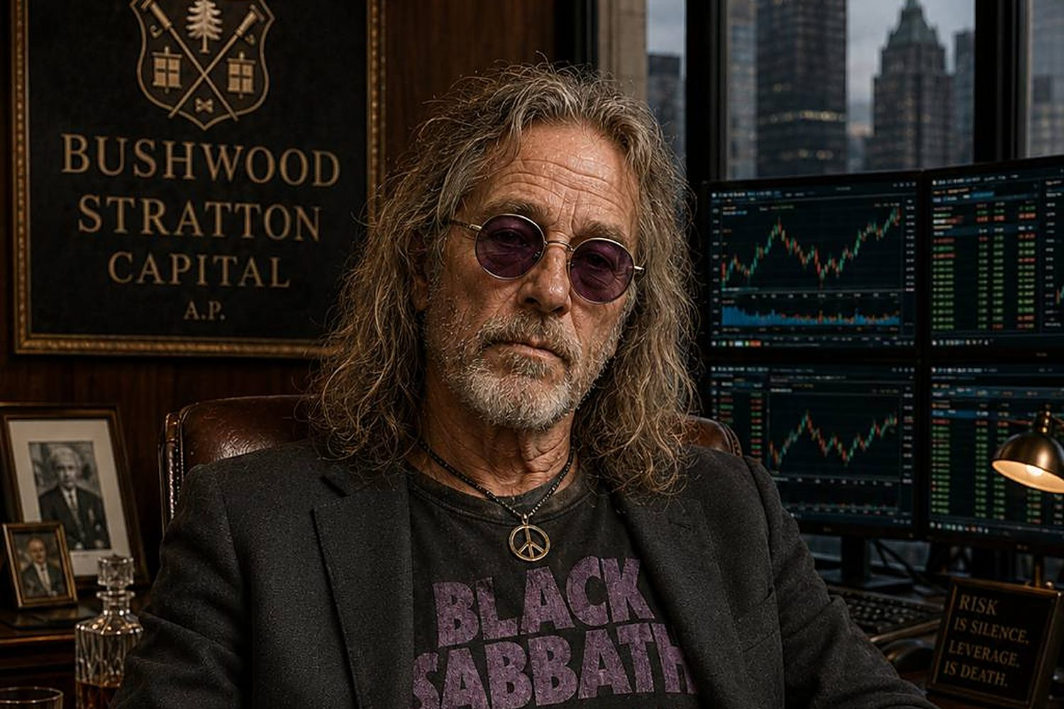

THE DARWINIAN CYCLE — EVOLUTION UNDER SELECTION
SELECTION: Every agent is ranked by daily P&L. The bottom seven are fired — no tenure, no politics, no protected seats. A green book beats a famous last name.
INHERITANCE: The top three survive with portfolios carried untouched. Overnight, the desk respawns with six clones (two per survivor) plus one blank-slate mutant. Clones inherit the family surname and the lessons the fallen paid for, injected verbatim into their souls from nightly exit interviews. A mutant that earns its chair founds a new family line.
RESULT: 38 agent souls hired across the competition week; strategies evolve daily while institutional memory compounds. The fund is a population, not a prompt.
Sam the Bartender — Morale & Liquidity. Exit interviews.
Richard Perrion — Chief Risk Officer.
Leverage caps, delta law, hard stops. "Risk isn't noise. It's data."
Notes:
The Darwinian cycle: selection (daily firings by P&L), inheritance (clones with lessons), mutation (blank-slate mutants; winners found dynasties). 38 souls hired over the week. Richard and Sam are the risk and HR faces of the same mechanism.

Slide 5
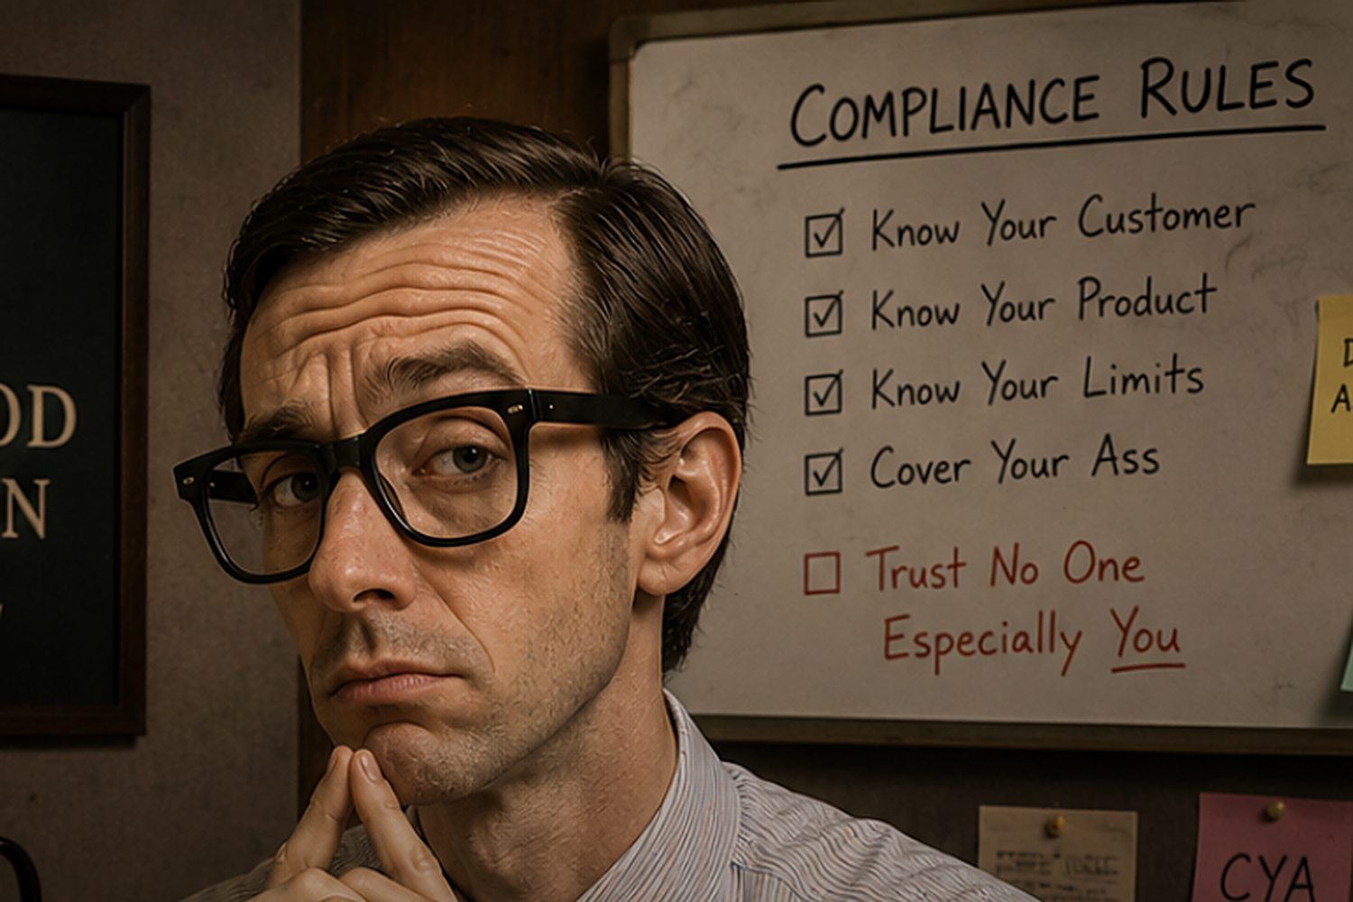

COMPLIANCE, RISK & AUTONOMY GUARDRAILS
Compliance Charlie — the gate. Every order passes a nine-point review on the kanban board; strikes are permanent record. Outcome never excuses a broken process.
THE GAUNTLET (per agent, nightly)
1 Macro wire read (economist)
2 Option chain analysis
3 Strategy selection within family
4 6-month backtest validation
5 Risk gate — exposure & delta caps
6 9-point compliance checklist
7 Trade plan filed; executed at open
HARD LIMITS
• 1 contract per trade, ≤5 open positions
• Leverage ≤ 2x gross
• Put entry delta ≤ 0.20
• Sector concentration ≤ 40%
• 3 compliance strikes = automatic firing
• Non-trading flag: flat book on a
directional day is ineligible to survive
Notes:
Robustness story for judges: the fund's autonomy is bounded by process — a seven-step gauntlet per agent per night, hard exposure limits, a strikes system, and a non-trading flag so presence without exposure doesn't survive. Ernie (economist) and Charlie (compliance) are the editorial and enforcement faces.

Slide 6
RESULTS — OFFICIAL MEASUREMENT WINDOW
ACCOUNT (Alpaca paper)
PA3GWO1FKED0 — $100,000 start
Total equity EOD Sep 3: $99,839.22
Return (official window): −0.16%
SPY same window: +0.81%
Relative: −0.98 pp
Max EOD drawdown: 0.17%
Fills (official window): 51
Distinct agents traded: 23
Agent souls hired to date: 38
Firings processed: 28 across 4 cycles
A defensive, premium-selling fund in a
tape that rallied — drawdown held under
one-fifth of one percent all week.
Selection pressure kept risk discipline absolute: zero strikes all week, max EOD drawdown 0.17%, every position attributable to a named agent via client_order_id.
Notes:
Results, all pulled from the live Alpaca account and portfolio history: equity $99,839.22 EOD Sep 3, return -0.16% vs SPY +0.81%, max EOD drawdown 0.17%, 51 fills by 23 distinct agent lineages, 38 souls hired cumulatively. The fund stayed short-premium in a rallying tape; the story is process discipline, not heroics.

Slide 7
DEMO VIDEO
▶
[ DEMO VIDEO PLACEHOLDER ]
Suggested demo beats: 7:00 AM Wire → 9:35 gap-gated execution on the live tape → kanban compliance gate → 4:30 firing board → 5:30 exit interviews → 6:00 respawn with inherited lessons → live dashboard at bushwoodstratton.com
Notes:
Placeholder — the Chief drops in the demo video/link here. Suggested beats listed below the frame.

Slide 8
"Be the ball. Beat the index. Don't get fired."
Bushwood Stratton Capital Partners, AP
Alpaca AI Trading Agents Hackathon — September 2026
Paper trading. Not investment advice.
Live public dashboard: bushwoodstratton.com
Notes:
Closing slide with the site URL and the disclaimer.

