Slide 1
MouserCV
STATUS & PLAN
Computer-vision pipeline for
automated mouse-behaviour scoring
What has been tried, what is in place today, and what is needed to validate the approach on the new top-down recordings.
May 2026
Prepared for the Bauer-lab review of the EGFR pruritus collaboration.

Slide 2
01 · APPROACH
Why a mask-feature pipeline
The objective is a scalable, label-free way to quantify scratching and grooming across cohorts, with as little manual annotation per video as possible.
SEGMENTATION
CLASSIFICATION
REVIEW LAYER
SAM3 prompt-propagation
Hierarchical state machine
Annotation web app
Per-frame silhouette masks for each animal, propagated through the clip from a single prompt. Choice driven by the goal of building a classifier directly on mask geometry — keeps the pipeline label-free and avoids per-cohort retraining.
Three-level decision on mask features (velocity → posture → behaviour) with thresholds auto-calibrated from the first 300 frames. Reliable for the geometry-distinct categories (rearing, idle); ambiguous for behaviours that share a silhouette.
React + FastAPI tool deployed at mousercv.dejandukic.dev. BORIS-grade keyboard workflow, in/out-point segments, per-mouse track lanes, undo/redo, autosave, CSV export. Built so a domain expert can review and correct labels quickly.
MouserCV · status & plan · May 2026
2 / 7

Slide 3
02 · WHAT WAS TRIED
Front-angle recordings: where the approach hit a wall
The pipeline was first run end-to-end on the original diagonal / front-angle cohort (Cage 17082, Cage 2, DOB 160810, RJ193/RJ191). SAM3 produced clean per-frame masks, and the state machine handled rearing and idle well. The blocker emerged upstream of behaviour classification.
THE BLOCKER
THE CONSEQUENCE
Identity tracking broke down under occlusion
Cannot evaluate the mask-feature classifier
From the diagonal viewpoint, animals overlapped and occluded one another frequently — especially in the WT scenes with multiple mice in close contact. Reassignment errors cascaded: once two masks merged or swapped, downstream features became unreliable for the rest of the bout.
Without a stable per-animal mask through a full bout, the question we actually want to answer — can mask geometry alone separate scratching from grooming — cannot be tested cleanly. Tracking failure, not the classifier itself, was the limiting factor on this footage.
MouserCV · status & plan · May 2026
3 / 7

Slide 4





ARCHITECTURE · END-TO-END
From raw video to reviewable behaviour timeline
Five stages, each a discrete service. Outputs of one stage become the input contract of the next, so any single layer can be swapped (e.g. classifier from rules to RF) without touching the rest.
INGEST
Video upload & storage
GCS upload · signed-URL streaming · per-cohort foldering
VISION
SAM3 prompt-propagation tracking
Per-mouse silhouette mask + centroid trajectory, propagated from a single prompt
FEATURES
Mask geometry & motion
Area · aspect ratio · convexity · velocity · oscillation spectrum
CLASSIFY
Hierarchical state machine
Velocity → posture → behaviour, with temporal smoothing into segments
REVIEW
Annotation web app
Timeline lanes · hotkey labelling · in/out points · CSV export
MouserCV · status & plan · May 2026
4 / 7

Slide 5
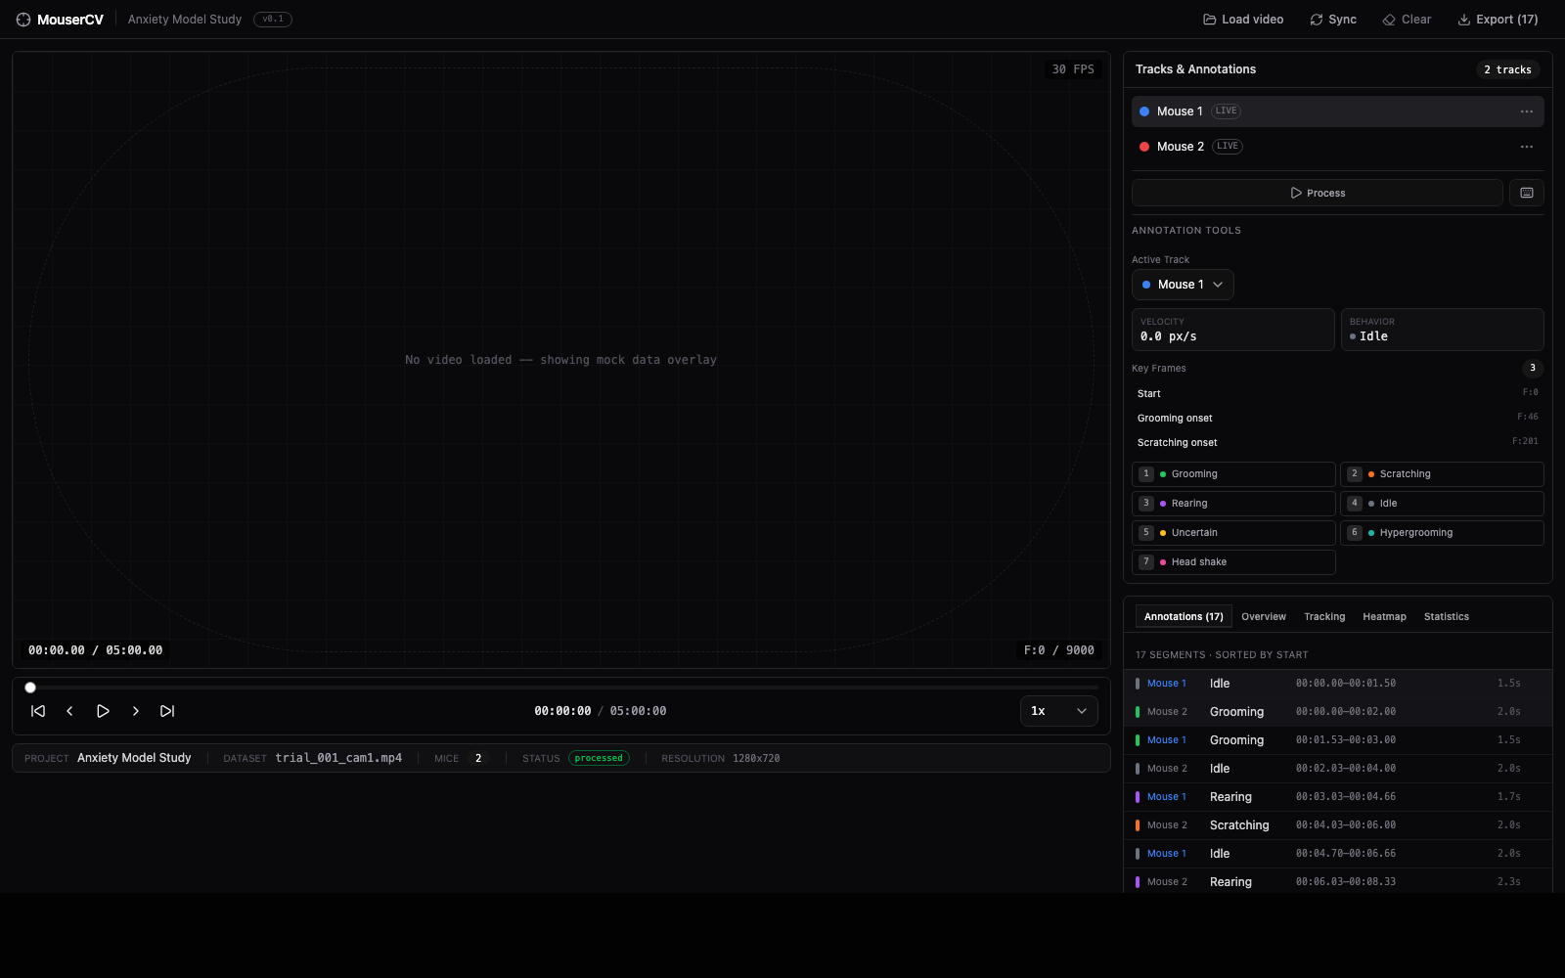
REVIEW LAYER · IN PRACTICE
Annotation tool — populated state
The review surface a domain expert lands on. Track lanes on the right, behaviour chips with hotkeys, segment list sorted by start frame, and the export hook in the top bar.
TRACK LANES
Per-mouse colour-coded lanes; identity stable across the clip from SAM3 propagation.
HOTKEYS
Seven behaviours mapped 1–7. In-point I, out-point O. Undo / redo, autosave to localStorage.
SEGMENT LIST
Default tab. Click a row to seek, hover to delete. Live count visible in the tab title.
EXPORT
CSV download with track labels, frame ranges, durations, notes — drops straight into downstream analysis.
MouserCV · status & plan · May 2026
5 / 7

Slide 6
03 · WHERE WE ARE NOW
Top-down pivot: tracking solved, questions opened
The collaboration moved to a top-down camera. Initial inspection on the available recording confirms that the tracking failure mode is gone — but the change of perspective re-opens the question of how each behaviour appears, and whether a single video is enough to draw conclusions.
RESOLVED
CHANGED
Animal reassignment no longer an issue
Silhouette geometry is different
From above, mice rarely occlude one another for long. SAM3 holds identity through the clip; the multi-WT failure mode does not appear in the top-down footage.
Postures that were distinctive from the side (rearing, hind-limb scratch) project differently from above. Existing thresholds calibrated on diagonal video do not transfer; the mask-feature set itself needs to be re-characterised.
SAMPLE LIMITATION
OPEN QUESTION
Only one top-down video on hand
Mask-only discrimination — feasibility unknown
Scratching is not prominent in this single clip, so the most behaviourally interesting category cannot yet be evaluated. A larger set of recordings — ideally enriched for scratching bouts — is the immediate gating need.
Whether mask features alone can separate scratching from grooming top-down is an open question, not a settled one. It cannot be answered without (a) more footage and (b) a small ground-truth set to calibrate against.
MouserCV · status & plan · May 2026
6 / 7

Slide 7
04 · PATH FORWARD
What unblocks the rest of the pipeline
The next steps are sequenced so that each one reduces a specific uncertainty and feeds the next. The label-free goal is preserved as the design target; whether it is achievable will be determined by the ground-truth calibration set.
01
Collect more top-down recordings
02
Build a small golden-standard set
Priority on clips with clear scratching activity. Until the set is broader, no statement about top-down scratch detection can be supported by data.
A few videos densely annotated by the domain expert — scratch, groom, hypergroom, head shake. This is what every later decision (feature choice, classifier shape, threshold tuning) will be calibrated against.
03
Validate DLC SuperAnimal keypoints top-down
04
Decide classifier form against the golden set
Run zero-shot pose estimation (top-view-mouse model) on the new footage and check per-keypoint confidence. Keypoints are the natural fallback signal if mask features turn out to be insufficient on their own.
With ground-truth in hand, test: (a) mask features alone, (b) mask + selected keypoints, (c) a learned model. Keep the simplest form that meets accuracy on the calibration set; remain label-free wherever feasible.
The annotation tool is ready to support this loop today; the bottleneck is footage and ground-truth, not infrastructure.
MouserCV · status & plan · May 2026
7 / 7

