Slide 1
EXECUTIVE SUMMARY
Used Car Market Intelligence
An Exploratory Data Analysis of Maine Craigslist Listings
2,290 analysis-ready listings after cleaning (from 2,800 raw records)
Median asking price $12,988; prices are strongly right-skewed
Mileage and age are each moderately correlated with price (r ≈ -0.41 to -0.43)
A systematic $99 “placeholder price” artifact was detected and removed
Truck-oriented brands (Ram, GMC, Ford) command the highest median prices
Student: Doan Duy Khoa Nguyen
Course: ALY6105 22718 Intro to Applied Statistics SEC 02 Fall 2026 [BOS-2A-HY]
Instructor: Roy Wada
*Claude and ChatGPT is used to assist on EDA dataset used_car_me.csv, generate visualization, ideas and findings for the presentation.

Slide 2
CONTEXT
Why Used-Car Listing Data Matters
Pricing Strategy
Benchmarking asking prices against mileage, age, and brand helps dealers and private sellers' price competitively.
DATASET SNAPSHOT
2,800
Raw listings scraped
Depreciation Planning
Understanding how fast value erodes with age and mileage informs trade-in timing and lease-end decisions.
2,290
Analysis-ready after cleaning
Inventory & Demand Signals
38
Manufacturers represented
Brand, fuel, and body-type mix reveal what a regional market supplies and rewards.
2000–2021
Model years covered
Data Quality as a Business Risk
Scraped marketplace data contains placeholder prices and missing fields that can silently distort any downstream model.
Maine
Single-state regional sample
Source: Sampled from a larger Craigslist used-vehicle dataset (Kaggle).
Northeastern University | Introduction to Applied Statistics
2

Slide 3
METHODOLOGY
Data Cleaning & Quality Assurance
2,800
−204
−293
−11
−1
−1
2,290
Raw listings
→
Non-positive placeholder prices
→
$99 teaser-price artifact (20+ brands)
→
Missing vehicle model
→
Invalid odometer reading
→
Model year beyond listing window
Final analysis-ready rows
(81.8% retained)
Type Conversion & Missing-Value Strategy
Outlier Philosophy
Column names standardized to snake_case; price/odometer/year cast to numeric, posting_date parsed to datetime.
Categorical fields (manufacturer, condition, transmission, drive, size, type, paint color) with missing values recoded as an explicit “unknown” level, preserving sample size rather than deleting rows.
VIN (91% missing) and county (100% missing) dropped as columns; not deletable via row filtering.
Rather than deleting every statistical extreme, outliers are flagged using the 1.5×IQR rule and retained for review. A $95,000 diesel truck is a legitimate high-end listing, not a data error. Removing it would understate real market range. 76 listings are flagged as high-price outliers (Slide 8 for detail).
Northeastern University | Introduction to Applied Statistics
3

Slide 4
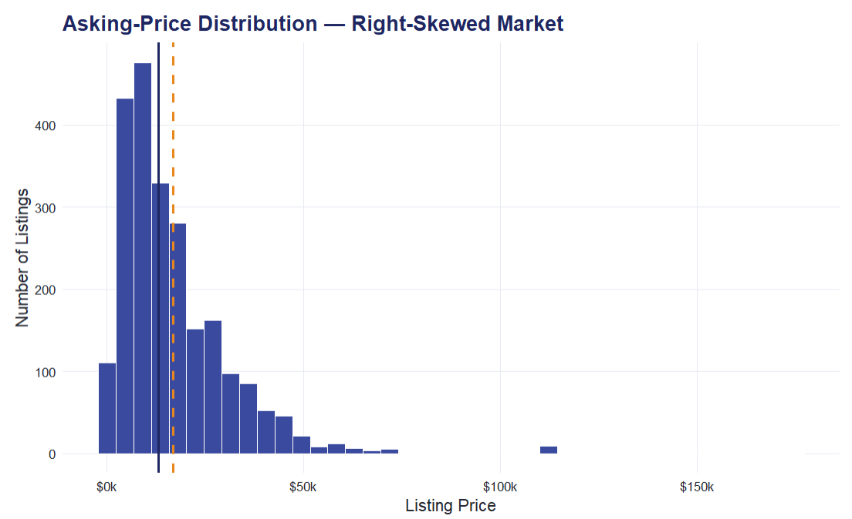
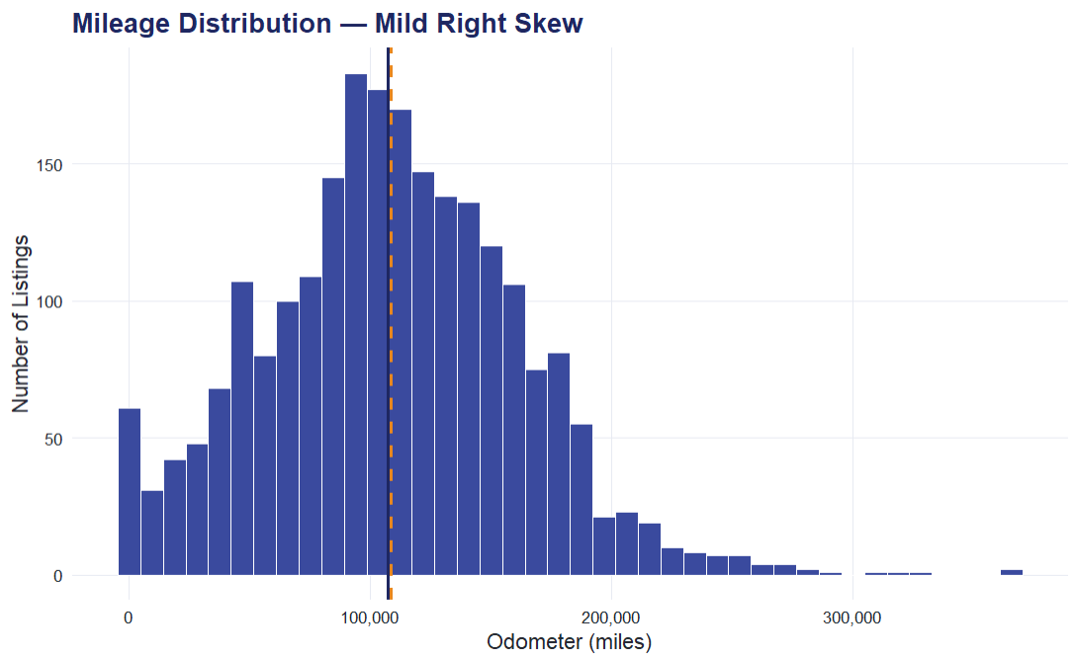
UNIVARIATE ANALYSIS
Price & Mileage: Two Skewed Distributions
Mean $16,802
Mean 108,567 mi
Median $12,988
Median 107,206 mi
Price is strongly right-skewed (skew = 2.86): most listings cluster $5k–$23k, with a long tail of premium trucks/SUVs pulling the mean ($16,802) well above the median ($12,988).
Mileage is only mildly right-skewed (skew = 0.29) and close to normally distributed around a median of 107,206 miles, which is typical for a used-vehicle marketplace.
Because price is skewed, the median is the more reliable “typical price” benchmark; the mean is pulled upward by a small number of high-value listings.
Northeastern University | Introduction to Applied Statistics
4

Slide 5
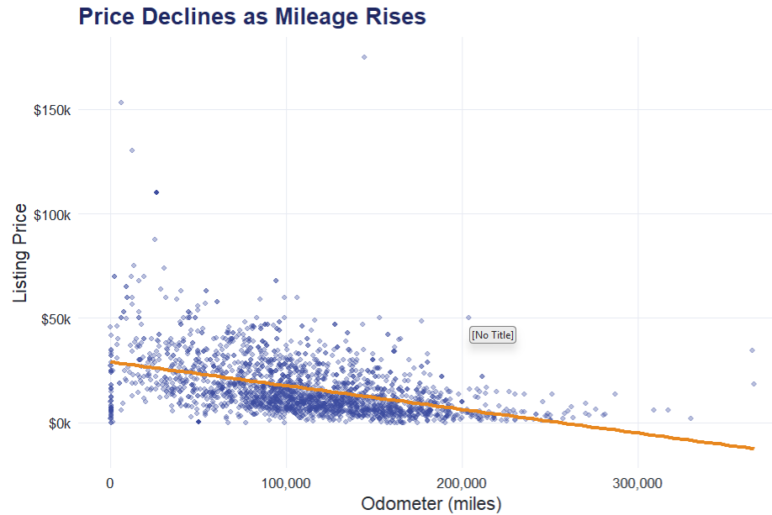
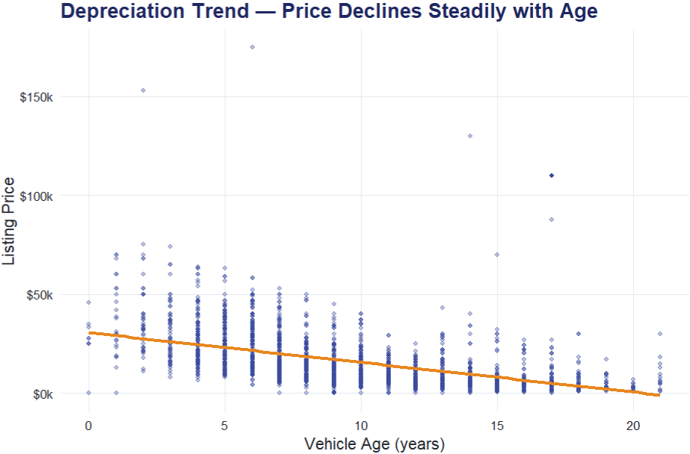
BIVARIATE ANALYSIS
Price vs. Mileage & Age: The Depreciation Signal
r = -0.41
r = -0.43
Both mileage (r = -0.41) and age (r = -0.43) show a moderate negative relationship with price, but neither alone explains most of the variation.
A log-price fit against age improves the correlation to r ≈ -0.49, consistent with vehicles losing a roughly constant percentage of value each year rather than a fixed dollar amount.
Brand and condition (Slide 6–7) explain additional variance the single-variable trend lines leave on the table.
Northeastern University | Introduction to Applied Statistics
5

Slide 6
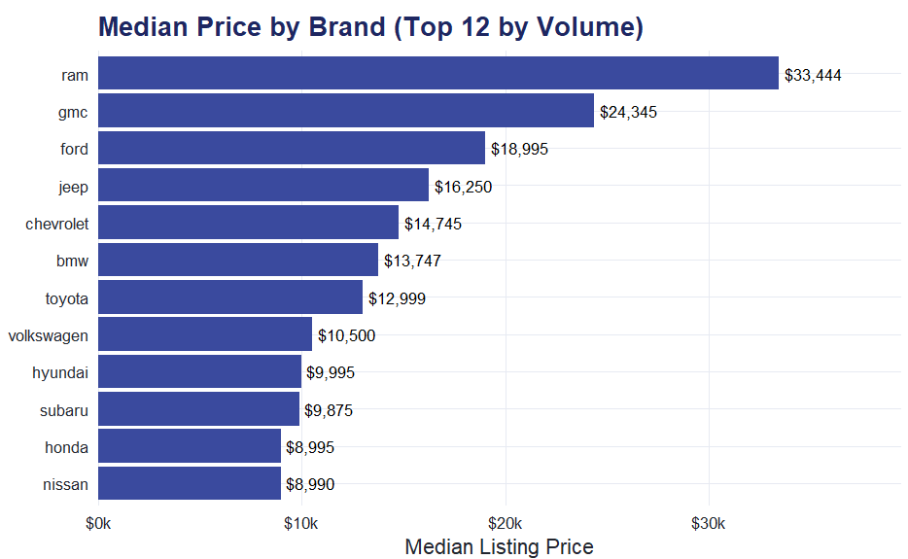
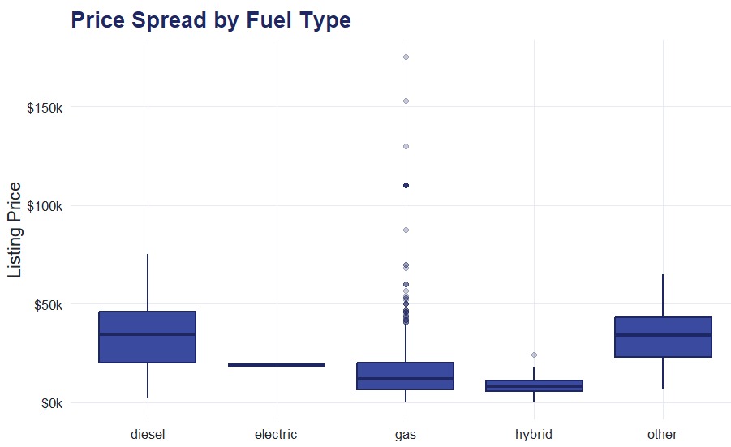
CATEGORICAL TRENDS
Brand, Fuel & Transmission Drive Price Tiers
Truck-oriented brands top the price ranking - Ram ($33,444 median), GMC ($24,345), and Ford ($18,995) - reflecting strong regional demand for trucks/SUVs in Maine.
Diesel-fueled listings command roughly 3x the median price of gas listings, driven by the same truck/heavy-duty skew rather than fuel type itself.
Automatic transmission dominates the market (90% of listings), leaving limited manual-transmission inventory as a smaller, likely enthusiast-driven segment.
Northeastern University | Introduction to Applied Statistics
6

Slide 7
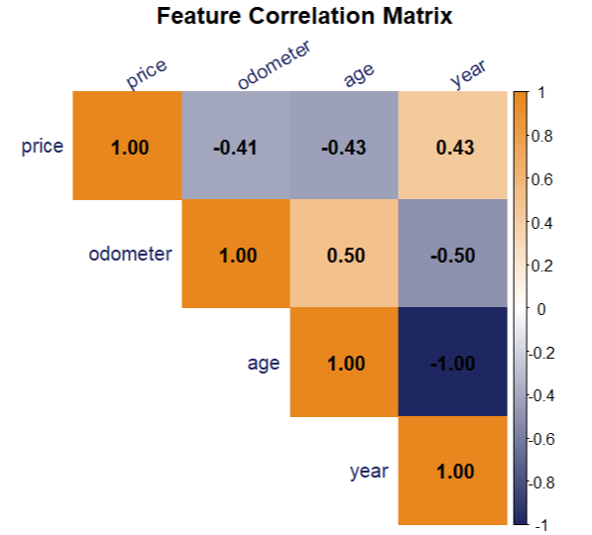
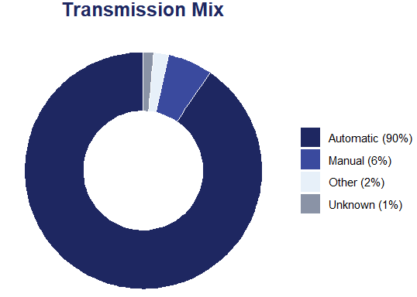
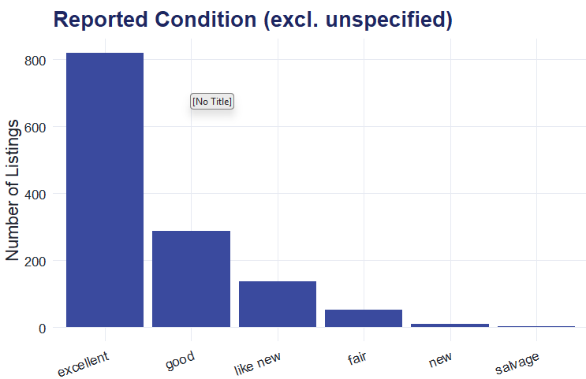
MULTIVARIATE ANALYSIS
How Price, Mileage, Age & Year Move Together
Age and odometer are themselves correlated (r = 0.50). Older vehicles have accumulated more mileage, so their effects on price partly overlap rather than add independently.
Nearly all listings (~90%) are automatic transmission, and “excellent” is the most common self-reported condition among sellers who specify one.
Northeastern University | Introduction to Applied Statistics
7

Slide 8
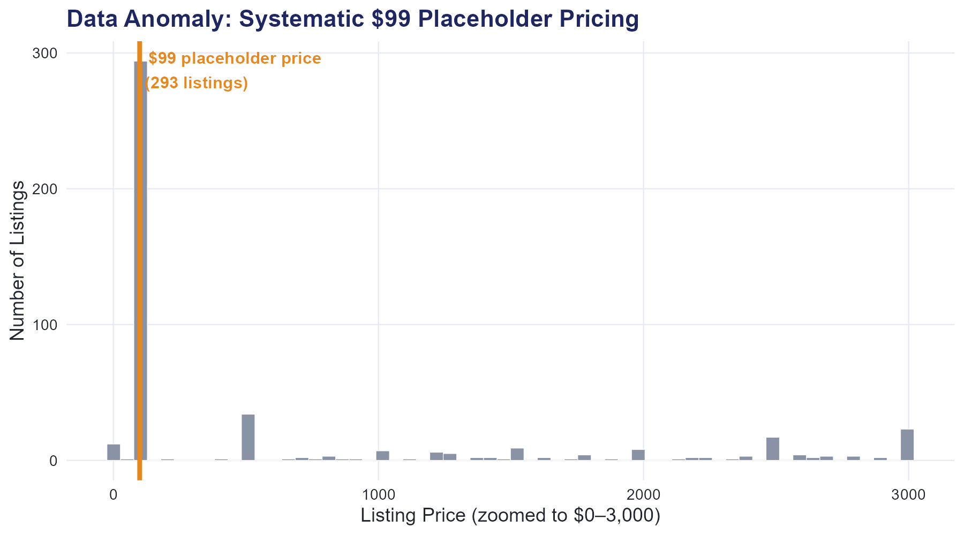
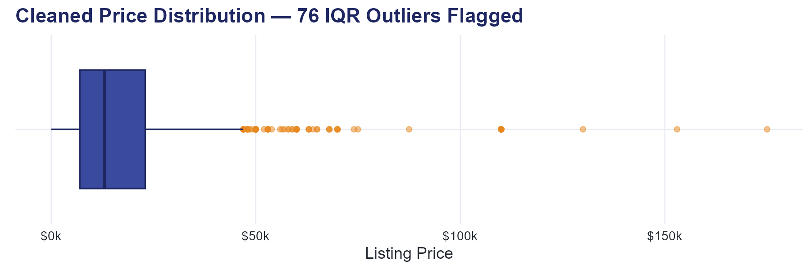
ANOMALY DETECTION
Key Outliers & Market Anomalies
BIGGEST DATA-QUALITY FINDING
76 listings remain flagged as legitimate high-price outliers (> Q3 + 1.5×IQR, which is above ~$47,000) after cleaning (mainly late-model diesel trucks and luxury SUVs). These are retained in the analysis as real market signal, not errors.
293 listings (10.5% of raw data) were priced at exactly $99 across 20+ brands, which is a dealer software default, not a real transaction price. Left uncorrected, this artifact would have fabricated a fake low-price cluster and biased every downstream price statistic.
Northeastern University | Introduction to Applied Statistics
8

Slide 9
CONCLUSIONS
Conclusions & Strategic Next Steps
What We Learned
Recommended Next Steps
Price is right-skewed and best summarized by the median ($12,988), not the mean.
Age and mileage each explain a moderate share of price variation. Neither alone is sufficient for pricing.
Brand tier (truck-oriented vs. compact/economy) is a stronger price driver than fuel type or transmission alone.
Data-quality issues (placeholder prices) can silently dominate a naive analysis, so detection and removal was essential.
Build a multivariate price model (brand, age, mileage, condition, fuel) to isolate each factor's independent effect.
Expand the sample beyond Maine to test whether brand price tiers and depreciation rates generalize regionally.
Add a rules-based data-quality check for teaser/placeholder prices ($99, $1, round-number defaults) to any future scrape.
Investigate the 76 flagged high-price outliers individually to confirm they reflect genuine premium listings.
Northeastern University | Introduction to Applied Statistics
9

Slide 10
APPENDIX
Reproducible R Environment & Code Structure
R Packages Used
Script Structure (used_cars_eda.R)
tidyverse
Data wrangling & ggplot2 visualization
0. Setup: libraries, seed, exec theme()
1. Load: read_csv() + clean_names()
2. Cleaning: documented, logged filter pipeline
3. Descriptive statistics: mean/median/sd/IQR/skew
4. Visualizations: ggplot2 panels (uni/bi/multivariate)
5. Export: cleaned CSV + PNG chart panels
janitor
clean_names(), consistent column naming
lubridate
Parsing posting_date to datetime
patchwork
Combining multi-panel chart layouts
scales / corrplot
Axis formatting & correlation heatmap
Northeastern University | Introduction to Applied Statistics
10

