Slide 1

Fall 2025
NLP-Driven Temporally-Aware 30-Day Readmission Prediction on
MIMIC-IV DATASCI 266 Fall 2025
David Lin and Daniel Chung

Slide 2
TABLE OF CONTENTS
TABLE OF CONTENTS
1
2
3
4
5
6
7
8
Motivation
The Fusion Paradox
Solution
Results
Additional Experiments
Takeaways and Impact
References
Thank you

Slide 3
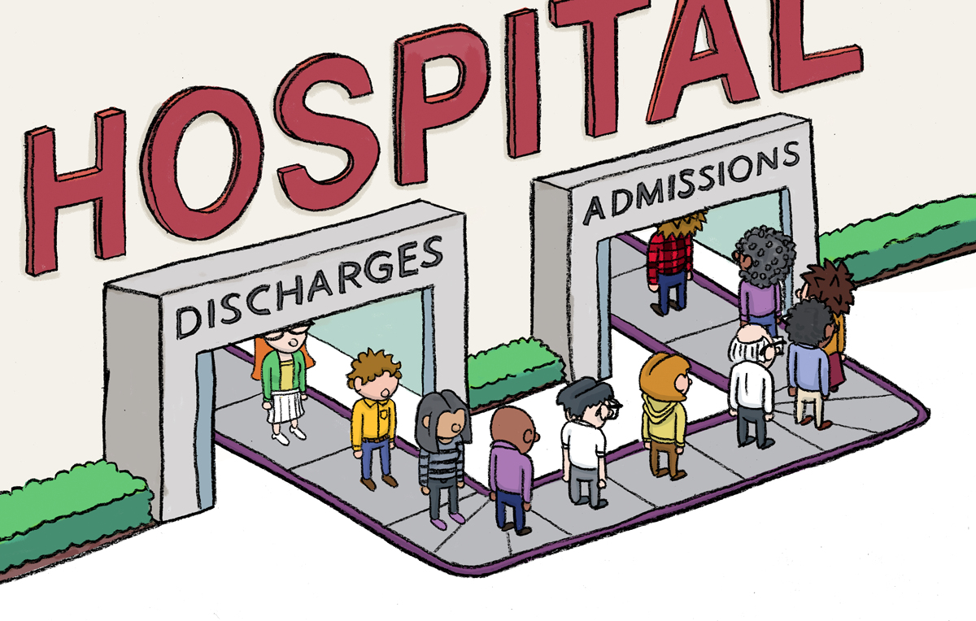
Motivation
Challenge
30-day hospital readmissions cost $26B annually
Current models use only structured data (labs, codes)
Missing critical information in clinical notes:
Discharge planning quality
Social determinants (housing, support)
Patient comprehension
Our Focus: High-risk Cardiorenal patients
25% readmission rate
≥15 day hospital stays
N = 15,659 admissions
Notes:
Hospital readmissions within 30 days are a massive healthcare problem
They cost Medicare $26 billion annually
About 15-20% of patients get readmitted within a month
Current prediction models rely entirely on structured data
Lab values, vital signs, billing codes, medication lists
But they're missing critical information that lives in clinical notes
Quality of discharge planning
Social determinants: Does patient have housing? Family support?
Patient comprehension: Can they understand their medications?
All of this is documented in text but ignored by traditional models
We focused on the highest-risk population
Patients with both heart failure and acute kidney injury
Extended hospital stays: 15 days or longer
These patients have a 25% readmission rate—much higher than general population
Our dataset from MIMIC-IV contains 15,659 of these high-risk admissions

Slide 4
The Fusion Paradox
Discovery: The “Fusion Paradox”
Problem
Naive fusion of text + structured data hurts performance
Why?
Text embeddings: High-variance, noisy (768 dim)
Structured features: Clean signal (128 dimensions)
Small data regime (~15k samples)
Result
Text noise overwhelms physiological signals
Naive concatenation → AUROC 0.611
Structured only → AUROC 0.641
Notes:
We built models to combine text and structured data
Expected: Adding text would improve predictions
Reality: Adding text actually made our model WORSE
We call this the "Fusion Paradox"
Text embeddings from transformer models like BERT:
768 dimensions
Inherently noisy
Contain administrative boilerplate, redundant descriptions
High linguistic variability
Structured features (lab values, medication sequences):
Only 128 dimensions
Clean physiological signal
Direct clinical measurements
In our small-data regime with ~15,000 training samples:
High-variance text completely dominates the feature space
Model overfits to text noise
Can't learn from clean physiological patterns
You can see this in our visualization:
Text embeddings form a diffuse, noisy cloud
Structured features are tightly clustered with clear signal
The numbers prove it:
Naive concatenation: 0.612 AUROC
Structured data ALONE: 0.641 AUROC
Adding data made performance worse

Slide 5
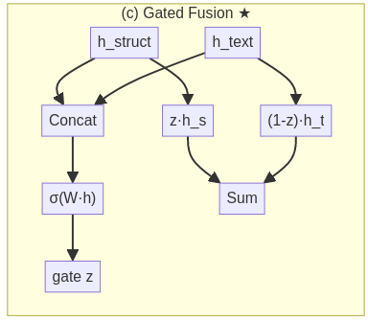
Solution
Solution: Gated Fusion Neural Network
Key Idea: Learn when to trust each modality
Architecture:
Structure EHR → Transformer Encoder (128 dim)
Clinical Notes → BioClinical-ModernBERT (768 dim → PCA to 64 dim)
Learned Gate (z): Weights modality reliability
h_fused = z * h_text + (1-z) * h_struct
Notes:
How do we fix the Fusion Paradox?
Our solution: Gated Fusion Neural Network
Key insight: Don't assume every modality is equally useful for every patient
Let the model LEARN when to trust text
Let it LEARN when to trust structured data
Here's our architecture [POINT TO DIAGRAM]
Structured EHR pathway:
Daily sequences of labs, medications, diagnoses
Encoded with Transformer (not GRU)
Output: 128-dimensional representation
Transformers better capture long-range dependencies in these 15-day stays
Clinical notes pathway:
Discharge summaries and radiology reports
Encoded with BioClinical-ModernBERT
Has 8,000 token context window—can fit entire discharge summary
We then apply PCA to compress from 768 to 64 dimensions
This compression is crucial—prevents text from overwhelming structured features
Gated fusion mechanism:
Learned gate: single number between 0 and 1
Model learns this during training
Formula: h_fused = z × h_text + (1-z) × h_struct
Dynamically decides how much weight to give each modality
Different for each patient
Result: We resolve the Fusion Paradox by adaptive weighting

Slide 6
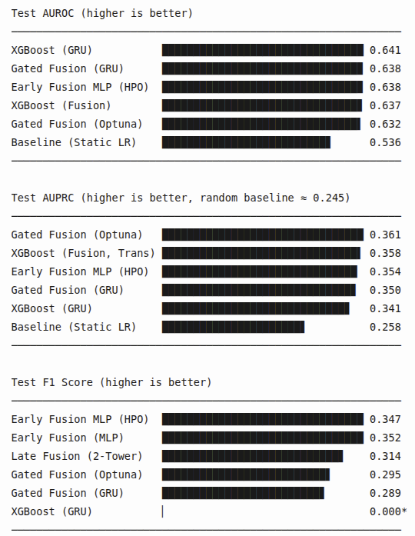
Results
Results: Top Models on Test Set (n=1,569)
Conservative threshold → predicts all negative
Key Findings:
Gated fusion recovers from Fusion Paradox
Matches tree baseline with better calibration
Transformer > GRU for temporal encoding (0.658 vs 0.651)
Notes:
Here are our test set results on 1,569 held-out admissions
XGBoost on structured data alone: Our strongest baseline
AUROC: 0.641
But F1 score is ZERO
Why? It's poorly calibrated—so conservative it predicts almost no one gets readmitted
Not useful for clinical deployment
Our Gated Fusion model:
AUROC: 0.638
Essentially matches the XGBoost baseline
F1 score: 0.29—much better!
Properly calibrated for clinical use
Early Fusion MLP (hyperparameter optimized):
Also 0.638 AUROC
Even better F1: 0.35
Shows that with proper tuning, even "simple" concatenation can work
Compare to naive concatenation:
Remember, naive approach only got 0.612
Gated Fusion RECOVERED the lost performance
We got back to baseline level and added clinical utility
Additional finding: Transformers vs GRUs
Transformer encoder: 0.658 validation AUROC
GRU encoder: 0.651 validation AUROC
Transformers are superior for these temporal clinical sequences
Attention mechanism captures long-range dependencies better
Key takeaway:
Smart fusion architecture matters MORE than just adding data
Learned weighting beats naive concatenation

Slide 7
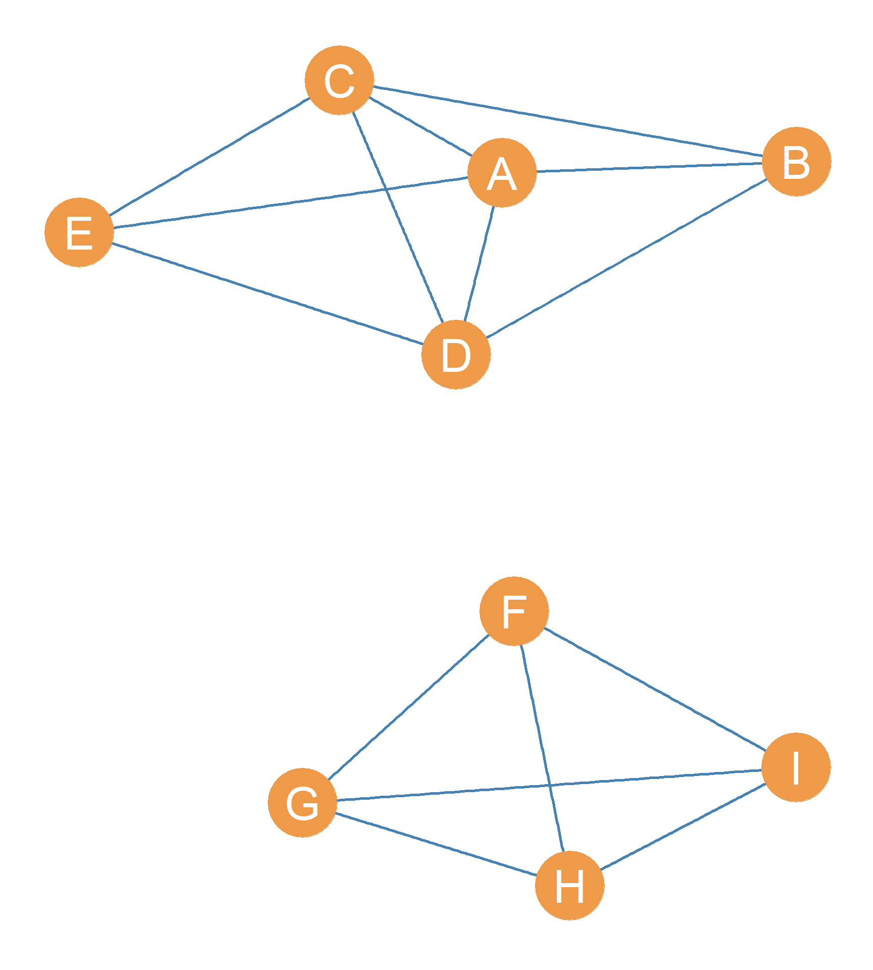
Additional Experiments
What Didn’t Work (and why)
Graph Neural Networks
Patient-similarity graph (k=15 neighbors)
High recall (72%) but low AUROC (0.596)
Training instability
LLM Prompting (Llama 70B)
Zero/one-shot: AUROC = 0.52 (random)
Few-shot: 97% predict readmitted (useless)
Validated our focused approach!
Notes:
We also tried some ambitious approaches that didn't work out
But they taught us important lessons
Graph Neural Networks (GraphSAGE):
Built patient-similarity graph with k=15 nearest neighbors
Based on multimodal features: EHR + text embeddings
Results: High recall (72%) but poor discrimination
AUROC only 0.596
Also very unstable during training
Trade-off: catch more readmissions but tons of false alarms
LLM prompting with Llama 3.1 70B:
Tried zero-shot, one-shot, and few-shot prompting
Gave it demographics, sparse EHR summary, and full clinical notes
Zero-shot and one-shot: AUROC ~0.52 (basically random)
Few-shot: AUROC 0.60 but completely useless
Why? Predicted 97% of patients would be readmitted
Perfect recall but terrible precision
What we learned:
These negative results validated our focused approach
Complex architectures (GNN) or massive models (70B LLM) don't automatically win
Domain-specific fusion design matters more than model size

Slide 8
Takeaways and Impact
Key Contributions:
Identified the “Fusion Paradox”
More data isn’t always better in small regimes
Gated Fusion resolves the paradox
Learned weighting > naive concatenation
Transformers > GRUs for clinical time series
Attention captures long-range dependencies
Deployment Recommendation:
XGBoost for ranking + Gated Fusion for high-recall alerts
Future Work:
End-to-end training of transformer + gated fusion
Notes:
To summarize, three main contributions:
Contribution 1: Identified the "Fusion Paradox"
In small-data regimes, more modalities ≠ better performance
High-variance embeddings can overwhelm clean signals
This is a general finding relevant beyond readmission prediction
Contribution 2: Gated Fusion resolves the paradox
Learned adaptive weighting beats naive concatenation
Recovers lost performance and improves calibration
Matches tree baseline while being clinically useful
Contribution 3: Validated Transformers for clinical time series
Self-attention > recurrent architectures
Better at capturing long-range dependencies
0.658 vs 0.651 on our temporal physiological sequences
For real-world deployment, our recommendations:
Use XGBoost for daily risk ranking (fast, interpretable)
Overlay Gated Fusion for high-recall alerts on top decile
Combines efficiency with clinical utility
Future work:
End-to-end training: jointly optimize Transformer encoder + Gated Fusion
Could push beyond current 0.64 AUROC plateau
External validation on other hospital systems
Thank you! Happy to take questions

Slide 9
References
Almeida, Moreno, Barata (2025) — Prediction of 30-day hospital readmission with clinical notes and EHR information.
Pandey, Tile, Oghaz (2025) — Predicting 30-day hospital readmissions using ClinicalT5.
Khan et al. (2025) — Predicting 30-Day Readmission for Heart Failure Using Code Embeddings on MIMIC-IV.
Licerio (2024) — Predicting 30-Day Unplanned ICU Readmissions Using Deep Learning and NLP: A MIMIC-IV Analysis.
Huang et al. (2020) — ClinicalBERT: Modeling Clinical Notes and Predicting Hospital Readmission.
Weiss, Jiang (2021) — Overview of Clinical Conditions With Frequent and Costly Hospital Readmissions by Payer, HCUP Statistical Brief #278.

Slide 10

THANK YOU
Any questions?

