Slide 1
Movie Shazam 1.0
Daniel Mooney & Nazar Al-Wattar

Slide 2
MOTIVATION
Build a Information Retrieval System to retrieve the name of the movie and other useful information from a query of a quote from the movie!
Both text and sound
Building an efficient way to play subtitles from a particular point in the movie. Enormous benefit to the Deaf!

Slide 3
Problem Definition
There is a need to build an accessible system to search subtitle files and display the relevant information of the search.
There is another need to make it useful for the special needs of people

Slide 4
RELATED WORK
Shazam (music recognition, support for live broadcast and recorded TV)
IntoNow (defunct, Yahoo Owned)
Viggle (Foursquare for watching TV)
TakeThat (shows the fashion items in the movie)
Quodb.com (online search enginge, good results but no voice input)

Slide 5
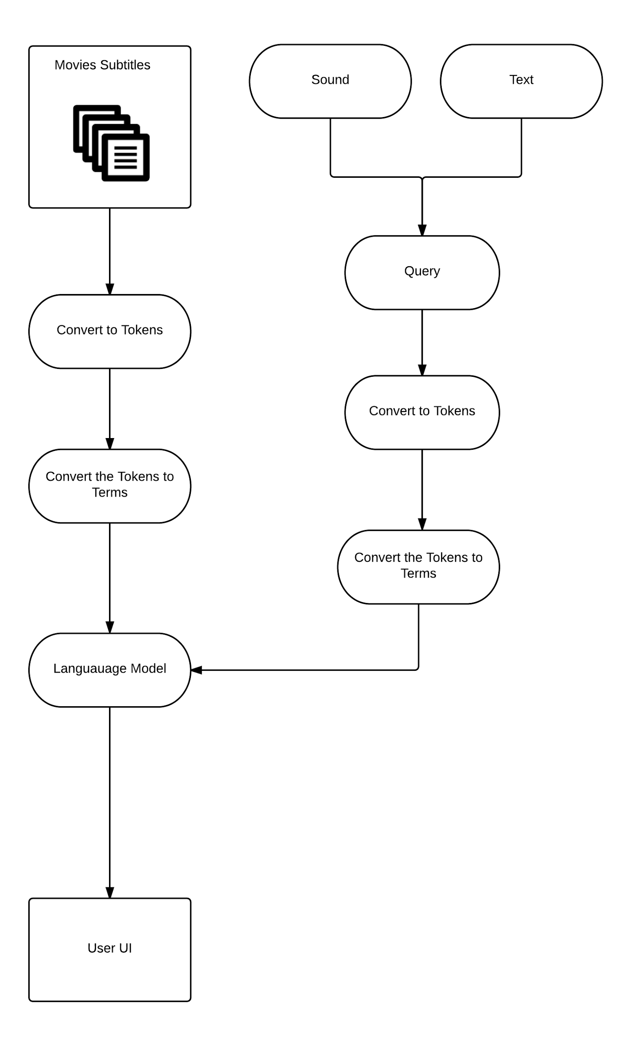
Workflow

Slide 6


OUR APPROACH
Unigram Language Model on top of PYQT UI

Slide 7
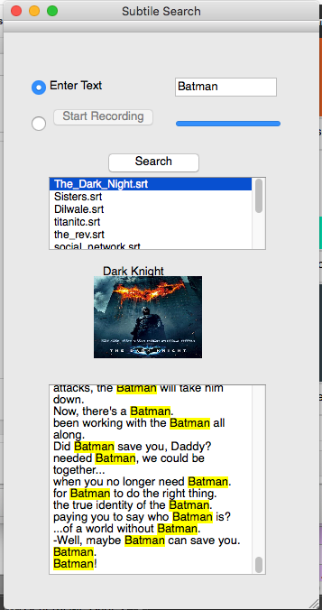

Slide 8
Key Issues and How They were Resolved
Accuracy is important
Subtitle data can be difficult to parse
Original model was slow -> better data structures sped it up 3000%
Python UI issues -> tried a couple of different frameworks and eventually worked with PyQT

Slide 9
Accuracy and Validation
Random subset from each of the subtitles was tested and run against the model
75-79% accuracy

Slide 10

FUTURE WORK
Deploy the UI to web or mobile app interface
Change Unigram to n-gram
Account for position
More Movie Information
Live Subtitle Player

Slide 11
CONCLUSIONS
Building a Information Retrieval System is not easy!
Updating our model to n-gram / positional may slow our application down but improve accuracy
Accuracy - Time Tradeoff
Unigram model has noticeable issues
Scoping out the IRS development is key
Shows how applications can be assistive

Slide 12
DEMO

