Slide 1
ELMO & BERT
Transfer learning for NLP

Slide 2
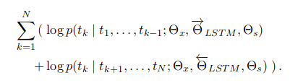
Transfer Learning
Deep
Unsupervised
Language
Model
Document
Features
User
Task
Predictions
0
1

Slide 3
ELMO
Forward language model p(x_{t}|x_{t-1}, x_{t-2},x_{t-3})
Backward language model p(x_{t}|x_{t+1}, x_{t+2},x_{t+3})
The quick fox jumped over the log.
t-3 t-2 t-1 t t+1 t+2 t+3

Slide 4
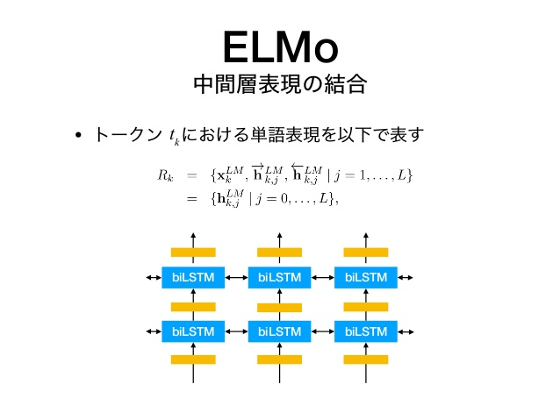

ELMO
At every token x_k
Loss
ELMO can be fine-tuned on different tasks
  γ^{task} determines how much a task is important
  s_{j}^{task} how layer j is important for task
h_{k,2}
p(x_{k}|x_{k-1}, x_{k-2},x_{k-3})
LSTM₂
h_{k,1}
LSTM₁
The quick fox jumped over the log.
LSTM₁
LSTM₁
LSTM₁
h_{k,1}
p(x_{t}|x_{k+1}, x_{k+2},x_{k+3})
LSTM₂
h_{k,2}

Slide 5
ELMO
+
h_{k,2}
-
Whenever we train a classifier on top of ELMO:
  task becomes fixed
  s_{j}^{task} gets fine-tuned
LSTM₂
h_{k,1}
LSTM₁
It was a decent movie

Slide 6
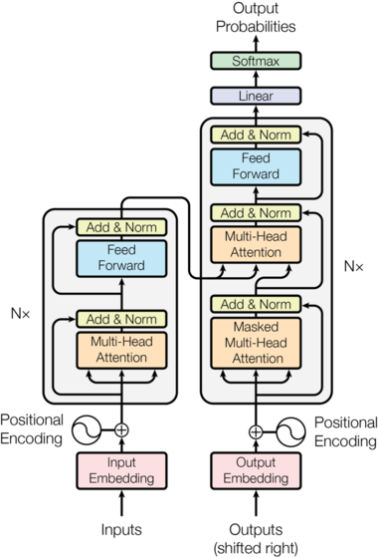
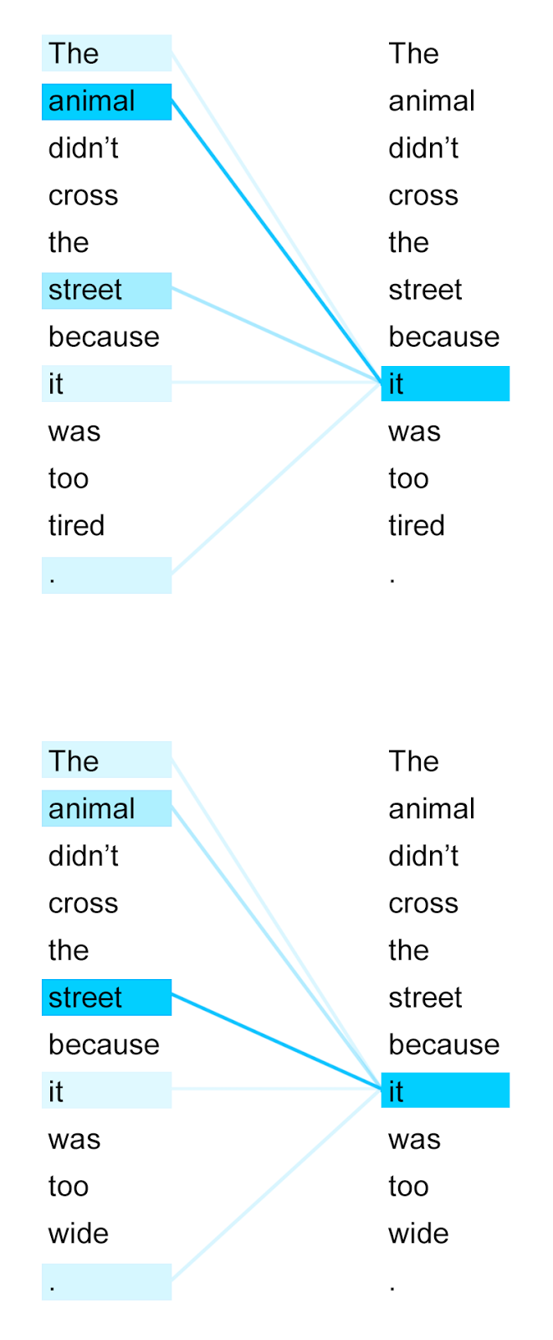
BERT
Is a transformer encoder
Trained on:
Masked Language Model
    The ice cream was [MASK] .
Sentence Adjacency
    Is B successor of A

