Slide 1
Superstore Business Performance Analysis
Data Storytelling & Statistical Validation
Project Context
Tools & Stack
Data Analytics Internship — ApexPlanet
Prepared by: Meghana D
PYTHON
PANDAS
TABLEAU
JUPYTER NOTEBOOK
STATISTICAL TESTING

Slide 2
BUSINESS OBJECTIVE
What Are We Solving For?
This analysis transforms raw Superstore transactional data into strategic business intelligence — enabling leadership to make confident, data-backed decisions.
Performance Analysis
Discount Impact
Analyse sales and profitability trends across segments, categories, and regions.
Evaluate how discount strategies affect profit margins at scale.
BI Dashboard
Data-Driven Decisions
Build an interactive Tableau dashboard for dynamic stakeholder exploration.
Support leadership with evidence-based insights and statistical validation.

Slide 3
DATASET OVERVIEW
Superstore Sales Dataset
9,994
24
Total Records
Features
Transactional order entries
Attributes per record
Key Attributes
Sales · Profit · Discount
Category · Region · Segment
Order Date · Order ID
Feature Engineering Applied
Year, Month, and Profit Margin derived columns were engineered post data cleaning and preprocessing in Python/Pandas.

Slide 4
CORE KPIS
Business Performance at a Glance
Total Sales
Total Profit
Profit Margin
$2.3M
$286K
12.03%
Cumulative revenue across all orders
Net profit after costs and discounts
Profit as a percentage of total sales
Total Orders
Avg. Order Value
5K
$458.6
Unique orders processed
Average revenue generated per order

Slide 5
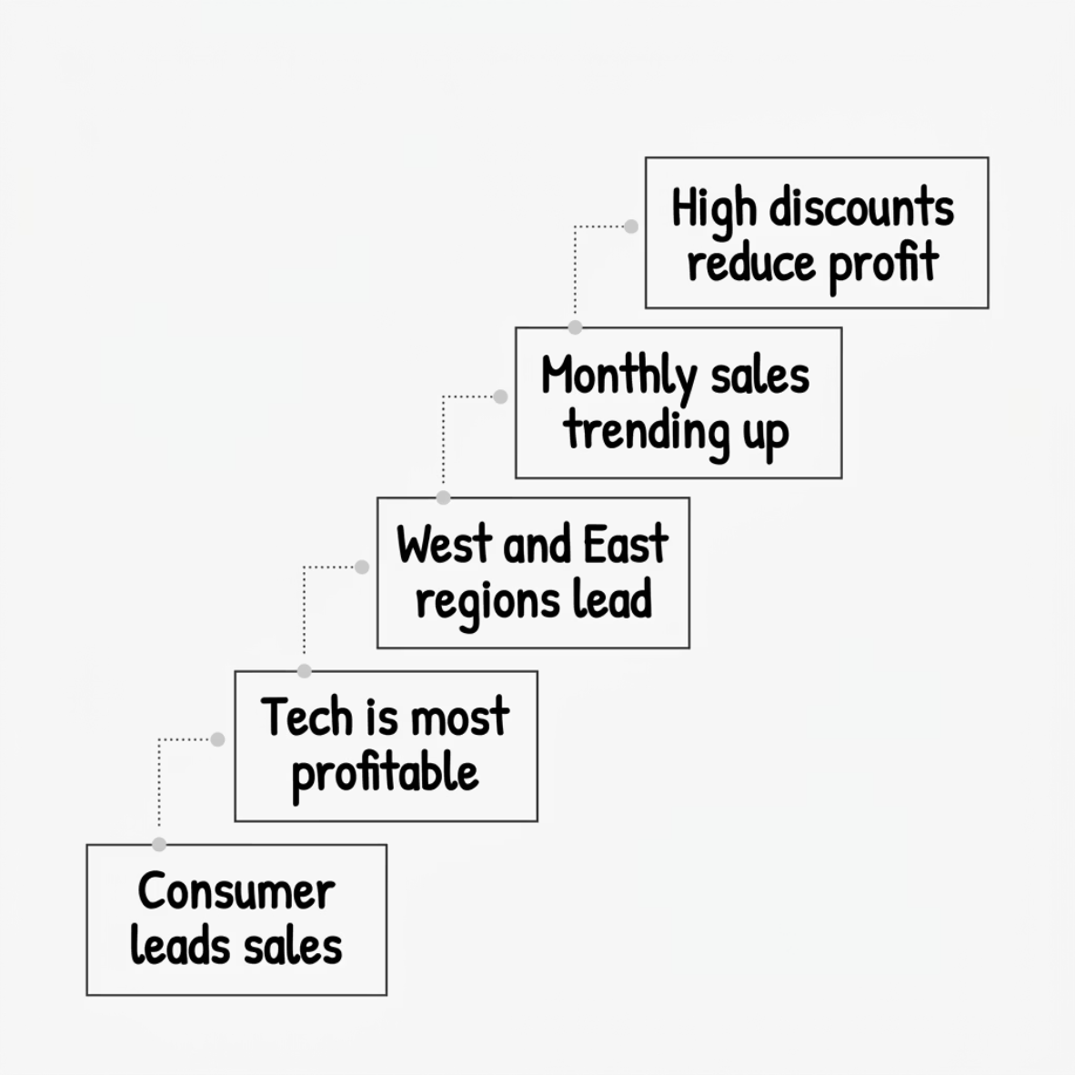

KEY INSIGHTS
What the Data Reveals
Consumer Segment Dominates
Technology Leads Profitability
The Consumer segment contributes the highest share of total sales volume and order count across all periods.
Technology category consistently generates the highest profit margins, outperforming Furniture and Office Supplies.
West & East Drive Revenue
Discounts Erode Margins
Excessive discounting is a statistically validated driver of profit loss — a key risk area for the business.
Western and Eastern regions demonstrate the strongest sales performance with healthy profit contribution.

Slide 6

TABLEAU DASHBOARD
Interactive Business Intelligence Dashboard
Built in Tableau with dynamic filtering — enabling business users to explore performance across any dimension in real time.
KPI Cards
Monthly Sales Trend
Segment Share Analysis
Treemap Visualisation
Heatmap Analysis
Regional Sales Map
Discount Impact Analysis
Interactive Filters
Dashboard enables stakeholders to slice data by Category, Region, Segment, and Time Period — with zero SQL or coding required.

Slide 7
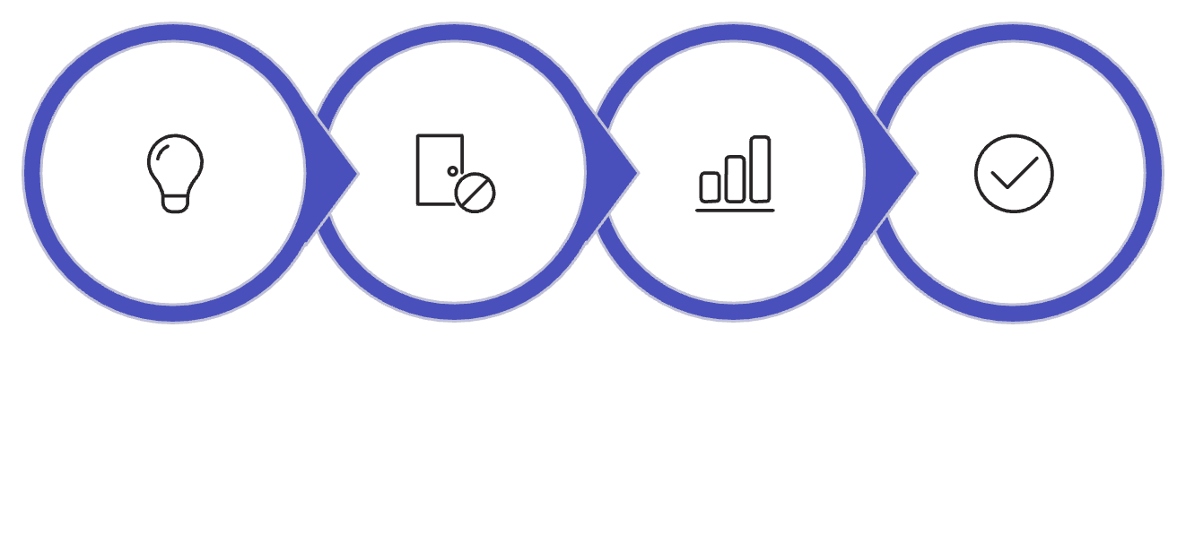

STATISTICAL VALIDATION
Hypothesis Testing — Discount vs. Profit
Statistical Results
T-Statistic
P-Value
16.14 — Strong separation between groups
2.29e-54 — Far below the 0.05 significance threshold
Average Profit by Group
Group
Avg. Profit
Business Hypothesis
Null Hypothesis
T-Test Applied
Reject H₀
Low Discount (≤ 20%)
$49.04
High Discount (> 20%)
-$97.18
Null hypothesis rejected. High discounts significantly and measurably destroy profit margins.

Slide 8




RECOMMENDATIONS
Strategic Business Recommendations
Optimise Discounting
Invest in Technology
Cap discounts at ≤ 20% to protect margins. Implement approval workflows for high-value discount requests.
Double down on Technology products — they deliver the highest profitability and should anchor the growth portfolio.
Regional Focus
Track Profit Margins
Strengthen supply chain and marketing investment in West and East regions where profitability is highest.
Shift KPI focus from top-line sales to profit margin — use the Tableau dashboard for continuous monitoring.

Slide 9
Conclusion
01
02
Raw Data → Actionable Intelligence
Analytics + Storytelling + Statistics
Successfully transformed 9,994 transactional records into clear, executive-ready business insights.
Combined Python analytics, Tableau dashboards, and hypothesis testing for a rigorous, multi-layered analysis.
03
04
Interactive Dashboard Delivered
Decision-Ready Recommendations
Built a fully interactive Tableau BI dashboard — empowering stakeholders to explore data independently.
Delivered five strategic business recommendations backed by statistical evidence and data storytelling.
"Data-driven insights enable smarter business strategies and sustainable growth."
Meghana D · Data Analytics Internship · ApexPlanet

