Slide 1
Perl Executing Browser:
yet another
GUI for scripts and
enhanced web client

Slide 2
Perl Executing Browser
Qt4/5 WebKit browser capable of
executing Perl, Python or PHP scripts
locally without a web server
https://github.com/ddmitov/perl-executing-browser
Dimitar D. Mitov
Valcho Nedelchev

Slide 3
Perl Executing Browser
Motivation
Searching for a nice and easy to use
and distribute cross-platform GUI for
local scripts
Problems with library bindings like
PerlTk, gtk2-perl, WxPerl, Perlqt4:
multiple dependencies to install,
difficult packing and distribution
Problems with front-ends like
Xdialog, Zenity, Yad:
non-flexible set of simple dialogs

Slide 4
Perl Executing Browser
Motivation
Local web server solution
not desirable for local scripts
Problems:
CGI timeout limitation –
incompatible with long-running scripts,
opening another port –
possible security vulnerability,
administrative privileges may be needed.

Slide 5
Perl Executing Browser
Inspiration
PHP Desktop, Perl Desktop
https://code.google.com/p/phpdesktop/
node-webkit
https://github.com/rogerwang/node-webkit
TideSDK
http://www.tidesdk.org/
Diogenes (software for classicists)
https://community.dur.ac.uk/p.j.heslin/

Slide 6
Perl Executing Browser
Main features
CGI scripts can be executed
locally in serverless mode,
feeding them from HTML forms using
CGI protocol GET and POST methods.
Long-running scripts can also be
executed locally in serverless mode.
(Limited) interaction with
the built-in Perl debugger.

Slide 7
Perl Executing Browser
Security
Locally scripts are executed with only few necessary environment variables, but have the same privileges as the user, who started the browser.
Browser does not download locally
executed scripts from remote locations
due to the huge security risks involved!
Local execution of scripts is not mixed
with the traditional browser access to
local or remote web servers.

Slide 8
Perl Executing Browser
Possible applications
Perl, Python or PHP desktop applications with HTML4/5 & CSS2/3 GUI
Web clients with
scripting capabilities based on
Perl, Python, PHP & JavaScript
GUI for existing local scripts
(Limited) GUI for the Perl debugger

Slide 9
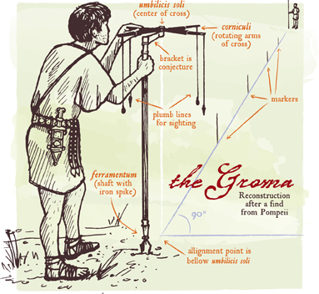
Thank you!

