Slide 1
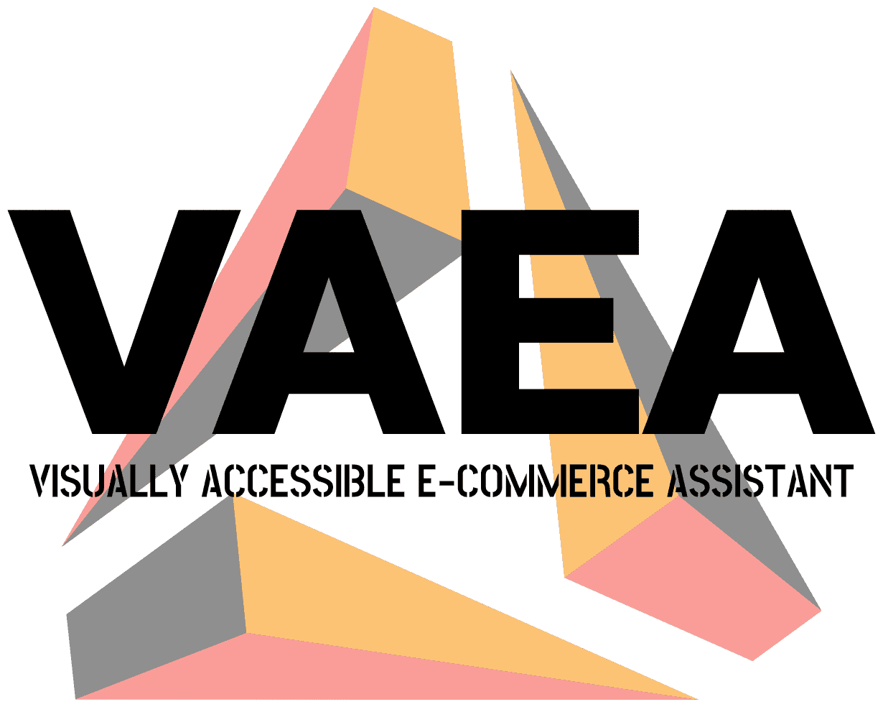
Visually Accessible E-commerce Assistant

Slide 2
catalogs
Introduction
System Overview
Model Deployment
Speech Engine
Feature Engineering
Matching Engineering
Generation Engineering
Interaction Engineering

Slide 3
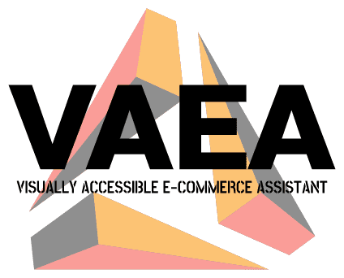
Introduction
Over the years, e-commerce has grown rapidly. However, it is easy to realize that the vast majority of e-commerce platforms have neglected to care for the visually impaired.
Visually Accessible E-commerce Assistant (VAEA) is a product recommendation and introduction system focused on enhancing the online shopping experience for visually impaired people.
Blind users can input interested products and product characteristics by voice, and this system generates the voice introduction of the products and displays them in the front-end.

Slide 4
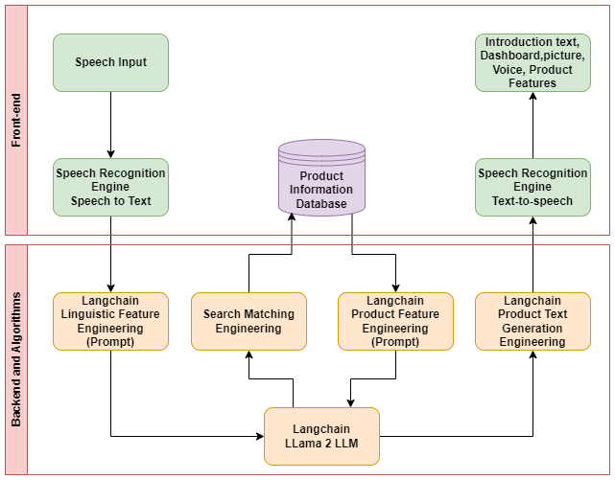
System overview
Speech-Text-Speech
Storage as the core
LLM as the driver
Plug-ins and algorithms as the engines
Trident Symmetric Architecture

Slide 5





Model deployment
OLLAMA
Llama2 70B
LLAMA2 – 70B
Local deployment
Deep learning workstation
3090Ti & 64G DRAM & 14700K

Slide 6

SPEECH ENGINE
We use the voice plugin that comes with the browser as our voice engine
Speech to Text
Text to Speech

Slide 7
When we get text, what happens next?

Slide 8
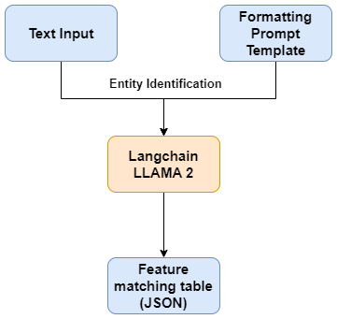
Feature Engineering
Feature engineering attempts to extract from a given input the features of a product that the user wants to be recommended and its feature values
We use the prompt engineering to format constraints on the output of LLAMA2.
Prepare a feature sheet(JSON) to be filled out as a PROMPT
Sends a request for the model to fill out the sheet based on user inputs

Slide 9
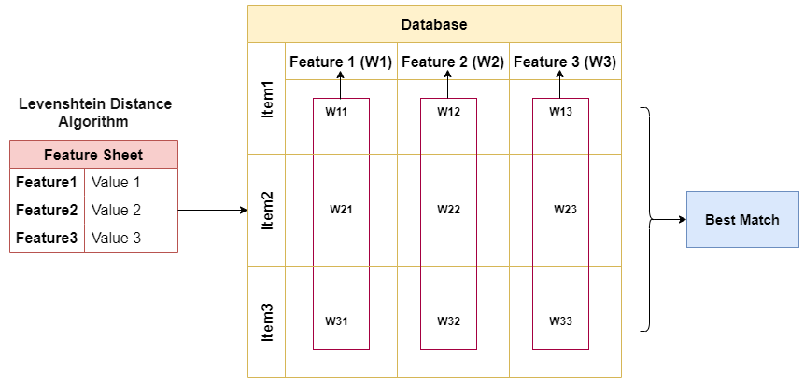
MATCHING Engineering
Although we have got the extracted features and feature values, it is not easy to match the best item from the database.
Match engineering always tries to match the closest item to the user's description to the best of its ability.
Attention Search Engine
Attentional Features Grading
Attention Feature Matrix Searching
Precision Search
Fuzzy Search

Slide 10
Generation Engineering
Product Introduction Text
Documentation Planning: Paragraph planning for given data
Micro Planning: Planning of feature points to be introduced in each paragraph
Langchain Chaining Task: Paragraph generation and collocation
Neural Network Based
Mixed with Rule Based
Dashboard Storytelling Text
Rule Based
Arria syntax and methods using python emulation

Slide 11
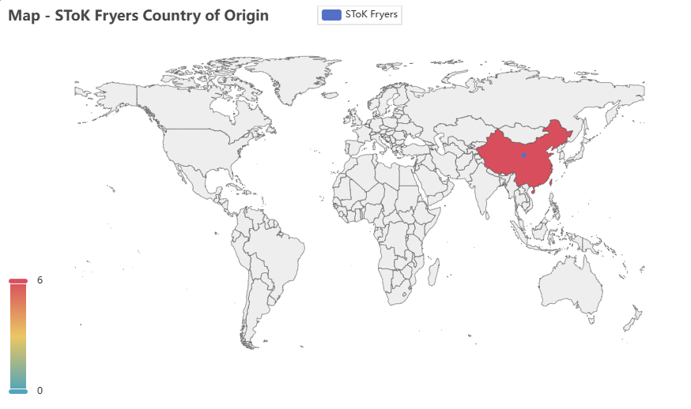
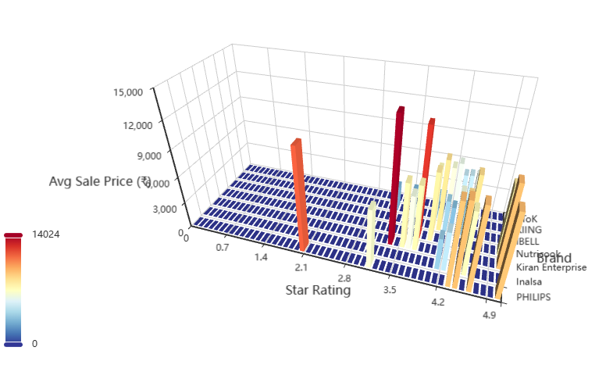
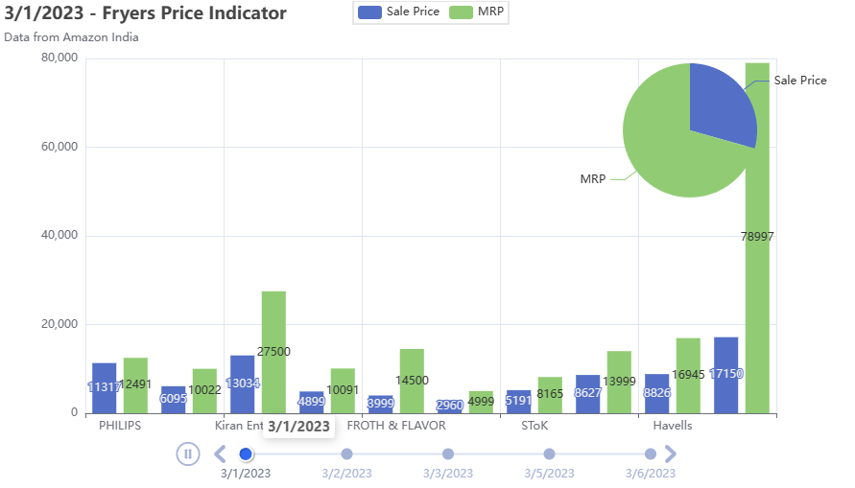
Interaction Engineering
We offer an interactive dynamic dashboard that can be controlled and switched using voice.
Each Dashboard has a corresponding storytelling voice announcement.

Slide 12
THANK YOU

