Slide 1

OverGrowth
An application for managing your plants

Slide 2
By: Dustin Nold and Wesley Millett

Slide 3

Plants can be hard to manage
Lack of understanding
Forgetting to water them
Improper care

Slide 4

Our Solution
Provide users with an easy way to search for their plants
Provide users with a plethora of basic information regarding the care for their plants
Provide users with additional exterior resources to research their plants.
Finally, provide a service that reminds users what plants they need to water and when.

Slide 5

Features of Overgrowth
Large Real-time database containing a large array of different plants. -- COMPLETE
Local SQLite database for offline usage -- COMPLETE
Ability to search this database in real-time -- COMPLETE
Ability to add plants to a user's personal garden -- COMPLETE
Ability to add a timer for each plant in a user’s personal garden -- COMPLETE
Ability to view plants in the database and develop a cursory understanding of how to care for the plant -- COMPLETE
A notifications view that shows all the plants with expired timers. -- COMPLETE
Ability to reset a timer with the press of a button -- COMPLETE
Push notifications when a timer expires. – INCOMPLETE
Dark Mode compatibility -- INCOMPLETE

Slide 6
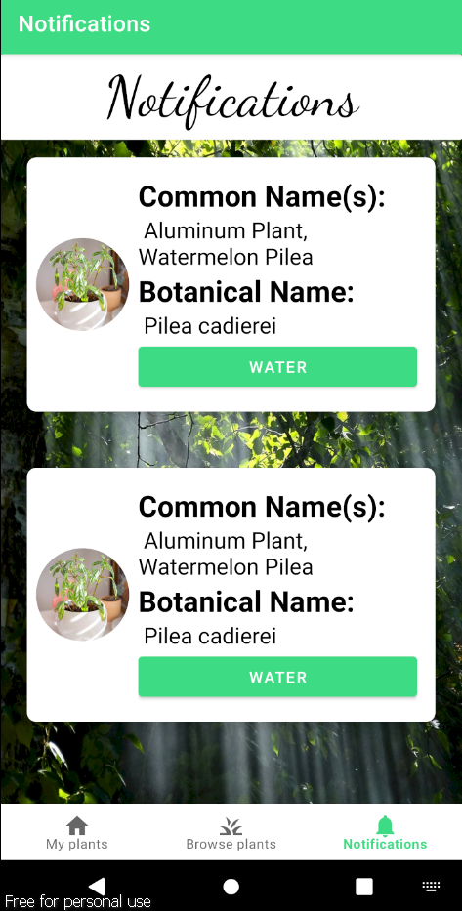
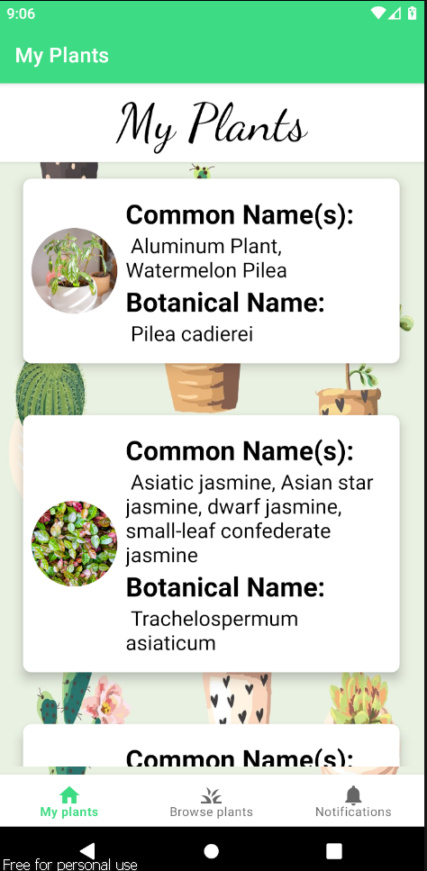
Home/Notifications
Home tab or “My Garden” will display the plants a user adds to their local database from the “Browse plants” tab. This is accessible offline.
Notifications tab will display any plants that have had a timer expire on them. Additionally in the detail view this will be visible via the calendar turning red. From here you can simply click “water” to reset the timer from the current time.

Slide 7
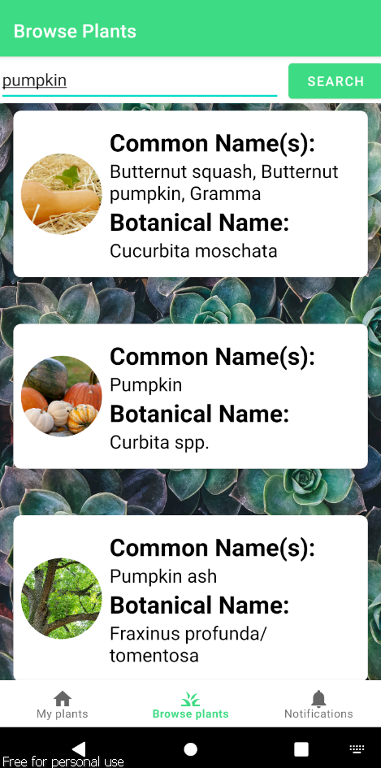
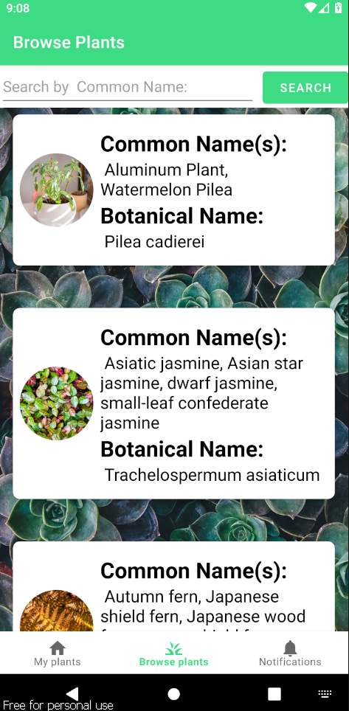
Browse Plants
Without a search input will feature plants in alphabetical order of their common name. When a user scrolls plants will continue to be generated 3 at a time.
With a search the tab will feature plants that match the common name you searched for. If no results are found the page is simply blank with no indication as of right now. When scrolling from here you will see results in alphabetical order.

Slide 8
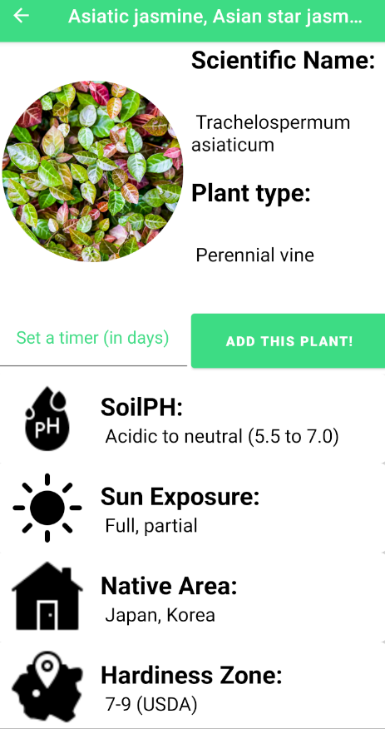
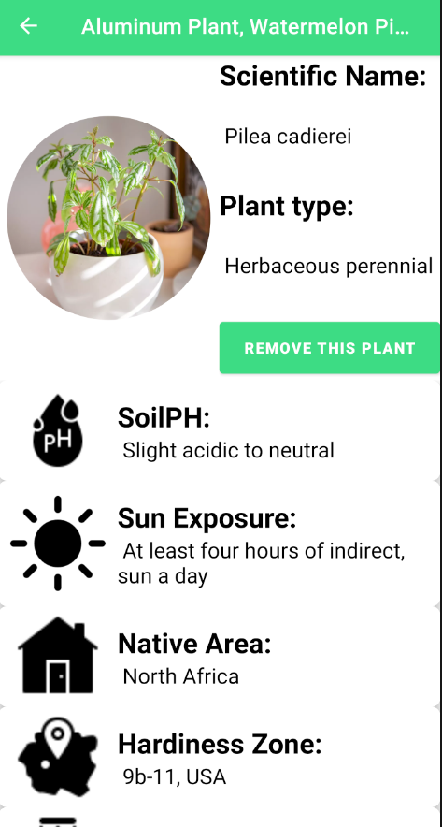
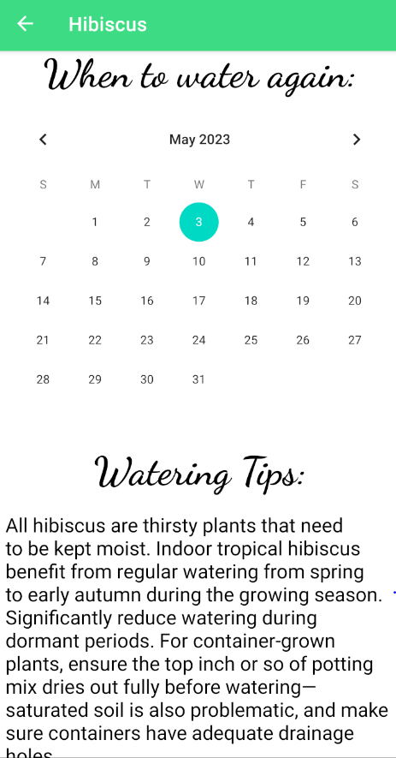
Detail Views
When you select a plant from “Browse plants” you will be taken to a detailed view of the plant. Here you can see information about the plant, add it to your list, and optionally set a timer in days.
When you select a plant from the home tab you will also be taken to a detailed view of the plant. Here you can remove the plant and additionally, a calendar view will show when your timer is set to expire.

Slide 9
Persistent Data |New Libraries
The only persistent data in this application is the application itself and the SQLite database.
Users control what data is stored in their SQLite database by adding or removing plants.
The only library we used that wasn’t covered in class I believe was Picasso.
Picasso is a library that allows you to perform transformations on images, which we used to make the images round via a CropCircleTransformation.

Slide 10

Problems faced
The first major problem was finding a way to store the immense amount of plant data we gathered.
Querying the real-time database logically to avoid slow speeds.
We didn’t want to store users’ plants remotely so they could still access them while offline.
Too much work on the main thread.
Dark mode.
Figuring out what a plant app should look like.

Slide 11
Future improvements
The addition of push notifications when a timer ends.
Dark mode compatibility.
Enabling the ability to create an account and store plants remotely to ensure local storage isn’t lost between devices.
Plant identification functionality.
Making the browse plants tab more inviting for users to “browse”.

Slide 12

Thank you for watching

