Slide 1
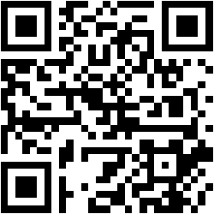
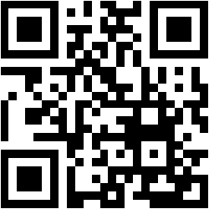
Service Bus
Damir Dobric
Microsoft PTSP (Partner Technical Solution Specialist) Microsoft Most Valuable Professional
Blog
Twitter
damir.dobric@daenet.com b-dadobr@microsoft.com

Slide 2
Agenda
Intro
Relay
Hybrid Connector
Queues
Topics

Slide 3




Service Bus
Event Hubs
Relays
Event Grid
Asynchronous enterprise messaging
Load-leveling, duplication detection, ordering, etc.
Distributed data streaming
Secure two-way communication without changes to your network
Cross-cloud reactive eventing

Slide 4
Service Bus Intro

Slide 5
Service Bus Namespace https://yourapp.servicebus.windows.net/foo/bar/baz
Naming tree
ATOM Feed at the root for discovery
Management via REST on the ATOM feed hierarchy
All names that can exist do exist
“Infinite” depth
Factually: 32 segments, 450 character path limit
Entities own the namespace tree leaves
Any branch can be differently secured with ACS
/
foo
bar
baz
abc
boo
bee
pqr
def
ghi

Slide 6
Service Bus Rights and Claims
Service Bus defines one authorization claim type with three possible values
‘Send’ – Permit ‘send’ operations on a Service Bus entity
‘Listen’ – Permit ‘send’ or ‘receive’ operations on a Service Bus entity
‘Manage’ – Permit management operations like creating, inspecting, or deleting Service Bus entities.
https://developers.de/blogs/damir_dobric/archive/2013/10/17/how-to-create-shared-access-signature-for-service-bus.aspx

Slide 7
Service Bus Relay (WCF/.NET)

Slide 8
Cloud/On-Premise Integration
Cloud-Hosted, reliable asynchronous Messaging Infrastructure with Publish/Subscribe
Cloud-Based Relay enabling NAT/Firewall Traversal for reach into on-prem assets
Cloud App
On-Prem assets

Slide 9

“Expose Web Services from anywhere to anywhere”
Key Capabilities
Relayed One-Way Unicast and Multicast
Relayed WCF NET.TCP with Direct Connect Option
Relayed WCF HTTP with support for REST and SOAP 1.1/1.2
Endpoint protection with Access Control
Outbound TCP (Ports 9350-9353)
9350 Unsecured TCP One-way (client)
9351 Secured TCP One-way (all listeners, secured clients)
9352 Secured TCP Rendezvous (all listeners except one-way)
9353 Direct Connect Probing Protocol (TCP listeners with direct connect)
Outbound HTTP (Port 80, Listeners)
TCP equivalent tunnel with overlaid TLS/SSL formed over pair of HTTP requests
Alternate connectivity path if outbound TCP is blocked
Outbound HTTPS (Port 443, Senders)
Connectivity Options

Slide 10
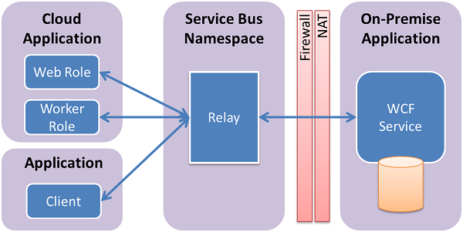
Hybrid Connector scenarios

Slide 11
Relay Programming Model
Full WCF Programming Model
Bindings functionally symmetric with WCF
WebHttpRelayBinding (HTTP/REST)
BasicHttpRelayBinding (SOAP 1.1)
WS2007HttpRelayBinding (SOAP 1.2)
NetTcpRelayBinding (Binary transport)
Special Service Bus Bindings
NetOnewayRelayBinding (Multicast one-way)
NetEventRelayBinding (Multicast one-way)
Transport binding elements for custom binding stacks
WebHttpRelayBinding provides full interoperability with any HTTP/REST client, BasicHttpRelayBinding with any SOAP client

Slide 12
Oneway
Backend Naming
Routing Fabric
sb://solution.servicebus.windows.net/a/b/
Subscribe
NetOnewayRelayBinding
All TCP and HTTP listeners use one-way as internal control channel
60KB message-size limit
One-way only
No rendezvous overhead
Route
Service Bus
Frontend Nodes
TCP/SSL HTTP(S)
NLB
TCP/SSL HTTP(S)
outbound connect one-way net.tcp
outbound connect bidi socket
Msg
Msg
Sender
NAT Firewall Dynamic IP
Receiver

Slide 13
Event
Backend Naming
Routing Fabric
sb://solution.servicebus.windows.net/a/b/
NetEventRelayBinding
Small-Scale Synchronous Multicast
60KB message-size limit
One-way only
No rendezvous overhead
Subscribe
Route
Service Bus
Frontend Nodes
TCP/SSL HTTP(S)
TCP/SSL HTTP(S)
outbound connect one-way net.tcp
outbound connect bidi socket
outbound connect bidi socket
Msg
Msg
Msg
Sender
Receiver
Receiver

Slide 14
Request/Reply (TCP & HTTP)
Backend Naming
Routing Fabric
sb://solution.servicebus.windows.net/a/b/
NetTcpRelayBinding
WebHttpRelayBinding
BasicHttpRelayBinding
WS2007RelayBinding
Rendezvous Handshake
Bi-Directional
Net.Tcp Full Duplex
No message size limit
Service Bus
Frontend Nodes
Oneway Rendezvous Ctrl Msg
Ctrl
NLB
2
HTTP/Socket Forwarder
3
TCP/SSL or HTTP
1
Ctrl
outbound socket connect
outbound socket rendezvous
Sender
4
Receiver

Slide 15
Hybrid Connect
Backend Naming
Routing Fabric
sb://solution.servicebus.windows.net/a/b/
Special Mode of NetTcpRelayBinding
TcpRelayConnection-Mode.Hybrid
Starts as relayed connection
Performs NAT probing and behavior prediction
Establishes direct connection and upgrades if possible
Upgrade driven by traffic
Takes large transfers off the Relay
No transfer charges, lower latency
Oneway Rendezvous Ctrl Msg
Service Bus
Frontend Nodes
TCP/SSL HTTP(S)
NAT Probing
Ctrl
NAT Probing
relayed connect
Upgrade
Upgrade
relayed rendezvous
Sender
Receiver
NAT Traversal Connection

Slide 16
Service Bus Relay Samples
demo
Read files from Machin behind firewall
Notes:
https://github.com/WindowsAzure-Samples/NorthwindMobileServiceBus

Slide 17
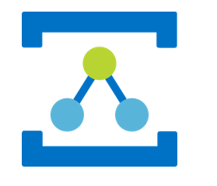
Hybrid Connector
https://docs.microsoft.com/en-us/azure/service-bus-relay/relay-hybrid-connections-dotnet-get-started

Slide 18
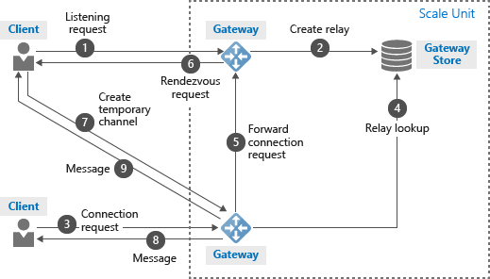
Architecture of Hybrid Connector
https://docs.microsoft.com/en-us/azure/service-bus-relay/relay-what-is-it

Slide 19
Messaging Service Assisted Communication

Slide 20
Relay vs. Message Broker
S
AuthN/Z
Relay
Backpressure Feedback
R
Route
The Relay routes messages ‘straight through’ with feedback path and network backpressure into sender
S
Broker
R
AuthN/Z
Query Filter
Pull
Brokers hold messages for retrieval and querying
Notes:
Slide Objectives:
Explain main differences between Relay and Broker
Speaking Points:
Main difference between Relay messaging and Broker messaging
Relay messaging goes through direct, TPC-like connection
Broker manipulate messages (such as stamping) while relay is pass-through
Broker has storage, allowing loose-coupling between the sender and the receiver

Slide 21
Push vs. Pull
S
Intermediary
R
‘Push’ is a sender initiated activity that results in delivery of a message to a receiver without the receiver explicitly asking for one or a particular message
S
Broker
R
‘Pull’ is a receiver initiated activity that delivers stored messages to the receiver in a context that the receiver controls. The context is decoupled from the ‘Push’ style send operation
Notes:
Slide Objectives:
Explain differences between Push and Pull
Transition:
This is a continuation of Relay vs. Broker discussion

Slide 22
Ways to Pull
Receive and Delete
Fastest. Message lost if receiver crashes or transmission fails.
Peek Lock
Message is locked when retrieved. Reappears on broker when not deleted within lock timeout.
Broker
R
Broker
R
Broker
R
Notes:
Slide Objectives:
Up and downs of different ways of polling
Speaking Points:
Receive and Delete may cause message lost
Peek and lock makes sure the message is processed at least once (but doesn’t guarantee if the same message is processed multiple times).

Slide 23
Messages
Brokered Message (.net)
Message (.net core)
User Properties
Properties
Key
Value
Key
Value
Key
Value
Key
Value
System Properties
Key
Value
EnqueuedTimeUtc
Value
Error
Bla, bla
LockTocken
Value
Body
Body
Body
Body
Notes:
Slide Objectives:
Overview of brokered message structure
Speaking Points:
The structure is more like a HTTP message instead of a SOAP message.

Slide 24
Create Message (.NET Core)
var message = new Message();
message.UserProperties.Add("USECASE", "UC-2.1-REQ");
message.TimeToLive = TimeSpan.FromMinutes(10);
message.ReplyTo = “sb://daenet.servicebus.windows.net/myqueue/1"
// Shows how to send complex type instance
var obj = new Book() { Isbn = "DE123", Title = "The life of Smittywerben Jaggermanjanson" };
string jsonObj = JsonConvert.SerializeObject(obj);
byte[] binData = Encoding.UTF8.GetBytes(jsonObj);
var message = new Message(binData);

Slide 25
Queues Point to Point pattern

Slide 26
Queues
S
Queue
R
Load Leveling
Receiver receives and processes at its own pace. Can never be overloaded. Can add receivers as queue length grows, reduce receiver if queue length is low or zero. Gracefully handles traffic spikes by never stressing out the backend.
Offline/Batch
Allows taking the receiver offline for servicing or other reasons. Requests are buffered up until the receiver is available again.
Notes:
Slide Objectives:
This slide and the next slide list some of integration patterns enabled by queues – load leveling, offline/batch, load balancing (competing consumers)

Slide 27
Queues
R
S
Queue
R
R
Load Balancing
Multiple receivers compete for messages on the same queue (or subscription). Provides automatic load balancing of work to receivers volunteering for jobs.
Observing the queue length allows to determine whether more receivers are required.

Slide 28
Topics and Subscriptions Publish Subscribe Pattern

Slide 29
Topics
R
R
S
Topic
Sub
R
Sub
Sub
R
R
Message Distribution
Each receiver gets its own copy of each message. Subscriptions are independent. Allows for many independent ‘taps’ into a message stream. Subscriber can filter down by interest.
Constrained Message Distribution (Partitioning)
Receiver get mutually exclusive slices of the message stream by creating appropriate filter expressions.
Notes:
Slide Objectives:
This slide introduces some integration patterns enabled by topics and subscriptions

Slide 30
Subscription Filters
Filter conditions operate on message properties and are expressed in SQL’92 syntax
InvoiceTotal > 10000.00 OR ClientRating <3
ShipDestCtry = ‘USA’ AND ShipDestState=‘WA’
LastName LIKE ‘V%’
Filters actions may modify/add/remove properties as message is selected
SET AuditRequired = 1
Notes:
Slide Objectives:
Additional integration patterns enabled by subscription filters
Notes:
One pattern can be easily called out is message router, where messages are routed to different recipients based on message attributes. Note that will subscription filters the messages are actually routed to ALL recipients and they are only filtered by subscriptions.

Slide 31
ServiceBus JavaScript

Slide 32
ServiceBus with Javascript: SbJSSdk
Massively Simplifies SB via REST
Developed by daenet in cooperation with SB team.
NuGet
SbJsSdk https://www.nuget.org/packages/SbJsSdk/ PM> Install-Package SbJsSdk -Version 1.0.0.1
Sample for Azure Service Bus JasvScript SDK https://www.nuget.org/packages/SbJsSdkSample/ PM> Install-Package SbJsSdkSample -Version 1.0.0.2
GitHub Source Code for both packages: https://github.com/ddobric/ServiceBusJavaScriptSdk/wiki

Slide 33
Service Bus Notification Hub

Slide 34

How Push Notifications Work
1
Retrieve device handle
4
Device notified (even when app is inactive)
PNS
(APNS, WNS, GCM)
2
Store handle in app back-end
3
Send notification to handle
Notes:
Slide Objectives:
Explains how notifications work without Service Bus Notification Hub
Speaker Notes:
Main challenges
Platform dependency – code multiple interfaces in the backend
Scale – PNS handle needs to be refreshed when app is launched; Most PNSs don’t support multicasting
Routing – not able to filter messages by custom criteria
http://msdn.microsoft.com/en-us/library/windowsazure/jj927170.aspx

Slide 35

How Service Bus Notification Hub Works
1
Retrieve device handle
PNS
4
Push notification
2
Registration with tags
3
Send notification to handle
Notes:
Slide Objectives:
Explains how notifications work with Service Bus Notification Hub
Speaker Notes:
Main benefits
Multiple-platforms – common interface to send notifications to all supported platforms
Pub/Sub routing – devices specify tags when register with notification hub
Scale – notification hubs scale to millions of devices without the need of architecting or sharding
http://msdn.microsoft.com/en-us/library/windowsazure/jj927170.aspx

