Slide 1
Sparse distributed representation classifier
Information Technology[M.Engg.] :Software engineering
By: Damir Dobric / Andreas Pech
Submitted by:
team_entropy
Karthik Kothamangala Sreenath (1438341)
Kushal Prakash (1429800)
Padmini Manjunatha (1427336)

Slide 2
content
Roles
Introduction
HTM
What is SDR classifier?
How does SDR classifier work?
Advantages for SDR classifier
Application of SDR classifier
Conclusion

Slide 3
roles
Kushal Prakash
Input from scalar encoder
Unit tests
Padmini Manjunatha
Documentation
Report
Karthik Kothamangala Sreenath
Documentation
Report
Slides
Review
Review

Slide 4
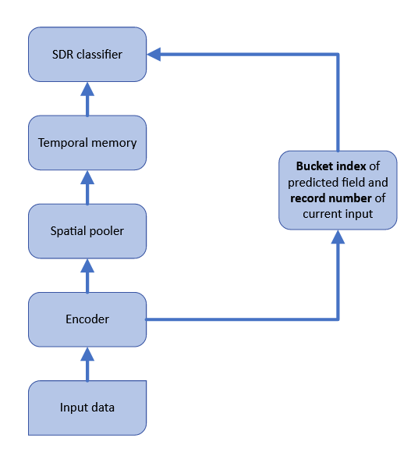
Introduction to classifiers and sdr
In machine learning, a classifier is an algorithm that takes a set of input data and assigns it to one of several predefined categories or classes. The goal of a classifier is to accurately predict the class label of new, unseen data based on patterns it has learned from the training data.
It is supervised learning algorithm, meaning they are trained on labeled data where the correct class labels are known.
Dense representation can lead to overfitting, high computation cost, and may not capture important features
Sparse distribution representation classifier addresses these issues by using a sparse feature representation.
This presentation will discuss the concept of sparse distribution representation classifier and its benefits.
Fig 1. HTM-SDR hierarchy

Slide 5
Hierarchical Temporal memory
Hierarchical Temporal Memory (HTM) is a machine learning algorithm based on the principles of the neocortex.
It is a type of neural network that is capable of learning and recognizing patterns in temporal data streams.
The basic unit of the HTM is the cortical column, which is a group of neurons that share common input and output connections.
The HTM algorithm works by learning and predicting patterns in the temporal data stream.
The input data is first encoded into a sparse distributed representation using a scalar encoder. The encoded data is then fed into the HTM model, which learns the patterns and sequences of the data over time.
The HTM model can also make predictions about the future patterns in the data stream based on the learned patterns.

Slide 6
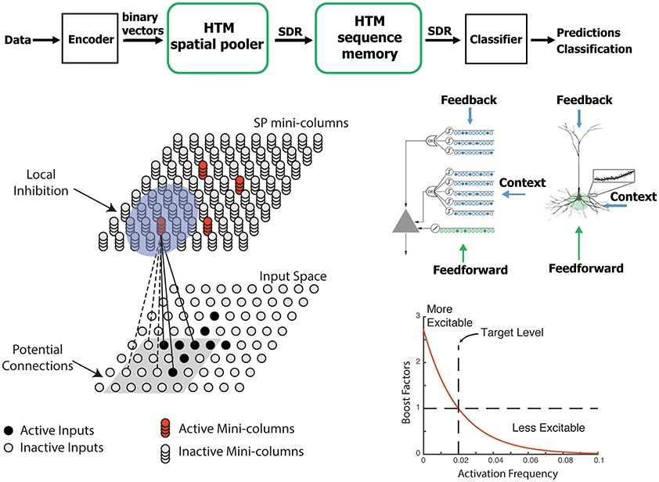
What is SDr classifier?
Sparse distribution representation classifier is a type of classifier that uses a sparse feature representation to classify data.
In sparse representation, only a subset of features is used to represent the data. If active, it is denoted by 1, else 0.
This reduces the dimensionality of the data and avoids overfitting, reduces computation cost, and may capture important features.
Fig 2. Shows the active features

Slide 7
How does sdr classifier work?
Compute : It is responsible for computing the predicted output based on the current input and previous state
Learn : It updates bucket entries and/or weight matrix
Calculate error: Measures the difference between desired and computed probabilities for all buckets
Infer: It uses already learned data to predict based on the input

Slide 8
Advantages of sdr classifier
Reduced overfitting: Sparse representation reduces the dimensionality of data, which can prevent overfitting.
Reduced computation cost: Sparse representation requires less computation than dense representation, making it more efficient.
Capturing important features: Sparse representation may capture important features that dense representation may not.

Slide 9
Applications of sdr classifiers
As seen from unit tests, SDR classifiers can be used for date/time, text, bitmap.
Image classification
Natural language processing
Financial fraud detection

Slide 10
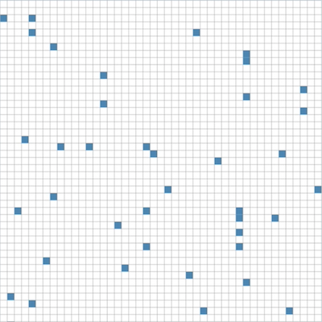
Conclusion
Sparse representation can reduce overfitting, computation cost, and may capture important features.
It is very resilient to noise.
Due to error calculation, it’s accuracy increases with more number of iterations.
Fig 3. Activated bits in SDR

Slide 11
Thank you

