Slide 1
Module: Software Engineering
Project Title:
Investigate and Implement KNN Classifier
Presented by Team KNN
Ankush Laxman Patil - 1448072
Ayan Borthakur -
Nasir Ishaq -
Guided by Prof. Dr. Damir Dobric

Slide 2
Agenda
Problem Statement
Introduction
Building blocks of the model
Design Parameters of kNN
Working Principles and Theoretical Background of kNN
kNN Model Construction and Unit Testing
Results
Conclusion

Slide 3
1. Problem Statement
Design the KNN Classifier that can work with the neocortex API and classify if the predicted sequence has a match or mismatch with the input sequence
Investigate the model by calculating the accuracy of the model with Unit testing

Slide 4
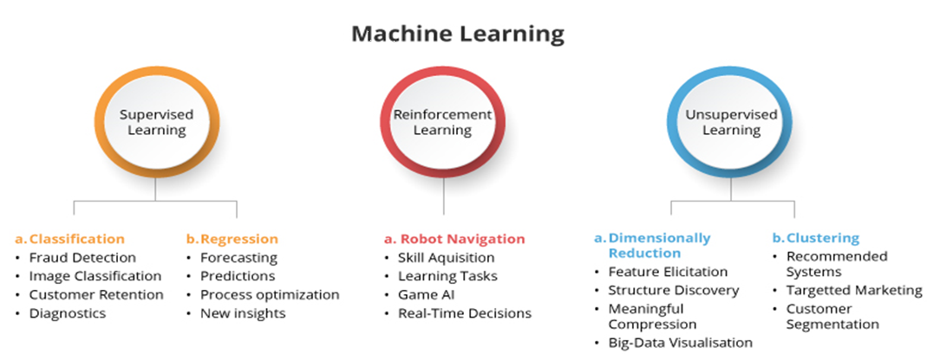
2. Introduction
Machine learning helps to create statistical models and algorithms that generate the "learn" method, which helps the computer in making predictions about the future based on data. Supervised learning, unsupervised learning, and reinforcement learning are the three main types of machine learning.
Figure 2.1 : Machine learning types and its applications

Slide 5
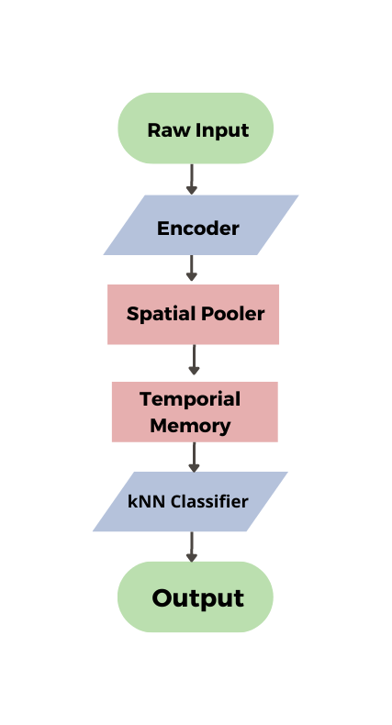

3. Building blocks of the model
Figure 3.1: Building blocks of the model

Slide 6
2. Design parameters of kNN Algorithm
In the KNN classifier algorithm, three parameters plays important role in model designing :
  K value selection: Select the number K of the neighbors for distance calculations. The odd value of k is advisable
  2. Distance calculations: There are many ways to calculate the distance between two points, but the Euclidian distance and Manhattan distance are used for the calculation as they are simple to implement
    Euclidean Distance:
    Manhattan distance:
  3. Voting principles: Calculate the vote and predict the outcome base on the distance table vote
  .

Slide 7
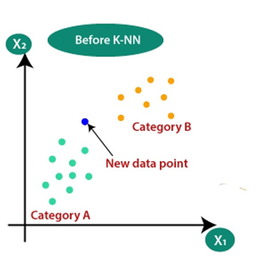
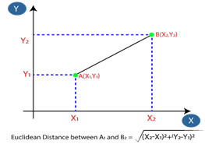
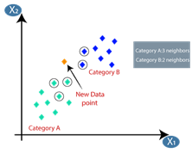
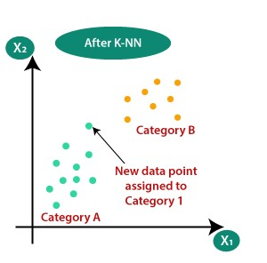
Working Principle and Theoretical Background of KNN
Step-1: Select the number K of the neighbors
Step-2: Distance calculation & distance matrix table
Figure. 1: Plotting the input data and select the value of k
Figure. 2: Euclidian Distance Calculation
Step-3:vote calculation for prediction of new point
Step 4: Predicting the category for new datapoint
Figure. 3: Voting Calculations based on labels
Figure. 4: Predicting the Output labels

Slide 8
6. kNN Model Construction kNN Model Construction and Unit Testing

Slide 9
7. Results

Slide 10
8. Conclusion

Slide 11
6. kNN Model Construction kNN Model Construction and Unit Testing

Slide 12
7. Results

