Slide 1
Analyzing Weather Patterns
Denise Dodd
DSC 530
Final Project

Slide 2
Statistical Question/ Hypothesis
The hypothesis of this project states:
Elements of weather are closely related and impact one another.

Slide 3
Variables
This data set records the weather of a particular location every hour every day of 2012. Data was obtained from
https://www.kaggle.com/datasets/bhanupratapbiswas/weather-data
There are several variables in this data set, but the specific quantitative variables that will be used in this project are:
Temp_C – The temperature recorded in degrees Celsius.​
Rel_Hum – Humidity measured as a percent of moisture in the air.​
Wind_Speed_km_h- Wind speed measured as kilometers per hour.​
Visibility_km – Visibility measured in kilometers.​
Press_kPa – Air pressure measured as kilopascal (one thousand times the unit of pressure and stress in the metre-kilogram-second system).

Slide 4
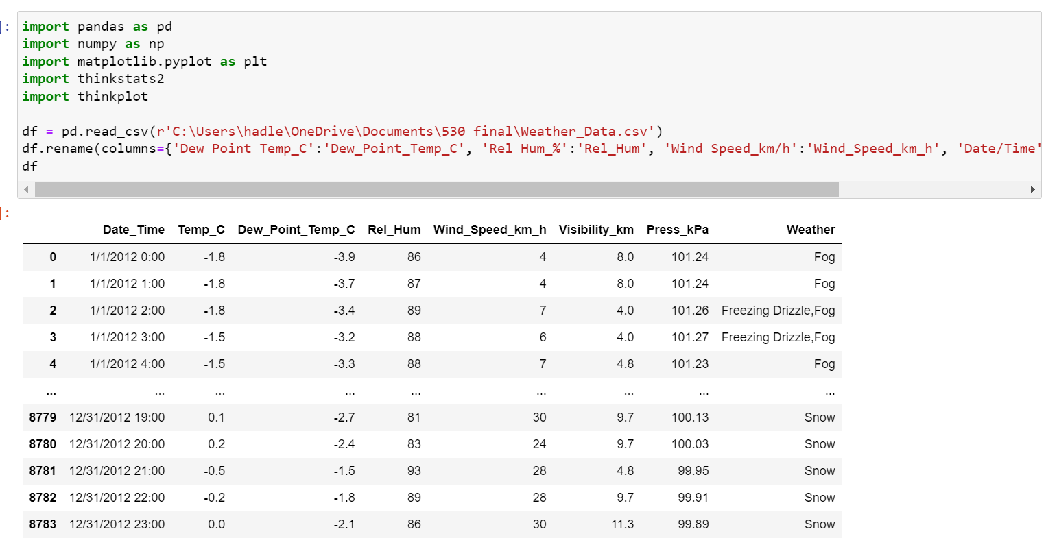
Introductory Coding

Slide 5
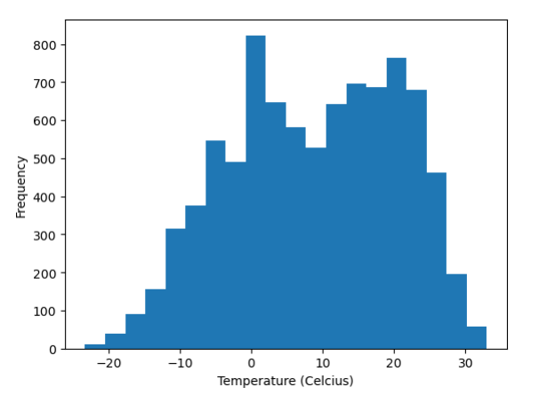
Temp_C Histogram

Slide 6
Temp_C Summary Statistics
Statistic | Result | Explanation
Mean | 8.80 C | Average Temp
Mode | 16.6 C | Most Common Temp
Spread (Var) | 136.6 | How far each number is from the mean and from every other number in the set.
Spread (std) | 11.69 | On average how far each score lies from the mean (sq rt of Var)
Tails | Small tail on the left | Slightly positive skew
Outliers | No major outliers. All the temperatures less than –15C occurred over a few days in the winter months. | This appears accurate. Nothing needs to be adjusted.

Slide 7
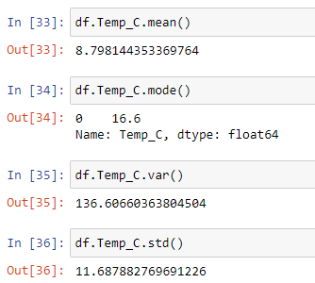

Temp_C Coding
Summary Statistics:
Histogram:

Slide 8
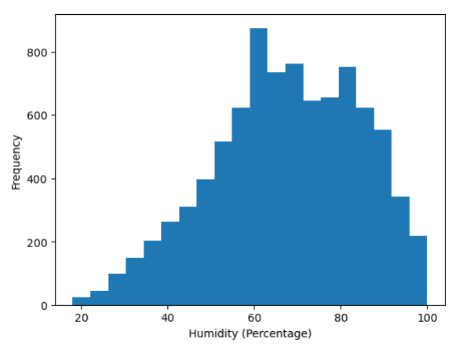
Rel_Hum Histogram

Slide 9
Rel_Hum Summary Statistics
Statistic | Result | Explanation
Mean | 67.43% | Average Humidity
Mode | 68% | Most Common Humidity
Spread (Var) | 286.25 | How far each number is from the mean and from every other number in the set.
Spread (std) | 16.91 | On average how far each score lies from the mean (sq rt of Var)
Tails | Tail on the left | Positive Skew.
Outliers | No major outliers. All humidity less than 25% occurred during the Spring months. | This appears accurate. Nothing needs to be adjusted.

Slide 10
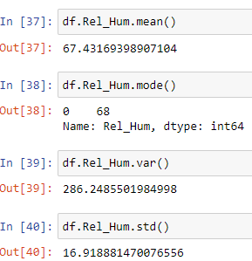

Rel_Hum Coding
Summary Statistics:
Histogram:

Slide 11
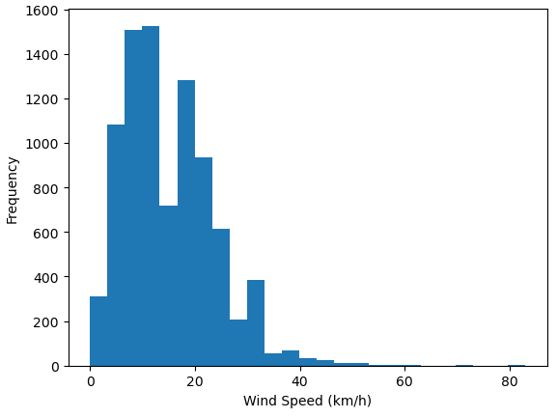
Wind_Speed _km_h Histogram

Slide 12
Wind_Speed _km_h Summary Statistics
Statistic | Result | Explanation
Mean | 14.95 km/h | Average Wind Speed
Mode | 9.0 km/h | Most Common Speed
Spread (Var) | 75.49 | How far each number is from the mean and from every other number in the set.
Spread (std) | 8.68 | On average how far each score lies from the mean (sq rt of Var)
Tails | Tail on the right | Negative Skew
Outliers | Wind speeds > 55 km/h all occurred for a brief time over a 3-day period. | Considered removing due to the large skewness, but these appear to be accurate measurements so will leave in dataset.

Slide 13
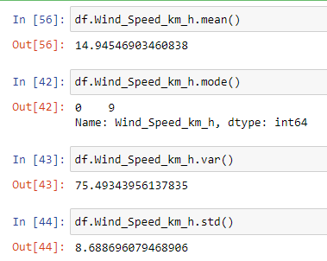

Wind_Speed _km_h Coding
Summary Statistics:
Histogram:

Slide 14
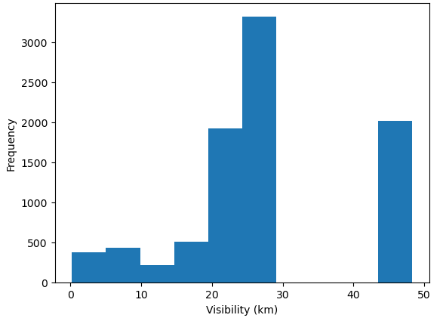
Visibility_km Histogram

Slide 15
Visibility_km Summary Statistics
Statistic | Result | Explanation
Mean | 27.66 km | Average Visibility
Mode | 25 km | Most Common Visibility
Spread (Var) | 159.33 | How far each number is from the mean and from every other number in the set.
Spread (std) | 12.62 | On average how far each score lies from the mean (sq rt of Var)
Tails | Tail on the left | Positive Skew
Outliers | No major outliers. The tail values have enough frequency and surrounding data validates it. | This appears accurate. Nothing needs to be adjusted.

Slide 16
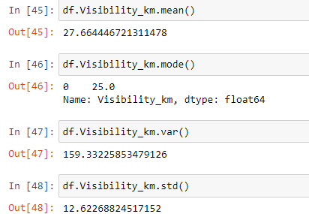

Visibility_km Coding
Summary Statistics:
Visibility Distance​
Histogram:

Slide 17
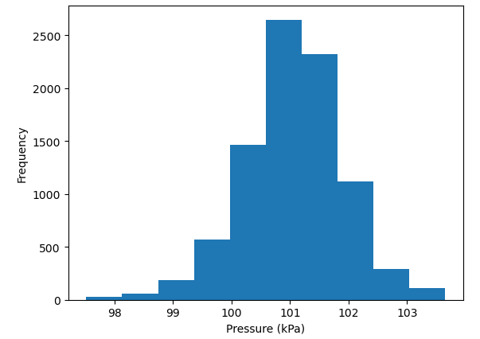
Press_kPa Histogram

Slide 18
Press_kPa Summary Statistics
Statistic | Result | Explanation
Mean | 101.05 kPa | Average Pressure
Mode | 101.13 kPa | Most Common Pressure
Spread (Var) | .71 | How far each number is from the mean and from every other number in the set.
Spread (std) | .84 | On average how far each score lies from the mean (sq rt of Var)
Tails | Small tail on the left | Slightly Positive Skew. This is the closest to a normal distribution of all the variables.
Outliers | No Outliers | No Adjustments Needed

Slide 19
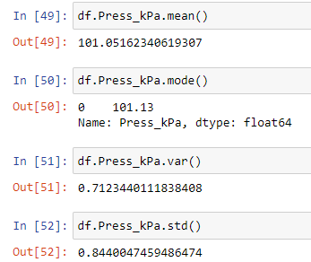

Press_kPa Coding
Summary Statistics:
Histogram:

Slide 20
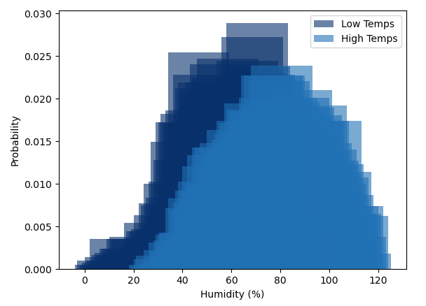
CDF
PMF
The PMF displays the probability of a particular humidity percentage being recorded.
The data is subset into humidity records associated with temperatures above and below the mean temperature.
It appears that lower temperatures are associated with lower percentage of humidity and higher temperatures are associated with a higher percentage of humidity although there is a substantial amount of overlap. This supports the hypothesis.

Slide 21
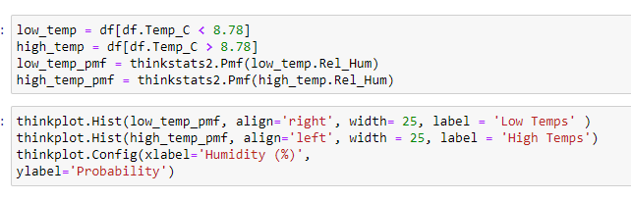
CDF
PMF - Coding

Slide 22
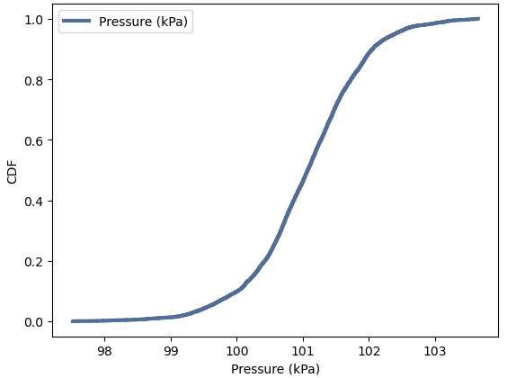
CDF
CDF
The CDF maps a specific pressure value to its percentile rank (the fraction of recorded pressure that are lower than the listed pressure).
The graph portrays a normal distribution which flattens out very slightly at the tails and has a steady increasing slant in the middle.
It appears that the point where 50% of the pressures are below a given recording happens between 101 and 102 kPa. This agrees with the previously calculated summary statistics stating that the mean pressure is 101.05 kPa.
In the next slide, I will subset the air pressure data by temp to determine how it impacts the hypothesis.

Slide 23

CDF
CDF - Coding

Slide 24
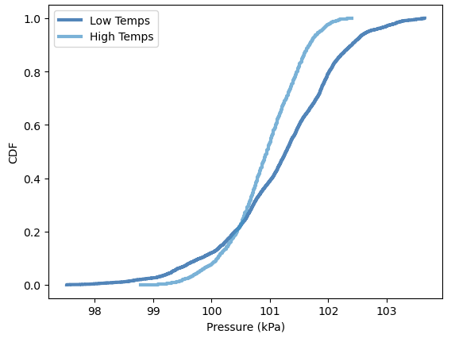
CDF
CDF
In the previous step, I separated the data into data associated with temperatures below the average temp and above the average temp. Here, I will graph the CDFs of the pressure data associated with these data sets to determine if there is any variation in pressure regarding temperature.
Based on this graph, it appears that temperature does play a slight role in air pressure. The lower temperatures have a wider range of possible air pressure. While the higher temps do not have as much of a range, it is overall displaying a steeper CDF which indicates a greater possibility of high air pressure with high temps. This supports the hypothesis.

Slide 25

CDF
CDF - Coding

Slide 26
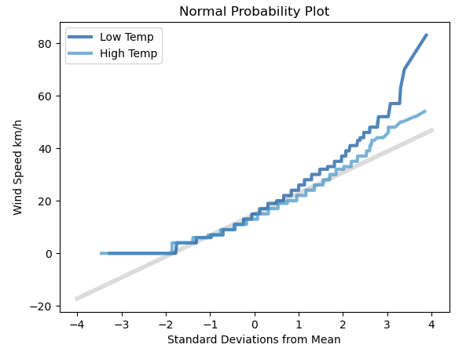
CDF
Analytical Distribution
The normal probability plot shows how many standard deviations the data in the wind speed variable is from the mean. The gray line is how we would anticipate the data to fall if this was a normal distribution with the mean at 0 and steady equidistant increases and decreases on each side.
Because the wind speed graphs do not have much overlap with the gray line, we can say that wind speed does not have a normal distribution.
Furthermore, we have divided wind speed by speeds that occur during high temps and speeds that occur during low temps. It appears that the low temp has more of the extreme outliers. However, aside from the outliers, it appears that wind speeds during low and high temps have significant overlap indicating that wind speed is independent of temperature.

Slide 27
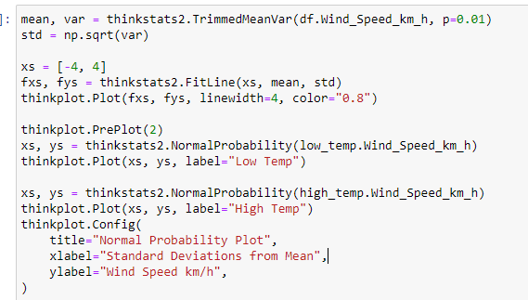
CDF
Analytical Distribution - Coding

Slide 28
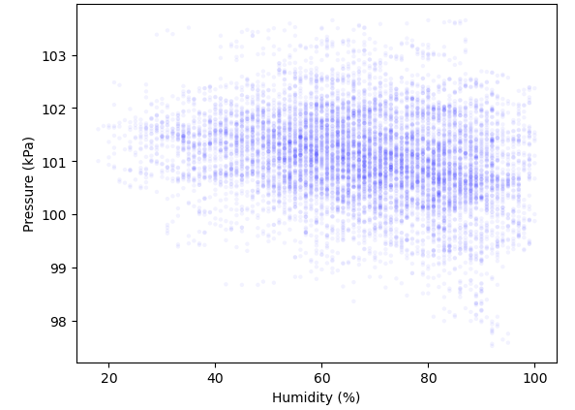
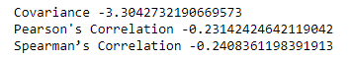
CDF
Scatterplot #1
Humidity and pressure have a negative covariance indicating that they move in opposite directions of one another. This is supported by the negative Person's and Spearman's correlations.
Both the Pearson's and Spearman's correlations are negative indicating that when humidity is high, air pressure tends to be low and vice versa. These correlations are on a scale of -1 to 1. A -.2 measurement is towards the middle of the scale showing a weak negative correlation. Because Spearman's correlation is slightly more negative than the Pearson's correlation, we can assume that Pearson's correlation might be skewed by outliers.
We can see this displayed in the scatter plot where outliers of high air pressure can occur regardless of humidity, but the lower outliers only occur when the humidity is high. Additionally, the more saturated areas of the scatter plot start to very slightly trend down on the right side of the graph representing high humidity and low air pressure.

Slide 29
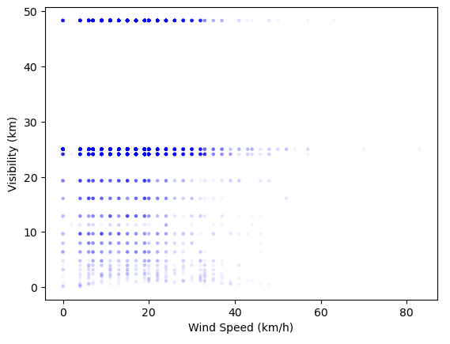

CDF
Scatterplot #2
Although wind speed and visibility have a positive covariance indicating that both variables move in the same direction, it is so small it is likely not significant. The strength of this relationship can be found with the Pearson's and Spearman's correlation values.
Both the Pearson's and Spearman's hover around the 0 mark and even cross over 0 with Pearson being positive and Spearman being negative. Both calculations are of such a small value, we can determine that visibility and wind speed have no impact on each other, and any relationship is coincidence.
We can see this illustrated in the scatterplot which shows wind speed generally stays within a consistent 0-40 km/h regardless of visibility. Visibility is most often close to 25 or 49 km regardless of wind speed.

Slide 30




CDF
Scatterplot - Coding
Scatterplot #1
Graph:
Scatterplot #1
Stats:
Scatterplot #2
Graph:
Scatterplot #2
Stats:

Slide 31
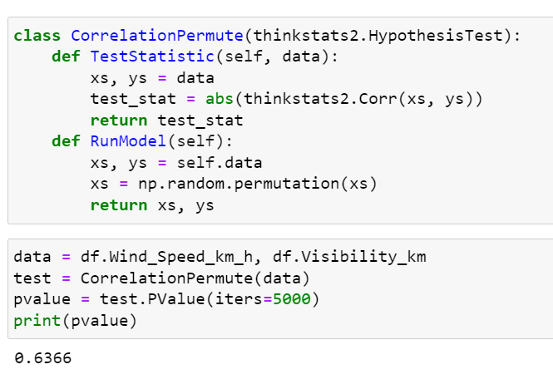
CDF
Hypothesis Test
CorrelationPermute runs a simulation where it shuffles the wind speed and visibility variables and computes the correlations among the shuffled values. It then checks the resulting correlation against the true wind speed/visibility correlation to determine what portion of iterations returns an equivalent correlation value. After running the test through 5,000 iterations a p-value of .6366 is returned.
This large p-value indicates that any correlation between wind speed and visibility is not statistically significant, and we can accept the null hypothesis that there is no connection between these variables.

Slide 32
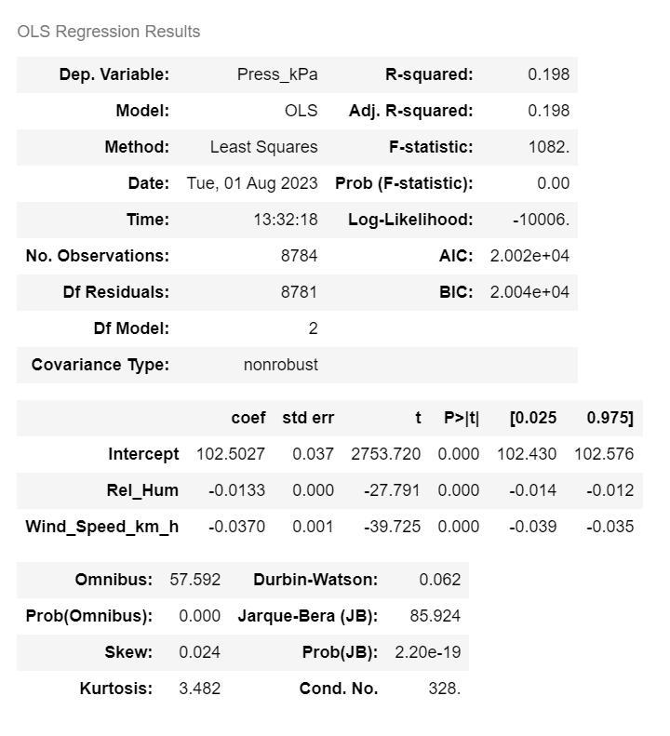
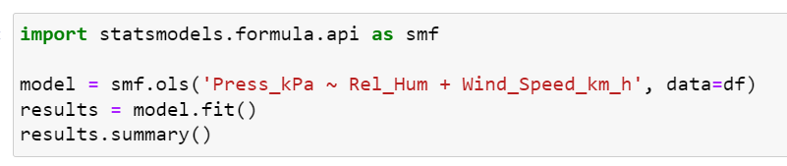
CDF
Regression Analysis
In the regression analysis, I used humidity and wind speed as explanatory variables and temperature as the dependent variable of air pressure.
The R-Squared calculation shows that the exploratory variables contribute to 19.8% of the variability in air pressure. Both explanatory variables have a 0 p-value and low measures of standard error.

