Slide 1
GPU-resident KV keeps prefix reuse working where host offload gives up
Llama-3.1-8B · SGLang 2P2D · 4x RTX A6000 · median of 3 reps · context 4k, 8k, 16k, 32k, 64k
Recompute
SGLang
Ours (host DRAM)
Ours
Notes:
Both charts are native PowerPoint charts: right-click > Edit Data for values, or the Chart Design / Format tabs for colours and axes. In (b), 1.0 means the arm did no better than recomputing the prefix from scratch. The medians at 64k hide a bimodal per-rep distribution -- see the next slide. Source: results/ttft_ctx/<arm>.json

Slide 2
At 64k the median hides how OFTEN the restore happened
Every arm except Ours is bimodal here: its best repetition restores the prefix in ~5s, its median falls through to a full re-prefill. So the median gap is mostly a difference in how RELIABLY the restore happens, not in how fast the transfer is.
Notes:
Bimodality at 64k: hicache best 5.11s / median 19.41s, Ours(host) best 5.49s / median 24.03s, Ours best 4.60s / median 4.60s (all three reps restored). Ours(host) is the FORCE_HOST ablation -- same index, eviction, reuse ranking and fetch code as Ours, park pool still allocated so the arms are memory-matched, only the storage medium moves to pinned host DRAM over PCIe. n=3 reps: the hit-rate difference (3/3 vs 1/3) is suggestive, not yet tight.

Slide 3
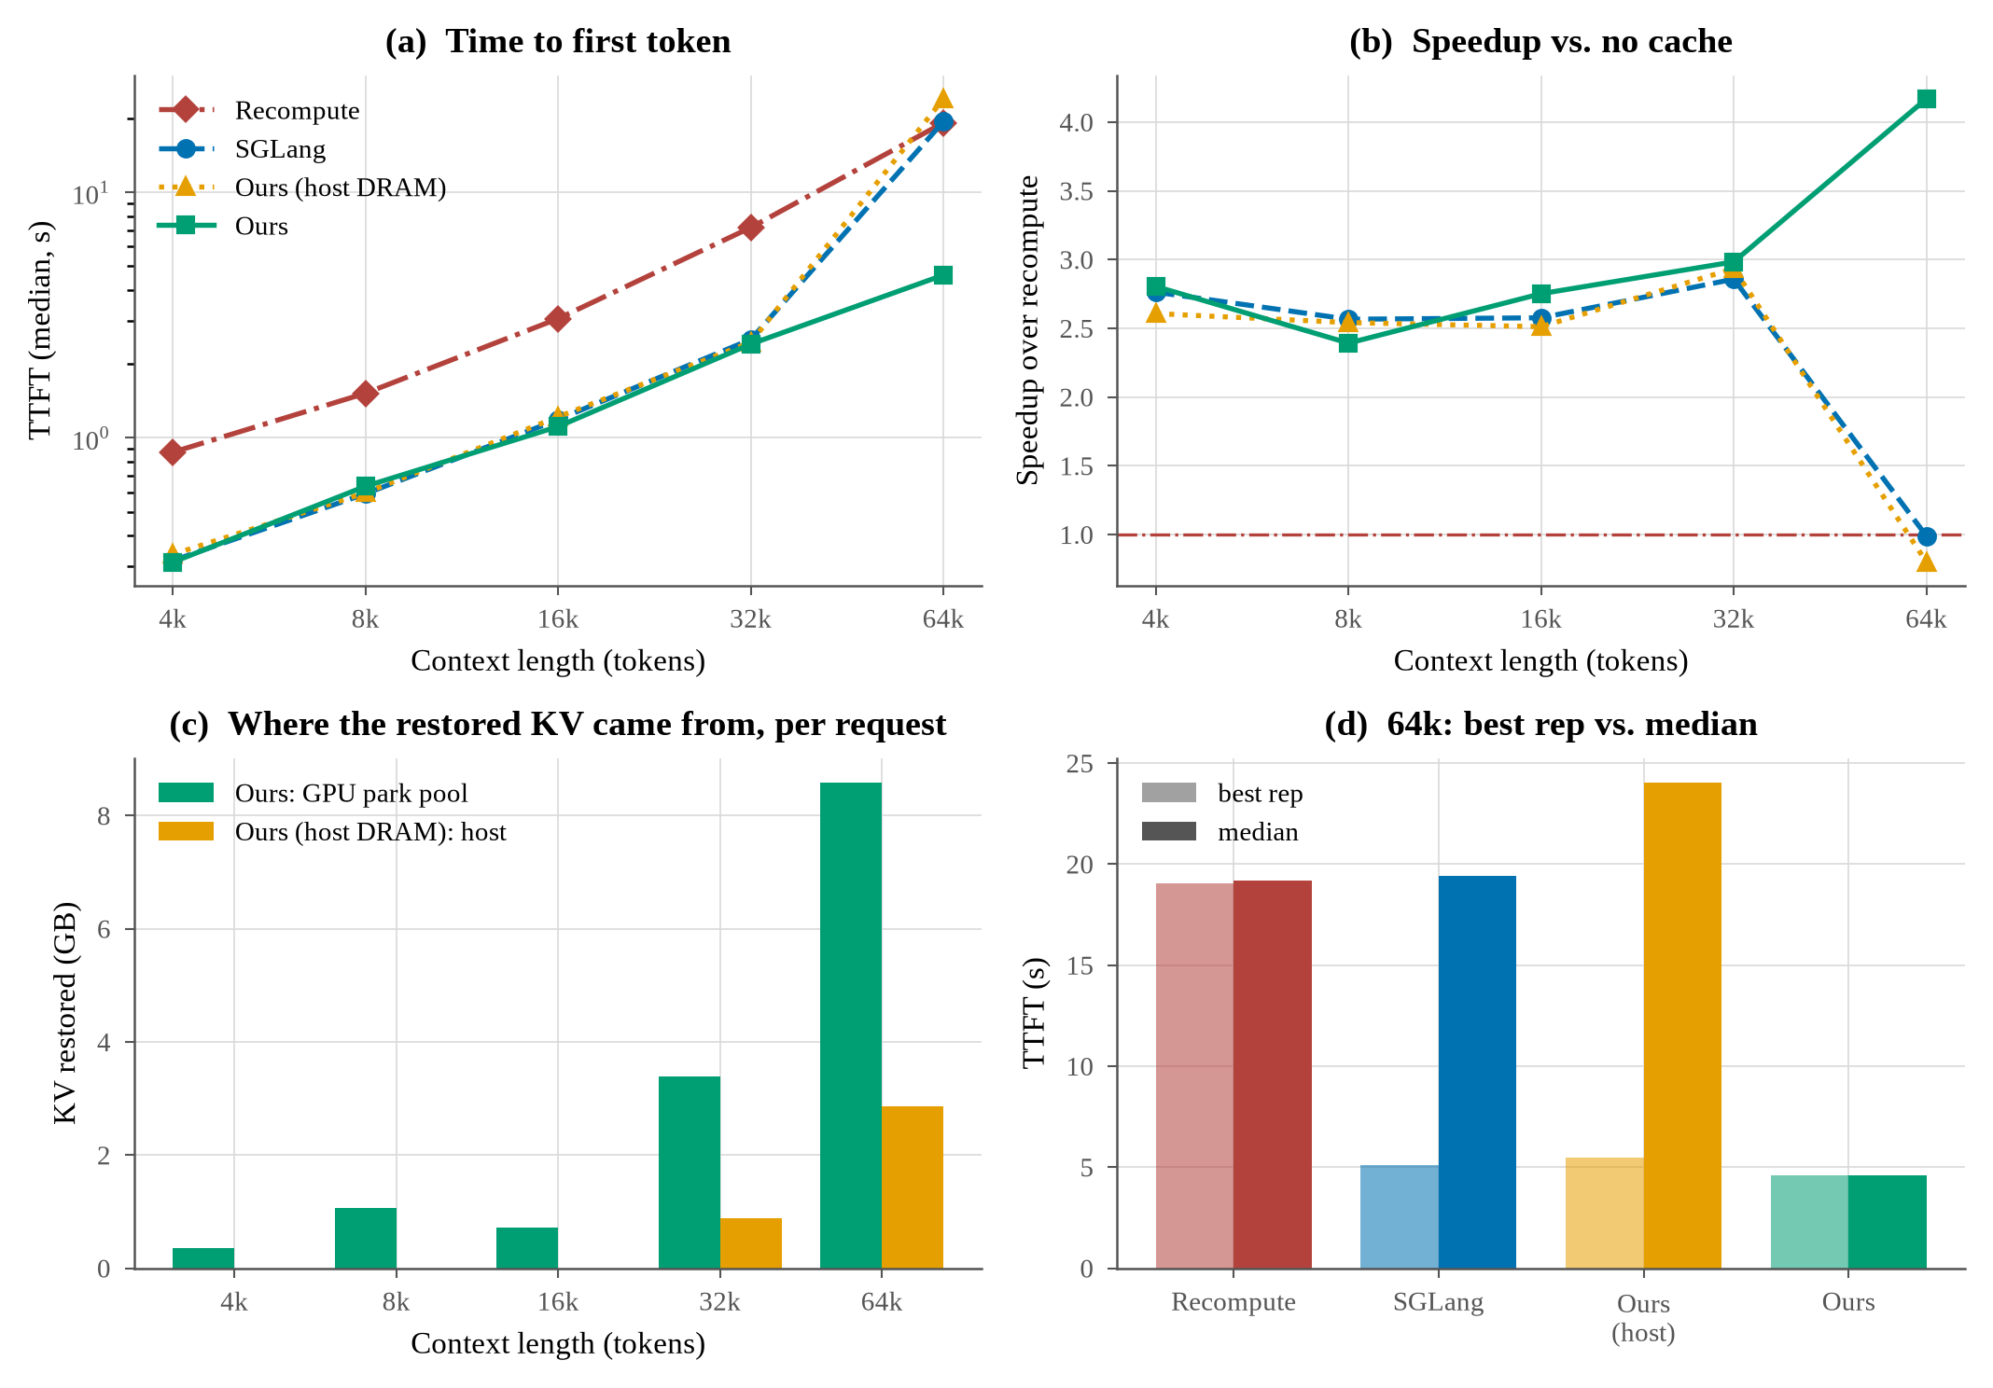
Full figure, as rendered (plot_ttft_ctx_panels.py)
Source: results/ttft_ctx/fig_ttft_ctx_panels.png

