Slide 1
The same reusable KV, held in idle GPU memory instead of CPU memory
Codex / SWE-bench Pro traces · 100 sessions · 8-15 turns · context 12k->48k tokens · C=4 · Llama-3.1-8B · SGLang 2P2D · 4x RTX A6000 (49GB each, two GPUs summed per role)
Recompute
SGLang
Ours
Read (a) and (c) together: on their own, more prefill HBM could be a leak and less host DRAM could be a smaller cache. Moving in opposite directions, they say the bytes changed location. (b) is flat because this run parks only onto each prefill's own GPU (PARK_PEER=0) and never reaches a decode one.
Notes:
Peaks from the FULL CSVs (not the 150-point sampling used to draw the charts): Recompute: prefill 49.7 GB, decode 85.3 GB, host 17.2 GB SGLang: prefill 49.6 GB, decode 85.3 GB, host 34.8 GB Ours: prefill 92.0 GB, decode 86.4 GB, host 17.2 GB GPU roles from PD_LAYOUT='a': prefill = gpu0+gpu1, decode = gpu2+gpu3. Charts are native: right-click > Edit Data, or the Chart Design / Format tabs.

Slide 2
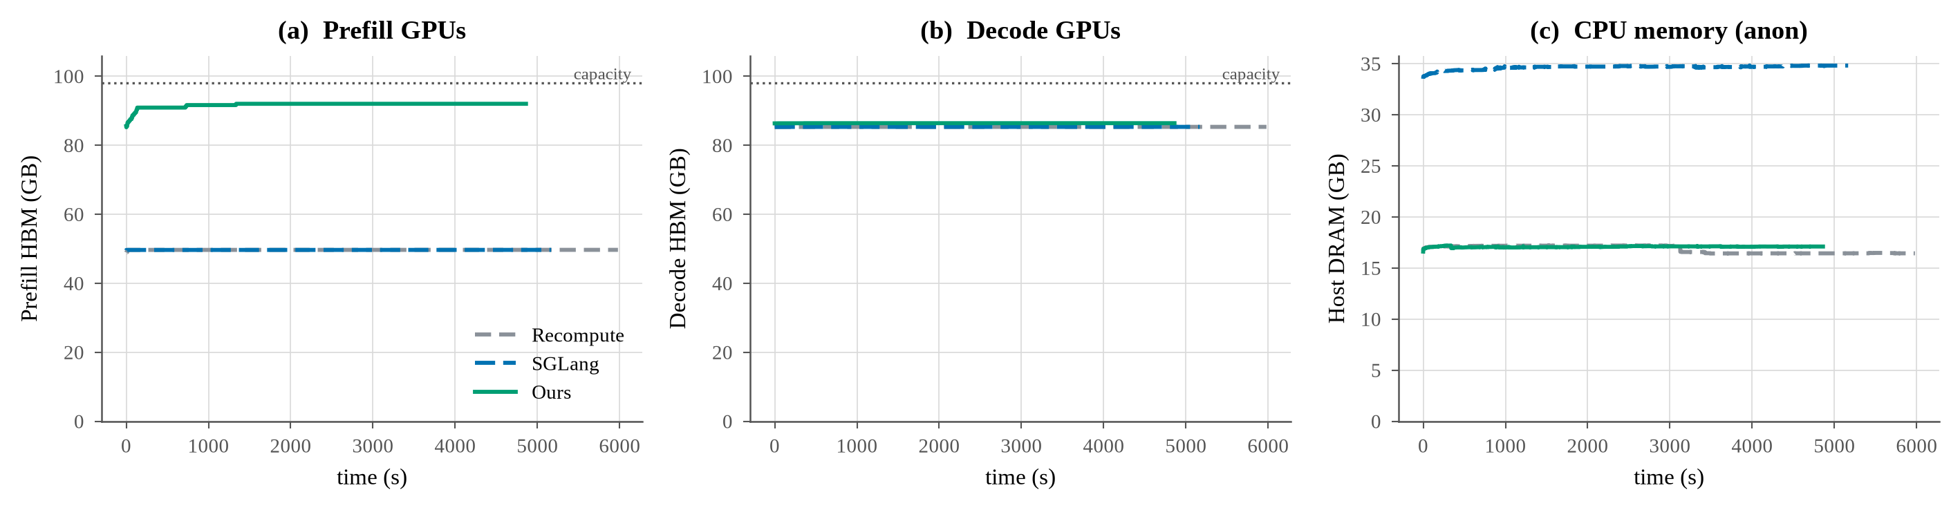
Full figure, as rendered (plot_agent_mem_timeline.py)
Source: results/agent_trace/fig_agent_mem.png

Slide 3
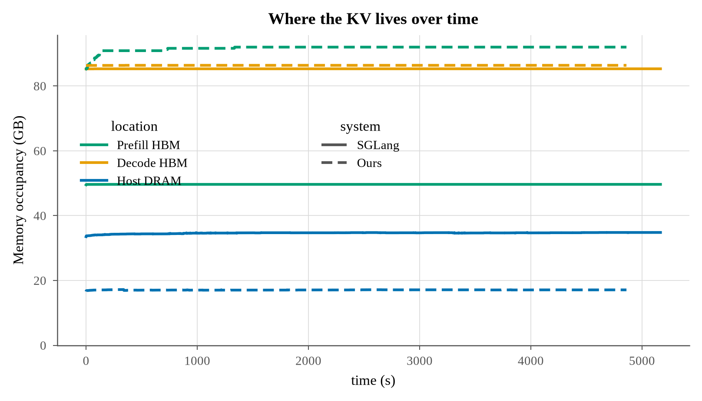
Single-axes version (--merge): colour = location, style = system
Source: results/agent_trace/fig_agent_mem_merged.png

