Slide 1
Prefill KV is saturated while decode KV sits idle
Codex / SWE-bench Pro traces · 100 sessions · 8-15 turns · context 12k->48k tokens · C=4 · Llama-3.1-8B · SGLang 2P2D · 4x RTX A6000 · pool occupancy = (max_total - available) / max_total, summed over the two GPUs of each role
SGLang Prefill
SGLang Decode
Ours Prefill
Ours Decode
SGLang: the prefill pool holds 96% on average and peaks at 100%, so almost every new prefix must evict something -- while the decode pool averages 28%. The headroom the victim cache claims is that gap, on the same node. Lines are a 15-sample (~30s) rolling mean; the decode pool oscillates request to request and is unreadable raw.
Notes:
Full-run values, UNSMOOTHED and at full resolution (the charts are drawn from a 180-point sampling with a 15-sample rolling mean): SGLang: prefill max 100.0% / mean 95.7% / final 96.6%; decode max 54.9% / mean 28.0% / final 16.0% (2668 samples over 5338s) Ours: prefill max 99.7% / mean 79.4% / final 53.8%; decode max 55.4% / mean 28.2% / final 16.0% (2669 samples over 5342s) token_usage is NOT this quantity: SGLang defines it as (max_total - available - evictable) / max_total, so a pool 100% full of reusable prefix cache and an empty one both report ~0. The sampler records both so they stay distinguishable. Charts are native: right-click > Edit Data, or the Chart Design / Format tabs.

Slide 2
How fast the pool fills — first 300 s
Same data, time axis clipped. Raw samples, no smoothing.
SGLang Prefill
SGLang Decode
Ours Prefill
Ours Decode
The prefill pool reaches ~95% within about 50 s of a 5342 s run — the working set of these agent sessions is several times the pool, so saturation is immediate and permanent, not a slow warm-up.
Notes:
Full-run values, UNSMOOTHED and at full resolution (the charts are drawn from a 180-point sampling with a 15-sample rolling mean): SGLang: prefill max 100.0% / mean 95.7% / final 96.6%; decode max 54.9% / mean 28.0% / final 16.0% (2668 samples over 5338s) Ours: prefill max 99.7% / mean 79.4% / final 53.8%; decode max 55.4% / mean 28.2% / final 16.0% (2669 samples over 5342s) token_usage is NOT this quantity: SGLang defines it as (max_total - available - evictable) / max_total, so a pool 100% full of reusable prefix cache and an empty one both report ~0. The sampler records both so they stay distinguishable. Charts are native: right-click > Edit Data, or the Chart Design / Format tabs.

Slide 3
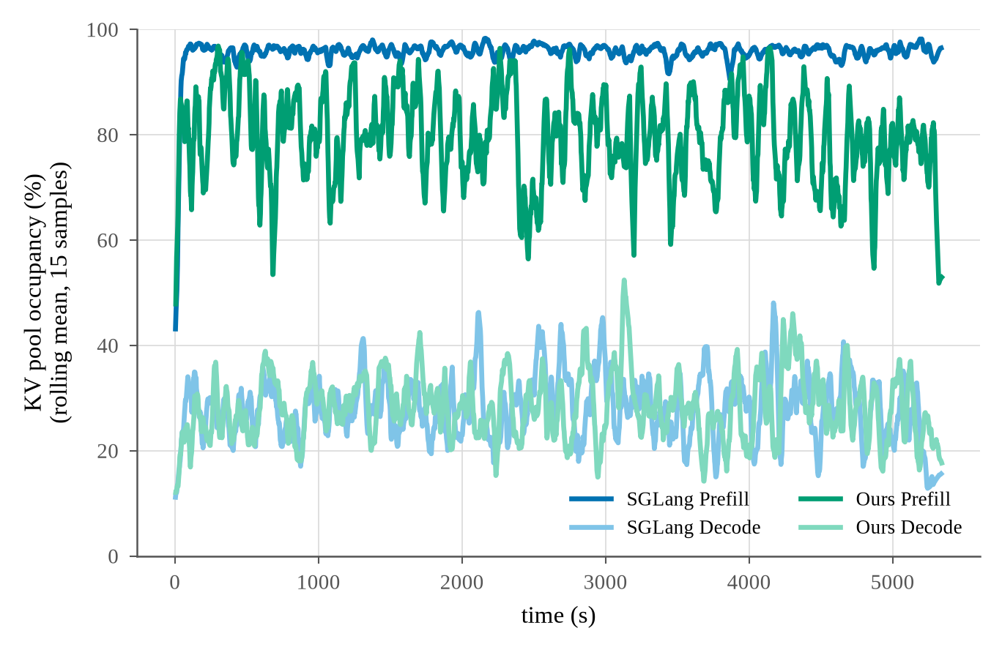
Full run, as rendered (plot_kv_occupancy.py --smooth 15)
Source: results/agent_trace/fig_kv_occupancy.png

Slide 4
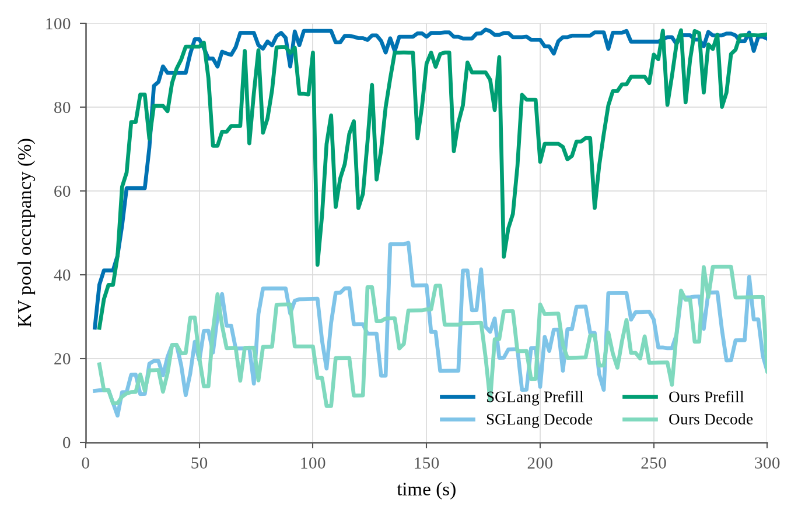
Ramp detail, as rendered (--xmax 300)
Source: results/agent_trace/fig_kv_occupancy_ramp.png

