Slide 1
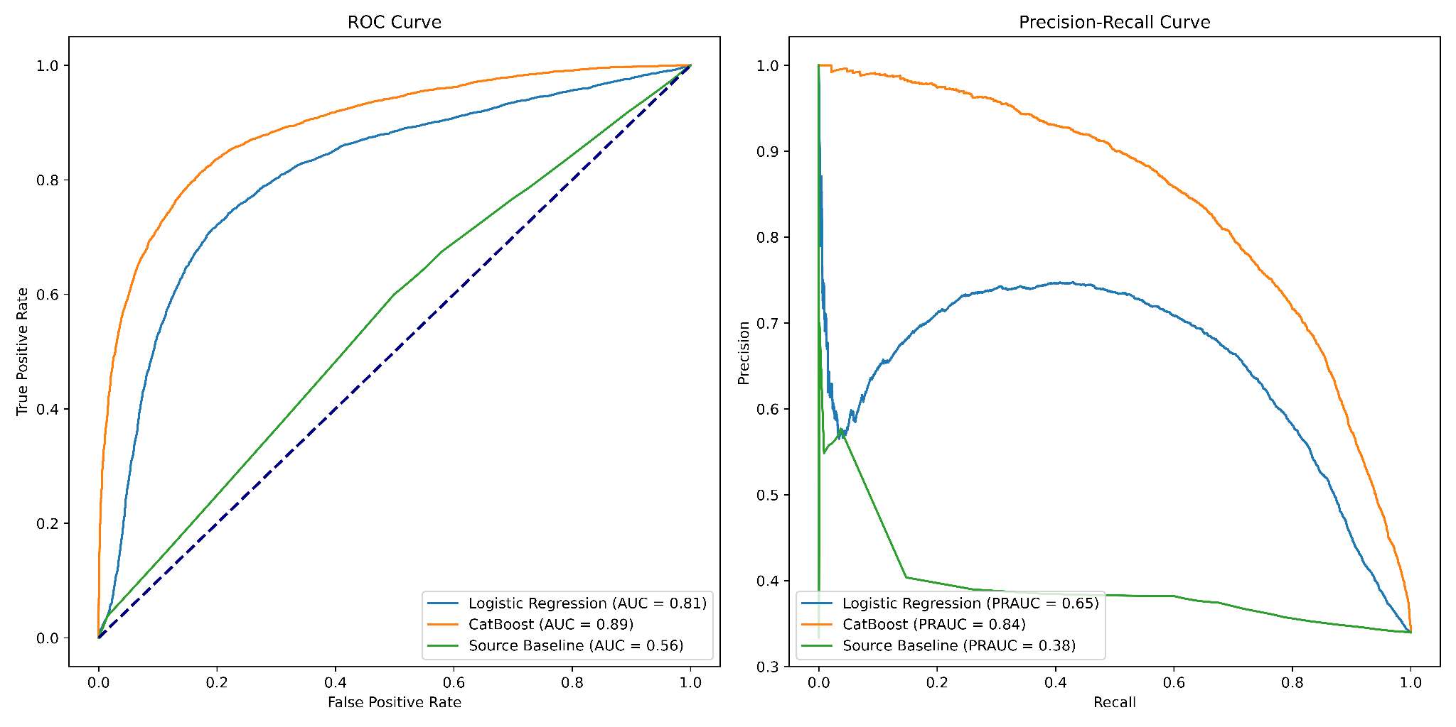

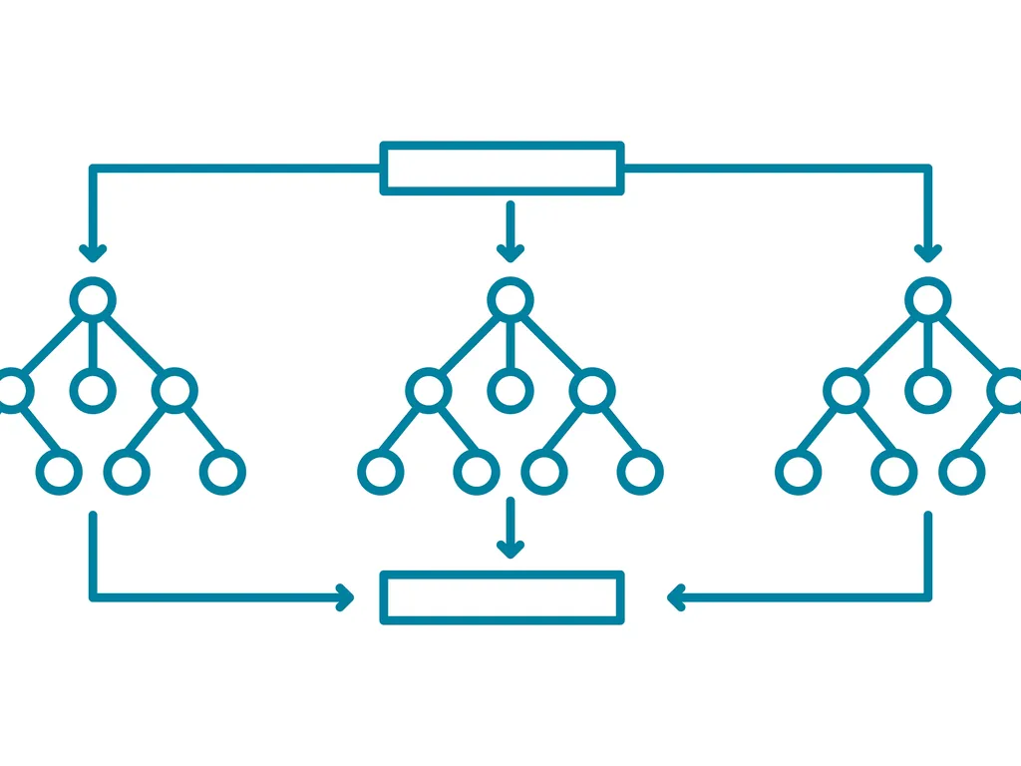

Disease subtyping
Dataset Features
Machine learning (ML) model
Genetic association
Disease A
Known drugs
Catboost Model
Input data
Pathways
Methods
Predict diseases’ with subtype
Disease A1
Disease A2
RNA expression
Medical Ontology
Text embedding
I. Known Subtypes model
II. Novel subtyping predictions &
ranked candidates
Catboost (Decision tree) classifier
Repeated model retraining & prediction
Novel subtype candidates
Performance Evaluation

