Slide 1
Project #0-2: Pintos Data Structures
[CSE4070]
Instructors
Prof. Euhyun Moon
Teaching Assistants
Kyuri Park
Fall 2022
Notes:
Class PT

Slide 2
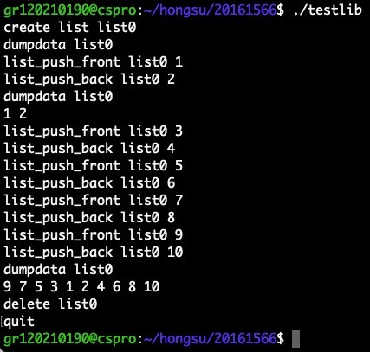
Outline
Before we dive into Pintos project, we will practice Pintos data structures.
Write the interactive program that can check functionalities of list, hash table and bitmap in Pintos kernel
Ex) list push
nothing dumpdata
dumpdata

Slide 3
Data Structures

Slide 4
Data Structures in Pintos Kernel
Before we dive into Pintos project, we will practice Pintos data structures.
Pintos provides kernel and user libraries.
You can find it in "pintos/src/lib/kernel" and "pintos/src/lib/user"
In this project, we will cover data structures of Pintos kernel libraries. → List, Hash table and Bitmap

Slide 5
List
List in Pintos is a doubly linked list.
It is different from usual list structure.
It splits list element pointers and data.
struct list_elem
Each structure that will be a list item must embed a struct list_elem member.
All the list functions operate on list_elem, not the list item.
Only list_elem structure is given in the source code.
You must implement new structure that consists of list_elem and data.
head
elem
elem
elem
tail

Slide 6
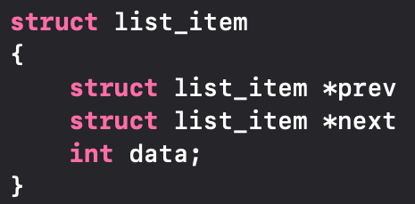
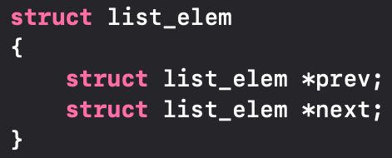
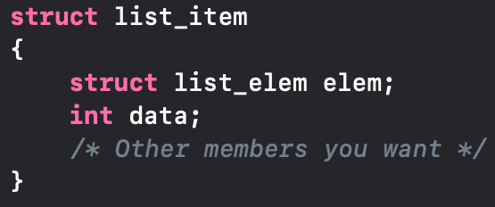
List
Linked List: Usual way
Linked List: Pintos kernel
list_item
list_item
*prev
*prev
*next
*next
int data
int data
list_item
list_item
list_elem elem
list_elem elem
*prev
*prev
*next
*next
※
int data
int data
Split the pointer and data
※ 'struct list_item' is not given in the source code, you need to implement it.

Slide 7
List Function Analysis
void list_init(struct list *list)
Initializes LIST as an empty list.
It should be executed before an element is inserted in LIST.
struct list_elem* list_begin(struct list *list)
Returns the first element of LIST.
Usually used to iterate the LIST.
struct list_elem* list_next(struct list_elem *elem)
Returns the next element of ELEM.
Usually used to iterate the LIST or search ELEM in the LIST.

Slide 8
List Function Analysis
struct list_elem* list_end(struct list *list)
Returns the last ELEM in the LIST.
Usually used to iterate the LIST.
#define list_entry(list_elem, struct, member)
Converts the pointer to LIST_ELEM into a pointer to STRUCT that LIST_ELEM is embedded inside.
Usually used to get address of STURCT which embeds LIST_ELEM.
sample_list
*e
list_elem head
*temp
/* Assume that there already exists a list, sample_list */
struct list_elem *e;
e = list_begin (&sample_list);
struct list_item *temp = list_entry(e, struct list_item, elem)
int temp_data = temp->data
By using list_elem, we can get address of list_item
*prev
*next
list_elem elem
*prev
*next
list_elem tail
*prev
*next
int data
struct list_item

Slide 9
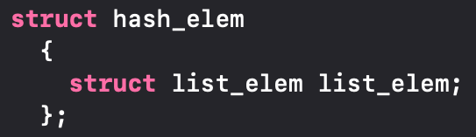
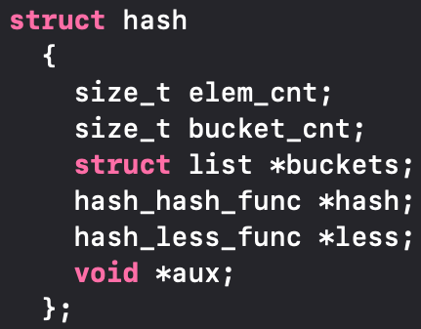
Hash Table
A hash table is a data structure that associates keys with values.
The primary operation is a lookup.
Given a key, find the corresponding value.
It works by transforming the key using a hash function into a hash.
※ Assume that key and value are same.
Key
Buckets
Entries
0
prev
100
1
head
next
tail
f(x)=x/100
2
100
Need to implement.
Refer struct list_item.
550
3
4
prev
prev
500
5
head
next
next
tail
6
500
550
7

Slide 10
Hash Table Function Analysis
void hash_init(struct hash *h, hash_hash_func *hash, hash_less_func *less, void *aux)
Initializes hash table H and sets hash function HASH and comparison function LESS.
You can see the example of hash function such as hash_int, hash_bytes, and hash_string. (You have to use hash_int function to pass the test.)
Comparison function LESS is used to compare two hash elements.
void hash_apply(struct hash *h, hash_action_func *action)
You can apply any ACTION function which you made to hast table H.
Used for applying specific function to all elements in hash table. e.g.) square function.
You can learn the usage of it from 'hash_apply.in' and 'hash_apply.out' in tester directory.

Slide 11
Hash Table Function Analysis
#define hash_entry(hash_elem, struct, member)
Converts pointer to HASH_ELEM into a pointer to STRUCT that HASH_ELEM is embedded inside.
Usually used to get address of STURCT which embeds HASH_ELEM.

Slide 12
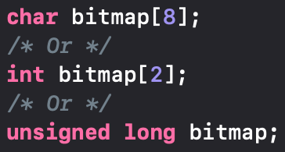
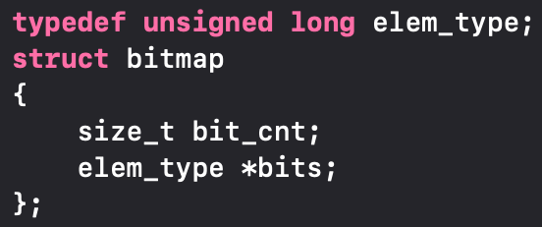
Bitmap
A bit array(or bitmap, in some cases) is an array which stores individual bits (Boolean values).
A bitmap can reduce the waste of memory space.
I
N
T
E
G
E
R
I
N
T
E
G
ᐧᐧᐧ
E
R
I
N
T
E
G
E
R
I
0
0
0
1
0
0
0
1
0
0
0
0
ᐧᐧᐧ
0
1
0
0
0
1
0
0
0
0
256 Bytes (2048 bit)
8 Bytes (64 bit)
Bitmap: Usual way
Bitmap: Pintos kernel

Slide 13
Bitmap Function Analysis
struct bitmap *bitmap_create(size_t bit_cnt)
Initializes a bitmap of BIT_CNT bits and sets all its bits to false.
void bitmap_set (struct bitmap *b, size_t idx, bool value)
Atomically sets the bit numbered IDX in B to VALUE.
size_t bitmap_count (const struct bitmap *b, size_t start, size_t cnt, bool value)
Returns the number of bits in B between START and START + CNT, exclusive, that are set to VALUE.
3
7
0
0
0
1
0
0
0
1
0
0
0
0
ᐧᐧᐧ
0
1
0
0
0
1
0
0
0
0
bitmap_count(b, 3, 4, 1) == 1
8 Bytes (64 bit)

Slide 14
Requirements

Slide 15
Project #0-2
Write the interactive program that can check functionalities of list, hash table and bitmap in Pintos kernel
Assumption
All inputs are from standard input (STDIN).
All inputs and outputs are lower cases.
All the types used in the program are integer.
Use hash_int() as hash function for hash table.
Use hash_int() in given library. (라이브러리의 hash_int()를 사용할 것.)
Use true or false when the return type is Boolean.
The number of list, hash table and bitmap is less than or equal to 10.
You can use any function in given source codes and you can implement your own code if it is needed.

Slide 16
Project #0-2: List of Functions to Implement
You should implement the following functions.
List
void list_swap(struct list_elem *a, struct list_elem *b)
Parameter: Two list elements that will be swapped.
Return value: None.
Functionality: Swap two list elements in parameters.
void list_shuffle(struct list *list)
Parameter: List that will be shuffled.
Return value: None.
Functionality: Shuffle elements of LIST in the parameter.
Implement list_swap() and list_shuffle() in list.c

Slide 17
Project #0-2: List of Functions to Implement
You should implement the following functions.
Hash table
unsigned hash_int_2(int i)
Parameter: Integer that will be hashed
Return value: Hash value of integer I
Functionality: Implement this in your own way and describe it in the document.
Bitmap
struct bitmap *bitmap_expand(struct bitmap *bitmap, int size)
Parameter: Bitmap that you want to expand and the size of it
Return value: Expanded bitmap if succeed, NULL if fail
Functionality: Expand the given BITMAP to the SIZE (backward expansion)
※ Do not use this function in your code, just implement hash_int_2() in your code
※ Use hash_int() as hash function to pass the test program 테스트 프로그램 통과를 위해 hash function은 hash_int()를 사용할 것.
Implement hash_int_2() in hash.c and bitmap_expand() in bitmap.c

Slide 18
Project #0-2
These are only few examples of command used in interactive program you will make.
You should check the tester file (*.in) to see what commands are used for the test. 어떤 명령어가 사용되는지 *.in 테스터 파일을 통해 직접 확인할 것.
create list <LIST>
Creates LIST.
create hashtable <HASH_TABLE>
Creates HASH_TABLE.
create bitmap <BITMAP> <BIT_CNT>
Creates BITMAP with the size of BIT_CNT.
delete <LIST | HASH_TABLE | BITMAP>
Deletes the given data structure.
dumpdata <LIST | HASH_TABLE | BITMAP>
Prints the given data structure to standard out (STDOUT)s
quit
Terminates the interactive program.

Slide 19
Project #0-2
Note that this is just the example of the test case. You should test your program by yourself or by test program!
Example (List)
$ ./testlib
create list list1
dumpdata list1
list_push_front list1 1
list_push_back list1 4
list_puch_back list1 3
dumpdata list1
1 4 3
list_max list1
4
list_shuffle list1
dumpdata list1
4 1 3
quit
$
No output yet
Output of 'dumpdata list1'
Output of 'list_max list1'
Output of 'dumpdata list1'

Slide 20
Project #0-2
Kernel Library source files are in ‘pintos/src/lib/kernel’
list.h, list.c, hash.h, hash.c, bitmap.h, bitmap.c
Some files are dependent on Pintos source codes.
You should use the source files in 'lib_hw1.tar.gz' which we provide. Don't copy the files from Pintos source code. 핀토스 소스코드에서 카피한 파일을 사용하지 마시오.

Slide 21
Project #0-2: Tester Program
You can use tester program (hw1_tester.sh) to test your implementation.
Download os_hw1_tester.tar.gz from e-class.
Extract it. ($ tar -zxvf os_hw1_tester.tar.gz).
Go to os_hw1_tester directory. ($ cd os_hw1_tester).
Run tester script with your interactive program. ($ sh hw1_tester.sh ../20189999/testlib).
It will produce .output files which show you the output contents of each test. .result files will show you the result of each test and Score.txt will show you the total score.
Tips
You may face that your program is being pended while testing list_swap.
Many students failed to swap 0th element and 1st element.

Slide 22
Project #0-2: Cautions
If you use printf() to print size_t type values, use length sub-specifier, such as z, not to harm the length of data.
Ex: size_t a=10; printf("%zu", a);
Refer the webpage http://www.cplusplus.com/reference/cstdio/printf/ for more. information.

Slide 23
Submission
Contents
Makefile (You will get no point if you do not use Makefile).
Provided libraries (given files in lib_hw1 directory).
Source code you made.
Document (softcopy). → Explain briefly all the library functions and functions which you wrote (functionality, parameter, return value)
Form and way to submit (Check it twice before submission. 제출 전, 두 번 이상 확인할 것)
Form of the File
document: document_[ID].docx (Other format is not allowed such as .hwp)
Submission contents should be contained in the directory that has ID as directory name
For example, if your ID is 20189999, Makefile, provided libraries, source code you made, and document file should be in '20189999' directory.
Compress the 'ID' directory into 'os#0_2_[ID].tar.gz'
You should use -zcf options for using tar. e.g.) tar -zcf os#0_2_20189999.tar.gz 20189999
Way to Submit: Upload the tar.gz file to e-class
The name of interactive program (produced by 'make' command) should be "testlib" (Other name such as a.out, output, and main is not allowed)
Do 'make clean' before you compress the directory
No Hardcopy.
Due Date: 2022. 10. 4 23:59
5% of point will be deducted for a wrong form and way to submit
Late submission is allowed up to 3 days (~10/8) and 10% of point will be deducted per day
[ID] 작성 시 대괄호는 포함하면 안됩니다.
20189999 (O), [20189999] (X)
make로 산출되는 실행 파일 이름은 testlib이어야 합니다.
압축 전 make clean 하세요.

Slide 24
Submission
Score
80% for test cases (implementation) and 20% for documentation.
If compile fails, you will get no point.
Copy will get a penalty (1st time: 0 Point and downgrading, 2nd time: F grade)​
Word Processor
Office 365 (Sogang Univ.) http://it.sogang.ac.kr/it/smart02_03.html, http://o365.sogang.ac.kr
Google Docs https://docs.google.com/

Slide 25
Appendix: Way to Submit Your Work

Slide 26
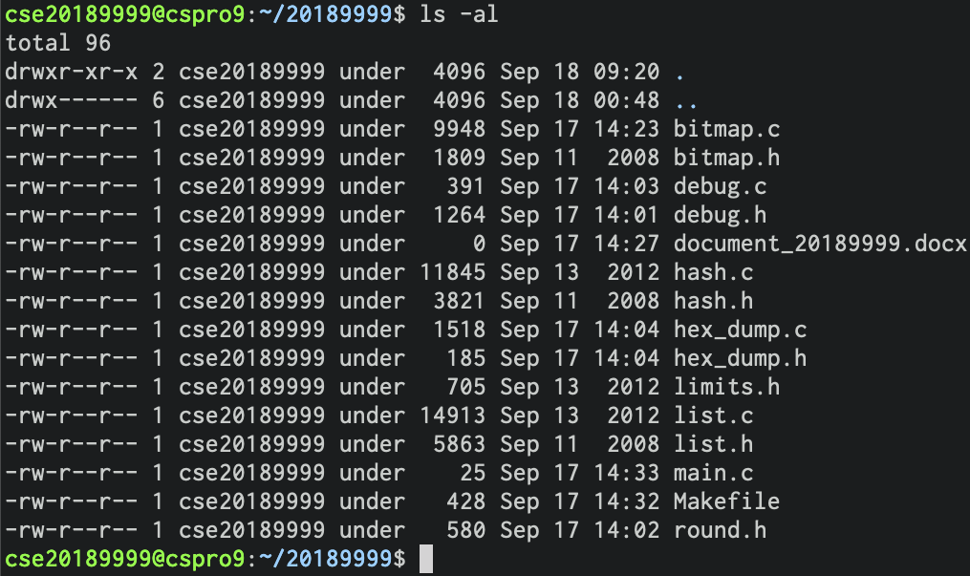
Way to Submit Your Work
Correct case
All the files should be in your 'ID' directory

Slide 27
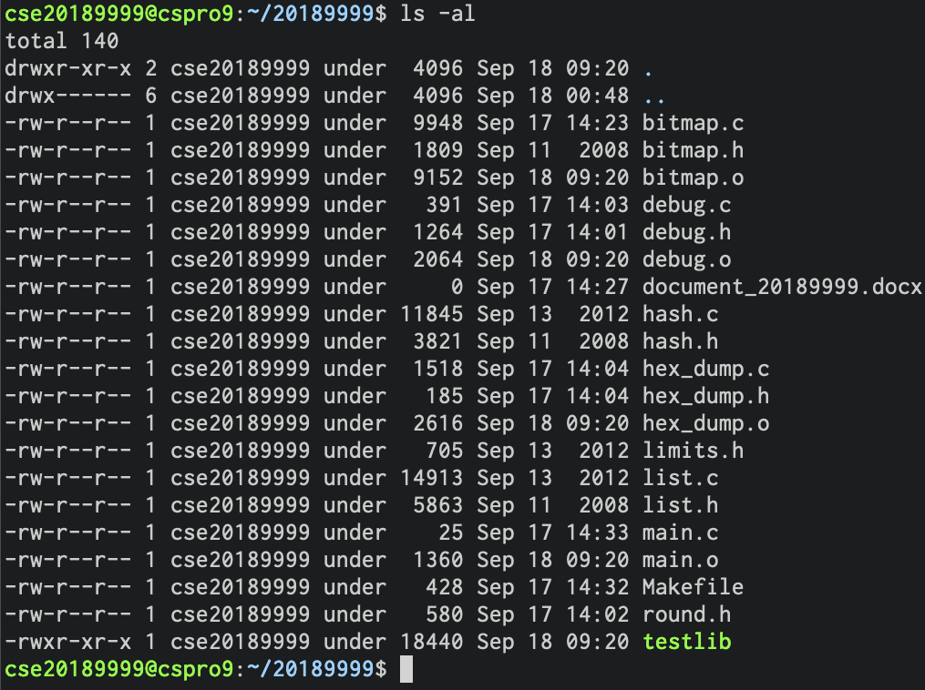
Way to Submit Your Work
Incorrect case (1)
'make clean' is not performed in this case (There are *.o and testlib files)

Slide 28
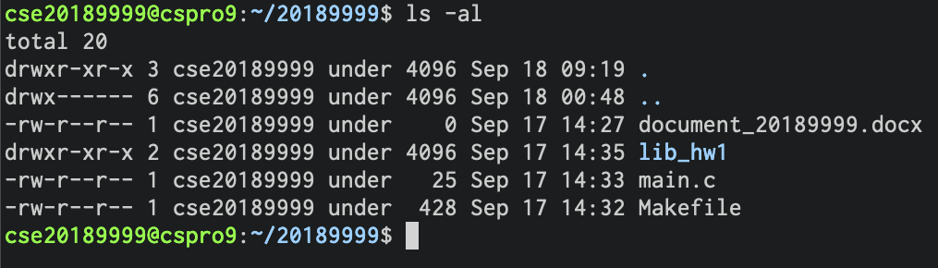
Way to Submit Your Work
Incorrect case (2)
Library files are in 'lib_hw1' directory in this case
Don't contain libraries in other directory, just contain it in 'ID' directory

Slide 29
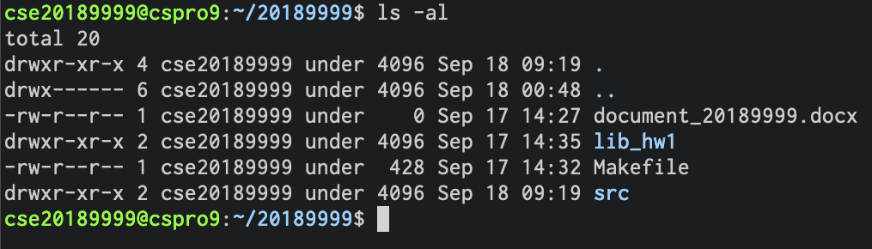
Way to Submit Your Work
Incorrect case (3)
Source codes are in 'src' directory and libraries are in 'lib_hw1'

Slide 30
Way to Submit Your Work
How to use tar (Assume that your ID is 20189999)
Compress: tar -zcvf os#0_2_20189999.tar.gz 20189999
Extract: tar -zxvf os#0_2_20189999.tar.gz
Don't compress your directory in Windows, compress it in Linux (on CSPRO).
20189999 directory, not os#0_2_20189999, should be shown after extracting tar.gz file.
If you try 'tar -zcvf os#0_2_20189999.tar.gz os#0_2_20189999', you will get os#0_2_20189999 directory after extracting os#0_2_20189999.tar.gz ← This is wrong case!

