Slide 1
Synchronous Design Labs
Kang Yi
HGU

Slide 2
Traffic Light Controller Example
farmway
Traffic_light
controller
hwy
x
clk
rst
X
highway
fwy
x
X=0
X : sensor that indicates
if there is a traffic in the farmway
start
S0
X=1
S1
Output Table (Moore type)
highway farmway
S0 Green Red
S1 Yellow Red
S2 Red Green
S3 Red Yellow
S3
X=0
S2
X=1

Slide 3
Traffic Light Controller Verilog Source
// traffic light definition
`define YELLOW 2’d0
`define RED 2’d1
`define GREEN 2’d2
// state assignment definition
`define S0 2’b00
`define S1 2’b01
`define S2 2’b10
`define S3 2’b11
module sig_controller
(hwy,fwy, X, clk,rst) ;
output [1:0] hwy, fwy;
reg [1:0] hwy, fwy ;
input X, clk, rst ;
reg [1:0] cs, nst ; // state variable
always @(posedge clk or posedge rst)
if(rst) cs <= `S0;
else cs <= nst;
always @(cs or x) case (cs)
`S0 : if(X) nst = `S1; else nst = `S0;
`S1 : nst = `S2;
`S2 : if(X) nst = `S2; else nst = `S3;
`S3 : nst = `S0;
endcase
always @(cs)
case (cs)
`S0 : begin hwy = `GREEN; fwy = `RED; end
`S1 : begin hwy = `YELLOW; fwy = `RED; end
`S2 : begin hwy = `RED; fwy = `GREEN; end
`S3 : begin hwy = `RED; fwy = `YELLOW; end
endcase
endmodule
Next state
FSM Output

Slide 4
Testbench
module testbench;
reg clk = 0;
reg rst ,X ;
wire [1:0] hwy, fwy;
module sig_controller (hwy,fwy, X, clk,rst) ;
initial forever #5 clk = ~ clk; // or always #５ clk = ~ clk;
initial begin
rst = 1;
#10 rst = 0; X = 1;
#40 X = 0;
#20 X = 1;
#10 rst = 1;
#10 rst = 0;
#20 $stop;
end
endmodule

Slide 5
TLC Lab Block Diagram
R1 G1 B1
R2 G2 B2
Yellow=R+G
Red=R
Green=G
Color_LED
Driver
Color_LED
Driver
hwy
fwy
TLC FSM
Debounce
&pulse_gen
BTN
X
en
en
clock enable generator
100Hz
0.5Hz
100MHzClk

Slide 6
Making FSM Slow-down by using clock enable for state register update control
Current state
Compute
Next state
(조합회로)
Next
state
State
register
Compute
output
(조합회로)
output
D
Q
input
enable
ce
100MHzClk
rst

Slide 7
Exercises
Design a Dice Game Machine. The game is played with 2 dices. The controller inputs are X, clock, and reset. The outputs are Win, Lose, Dice0[2:0], and Dice1[1:0]. The Flowchart for the game is as follows.
Point <= sum
Roll two dices
Sum = 7 or 11
Yes
Roll two dices
No
Sum = 7 or 6
Yes
Sum = 6
No
Sum = Point
No
Yes
Yes
lose
win
win
lose

Slide 8
Hints for the Ans (1)
The Top-Level Submodules
clk
Reset
roll
Dice game
win
lose
roll
Synchronizer
eq
datapath
D₆
D₇
D₁₁
ld
inc
controller
win
lose
clock
reset roll

Slide 9
Hints for the Ans (2)
The Datapath and Control Signals
D7
D11
D6
eq
roll
Game
controller
loadP
Inc1
win
lose
inc1
Dice0
inc2
Dice1
3-bit Adder
comparator
eq
D7
D11
D6
Point Reg
loadP
Decoder
clk
Dice Game Datapath

Slide 10
Hints for the Ans (3)
The Game Controller
roll’
S0 is an initial state
This FSM has Synchronous Reset
S0
reset
roll
reset
roll/inc
S2/win
S1
S3/lose
roll’ (D₇+D₁₁)
roll’ D₆
reset’
reset’
roll’ D₇’ D₁₁’ D₆’/ld
S4
roll’
roll
roll’ Eq’D₇’ D₆’
roll’ eq
S5
roll’ rq’(D₇ +D₆)
roll/inc

Slide 11
Hints (Synchronizer Design)
Sometimes Asynchronous Inputs are unavoidable (e.g. User Inputs: roll)
Asynchronous Inputs : Signals from different Clock Domain
Synchronizer Objectives : Synchronization & DeBouncing
Clock domain B
Clock domain A
System
core logic
Asynchronous
Inputs X
A
Y
Clock A
Clock B
Clock A
X
A
Y

Slide 12
Dice Game Lab Extension
Add Dice0, Dice1, Point, and Sum value output port to the datapath
Add 7segment display to the game top module
Add state indicator with LEDs (Win, Lose, Wait)
Win Lose Wait Init
a b ,… ,g
AN3 AN2 AN1 AN0
7 segment display driver
state
decoder
controller
status
datapath
roll
sync
Point
Sum
Dice1
Dice0

Slide 13
Candy Vending Machine
50원, 100원 동전 사용 가능
Candy값: 150원,
200원 이상 입력시 잔돈 배출
시작
sum ← 0
N
50원 입력?
Y
Y
N
100원 입력?
sum ← sum+50
sum ← sum+100
Y
sum >= 150
N
LED1
Y
LED2
sum == 200
N

Slide 14
Datapath
50 100
LED1: 물건출력
LED2: 잔돈출력
GE150: sum>=150
EQ200: sum=200
ld: load sum reg
sel1, sel2 : MUX sel
0 1
sel2
0
+
0 1
sel1
Q_in
sum
ld
dec
GE150
EQ200
LED1_set
LED1_clr
D Q
LED1
LED2_clr
LED2_set
D Q
LED2

Slide 15
Controller
start
start
S0
S0/
sum←0
No input
sm ←0
No input
S1
50원
100원
S1
S2
/sum ← sum+50
S3/
sum← sum+100
50원/
sum←
sum+50
100원/
sum←
sum+100
GE150’, GE200/-
S2
S4
GE150
GE150, GE200’/
LED1_set
GE150, GE200/
LED1_set,
LED2_set
S5/
sum← 0, LED1set
S6/
LED2set
EQ200
LED1clr, LED2clr 신호는?

Slide 16
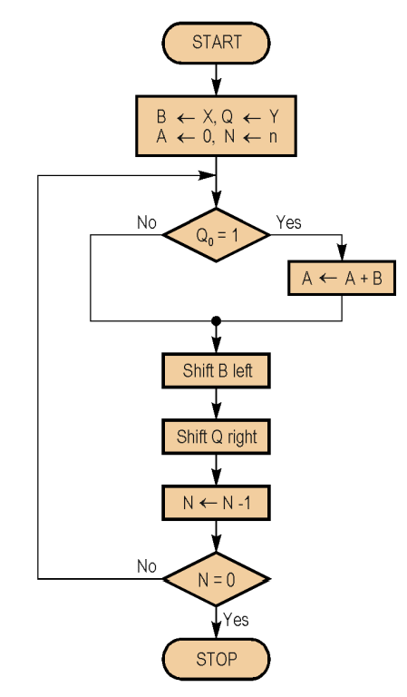
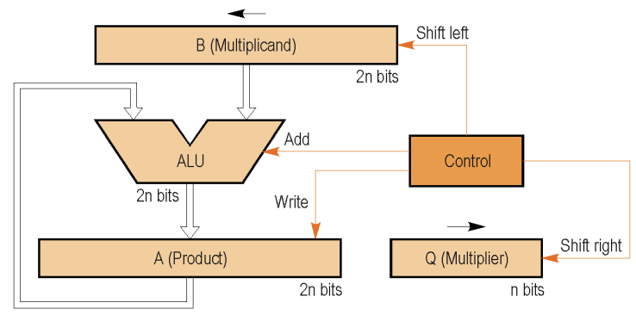
n-bit Add & Shift Multiplier Lab (v1)
Product(A) ⬅ Multiplicand(B) * Multiplier(Q)
Multiplicand (B=9) 1001
Multiplier(Q=11) x 1011
---------
1001
1001
0000
1001
---------
Product(A:99) 1100011
x
B(multiplicand): 1001
A(Product): 0000
Q(multiplier): 1011

Slide 17
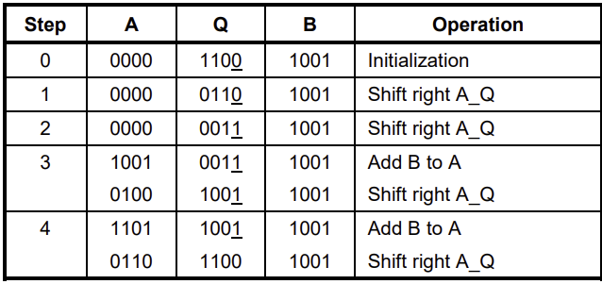
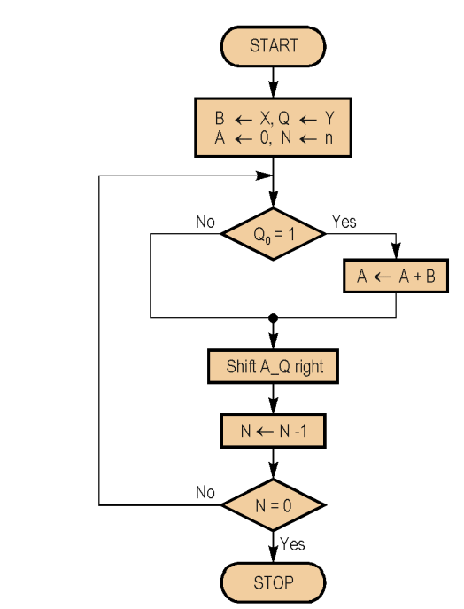
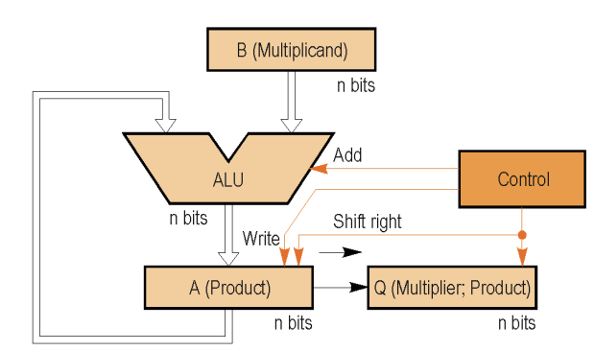
n-bit Add & Shift Multiplier Lab (v2)
{N, Q}
⬅ A * B
datapath

Slide 18
Multiplier Extension Lab
SW7~SW4
SW3~SW0
CA ~ CG
AN[7]~ AN[0]
7segment display
Reg X
Reg Y
cvBCD4
cvBCD4
0
bin2BCD255
4
4
8
BTN
B
A
Product
(A,Q)
main_ctrl
Multiplier
Ld_in
multiply
start
sync
go
done
stop
bin2BCD_start

