Slide 1
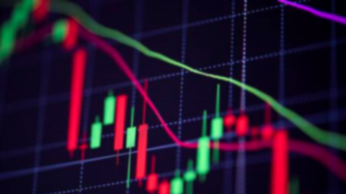
Deep learning approaches for financial forecasting
Fiorenzo Parascandalo – Daniele Domenichelli
Machine Learning for Computer Vision

Slide 2
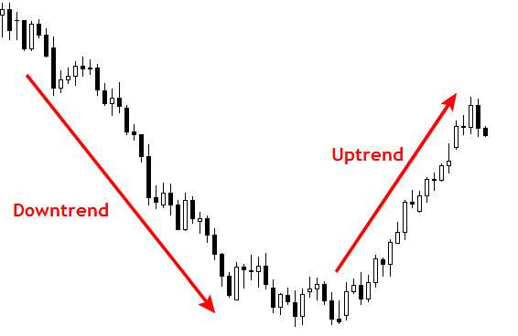
Stock Market Prediction
People with financial background and experience can predict the market trends.
Many researchers tried to emulate the expertise in the field through machine and deep learning algorithms.
The problem consists in predicting the sign of the derivative of the trend given a certain date, such that it is possible to qualitatively forecast the trend growth.
Stock Market – predicting sign of trend derivative

Slide 3
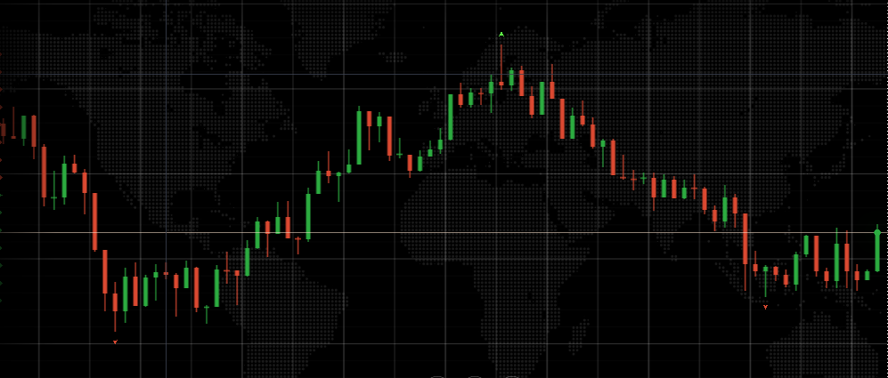
OHLC Model
The market can be described by a 4 time-dependente factors models:
Open – starting price of the day
Close – ending price of the day
High – highest value of the day
Low – lowest value of the day
Optionally we can add another feature:
Volume – number of value transactions
With this model, we can describe the trend derivative as the difference between the open of the subsequent day and the close of the current.
Example of a OLHC (Candlestick) Chart

Slide 4
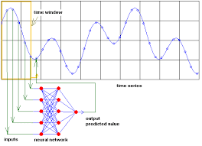
State of the art
This field is largely studied by many researchers involving many different fields. For this reason, many neural approaches came up from time to time, since 2000:
Statistical Approaches
Sentiment Analysis
Supervised/Unsupervised Learning
Pattern Recognition
LSTM/GRU
Hybrid
The current best accuracy is around 55%, provided that the market is constantly changing and that an accuracy over 50% must be intended as a gain in the final income.
Firsts neural approach to Stock Market forecasting

Slide 5
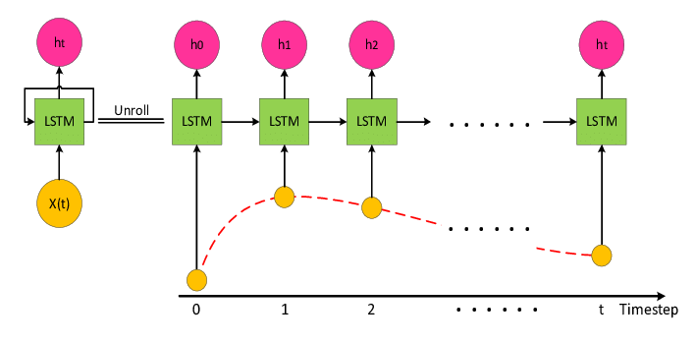
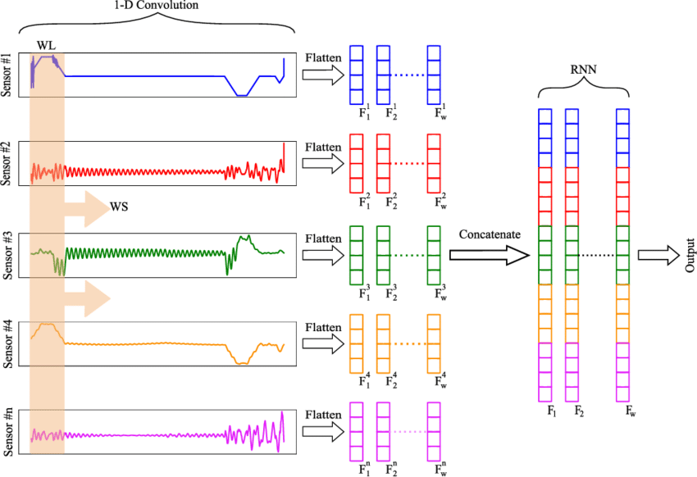
State of the art
From 2013, with the explosion of the CNNs, many researchers started to study the application of image pattern recognition over stock market charts.
In 2015 was proposed an approach to encode time series into images exploiting properties of the Gramian Matrix.
In these 6 years, with more develop on neural network image processing, CNNs models outperformed the most stable LSTM/GRU approaches, head of the ranking in 2015.
LSTM vs CNN time series forecasting

Slide 6
Proposed approach
INPUT
CNN
CNN
CNN
CNN
CNN
CNN
Our approach consists in an ensemble of rescaled CNNs backbones trained over a dataset of preprocessed images. At the bottom of the model, a tiny classifier outputs the sign of the trend derivative.
At last, the ensemble applies a weighted voting policy and threshold the result to predict the sign as a class in the set [-1, 0, 1].
To improve the training, we adopted a reinforcement learning method which drives the voting policy.
This approach was then tested over two different datasets: Candlestick Charts and Gramian Angular Field images.
CNN
CNN
CNN
FC
FC
FC
FC
FC
FC
CNN
CNN
CNN
FC
FC
FC
FC
FC
FC
ENSEMBLE
OUTPUT
REINFORCE

Slide 7
Dataset
The dataset was taken by the Kaggle US-based stocks and ETFs for NYSE, NASDAQ and NYSE MKT.
It is a series of csv tables, one for each company or corporation, containing for each row the date and OCHLV data.
Given our computational capabilities, we were decided to take in account just a part of the entire dataset (~1M of rows) from ETFs data.
Date | Open | Close | High | Low | Volume
String | Float | Float | Float | Float | float
Row Dataset Format
Total Items | Negative Trend | Positive Trend
928632 | 53.37% | 46.63%
Dataset Distribution

Slide 8
Dataset
The dataset was taken by the Kaggle US-based stocks and ETFs for NYSE, NASDAQ and NYSE MKT.
It is a series of csv tables, one for each company or corporation, containing for each row the date and OCHLV data.
Given our computational capabilities, we were decided to take in account just a part of the entire dataset (~1M of rows) from ETFs data.
As we tried different models, we found out that the volume did not significantly impact the performances, so we decided to drop it.
Date | Open | Close | High | Low | Volume
String | Float | Float | Float | Float | float
Row Dataset Format
Total Items | Negative Trend | Positive Trend
928632 | 53.37% | 46.63%
Dataset Distribution

Slide 9
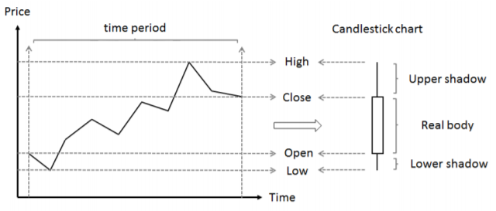
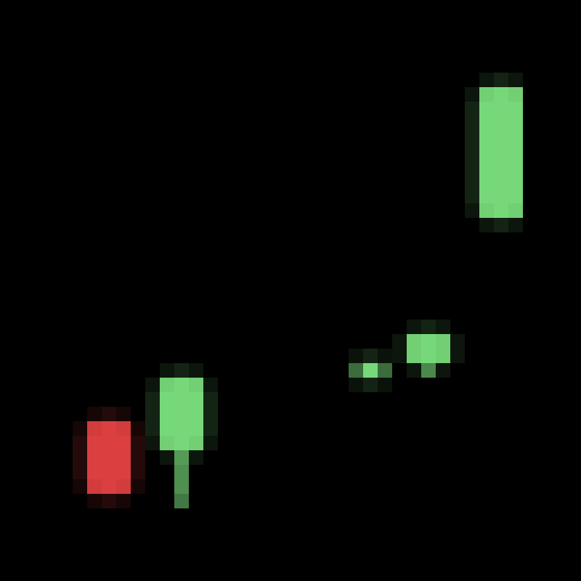
Candlestick chart
The candlestick chart is just a compact view of the OCHL model.
From the Kaggle ETFs Dataset, we extracted the candlesticks as follow:
Set the time period of a candle
Compute the Upper/Lower Shadow and the real body
Plot positive real body in green, negative in red
Candle computation
Rescaled Sample

Slide 10
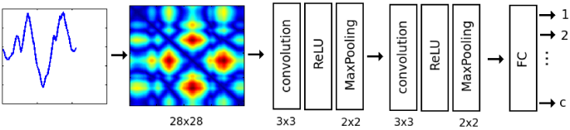
Gramian angular field (GAF)
The Gramian Angular Field (GAF) was explored in 2015, in the field of time series analysis.
This technique is a space augmentation method that allows to represent data in a space expanded by one dimension. That dimension roughly represent the correlation between two points in the original space.
In our case, 1D time series are encoded in 2D RGB images using the GAF encoding and a colormap schema, which map grayscale to a specific color.
Usual use of GAF in time series classification

Slide 11
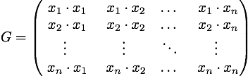
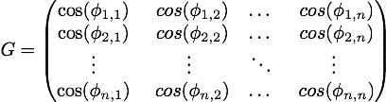
GAF ENCODING
Each element of the GM is the dot product between two point of the time series.
The first step of the encoding is the signal normalization in the range [-1, 1], such that we can collapse the signal.
Then the normalized signal is transformed in polar coordinates, to gain several benefits:
bijectiveness
signal shape preserved on the diagonal
dot product simplified (angular cosine)
highleted temporal correlations
Time series Gramian Matrix
Unitary Gramian Matrix
GAF encoding of a sinusoidal signal

Slide 12
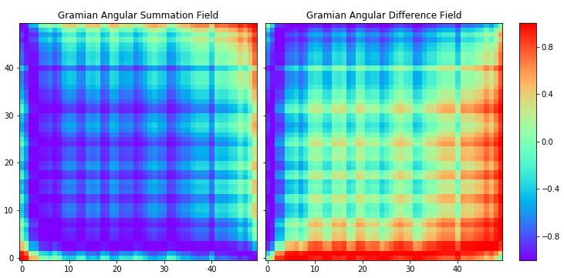
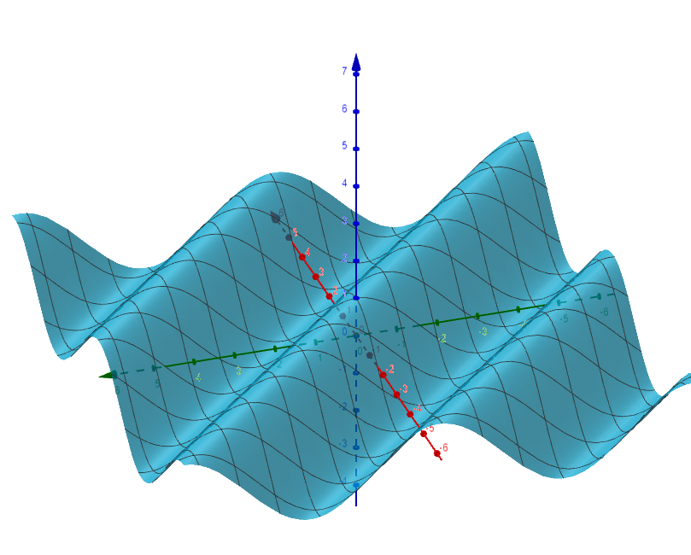
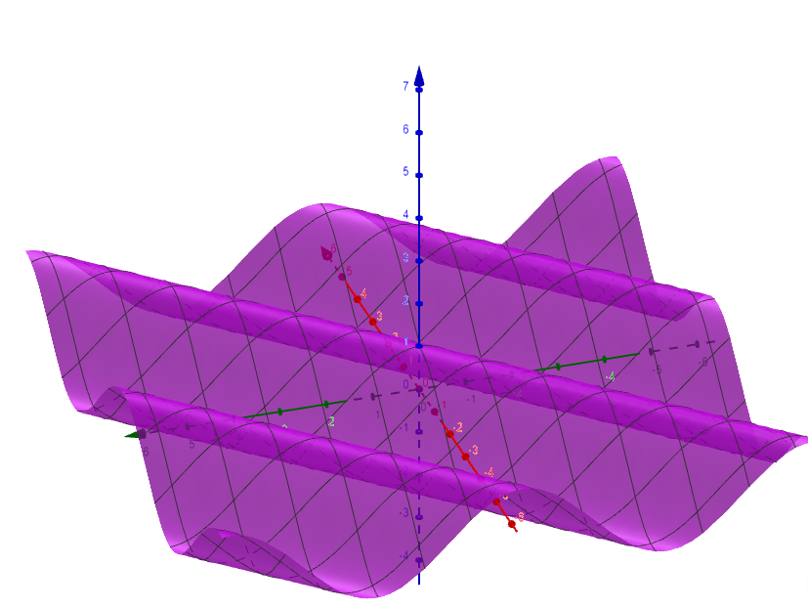

GAF ANGULAR SIMILARITY
The GAF presents two way to compute similarity between angles:
SUM (GASF) – $\cos\left(φ_{1}+φ_{2}\right)$
DIFFERENCE (GADF) – $\cos\left(φ_{1}−φ_{2}\right)$
These methods produces an image that look inverted, but their patterns differ: the only property maintained between the two is the symmetry along the secondary diagonal.
We can note how the pattern mantined between the two images are those natural modes that presents a periodical correlation (stagionality).
GASF vs GADF

Slide 13
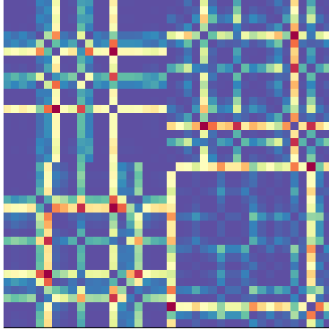
GAF IMAGES
1 days/pixel
2 days/pixel
As normal image have different resolution, even the GAF images can be computed at different time resolution.
To create a different time scale, it is needed to aggregate the data in order to downsample it.
As we are in a forecasting problem, we can use open and close of the entire time period and predict the label of the next period.
In order to create a multiscale, time-independent model we composed an image of a fixed size window with different aggregation periods.
From our tests, GADF perfomed better than GASF.
3 days/pixel
5 days/pixel
GASF - 20x20 days window

Slide 14
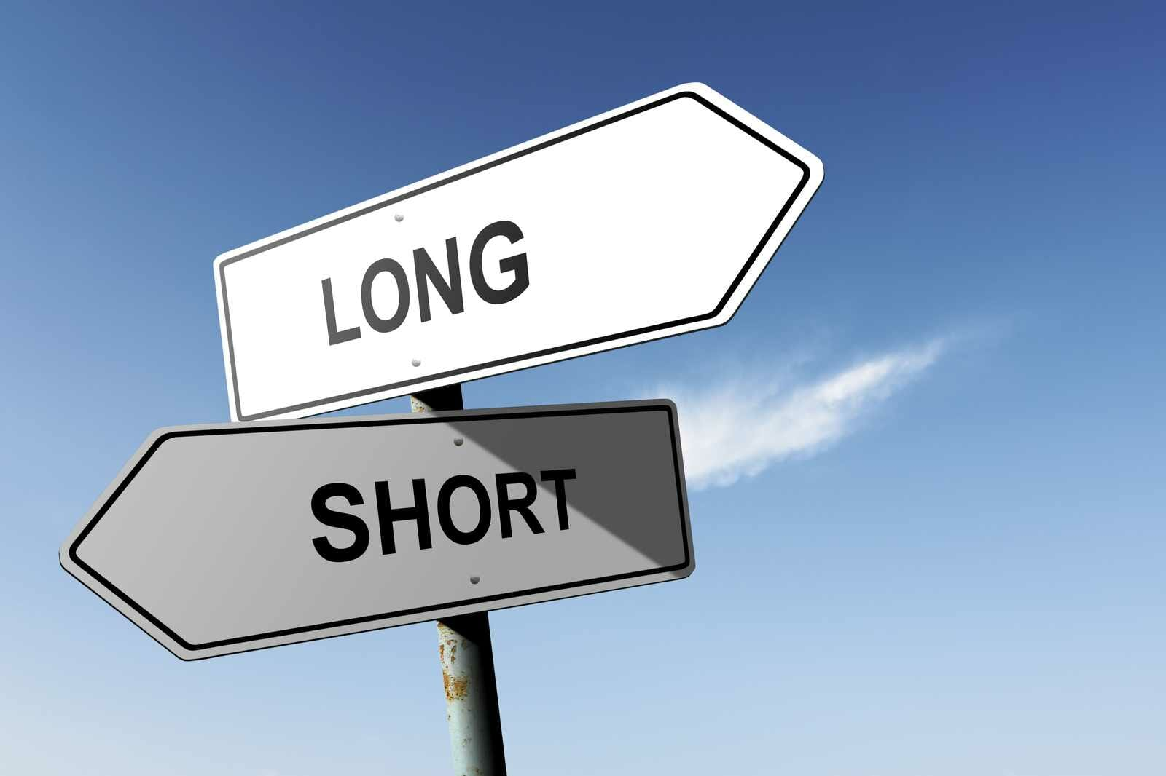
OUTPUT
The theoretical output of this task is the sign of the trend derivative, which should be ±1.
A practical aspect, involving the ensemble policy, is to give a confidence about the obtained results.
The confidence is expressed by the output range [0, 1] and then enforced by a threshold. This means that if the ensemble is not enough confident about the choiche (discording CNNs) then is preferable to avoid any action in the stock market.
The third output class (0.5) means that the ensemble did not reached the quorum for a confident choiche.
POSSIBLE ENSEMBLE ACTIONS
-1 | LONG
0 | HOLD
1 | SHORT

Slide 15
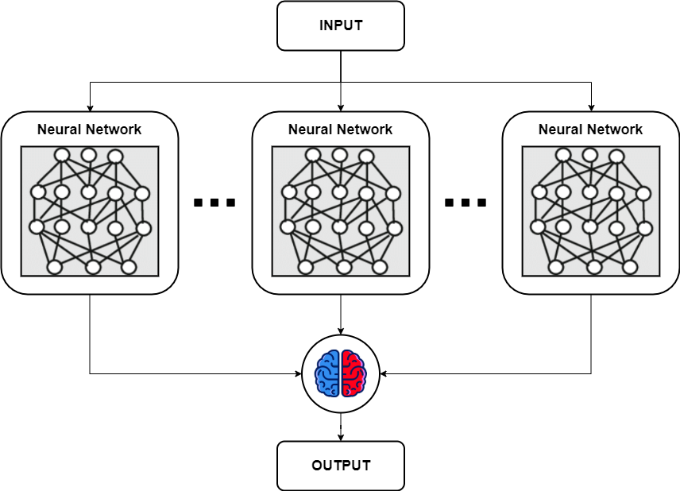
Architecture
Out architecture follows the modular principle of modern CNNs:
CNNs Ensemble:
Tiny VGG16 or Tiny ResNet
Non Local Block availability
FC classifier
Deep Q Learning reinforcer:
Example of an ensable

Slide 16
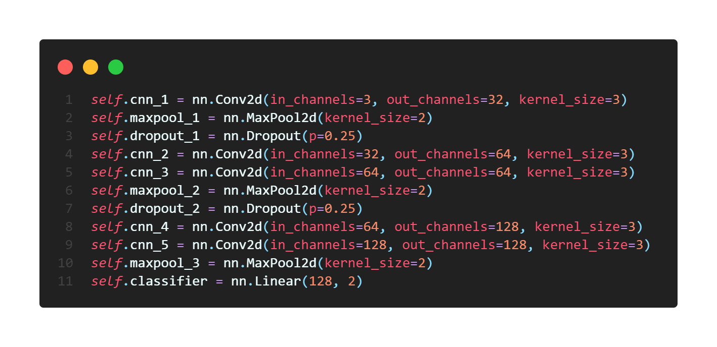
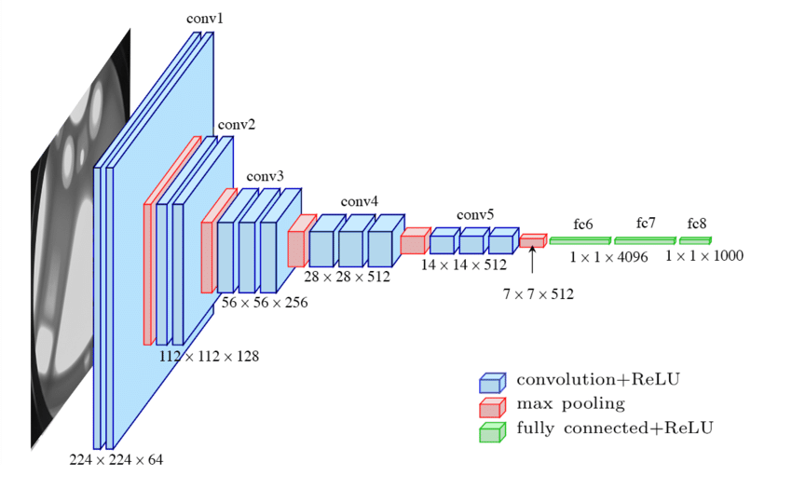
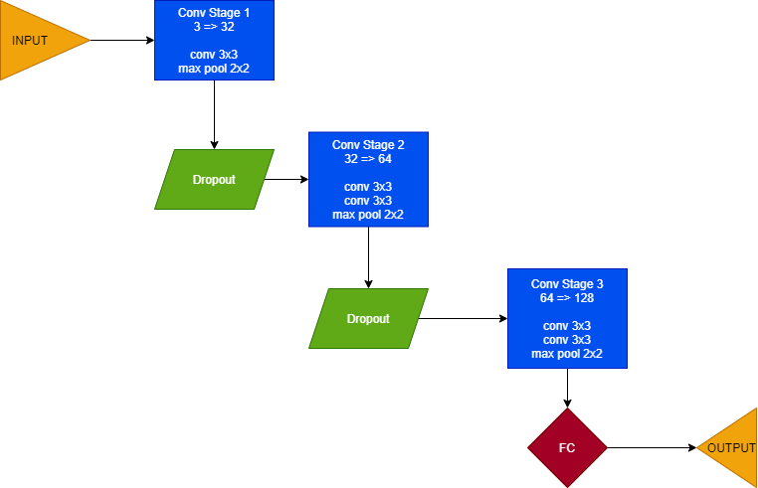
Tiny Vgg16
Just 5 conv+relu layers
Dropout after MaxPool (except last)
VGG16
Tiny VGG16

Slide 17
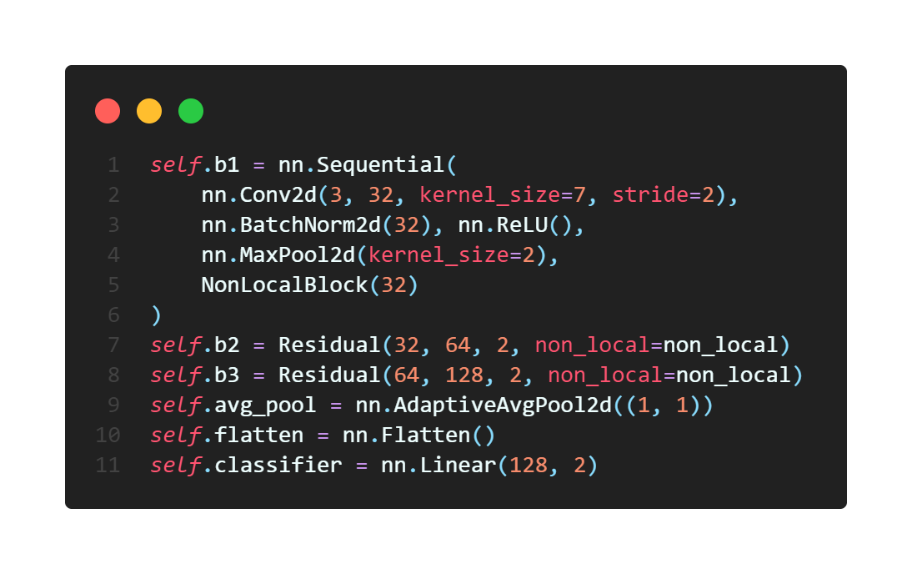
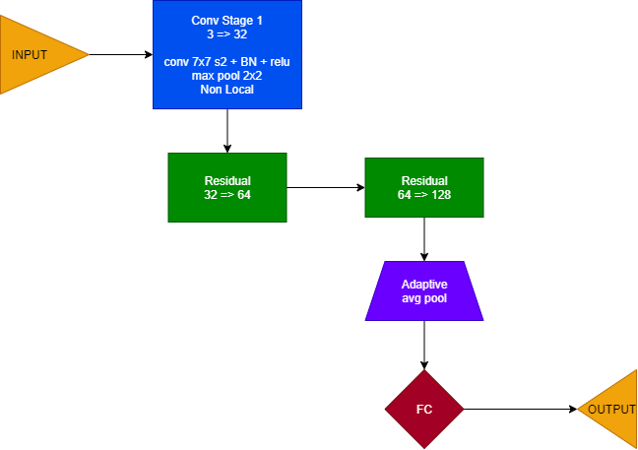
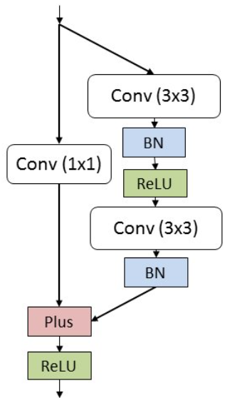
Tiny Resnet
Introduction of non local blocks
Two different stemming:
Global- k7x7 s2 +BN + ReLU
Local – k4x4 s4 + BN + ReLU, strides the kernel over each subimage, divinding the input in time relative subsamples. This stemming produces an image also subdivided in time frames like the initial.
Adaptive Average Pooling
Tiny ResNet Residual Block
Tiny ResNet

Slide 18
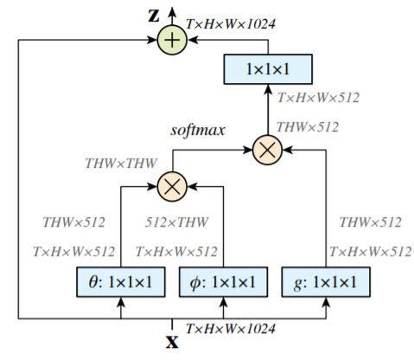
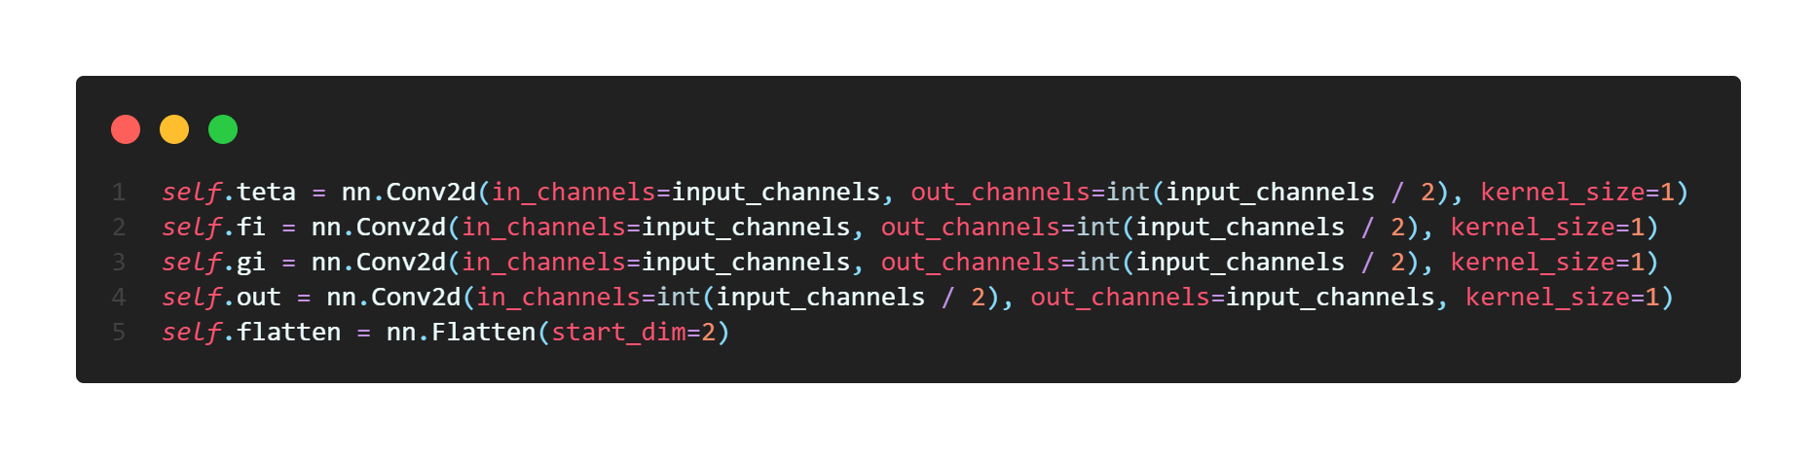

Non local block
Computes the response at a position as a weighted sum of the features at all positions:
$$y_{i}=\frac{1}{C(x)}\sum_{∀j}{f\left(x_{i},x_{j}\right)g(x_{j})}$$
Inspired by Non Local Means, a classical filter algorithm.
Non Local Block

Slide 19
Ensemble policy – Threshold approach
The ensemble consists in 20 different CNNs.
10 different initializations are used, half of the networks are then randomly initialized, while the rest is seeded.
Each network can output a value in the set {0, 1}, then the percentage of each class is computed among the network outputs.
A quorum threshold is set in order to decide if the percentage is enough to take an action in the market or just being idle.

Slide 20
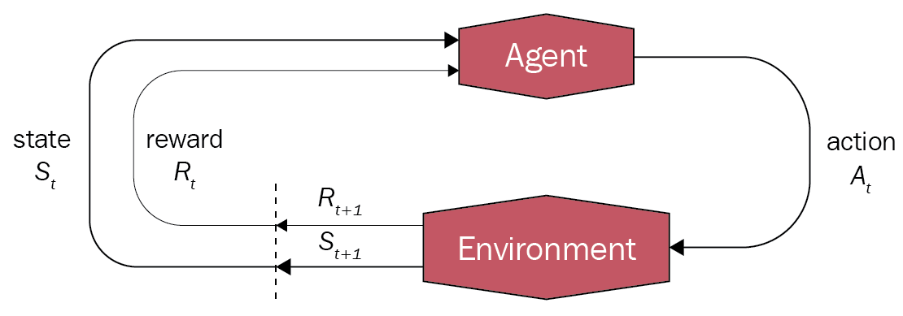
Ensemble training – Deep q learning
We thought that trading can be learned as a renfoircement learning problem, modelling it with the following ideas:
Environment: the market
Observations: our GADF/Candlesticks
Actions: Long, Short, Hold (but not quantified)
Rewards: money gain or losses
Deep Q Framework
We created a simplified reward system where a repaying action is promoted (+1), a loosing action is punished (-1) and holding is just ignored (0).
By doing this we created a virtual wallet to keep track of the rewards along the history.
The trainer is composed just by a FC module which guides the threshold and the weights for the ensemble.

Slide 21
Training
We proposed two different approaches:
Classification
CNN singular training
CEL for each CNN
Deep Q
CNN collective training
Smooth L1 loss
For both, we used the Adam optimizer.
Also, during the training phase we found out some precautions on the dataset to gain some precious points in the final score of the model.

Slide 22
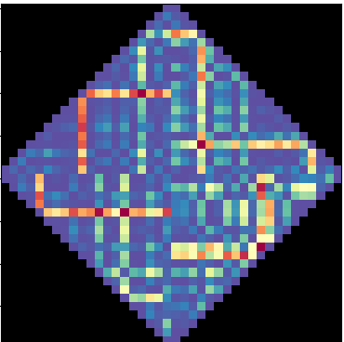
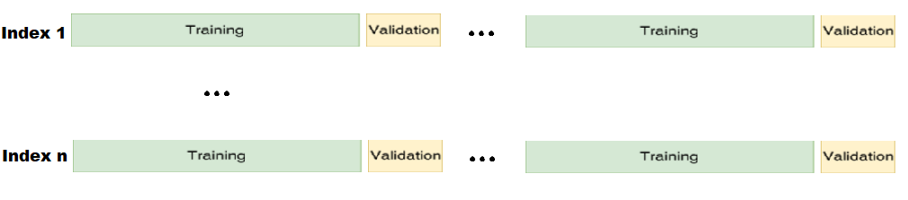
Rotation and Rhombus
Walks
GASF Rhombus cut
Training interleaving walks
Experiments showed how the network can be faster if we simplify the image by applying properly rotations and a rhombus crop: the images are indeed symmetrical over their diagonals.
The rotation allows also to place in the same are relatively near time periods.
Another experiment we have done is to subdivide the training and validation test such that they are interleaved. The evaluation on the validation will be smoother and more reliable, given that we are in a forecasting environment.
The training results faster and more stable.

Slide 23
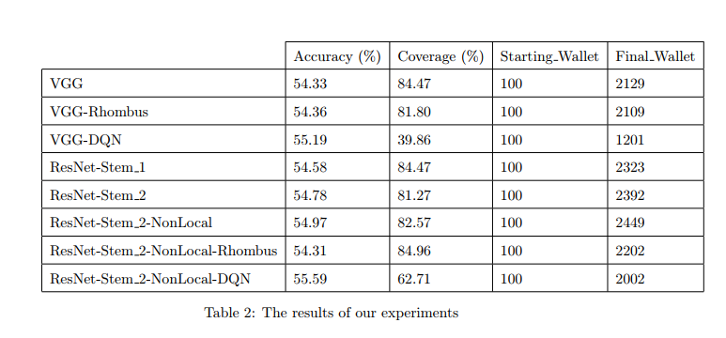
results
Final results
Notes:
Non abbiamo altri dati da comparare sullo stesso dataset ma sappiamo che la migliore accuracy media (SOTA) si aggira intorno al 55%

Slide 24

Conclusions & Remarks
We explored several aspects of stock marketing related to computer vision algorithms.
We found out that Deep Q Learning is well suitable for this task.
The addition of Non Local Blocks lead us to believe that in financial domain there are correlation between features that are not temporally local.
Our results look promising, giving an improvement in accuracy of 0.69% compared to an approach which had achieved a significative profit in real trading.
Thanks for the attention

