Slide 1





Strike
Strike
?
Archer
Mage
Move
Move
Move
Archer
Mage
King

Slide 2
K
M
A
W

Slide 3


Slide 4


Slide 5
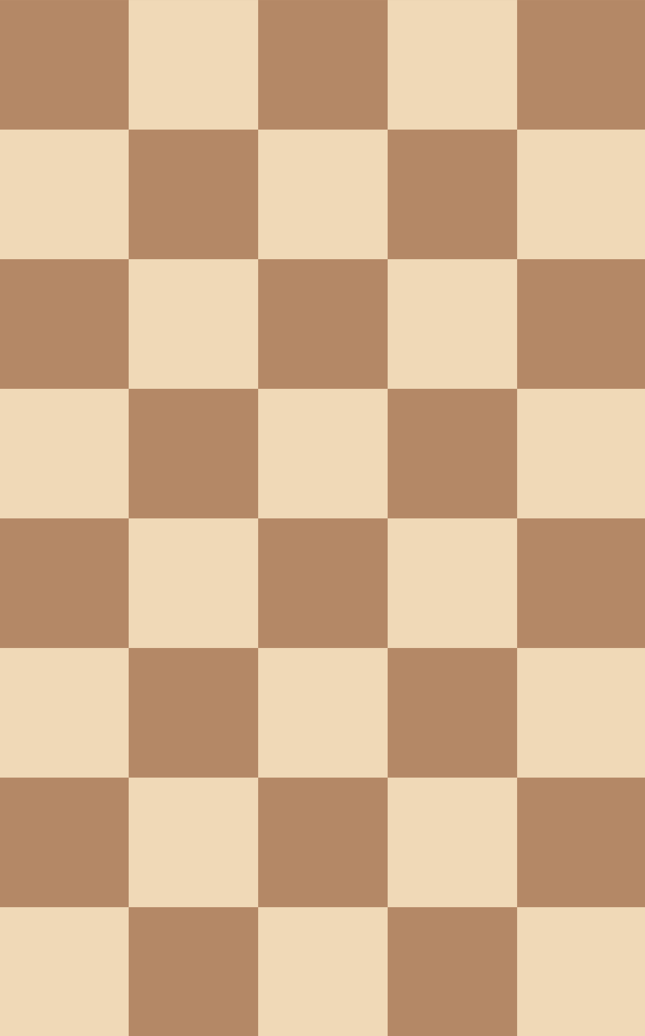
(-320,
-570)

