Slide 1
London areas classified by eating out options
Coursera project

Slide 2
Introduction
London postal districts (e.g. SW19) are often used to describe less or more ‘trendy’ or ‘desirable’ areas.
Whist such perceptions quickly change over time, this project aims to offer descriptions of areas from perspective of eating out options to supplement any existing views.
Such content could be used for various publications and by individuals who want discover new areas to rent or buy a property.

Slide 3
Data, methodology & Findings
Open-source Postal districts data was used to define geographical scope.
Only inner London areas were included.
Foursquare data on eating out places (‘food’ and ‘coffee’) was pulled using Explore API endpoint and attributed to districts.
After cleaning and transforming data four clusters were generated that corresponded to:
City, West End and Canary Wharf (business districts)
South-West & East (well-served, ‘trendy’ areas)
West and parts of South (medium penetration)
South, North and East areas that are low on eating out options.

Slide 4
Distribution of eating out places by category (top 15)

Slide 5
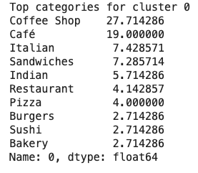
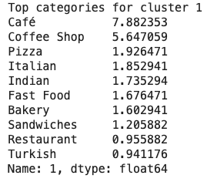
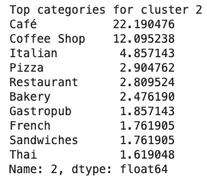
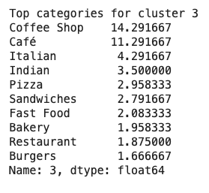
Cluster profiles show differences in total volume and composition of clusters

Slide 6
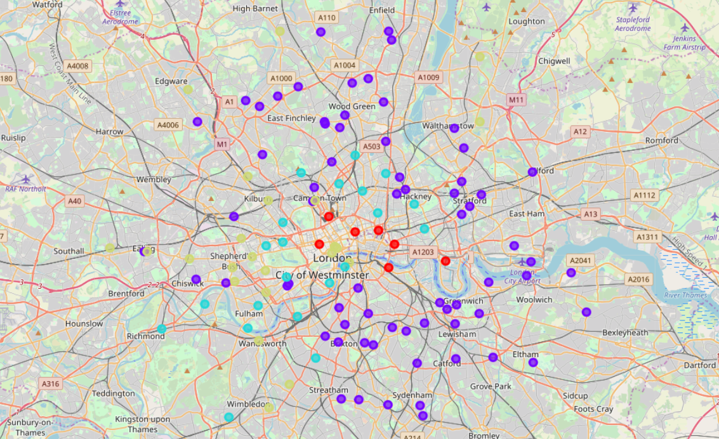
Clustering confirms existing perceptions of areas in London
Central, South west and east have greater penetration of eating out places, and offer good variety
Red – Cluster 0
Purple – Cluster 1
Light Blue – Cluster 2
Yellow – Cluster 3

Slide 7
cluster | postal_district | district_description | cluster | postal_district | district_description |  | cluster | postal_district | district_description
1 | E10 | Leyton | 1 | NW9 | The Hyde |  | 2 | E3 | Bow
1 | E11 | Leytonstone | 1 | SE10 | Greenwich |  | 2 | E9 | Homerton
1 | E12 | Manor Park | 1 | SE12 | Lee |  | 2 | N1 | Northern Head district
1 | E13 | Plaistow | 1 | SE13 | Lewisham |  | 2 | N16 | Stoke Newington
1 | E15 | Stratford | 1 | SE14 | New Cross |  | 2 | N4 | Finsbury Park
1 | E16 | Victoria Docks and North Woolwich | 1 | SE15 | Peckham |  | 2 | N5 | Highbury
1 | E17 | Walthamstow | 1 | SE17 | Walworth |  | 2 | N6 | Highgate
1 | E2 | Bethnal Green | 1 | SE18 | Woolwich |  | 2 | N7 | Holloway
1 | E20 | Olympic Park | 1 | SE19 | Norwood |  | 2 | NW8 | St John's Wood
1 | E5 | Clapton | 1 | SE2 | Abbey Wood |  | 2 | SE11 | Kennington
1 | E6 | East Ham | 1 | SE20 | Anerley |  | 2 | SW1 | South Western Head district
1 | E7 | Forest Gate | 1 | SE21 | Dulwich |  | 2 | SW11 | Battersea Head district
1 | E8 | Hackney | 1 | SE22 | East Dulwich |  | 2 | SW12 | Balham
1 | N10 | Muswell Hill | 1 | SE23 | Forest Hill |  | 2 | SW13 | Barnes
1 | N11 | New Southgate | 1 | SE24 | Herne Hill |  | 2 | SW14 | Mortlake
1 | N12 | North Finchley | 1 | SE26 | Sydenham |  | 2 | SW15 | Putney
1 | N13 | Palmers Green | 1 | SE27 | West Norwood |  | 2 | SW20 | West Wimbledon
1 | N14 | Southgate | 1 | SE28 | Thamesmead |  | 2 | SW6 | Fulham
1 | N15 | South Tottenham | 1 | SE3 | Blackheath |  | 2 | SW7 | South Kensington
1 | N17 | Tottenham | 1 | SE4 | Brockley |  | 2 | W2 | Paddington Head district
1 | N18 | Upper Edmonton | 1 | SE5 | Camberwell |  | 2 | W9 | Maida Hill
1 | N19 | Upper Holloway | 1 | SE6 | Catford |  | 3 | E18 | Woodford and South Woodford
1 | N2 | East Finchley | 1 | SE7 | Charlton |  | 3 | E4 | Chingford
1 | N21 | Winchmore Hill | 1 | SE8 | Deptford |  | 3 | EC3 | Fenchurch Street
1 | N22 | Wood Green | 1 | SE9 | Eltham |  | 3 | EC4 | Fleet Street
1 | N3 | Finchley | 1 | SW10 | West Brompton |  | 3 | N20 | Whetstone
1 | N8 | Hornsey | 1 | SW16 | Streatham |  | 3 | NW2 | Cricklewood
1 | N9 | Lower Edmonton | 1 | W14 | West Kensington |  | 3 | NW3 | Hampstead
1 | NW1 | North Western Head district | 1 | W4 | Chiswick |  | 3 | NW6 | Kilburn
1 | NW10 | Willesden | 0 | E1 | Eastern Head district |  | 3 | NW7 | Mill Hill
1 | NW11 | Golders Green | 0 | E14 | Poplar |  | 3 | SE1 | South Eastern Head district
1 | NW4 | Hendon | 0 | EC1 | Eastern Central Head district |  | 3 | SE25 | South Norwood
1 | NW5 | Kentish Town | 0 | EC2 | Bishopsgate |  | 3 | SW17 | Tooting
1 | SW2 | Brixton | 0 | SE16 | Rotherhithe |  | 3 | SW18 | Wandsworth
1 | SW3 | Chelsea | 0 | W1 | Wstern Head district |  | 3 | SW19 | Wimbledon
1 | SW4 | Clapham | 0 | WC1 | Western Central Head district |  | 3 | SW5 | Earls Court
1 | SW8 | South Lambeth |  |  |  |  | 3 | W10 | North Kensington
1 | SW9 | Stockwell |  |  |  |  | 3 | W11 | Notting Hill
1 | W13 | West Ealing |  |  |  |  | 3 | W12 | Shepherds Bush
 |  |  |  |  |  |  | 3 | W3 | Acton
 |  |  |  |  |  |  | 3 | W5 | Ealing
 |  |  |  |  |  |  | 3 | W6 | Hammersmith
 |  |  |  |  |  |  | 3 | W7 | Hanwell
 |  |  |  |  |  |  | 3 | W8 | Kensington
 |  |  |  |  |  |  | 3 | WC2 | Strand

