Slide 1

Temperature near the equator: A presentation on motionless data
-By: Zettabites

Slide 2
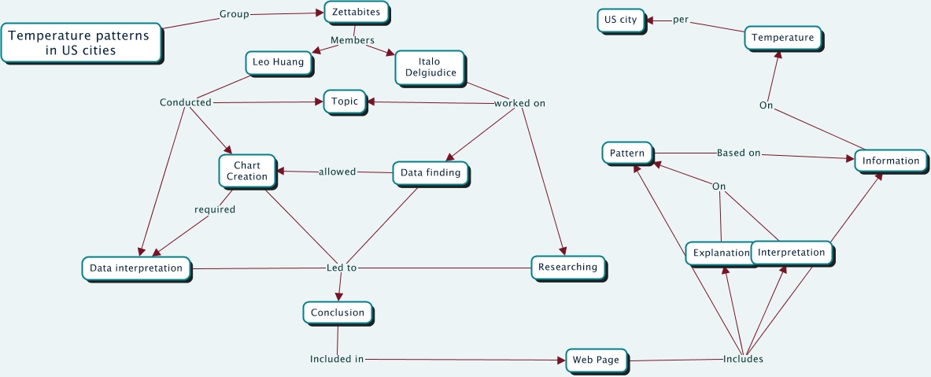
Our CMap

