Slide 1


Bengali Character Recognition Using Template Matching with NCC
Department of Computer Science and Engineering

Slide 2
Bengali Character Recognition Using Template Matching with NCC
Course Name: Pattern Recognition Laboratory
Course Code: CSE 460
Semester Final Project
Submitted By -
DHRUBA DEY
ID: 2103910202149
Semester: 8^{th,} Year: 4th
Section: A2, 39th Batch
Department of Computer Science and Engineering
Premier University, Chittagong
Submitted To -
DR. KAUSHIK DEB, Ph.D
Professor
Department of Computer Science and Engineering (CSE)
Chittagong University of Engineering and Technology (CUET)

Slide 3
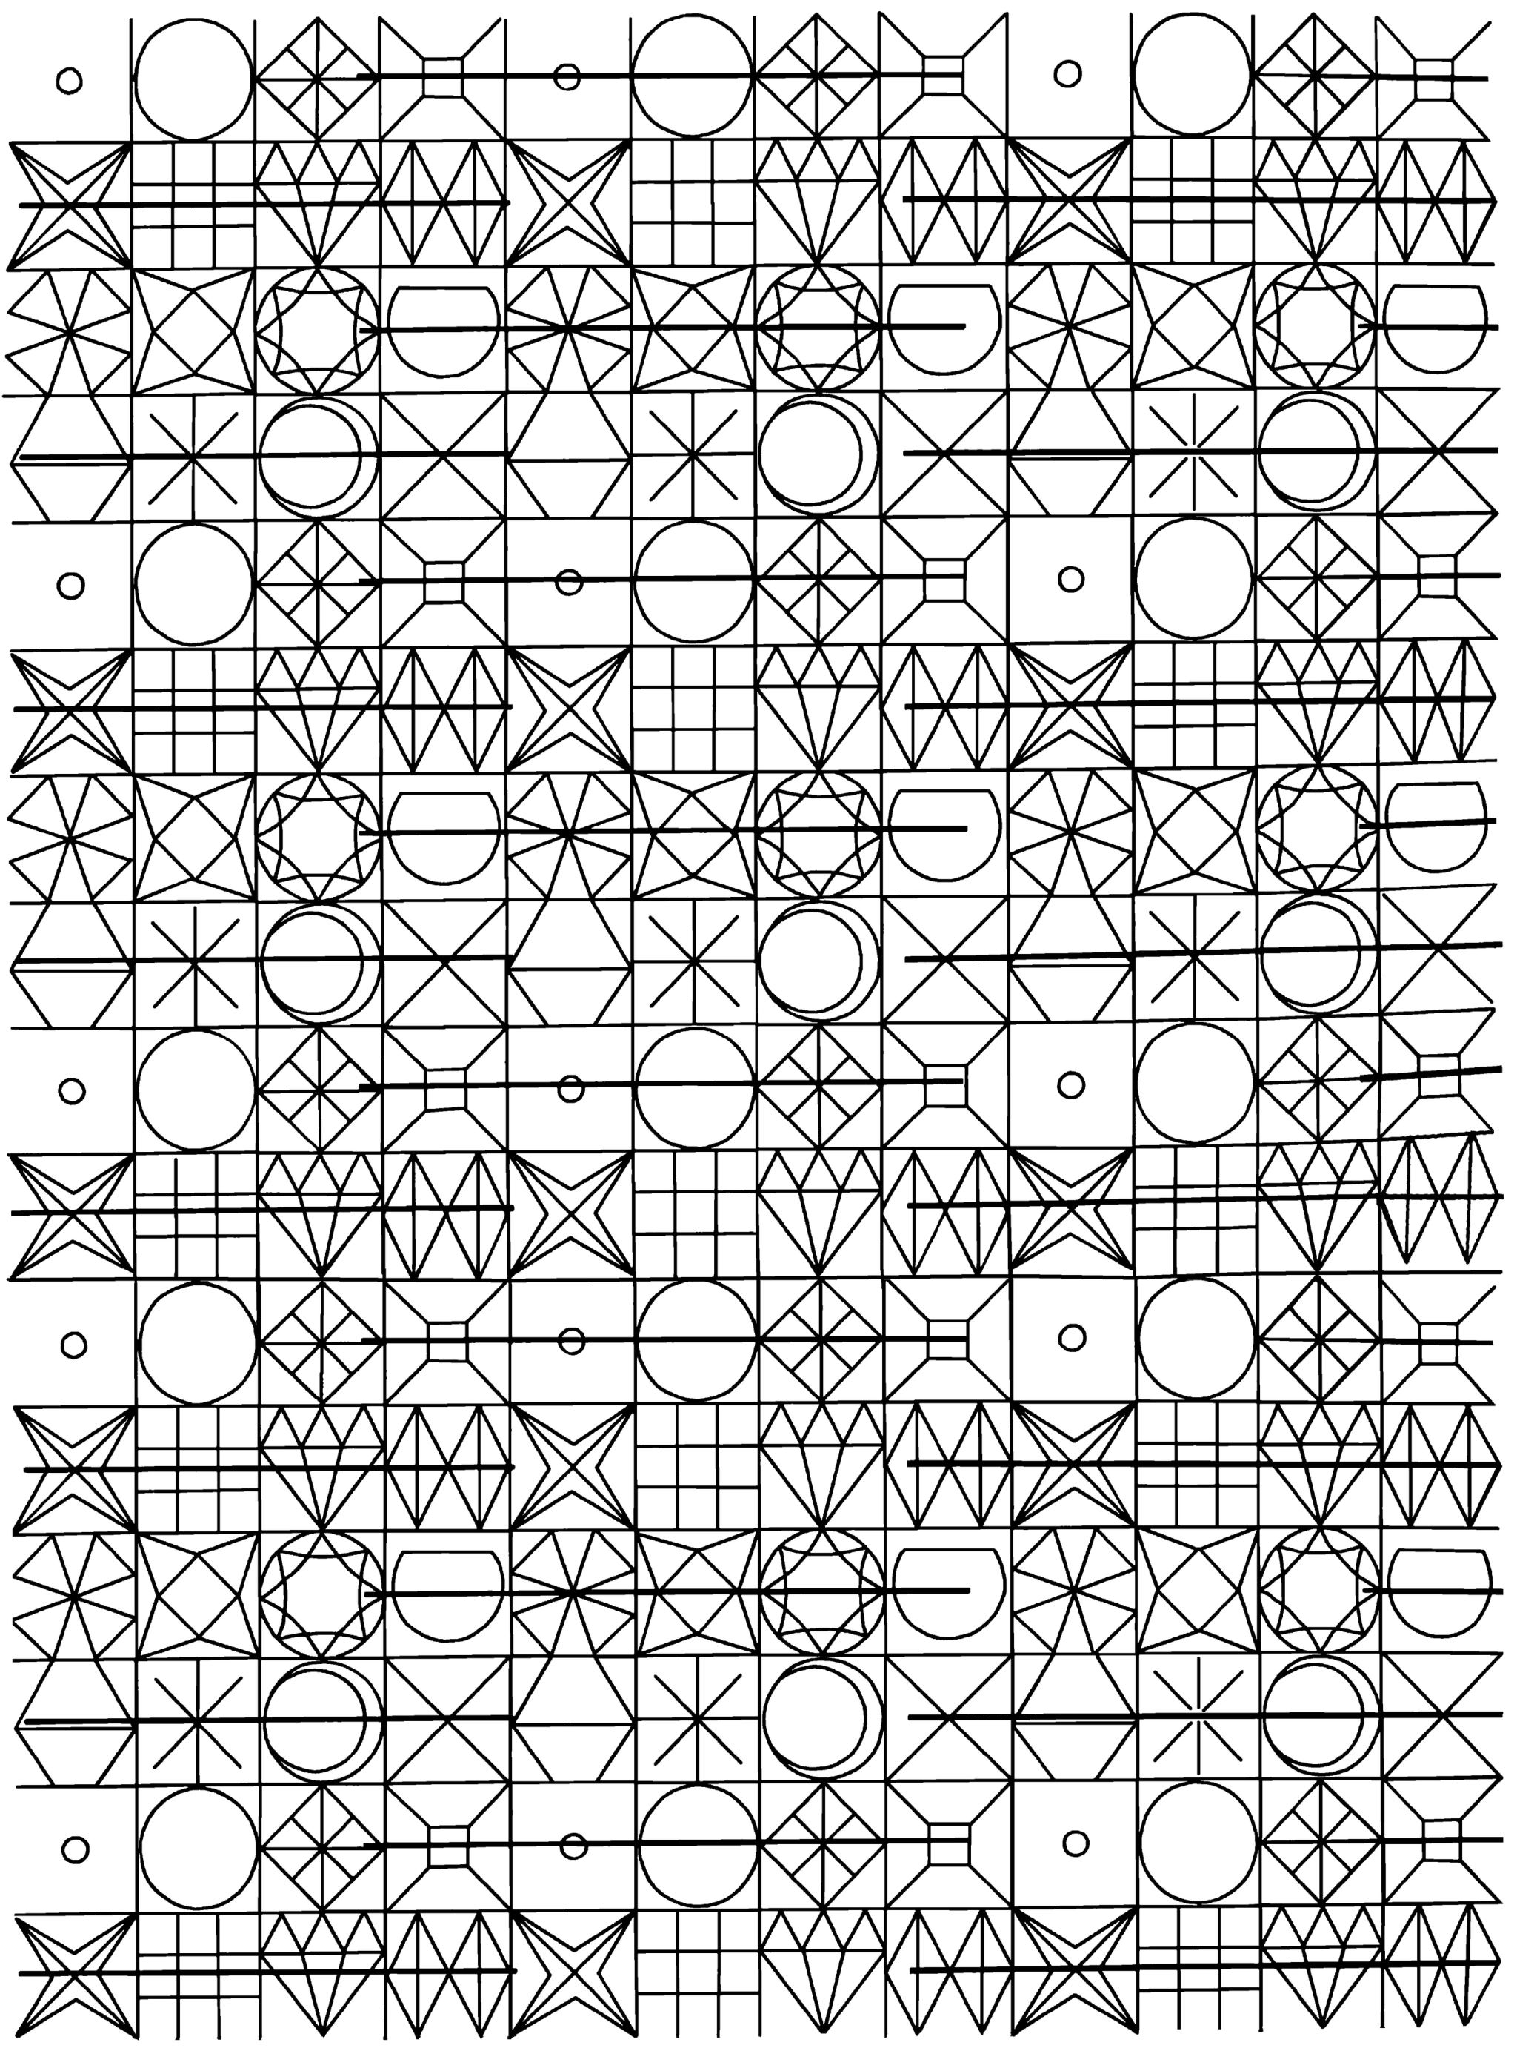
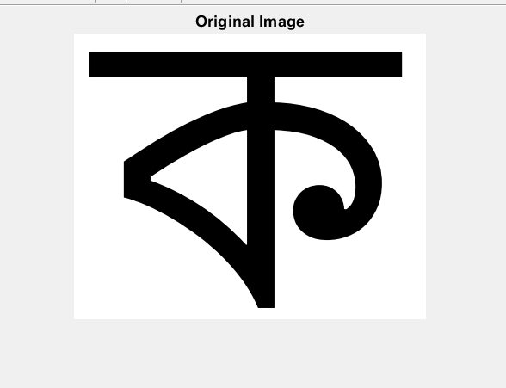
Introduction
OCR system for Bengali script recognition.
Method: Template matching with Normalized Cross-Correlation (NCC) in MATLAB.
Dataset: kalpurush and sutonnymj font characters; Test: 151 noisy variants.

Slide 4

Motivation

Slide 5
Motivation
Bengali: 4th most spoken language, limited OCR support.
Automate text digitization for regional scripts.
Learn NCC-based image processing in MATLAB

Slide 6

Application

Slide 7



Application
Digitize Bengali books and manuscripts.
Enhance educational tools with real-time recognition.
Support NLP preprocessing for Bengali text.

Slide 8

Framework

Slide 9

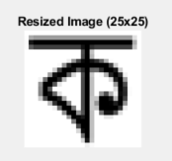
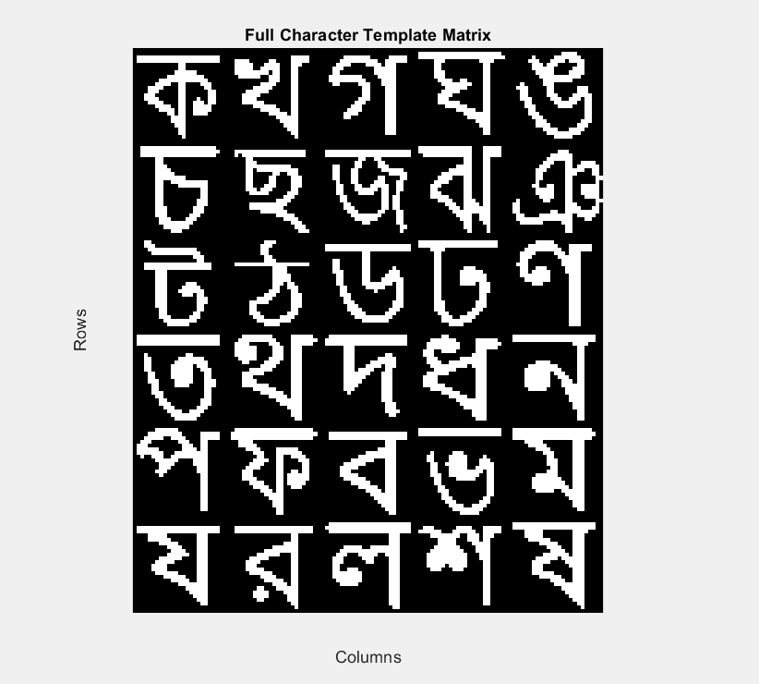
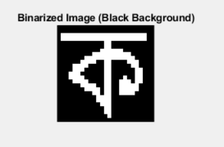
Framework
Input Image
Preprocessing (Grayscale, Resize, Binarize)
Template Creation
Test Generation (Noise)
NCC Template Matching
Performance Evaluation

Slide 10

Result

Slide 11
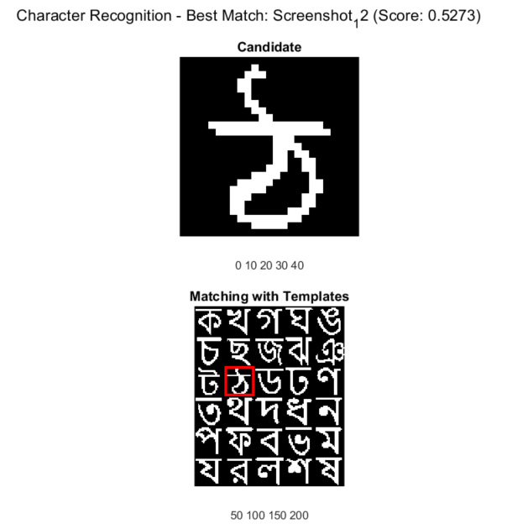
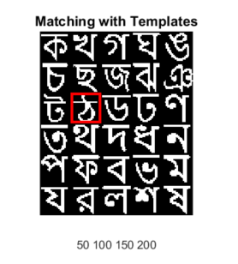
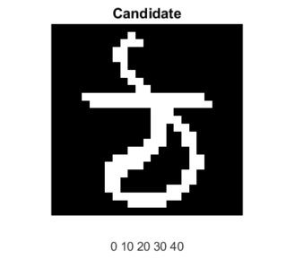
Result
Performance Matrix when dataset = sutonnymj (20 fonts)
 | Metric | Value
1 | Overall Accuracy | 13.91%
2 | Average Precision | 27.34%
3 | Average Recall | 13.91%
Performance Matrix when dataset = kalpurush (36 fonts)
 | Metric | Value
1 | Overall Accuracy | 21.85%
2 | Average Precision | 51.29%
3 | Average Recall | 21.85%

Slide 12
Conclusion

Slide 13




Conclusion
Pros: Simple NCC method, effective for clean templates.
Cons: Low accuracy with noise, small dataset (20 characters).
Suggestion: Expand dataset, refine NCC threshold.
Future Work: Integrate deep learning, multi-font support.

Slide 14

Reference

Slide 15
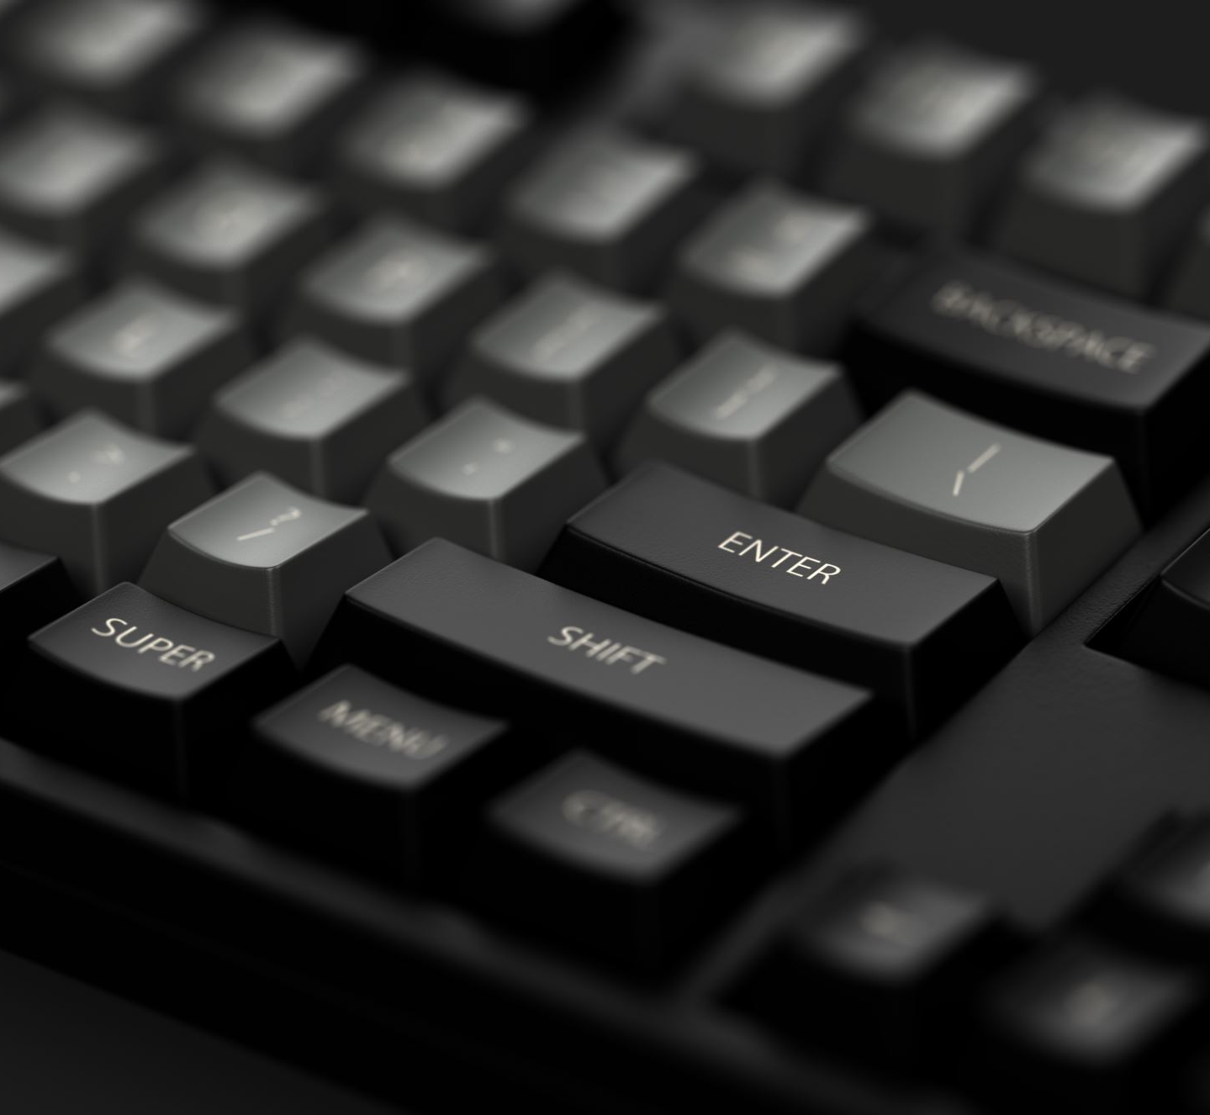
Reference
→ MATLAB Image Processing Toolbox: NCC Documentation.
→ Dataset: kalpurush font from Avro Keyboard, sutonnymj from Bijoy Keyboard, 20 characters.

Slide 16

Appendix

Slide 17

Appendix
CODE: https://github.com/ddpuc/PRL_project_bengali_ocr_MATLAB/tree/master

Slide 18
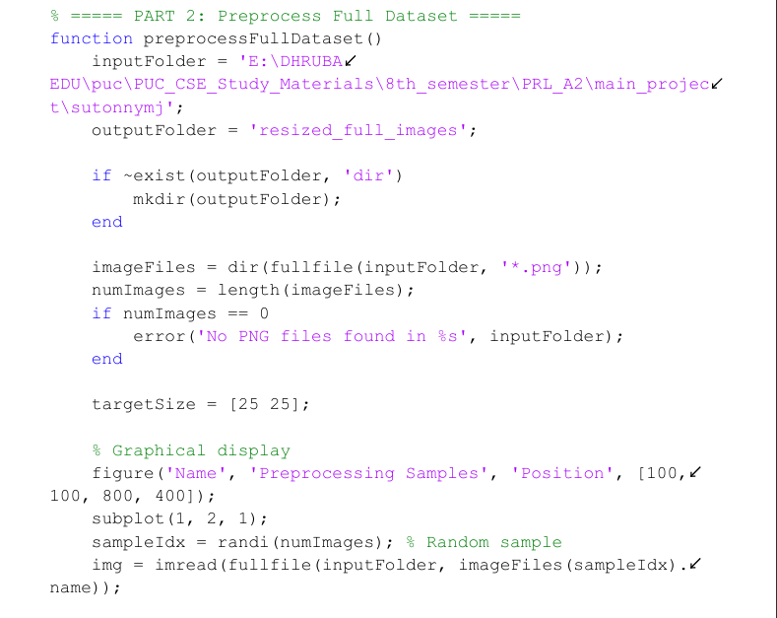
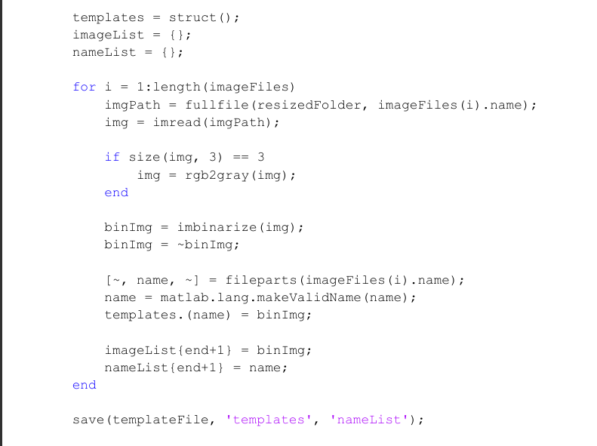

Slide 19

This Photo by Unknown Author is licensed under CC BY-SA

