Slide 1
Appium Samples In a Box
Architecture & Sequence Flow Diagrams
Generated from scripts/run_tests.py
Docker Container Integration
Digital.ai Testing Cloud Platform

Slide 2
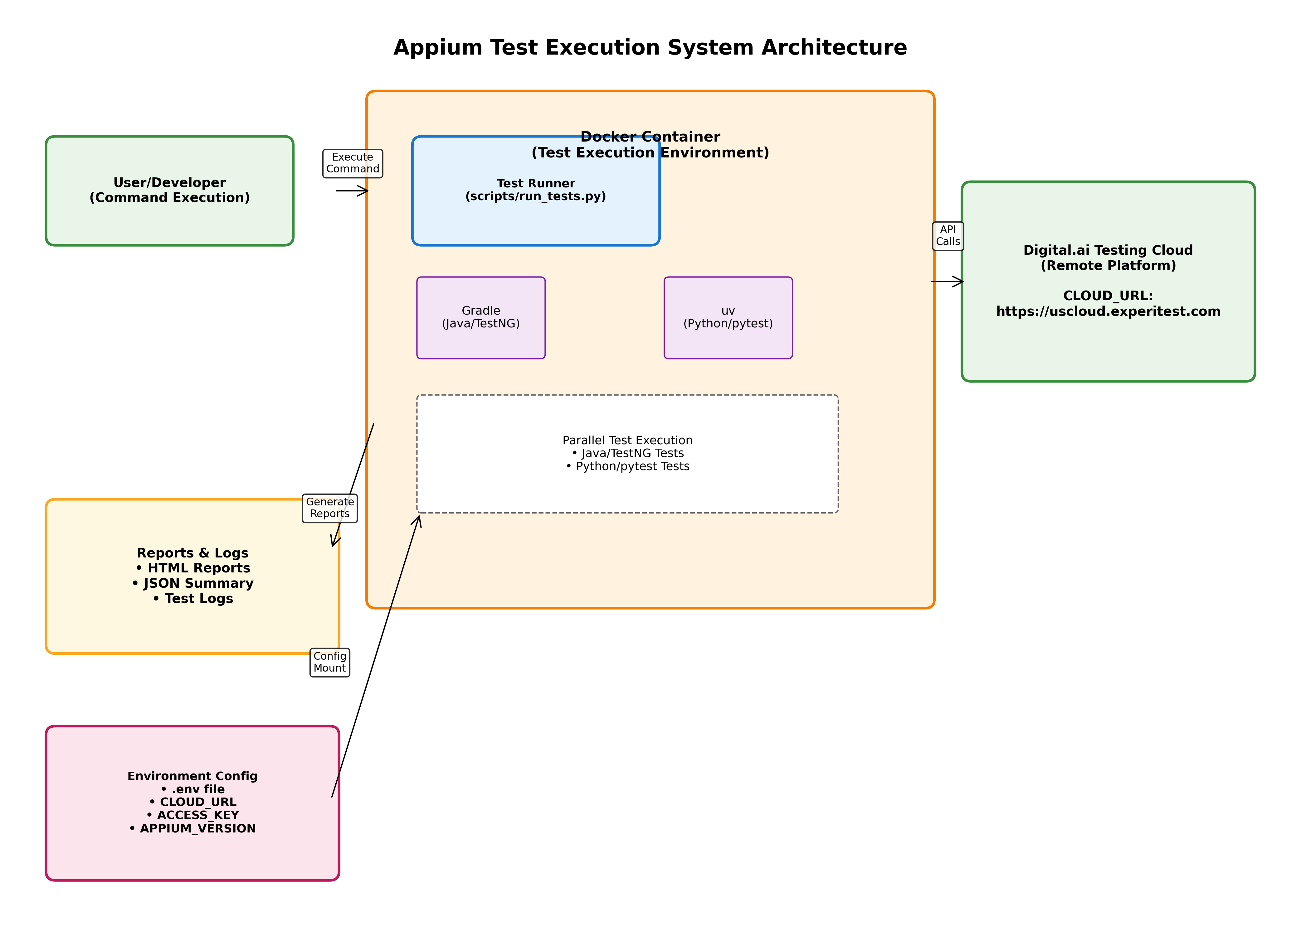
System Architecture Overview
Key Components: Test Runner (Python) • Docker Container • Build Tools (Gradle/uv) • Digital.ai Testing Cloud

Slide 3
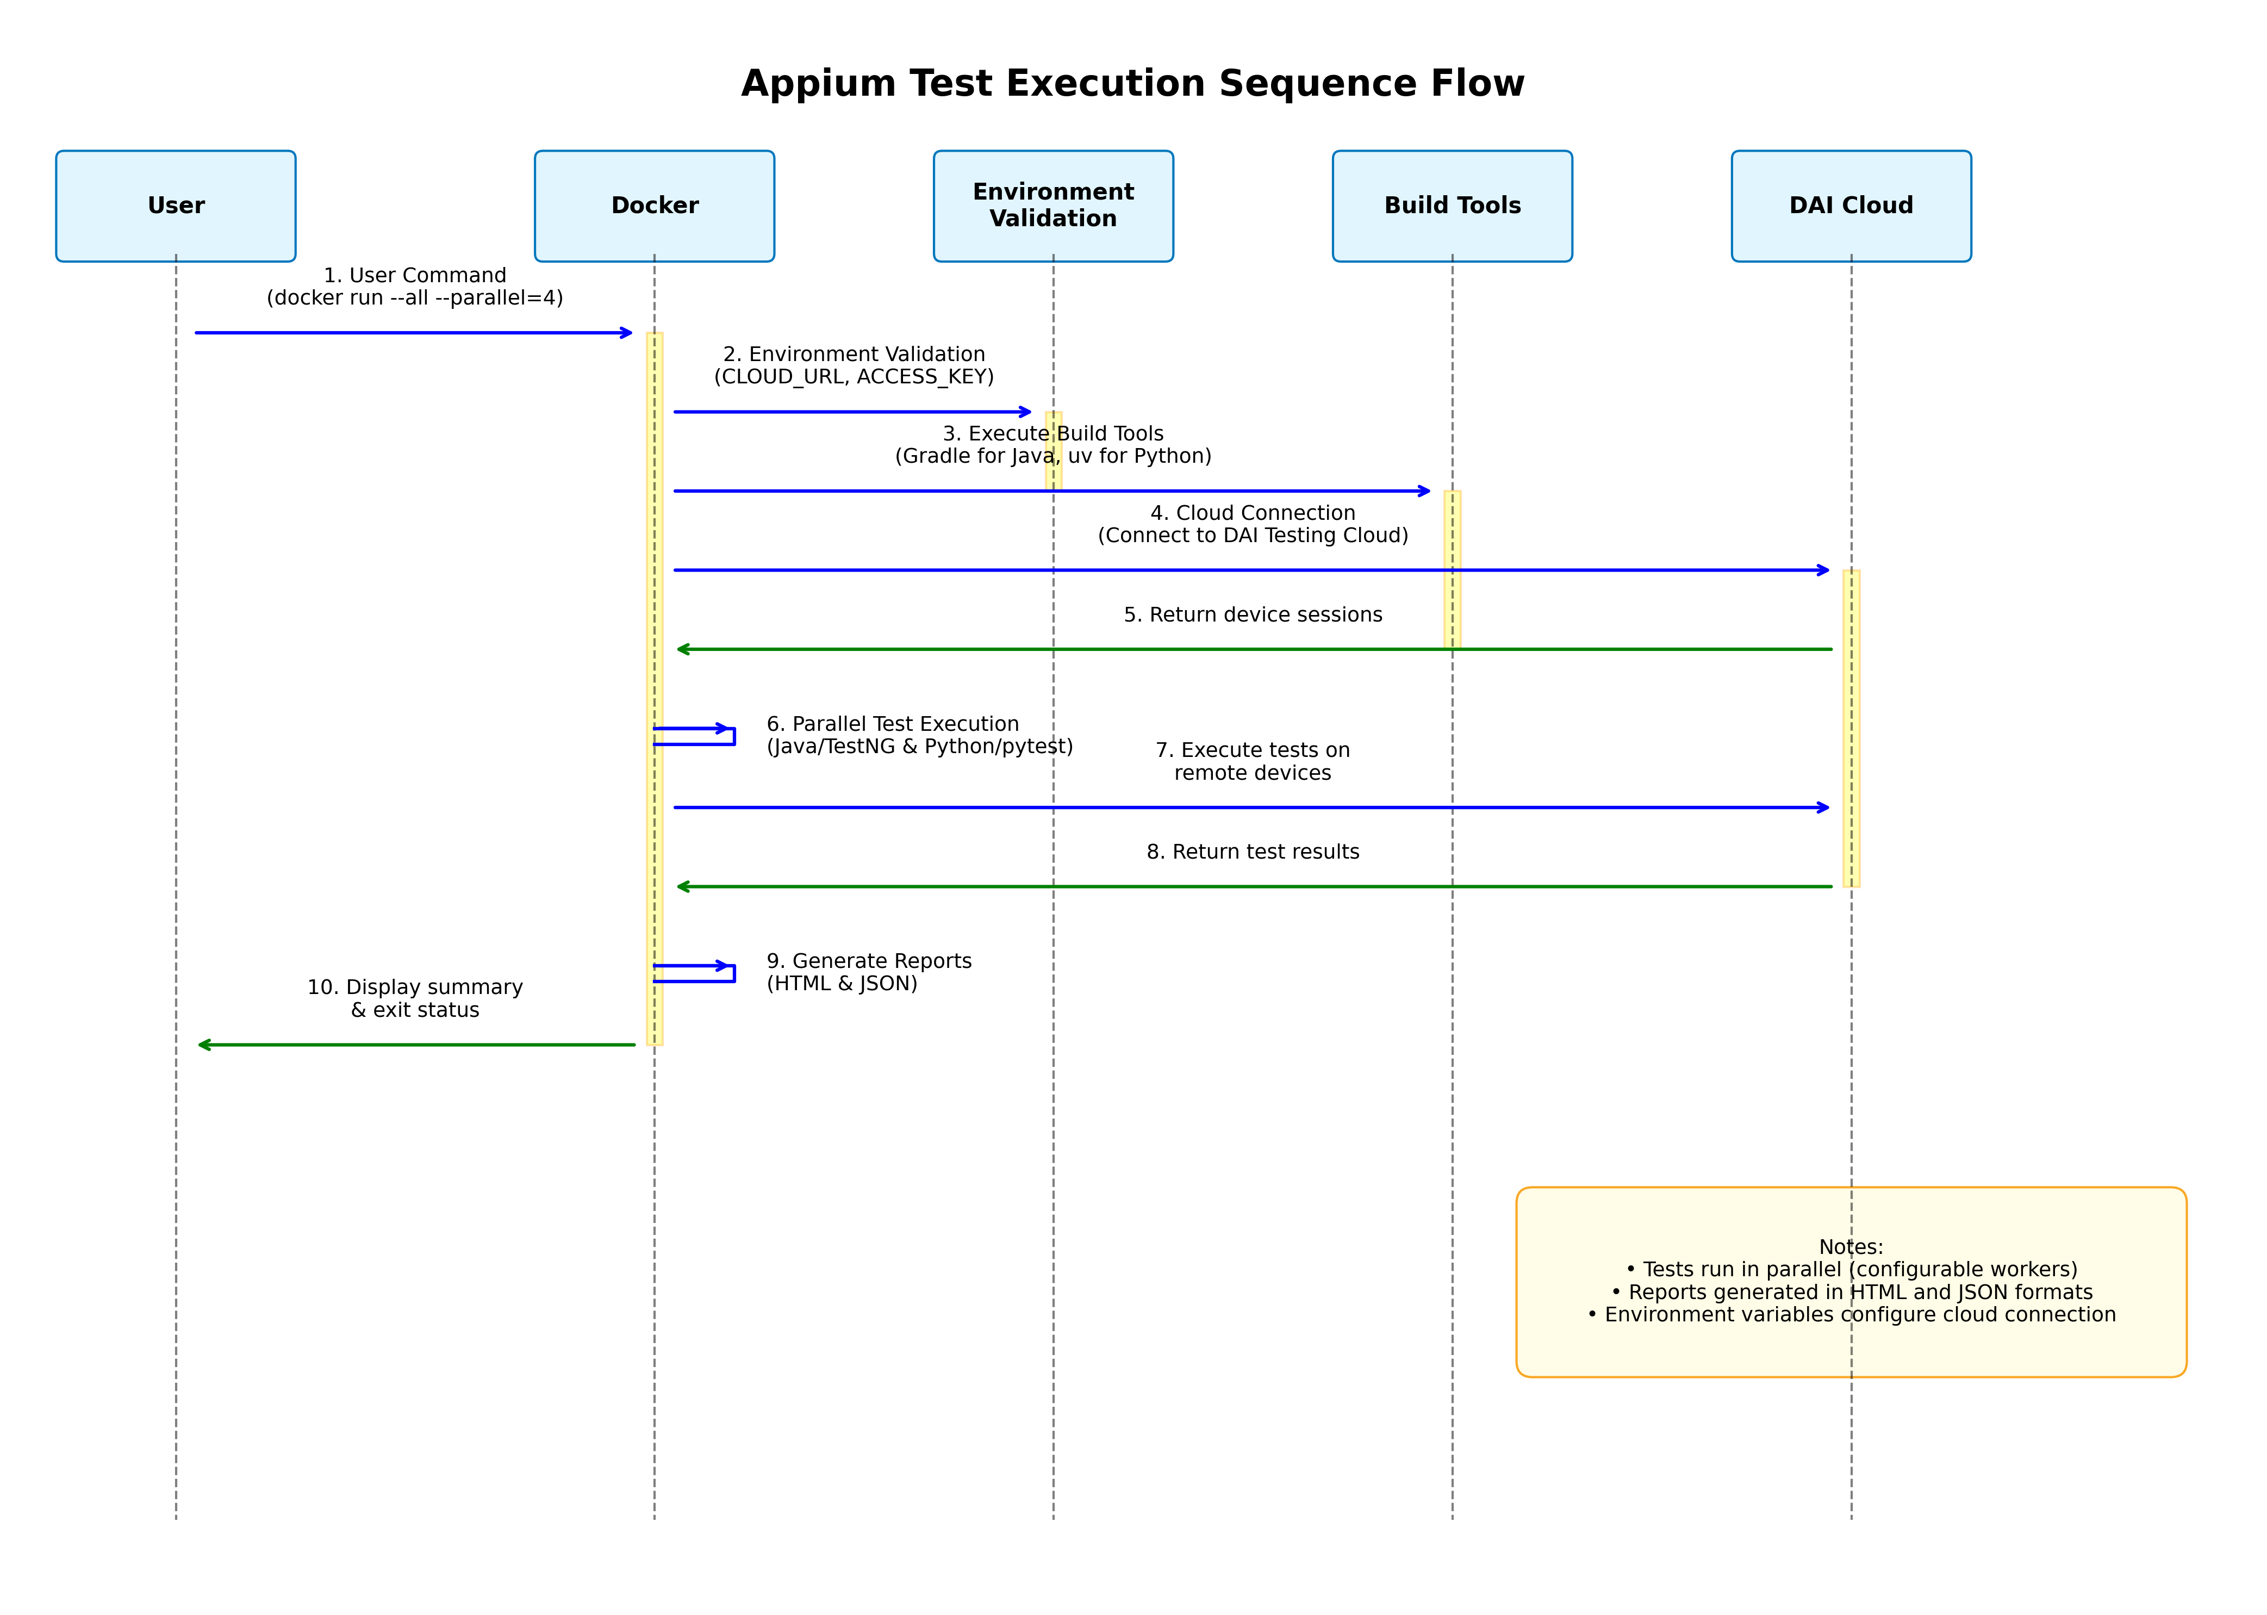
Test Execution Sequence Flow
Execution Flow: User Command → Environment Validation → Docker → Build Tools → Cloud Connection → Parallel Testing → Reports

Slide 4
Key Features & Configuration
🎯 Test Execution Features: • Parallel execution with configurable workers (default: 4) • Support for Java/TestNG and Python/pytest test suites • Docker containerized execution environment • HTML and JSON report generation • Real-time test output streaming 🔧 Environment Configuration: • CLOUD_URL: https://uscloud.experitest.com • ACCESS_KEY: Digital.ai Testing Cloud access key • APPIUM_VERSION: 2.0.0 (configurable) • ANDROID_DEVICE_QUERY: Device selection filters • IOS_DEVICE_QUERY: Device selection filters 🐳 Docker Integration: • Volume mounting for reports and logs persistence • Environment variable injection from .env file • Resource limits and parallel execution control • Separate dev and runtime container profiles 📊 Report Generation: • HTML test reports (Java & Python) • JSON summary with execution statistics • Test logs with timestamps • Mounted volumes for external access

