Slide 1
Helen: Maliciously Secure Coopetitive Learning for Linear Models
CS294 AI-Sys
Presented by Dylan Dreyer
April 10, 2019

Slide 2
Outline
Motivation + Problem Statement
Background + Threat Model
Overview of Helen + Key Features
Results
Discussion

Slide 3
Outline
Motivation + Problem Statement
Background + Threat Model
Overview of Helen + Key Features
Results
Discussion

Slide 4




Motivation #1
Model
Notes:
money laundering -> criminals move money back and forth
cannot share customers’ data in plaintext

Slide 5

Motivation #2
Model

Slide 6
Problem
“collaboratively train machine learning models on combined datasets for a common benefit”
“organizations cannot share their sensitive data in plaintext due to privacy policies and regulations or due to business competition”
Notes:
Collaboration is beneficial
higher quality models
enable new applications

Slide 7
Outline
Motivation + Problem
Background + Threat Model
Overview of Helen + Key Features
Results
Discussion

Slide 8
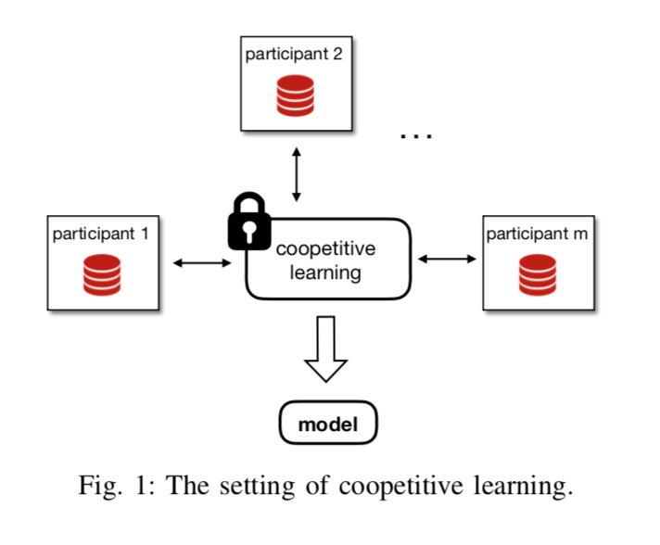
Background on Coopetitive Learning
Coopetitive -> cooperative and competitive
Secure multi-party computation (MPC)
inefficient
Previous works are limited
unrealistic threat models
limited to two parties
Notes:
General secure MPC is inefficient
inefficient -> the paper implements SGD using SPDZ (maliciously secure MPC library that they also use for Helen), and notes that for 4 parties, 100K data points per party, 90 features -> 3 months to train.
Previous works - homomorphic encryption, privacy preserving distributed computation
threat model is unrealistic -> rely on outsourcing to non-colluding servers, assume a passive attacker that doesn’t deviate from the protocol, base confidentiality of their data on correct behavior of others
limited because only involve two parties (SecureML), utilizes trusted hardware which opens up more avenues of vulnerability

Slide 9
Threat Model
malicious setting - only trust yourself!
all other parties can misbehave/be malicious during protocol
all parties agree on a functionality to compute
confidentiality of final model not protected

Slide 10
Background on Crypto Building Blocks
threshold partially homomorphic encryption
partially homomorphic
ex. Paillier -> Enc(X) * Enc(Y) = Enc(X+Y)
threshold
need enough shares of secret key to decrypt
zero knowledge proofs
prove that a certain statement is true without revealing the prover’s secret
secure multi party computation
jointly compute a function over inputs while keeping inputs private
SPDZ chosen over garbled circuits because matrix operations are more efficient
Notes:
Helen uses a threshold of all parties

Slide 11
Outline
Motivation + Problem
Background + Threat Model
Overview of Helen + Key Features
Results
Discussion

Slide 12
Overview of Helen
platform for maliciously secure coopetitive learning
supports regularized linear models
paper notes that these types of models are widely used
few organizations, lots of data, smaller number of features

Slide 13
Key Features of Helen
Overarching goal: Make expensive cryptographic computation independent of number of training samples
Make all parties commit to input dataset and prove it
Use ADMM (Alternating Direction Method of Multipliers)/LASSO
use partially homomorphic encryption to encrypt global weights such that each party can compute in a decentralized manner
5 phases
Agreement Phase
Initialization Phase
Input Preparation Phase
Model Compute Phase
Model Release Phase

Slide 14


Input Preparation Phase
Goal: broadcast encrypted summaries of data and commit
Why? Malicious parties could use inconsistent data during protocol
How? Encrypt data and attach various proofs of knowledge
Naive method: commit on input dataset
crypto computation scales linearly
requires complex matrix inversions in MPC
Notes:
zero knowledge proof proves that party knows value of data
commit to X_i and
after this, any party cannot use different inputs for the rest of the algorithm
each party stores the encrypted summaries from every other party -> paper notes this is viable due to summaries being much smaller than data

Slide 15

Input Preparation Phase
Goal: broadcast encrypted summaries of data and commit
Why? Malicious parties could use inconsistent data during protocol
How? Encrypt data and attach various proofs of knowledge
Better method: Decompose A and b via SVD
all of these matrices are dimension d, no longer n
Each party broadcasts encrypted A, b, y*, V, Σ, ϴ along with proofs of knowledge

Slide 16
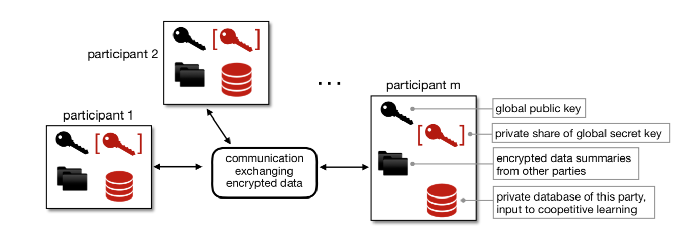
Input Preparation Phase
End of input preparation phase
Notes:
after this, any party cannot use different inputs for the rest of the algorithm
each party stores the encrypted summaries from every other party -> paper notes this is viable due to summaries being much smaller than data

Slide 17
Model Compute Phase
Goal: run ADMM algorithm iteratively and update encrypted global weights
Why ADMM?
efficient for linear models
converges in few iterations (10)
supports decentralized computation
reduces number of expensive MPC syncs
thus, efficient for cryptographic training
Notes:
SGD scales linearly with the number of samples

Slide 18
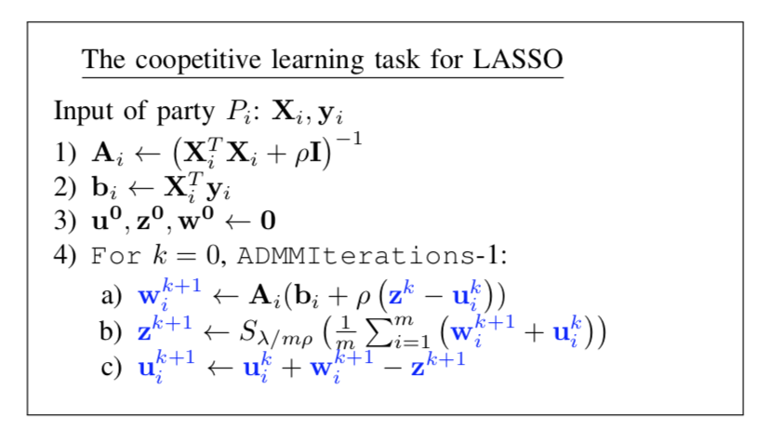
Model Compute Phase
Goal: run ADMM iteratively to update encrypted global weights
1. Local optimization
Each party calculates Enc(w_{i}^{k+1})
also generate a proof of this
2. Coordination using MPC
Parties use input summaries to verify Enc(w_{i}^{k+1})
Convert weights to MPC
Compute softmax via MPC
Convert z back into encrypted form

Slide 19
Model Release Phase
Goal: jointly decrypt and release model parameters (z)
ciphertext to MPC conversion
verify this conversion
jointly decrypt model parameters (z)

Slide 20
Outline
Motivation + Problem
Background + Threat Model
Overview of Helen + Key Features
Results
Discussion

Slide 21
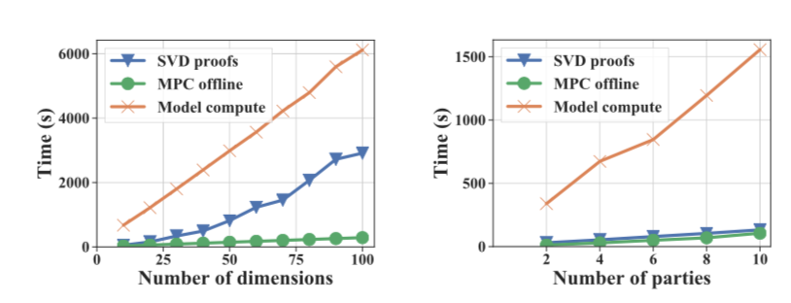
Results
Evaluation of runtime of Helen’s different phases using a synthetic dataset
Notes:
SVD, although it operates on n, the number of features, is fast due to operating on plaintext data

Slide 22
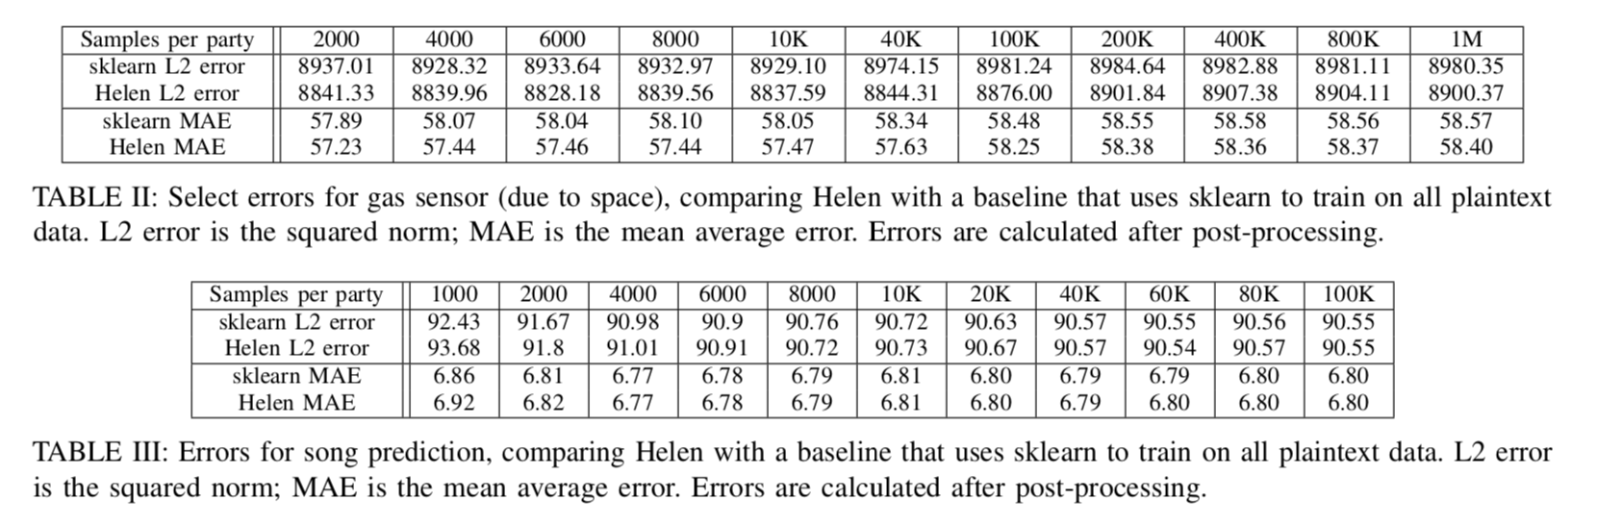
Results
Notes:
used sklearn on plaintext data instead of SGD because does not compile on large instances
maybe would have liked to see comparison of using same algorithm as Helen/using SGD

Slide 23
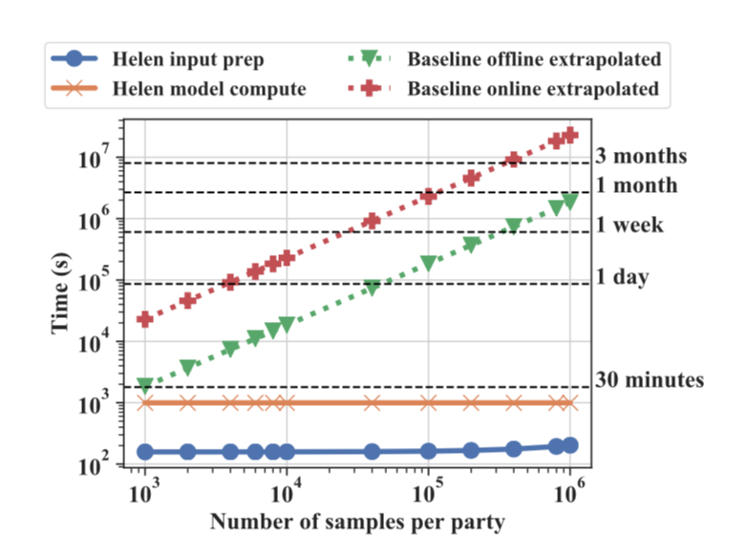
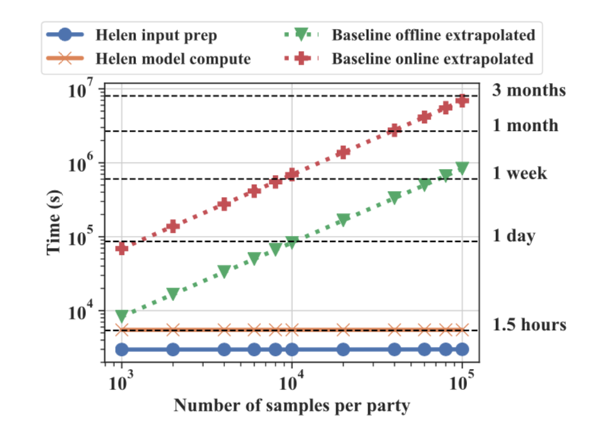
Results
Notes:
Helen vs. SGD baseline
Helen achieves orders of magnitude faster training time
Helen input prep very slow to scale -> only part that scales is plaintext SVD calculation
would have been nice to test against other baselines as well
would have been nice to see error compared to SGD baseline

Slide 24
Outline
Motivation + Problem
Background + Threat Model
Overview of Helen + Key Features
Results
Discussion

Slide 25
Discussion
Is there a need to extend to other types of models? Consequences of this?
Trusted hardware (enclaves) is another popular approach to computing on sensitive data. Is it more viable?
What happens when more parties get involved? Comparison vs. federated learning?
Questions?

