Slide 1
Prototype Testing (Customer Discovery)
Dr. Glory Aguzman, S.Sos, M.M., CDMS, CCP

Slide 2
Subtopics
Create Video Interview
Prototype Testing (Customer Discovery)
Student Activities
Next Session Preparation

Slide 3
Acknowledgement
Michael Lewrick, Patric Link, Larry Leifer (2018) The Design Thinking Playbook – Mindful Digital Transformation of teams, products, services, Businesses And Ecosystems, Wiley, P121-123

Slide 4
Learning Outcome
LO1: Create a prototype relevant to market needs.
LO2: Test the prototype to assess business potential.

Slide 5
Prototype Testing (Customer Discovery)
Prepare several prototype versions
Decide the team roles:
Moderator: explains the context and asks questions.
Actor: plays a role in the scenario.
Observer: observes and records the results.
Questions for User
1. Questions about the user experience
“How does it feel when using this product?”
“Is it easy to use?”
“Which part do you find most interesting or enjoyable?”
2. Questions about user actions
“Why did you choose to press/slide/select that part?”
“What did you expect to happen when you did that?”
“Which part made you feel confused?”
3. Questions about usefulness
“Do you think this product helps with your needs?”
“In what situations would you use this product?”
“What is the biggest benefit you feel from this product?”
4. Questions for suggestions
“What should we improve?”
“If you could change one thing about this product, what would it be?”

Slide 6
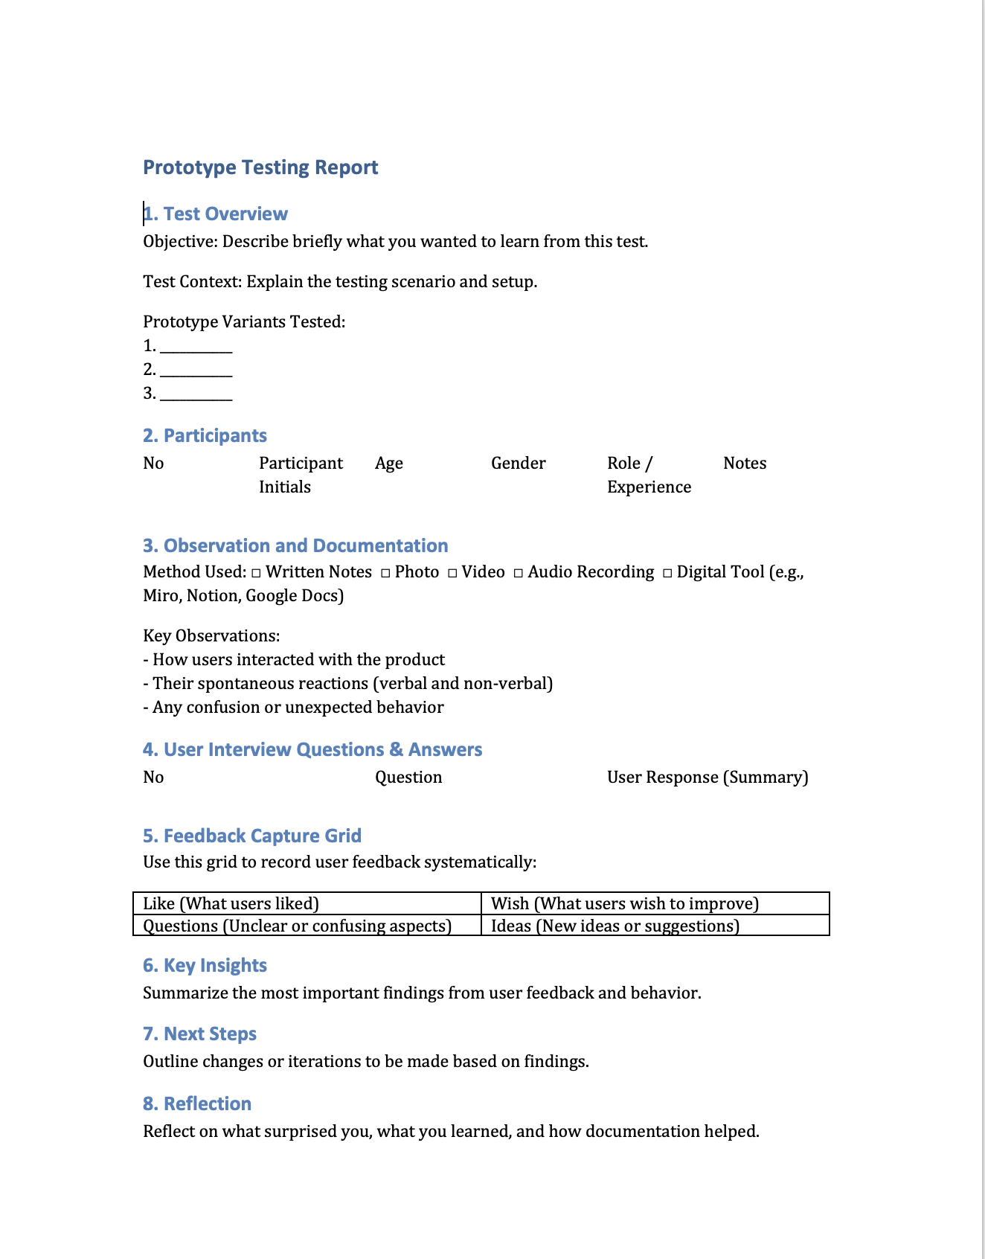
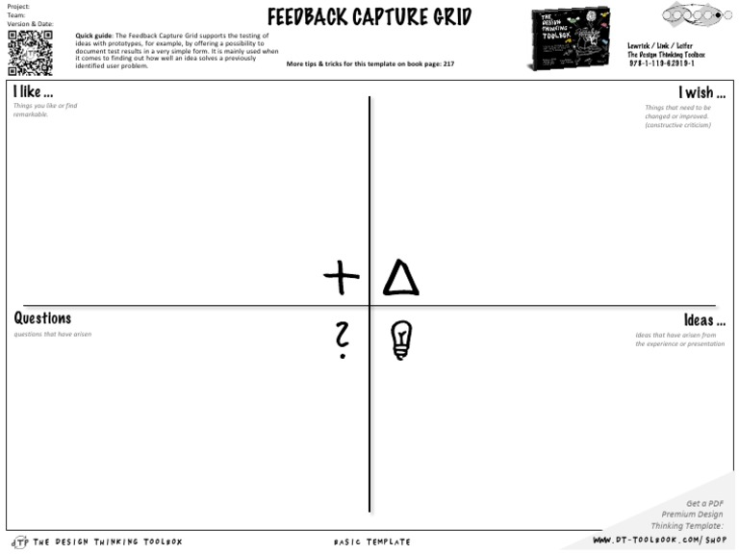
Prototype Testing Report

Slide 7
Student Activities
Prototyping Testing
Prototype Testing Report

Slide 8
Next Session Preparation
Student Video Interview Presentation
Product or Service Demonstration
Create a Feedback Capture Grid
Present the Feedback Grid
Prototype Iteration and Feedback Session
Design Iteration

Slide 9
REFERENCES
Michael Lewrick, Patric Link, Larry Leifer (2018) The Design Thinking Playbook – Mindful Digital Transformation of teams, products, services, Businesses And Ecosystems, Wiley

