Slide 1




Mobile Application Development
Produced
by
Dave Drohan (david.drohan@setu.ie)
Department of Computing & Mathematics
South East Technological University Waterford, Ireland
Updated & Delivered
by
Gongzhe Qiao (003969@nuist.edu.cn)
Department of Computer Science
Nanjing University of Information Science and Technology Nanjing, China
nuist.edu.cn
setu.ie

Slide 2
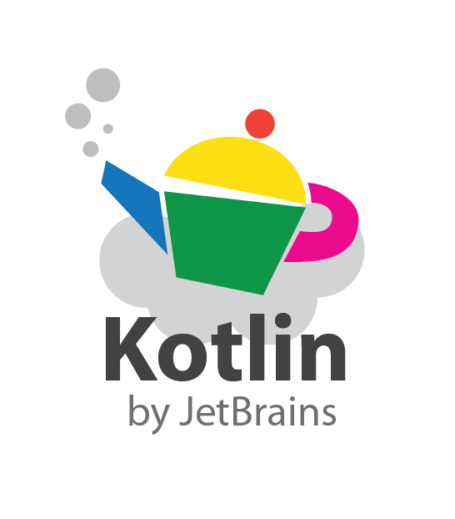
Introducing Kotlin
Overview – Part 1

Slide 3
Agenda
What is Kotlin?
Context - Java Vs JVM
Kotlin History
Milestones
General Overview & Features
Kotlin & IntelliJ IDEA
Conclusion

Slide 4
Agenda
What is Kotlin?
Context - Java Vs JVM
Kotlin History
Milestones
General Overview & Features
Kotlin & IntelliJ IDEA
Conclusion

Slide 5
What is Kotlin?
A (relatively) new statically-typed language from JetBrains (creators of IntelliJ IDEA which it works seamlessly with)
Tries to fix many of Java’s shortcomings
Compiles to JVM bytecode, JavaScript and Kotlin native
Created with focus on Java interoperability – Kotlin and Java classes can be used together in a project
Gained a lot more traction and is being increasingly adopted (see later slides)
Has very good support from JetBrains, an established company, who use Kotlin to develop their own products

Slide 6
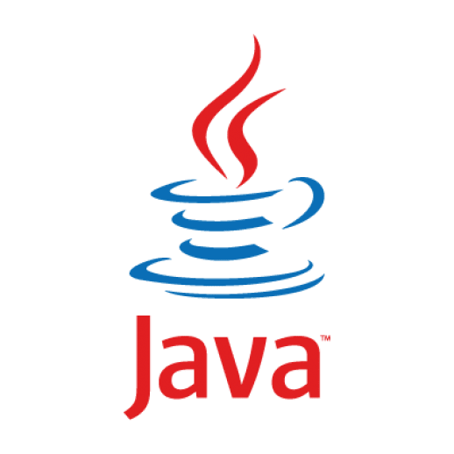
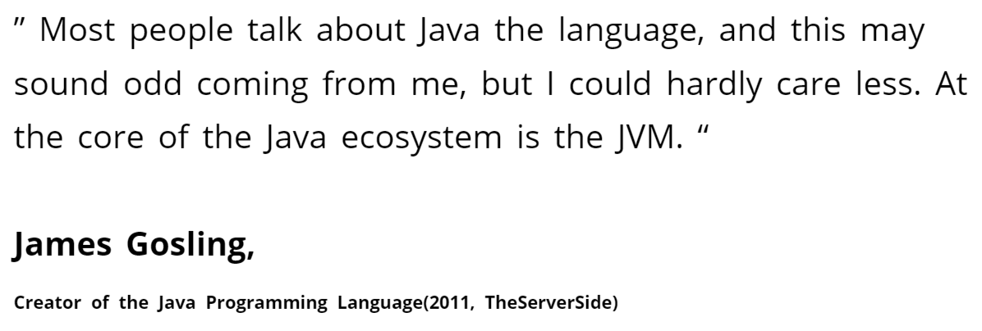

Context - JAVA Vs JVM

Slide 7
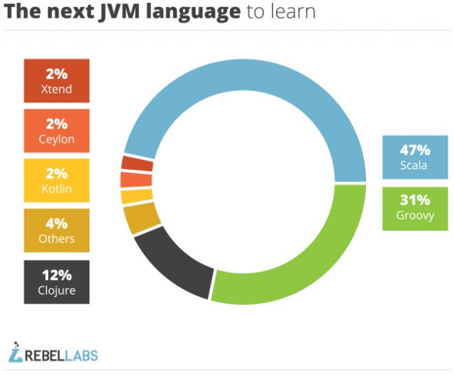

https://zeroturnaround.com/rebellabs/a-month-of-jvm-languages-groovy-ceylon-kotlin-and-scala/

Slide 8
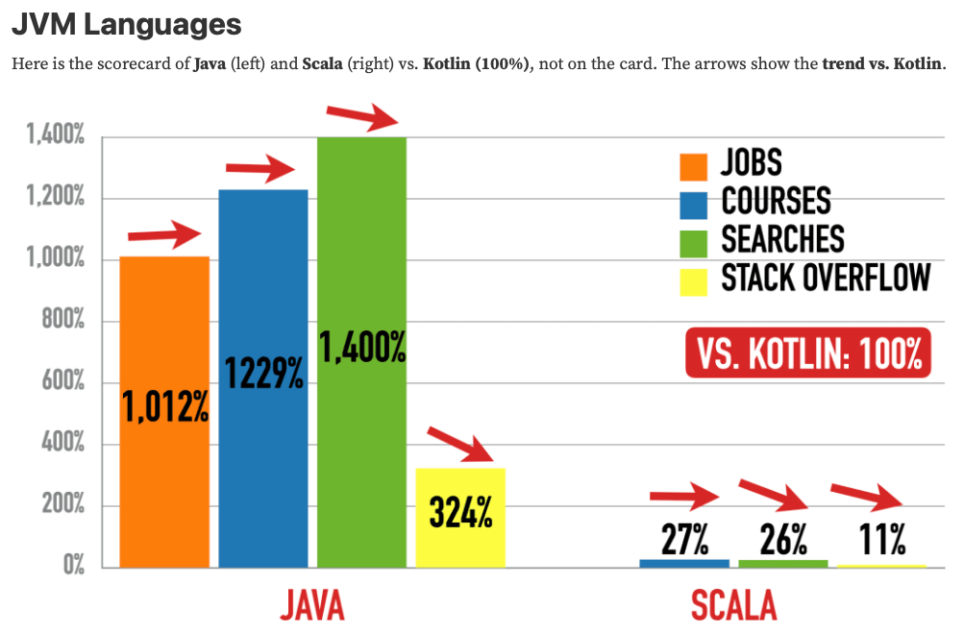
Q1/2024
https://betterprojectsfaster.com/guide/java-tech-popularity-index-2024-q1/main/#jvm-languages
Notes:
Scorecard started Nov 2022

Slide 9
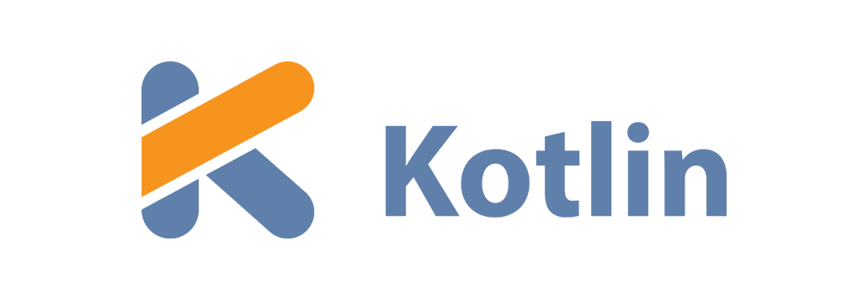
History of
In July 2011 JetBrains started Project Kotlin, a new language for the JVM, which had been under development for a year.
JetBrains hoped that the new language would drive IntelliJ IDEA sales.
Kotlin v1.0 released on February 15, 2016.
In May 2017 Google make an announcement that changes the Kotlin roadmap completely

Slide 10
April 21st 2017

Slide 11
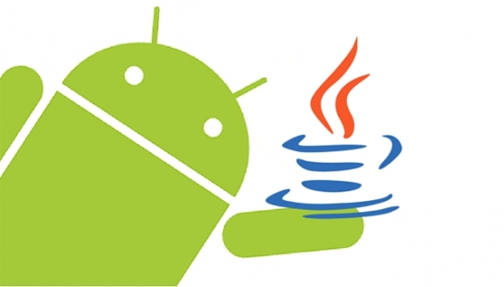
“Java is the primary and official language for Android development, but that doesn’t mean it is the best or the only choice.” “To give Java credit, it is a robust language that has been around for a while, but it comes with a specific set of challenges that can be a deterrent for developers.” “A new breed of modern JVM languages is slowly gaining traction within the Android community, and Kotlin is leading the pack.”
Dzone Article (Why You Should Consider Kotlin For Android Development)
Source: Dzone, April 21st 2017
Notes:
All the Boilerplate Java code is an issue for developers in Android Development

Slide 12
May 17th 2017

Slide 13
Google I/O 2017 - Google announces that Kotlin would receive first-class support for Android development

Slide 14
JetBrains Posted (same day) ….
“For Android developers, Kotlin support is a chance to use a modern and powerful language, helping solve common headaches such as runtime exceptions and source code verbosity.
Kotlin is easy to get started with and can be gradually introduced into existing projects, which means that your existing skills and technology investments are preserved.”
“Starting now, Android Studio 3.0 ships with Kotlin out of the box, meaning Android developers no longer need to install any extras or worry about compatibility. It also means that moving forward, you can rest assured that both JetBrains and Google will be supporting Android development in Kotlin.”
https://blog.jetbrains.com/kotlin/2017/05/kotlin-on-android-now-official/
Notes:
Kotlin is interoperable with Java – you don’t have to ‘bin’ all your Java code to make the changeover

Slide 15
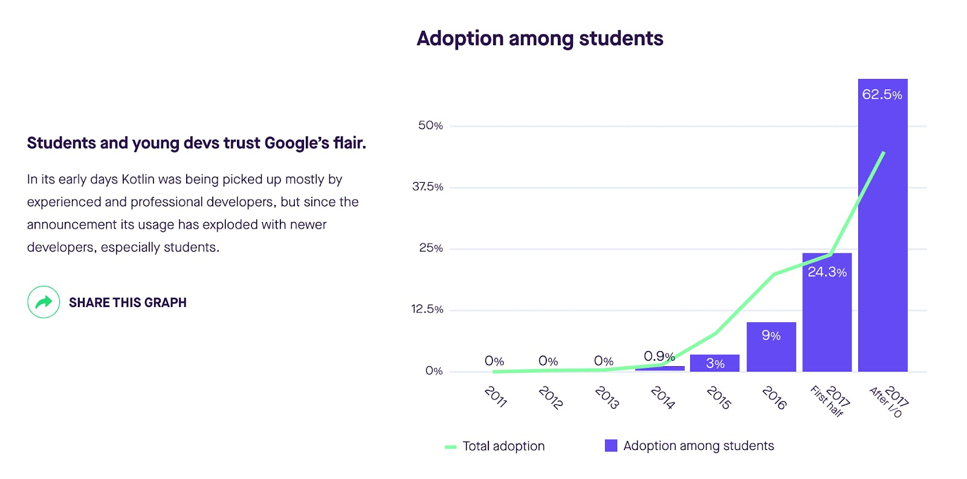
Many companies like Netflix, Uber, Trello, Pinterest etc. are using Kotlin (along with other programming languages) to create applications.
https://hackernoon.com/rise-of-kotlin-the-programming-language-for-the-next-generation-27beeb529204

Slide 16
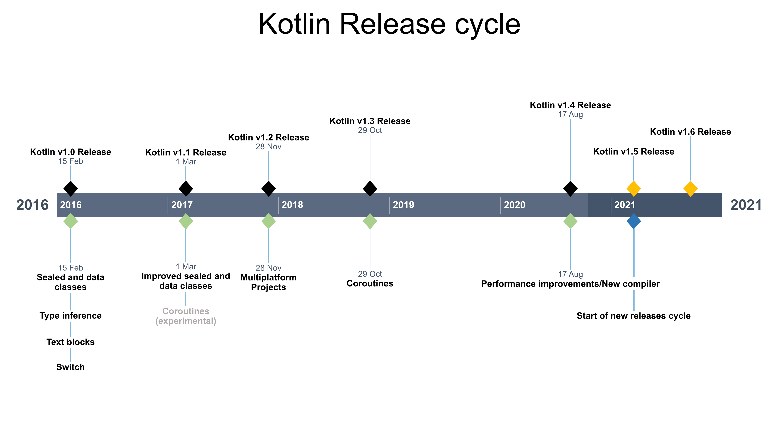

Kotlin v1.7 Release
Kotlin v1.9 Release
2024
2022 2023
Kotlin v1.8 Release
Kotlin v2.0 Release
Notes:
V2.0.0 May 21st 2024

Slide 17
Current State of Kotlin
Google estimates that 70% of the top 1,000 apps on the Play Store are written in Kotlin, including 60 of Google's own apps, such as Maps and Drive. JetBrains, the developer of Kotlin, reckons that 95% of the top 1,000 Android apps include some Kotlin code.
https://www.dice.com/career-advice/state-of-kotlin-in-2024#:~:text=Google%20estimates%20that%2070%20percent,apps%20include%20some%20Kotlin%20code.
Notes:
May 30th 2024

Slide 18
Agenda Recap
What is Kotlin?
Context - Java Vs JVM
Kotlin History
Milestones
General Overview & Features
Kotlin & IntelliJ IDEA
Conclusion

Slide 19



