Slide 1




Mobile Application Development
Produced
by
Dave Drohan (david.drohan@setu.ie)
Department of Computing & Mathematics
South East Technological University Waterford, Ireland
Updated & Delivered
by
Gongzhe Qiao (003969@nuist.edu.cn)
Department of Computer Science
Nanjing University of Information Science and Technology Nanjing, China
nuist.edu.cn
setu.ie

Slide 2

Introducing Kotlin
Overview – Part 2

Slide 3
Agenda
What is Kotlin?
Context - Java Vs JVM
Kotlin History
Milestones
General Overview & Features
Kotlin & IntelliJ IDEA
Conclusion

Slide 4
Agenda
What is Kotlin?
Context - Java Vs JVM
Kotlin History
Milestones
General Overview & Features
Kotlin & IntelliJ IDEA
Conclusion

Slide 5

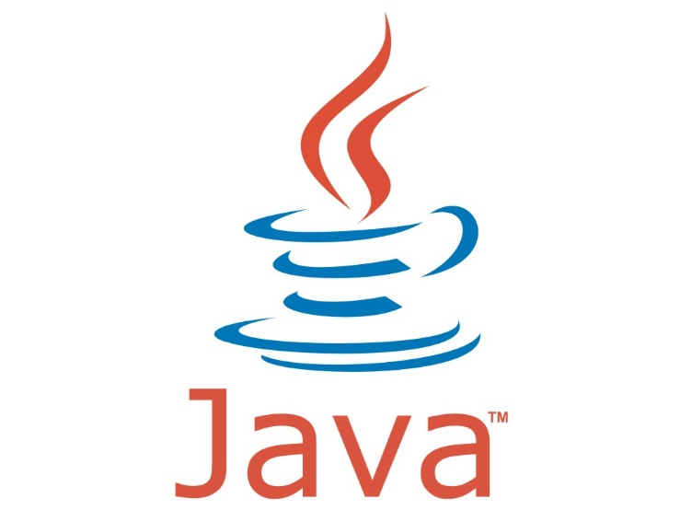
Kotlin Overview

Slide 6
Based on : https://en.wikipedia.org/wiki/Kotlin_(programming_language)
runs on Java Virtual Machine (JVM).
is an evolution of the Java syntax but is more concise and has cleaner syntax.
is not syntax compatible with Java; but is interoperable with Java.
relies on some Java Class Libraries e.g. Collections framework.
is a statically-typed programming language.
offers null safety.

Slide 7
Based on : https://en.wikipedia.org/wiki/Kotlin_(programming_language)
runs on Java Virtual Machine.
is an evolution of the Java syntax but is more concise and has cleaner syntax.
is not syntax compatible with Java; but is interoperable with Java.
relies on some Java Class Libraries e.g. Collections framework.
is a statically-typed programming language.
offers null safety.

Slide 8
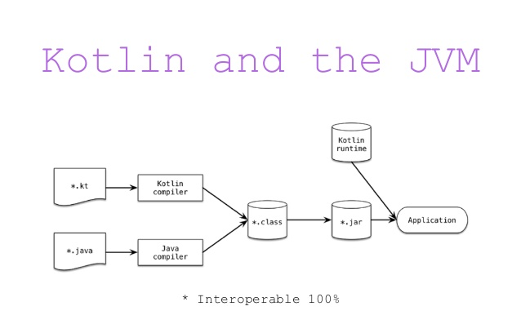
Runs on Java Virtual Machine
Kotlin compiles to JVM ByteCode (like Java)
Note: Kotlin also compiles to JavaScript

Slide 9
Based on : https://en.wikipedia.org/wiki/Kotlin_(programming_language)
runs on Java Virtual Machine.
is an evolution of the Java syntax but is more concise and has cleaner syntax.
is not syntax compatible with Java; but is interoperable with Java.
relies on some Java Class Libraries e.g. Collections framework.
is a statically-typed programming language.
offers null safety.

Slide 10
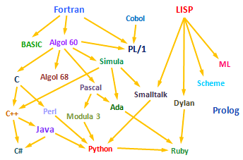
JVM Language Evolution
Objective-C
Scala
Groovy
Swift
Xtend
Go
Kotlin

Slide 11
Kotlin (Concise) Vs Java (Overly Verbose)
Rough estimates indicate approximately a 40% cut in the number of lines of code.
https://kotlinlang.org/docs/reference/faq.html

Slide 12
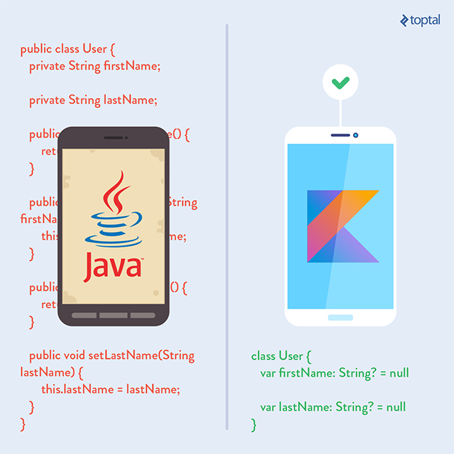
Kotlin (Concise) Vs Java (Overly Verbose)
Kotlin drastically reduces the amount of boilerplate code you have to write.
The less code you write, the fewer mistakes you make, the less to test, the better the execution.

Slide 13
Easy(ish) learning curve for Java Developers
“Kotlin is approachable and can be acquired in a few hours by simply reading the language reference. It has a lean and intuitive syntax.”
“Kotlin is also designed to have a gentle learning path for Java developers. Java programmers will find that most of the Kotlin syntax feels familiar.”
https://dzone.com/articles/why-you-should-consider-kotlin-for-android-develop?fromrel=true
Notes:
Kotlin is borne out of Java and a bit of Swift and can be picked up easily, especially by Java developers as it’s quite similar – we’ll look at the syntax itself in later slides

Slide 14
Based on : https://en.wikipedia.org/wiki/Kotlin_(programming_language)
runs on Java Virtual Machine.
is an evolution of the Java syntax but is more concise and has cleaner syntax.
is not syntax compatible with Java; but is interoperable with Java.
relies on some Java Class Libraries e.g. Collections framework.
is a statically-typed programming language.
offers null safety.

Slide 15
Kotlin / Java Interoperability
Kotlin and Java are 100% interoperable; Java and Kotlin code can co-exist very well in the same project and compile perfectly.
Kotlin can be called from Java and Java from Kotlin.
Both .java and .kt files are compiled to .class bytecode.
When a project containing both Java and Kotlin is compiled, it would be difficult to tell which parts were created in Java and which in Kotlin.
You can start using Kotlin in an existing Java project, without having to convert the project to Kotlin (no need to bin all your Java code!)
https://dzone.com/articles/why-you-should-consider-kotlin-for-android-develop?fromrel=true

Slide 16
Based on : https://en.wikipedia.org/wiki/Kotlin_(programming_language)
runs on Java Virtual Machine.
is an evolution of the Java syntax but is more concise and has cleaner syntax.
is not syntax compatible with Java; but is interoperable with Java.
relies on some Java Class Libraries e.g. Collections framework.
is a statically-typed programming language.
offers null safety.

Slide 17
Kotlin and the Java Class Libraries
Interoperability advantages:
you can use any of the vast number of Java Libraries and Frameworks in a Kotlin project.
Kotlin can also easily integrate with Maven, Gradle and other build systems.
https://dzone.com/articles/why-you-should-consider-kotlin-for-android-develop?fromrel=true
https://www.xenonstack.com/blog/overview-of-kotlin-comparison-between-kotlin-java

Slide 18
Based on : https://en.wikipedia.org/wiki/Kotlin_(programming_language)
runs on Java Virtual Machine.
is an evolution of the Java syntax but is more concise and has cleaner syntax.
is not syntax compatible with Java; but is interoperable with Java.
relies on some Java Class Libraries e.g. Collections framework.
is a statically-typed programming language.
offers null safety.

Slide 19
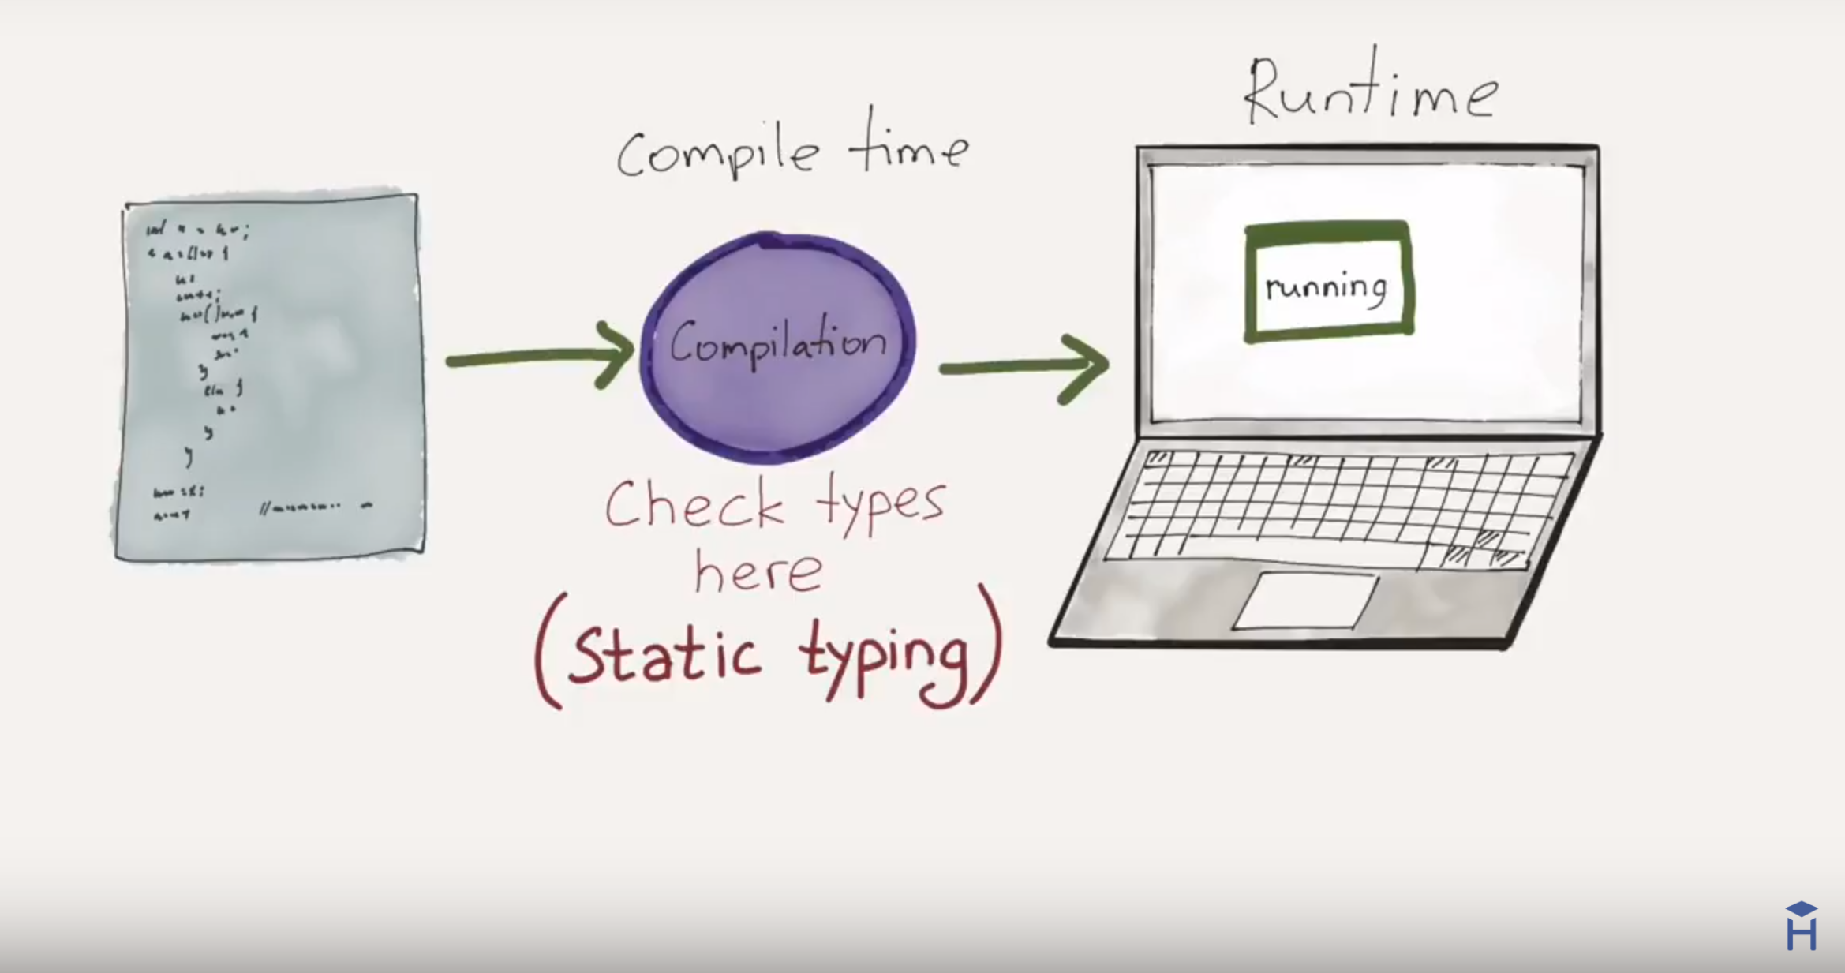

STATIC TYPING
“Variable declarations are mandatory before usage,
else results in a compile-time error"

Slide 20
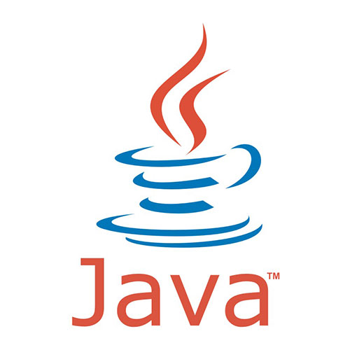
Static Typing – Example
String greeting = "Hello!";
int someRandomInteger = 100;
double aDoubleVariable = 2.2;
In Java, if we don’t assign a type, we get a compiler error → Java is statically typed.
Types determine the operations we can perform on the variables.
A type is assigned to each variable.
https://howtoprogramwithjava.com/dynamic-typing-vs-static-typing/

Slide 21
Static Typing – Example
fun main(args : Array<String>)
{
var someRandomInteger = 100
var aDoubleVariable = 2.2
println (someRandomInteger)
println (aDoubleVariable)
}
In Kotlin, you don’t have to (but still can!) specify the type of each variable explicitly, even though Kotlin is statically-typed.
Here, Kotlin determines the type from the initialisation.
http://petersommerhoff.com/dev/kotlin/kotlin-for-java-devs/#type-inference

Slide 22
Static Typing – Example
fun main(args : Array<String>)
{
var someRandomInteger : Int = 100
var aDoubleVariable : Double = 2.2
println (someRandomInteger)
println (aDoubleVariable)
}
However, you can choose to explicitly define a data type.

Slide 23
Static Typing – Example
fun main(args : Array<String>)
{
var someRandomInteger //compile error
var aDoubleVariable : Double = 2.2
println (someRandomInteger)
println (aDoubleVariable)
}
With Kotlin, you have to either define a type or initialise the variable (kotlin then determines the type!).

Slide 24
Static Typing – Example
fun main(args : Array<String>)
{
var someRandomInteger : Int = 100
var aDoubleVariable : Double = 2.2
someRandomInteger = 2.65 //compile error
aDoubleVariable = 233 //compile error
println (someRandomInteger)
println (aDoubleVariable)
}
http://petersommerhoff.com/dev/kotlin/kotlin-for-java-devs/#type-inference

Slide 25
Based on : https://en.wikipedia.org/wiki/Kotlin_(programming_language)
runs on Java Virtual Machine.
is an evolution of the Java syntax but is more concise and has cleaner syntax.
is not syntax compatible with Java; but is interoperable with Java.
relies on some Java Class Libraries e.g. Collections framework.
is a statically-typed programming language.
offers null safety.

Slide 26
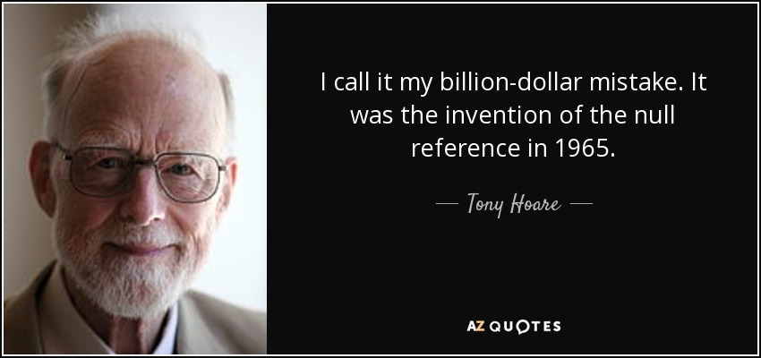
Aside - Null (The Billion Dollar Mistake)
- who developed the sorting algorithm: QuickSort
Notes:
So costly due to the number of lines of java code written to handle Null reference errors (NPEs)

Slide 27
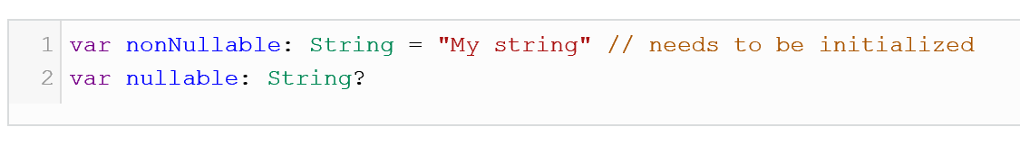
Kotlin and Null Safety
Kotlin eliminates most sources of null references by making all types non-nullable by default — meaning that the compiler won’t let you use a non-initialized, non-nullable variable.
If you need a variable to hold a null value, you have to declare the type as nullable by adding a question mark after the type (more on this in later lectures).
Source: https://dzone.com/articles/kotlin-vs-java-first-impressions-using-kotlin-for

Slide 28
Agenda Recap
What is Kotlin?
Context - Java Vs JVM
Kotlin History
Milestones
General Overview & Features
Kotlin & IntelliJ IDEA
Conclusion

Slide 29



