Slide 1




Mobile Application Development
Produced
by
Dave Drohan (david.drohan@setu.ie)
Department of Computing & Mathematics
South East Technological University Waterford, Ireland
Updated & Delivered
by
Gongzhe Qiao (003969@nuist.edu.cn)
Department of Computer Science
Nanjing University of Information Science and Technology Nanjing, China
nuist.edu.cn
setu.ie

Slide 2

Introducing Kotlin Syntax - Part 1.1

Slide 3
Agenda
Basic Types
Local Variables (val & var)
Functions
Control Flow (if, when, for, while)
Strings & String Templates
Ranges (and the in operator)
Type Checks & Casts
Null Safety
Comments

Slide 4
Agenda
Basic Types
Local Variables (val & var)
Functions
Control Flow (if, when, for, while)
Strings & String Templates
Ranges (and the in operator)
Type Checks & Casts
Null Safety
Comments

Slide 5
Basic Types
Numbers, Characters & Booleans

Slide 6

Basic Types
In Kotlin, everything is an object in the sense that we can call member functions and properties on any variable.
Notes:
In Java we would have had primitives and objects, but Kotlin is just all objects

Slide 7
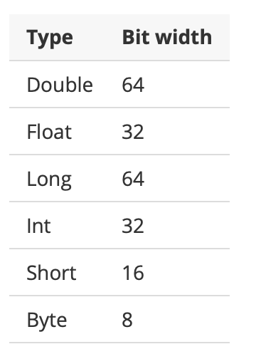
Basic Types – Numbers

Slide 8
Basic Types – Numbers
val doubleNumber: Double = 100.45
val floatNumber: Float = 100.45f
val longNumber: Long = 100L
val intNumber: Int = 100
val shortNumber: Short = 100
val byteNumber: Byte = 100
Explicitly defining a numeric type
Notes:
Remember Kotlin is Statically typed so you must provide either Type or a value

Slide 9
Basic Types – Numbers
val doubleNumber = 100.45
val floatNumber = 100.45f
val longNumber = 100L
val intNumber = 100
val shortNumber = 100
val byteNumber = 100
Type Inference

Slide 10
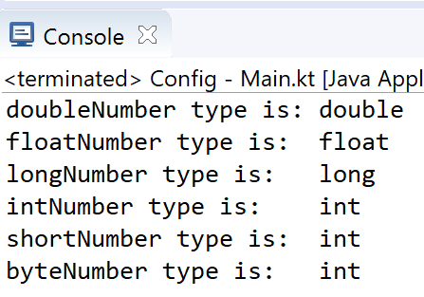
Basic Types – Numbers
val doubleNumber = 100.45
val floatNumber = 100.45f
val longNumber = 100L
val intNumber = 100
val shortNumber = 100
val byteNumber = 100
Type Inference
println("doubleNumber type is: " + doubleNumber.javaClass)
println("floatNumber type is: " + floatNumber.javaClass)
println("longNumber type is: " + longNumber.javaClass)
println("intNumber type is: " + intNumber.javaClass)
println("shortNumber type is: " + shortNumber.javaClass)
println("byteNumber type is: " + byteNumber.javaClass)

Slide 11
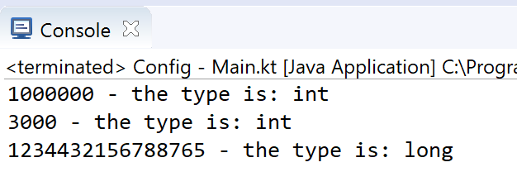
Basic Types – Numbers
val oneMillion = 1_000_000
val threeThousand = 3_000
val creditCardNumber = 1234_4321_5678_8765
fun main(args : Array<String>)
{
println("" + oneMillion + " - the type is: " + oneMillion.javaClass)
println("" + threeThousand + " - the type is: " + threeThousand.javaClass)
println("" + creditCardNumber + " - the type is: " + creditCardNumber.javaClass)
}
You can use underscores to make number constants more readable.

Slide 12
Basic Types – Numbers: Explicit Conversions
In Kotlin, there are no implicit widening conversions for numbers i.e. smaller types (e.g. Byte) are not subtypes of bigger ones (e.g. Int)
→ smaller types are NOT implicitly converted to bigger types.

Slide 13
Basic Types – Numbers: Explicit Conversions
In Kotlin, there are no implicit widening conversions for numbers i.e. smaller types (e.g. Byte) are not subtypes of bigger ones (e.g. Int)
→ smaller types are NOT implicitly converted to bigger types.
val byteNumber: Byte = 10 //static type check: OK
val intNumber: Int = byteNumber //syntax error
BUT, we can use explicit conversions to widen numbers
val byteNumber: Byte = 10 //static type check: OK
val intNumber: Int = byteNumber.toInt() //OK

Slide 14
Basic Types – Numbers: Explicit Conversions
Every number type supports the following conversions:
toByte(): Byte
toShort(): Short
toInt(): Int
toLong(): Long
toFloat(): Float
toDouble(): Double
toChar(): Char
//Explicit Conversion
val intNumber: Int = byteNumber.toInt()
val floatNumber: Float = byteNumber.toFloat()

Slide 15
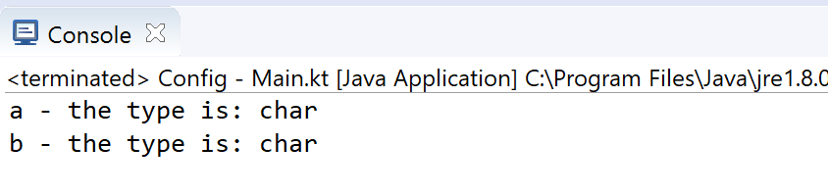
Basic Types – Characters
val aChar = 'a'
val bChar: Char = 'b'
fun main(args : Array<String>)
{
println("" + aChar + " - the type is: " + aChar.javaClass)
println("" + bChar + " - the type is: " + bChar.javaClass)
}

Slide 16
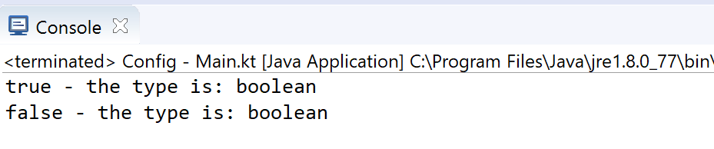
Basic Types – Booleans
val aFlag = true
val bFlag: Boolean = false
fun main(args : Array<String>)
{
println("" + aFlag + " - the type is: " + aFlag.javaClass)
println("" + bFlag + " - the type is: " + bFlag.javaClass)
}

Slide 17
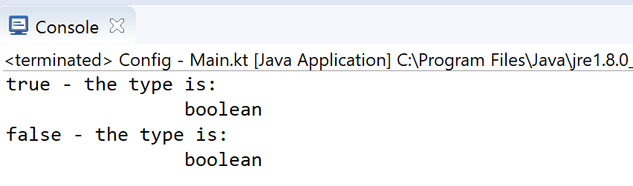
Basic Types – Escape Characters
Special characters can be escaped using a backslash:
\t \b \n \r \’ \“ \\ \$
val aFlag= true
val bFlag: Boolean = false
fun main(args : Array<String>) {
println("" + aFlag + " - the type is: \n\t\t" + aFlag.javaClass)
println("" + bFlag + " - the type is: \n\t\t" + bFlag.javaClass)
}

Slide 18
Local Variables
val (read-only) and var (mutable)

Slide 19
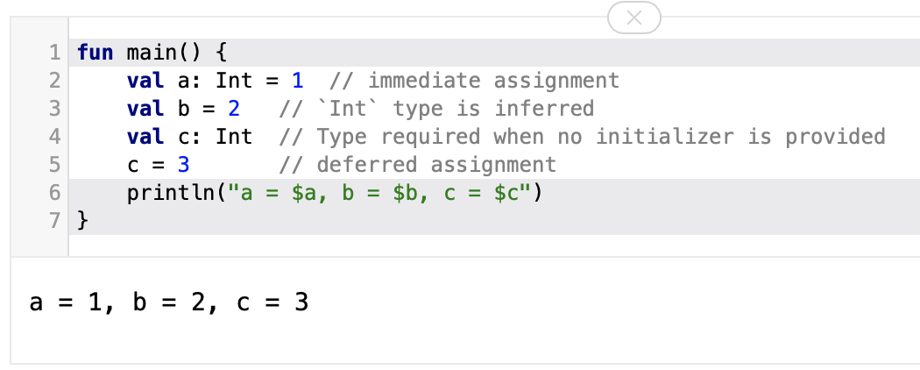
Local Variables – val (read-only)
Defined using the keyword val. They can be assigned a value only once.

Slide 20
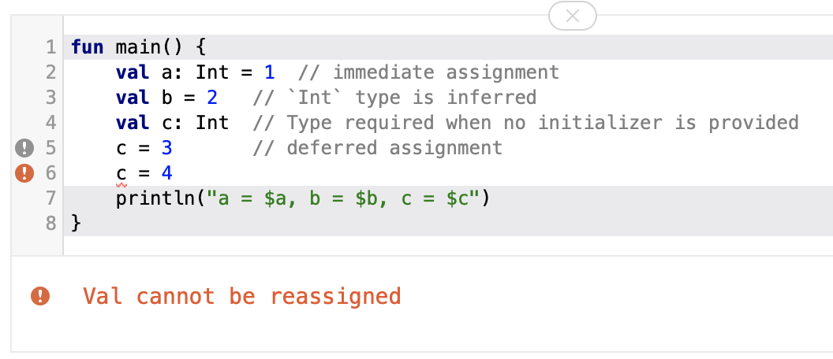
Local Variables – val (read-only)
Defined using the keyword val. They can be assigned a value only once.

Slide 21
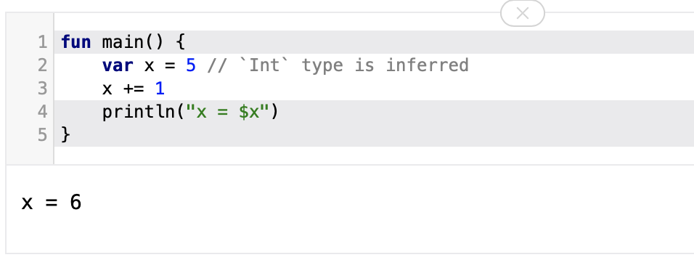
Local Variables – var (mutable)
Variables that can be reassigned use the var keyword:

Slide 22
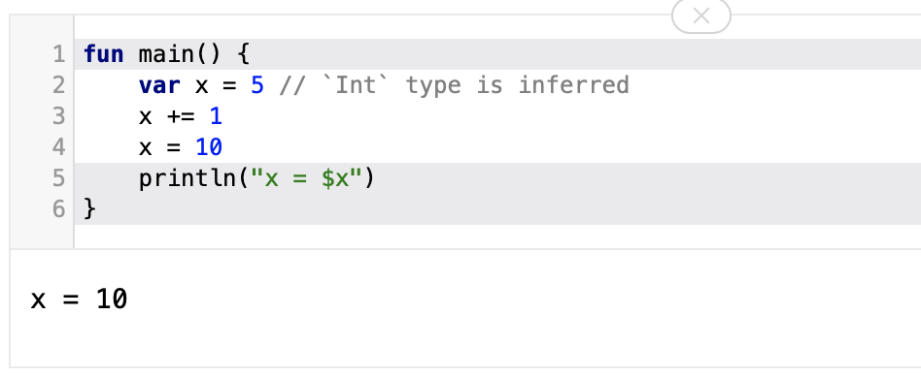
Local Variables – var (mutable)
Variables that can be reassigned use the var keyword:

Slide 23
References
Sources: http://kotlinlang.org/docs/reference/basic-syntax.html
http://petersommerhoff.com/dev/kotlin/kotlin-for-java-devs/
https://www.programiz.com/kotlin-programming
https://medium.com/@napperley/kotlin-tutorial-5-basic-collections-3f114996692b

Slide 24


