Slide 1




Mobile Application Development
Produced
by
Dave Drohan (david.drohan@setu.ie)
Department of Computing & Mathematics
South East Technological University Waterford, Ireland
Updated & Delivered
by
Gongzhe Qiao (003969@nuist.edu.cn)
Department of Computer Science
Nanjing University of Information Science and Technology Nanjing, China
nuist.edu.cn
setu.ie

Slide 2

Introducing Kotlin Syntax - Part 1.2

Slide 3
Agenda
Basic Types
Local Variables (val & var)
Functions
Control Flow (if, when, for, while)
Strings & String Templates
Ranges (and the in operator)
Type Checks & Casts
Null Safety
Comments

Slide 4
Agenda
Basic Types
Local Variables (val & var)
Functions
Control Flow (if, when, for, while)
Strings & String Templates
Ranges (and the in operator)
Type Checks & Casts
Null Safety
Comments

Slide 5
Functions
Parameters, return types, expression body,
inferred return type

Slide 6
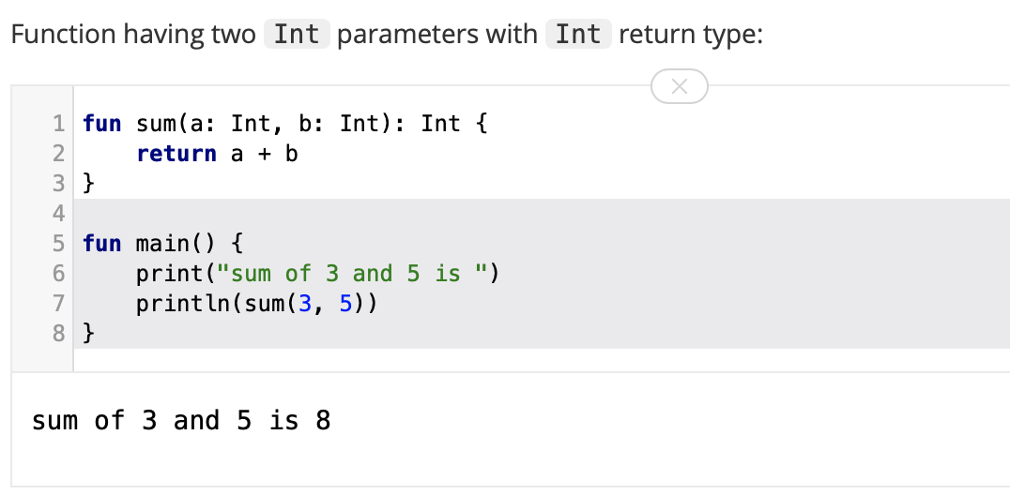
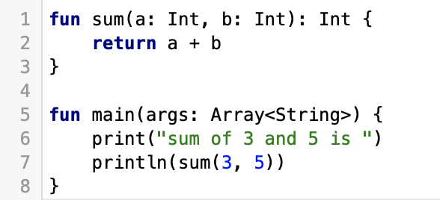
Functions – parameters and return types

Slide 7
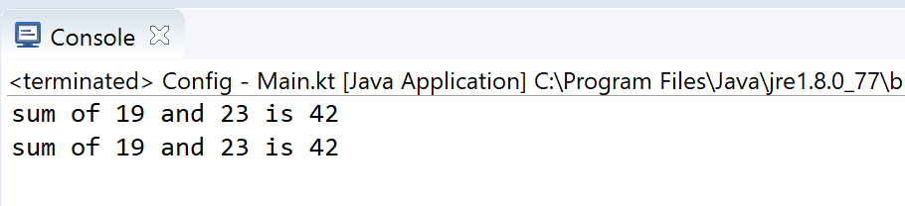
Functions – expression body, inferred return type
fun sum(a: Int, b: Int) = a + b
fun main(args: Array<String>) {
println("sum of 19 and 23 is ${sum(19, 23)}")
println("sum of 19 and 23 is " + sum(19, 23))
}
Function “sum” with an expression body and inferred return type

Slide 8
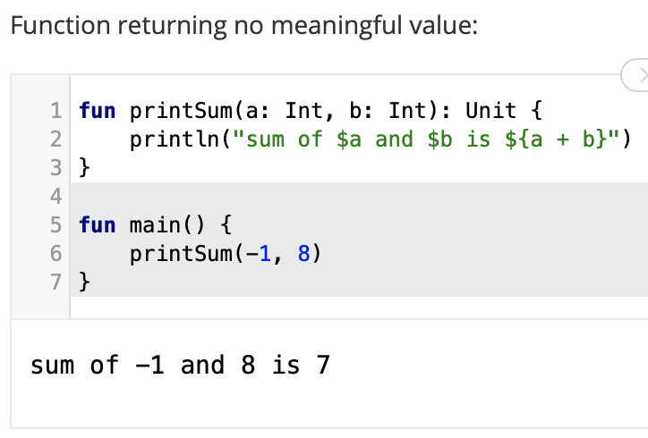
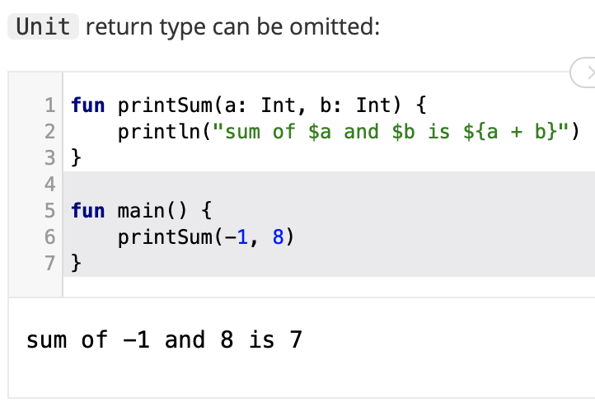
Functions – no return data

Slide 9
Functions – no return data

Slide 10
Control Flow
if, when, for, while

Slide 11
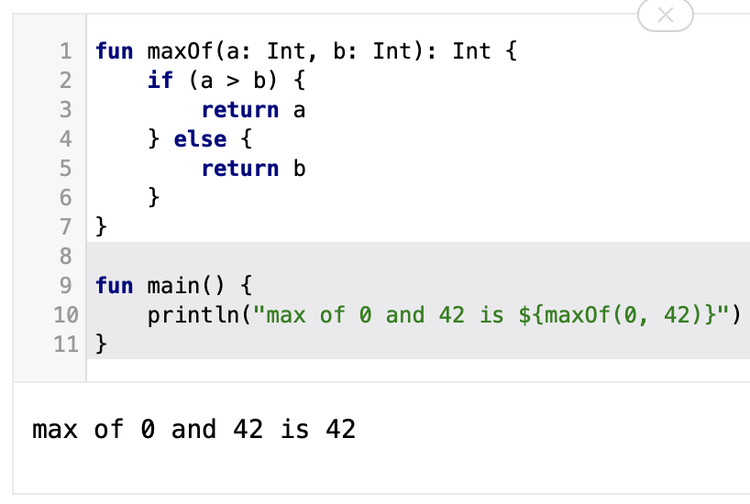
Control Flow – if
The traditional way to write if’s

Slide 12
Control Flow – if
The traditional way to write if’s
HOWEVER….in Kotlin, if is an expression, i.e. it returns a value. Therefore there is no ternary operator (condition ? then : else), because ordinary if works fine in this role.

Slide 13
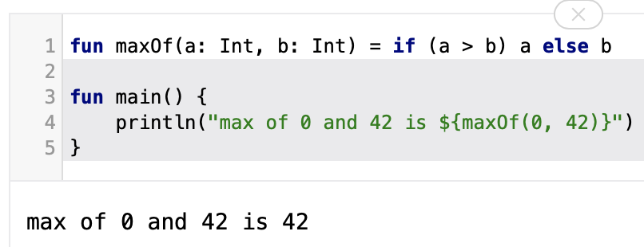
Control Flow – if
Using if as an expression

Slide 14
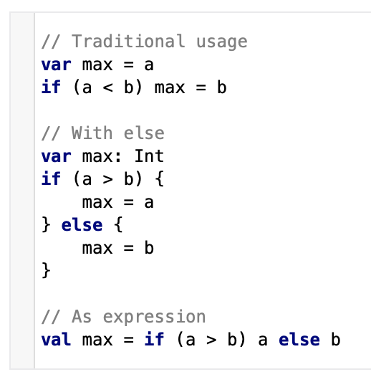
Control Flow – if
Some examples without using functions.
The first two examples use if as a statement.
The last example uses if as an expression.

Slide 15
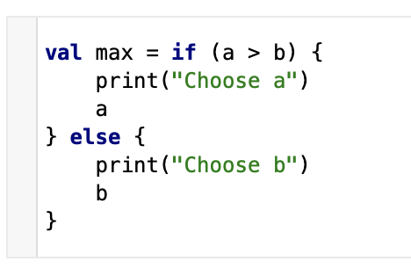
Control Flow – if
if branches can be blocks, and the last expression is the value of a block:
In general, if you're using if as an expression rather than a statement (for example, returning its value (as above) or assigning it to a variable), the expression is required to have an else branch.

Slide 16
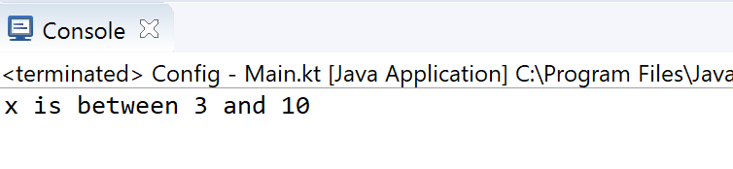
Control Flow – when
when replaces switch in Java
val x = 10;
when (x){
1 -> print("x is 1")
2 -> print("x is 2")
in 3..10 -> print ("x is between 3 and 10")
}

Slide 17
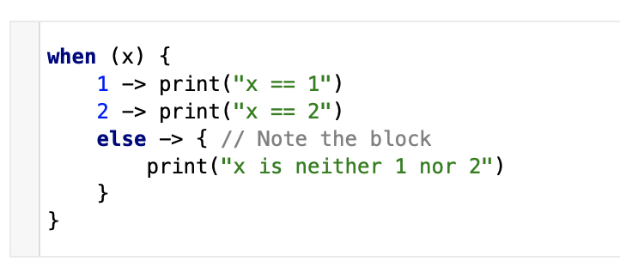
Control Flow – when

Slide 18
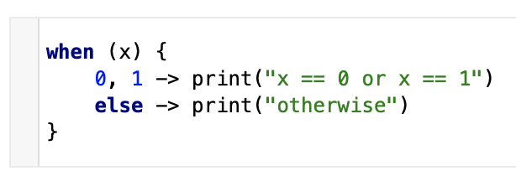
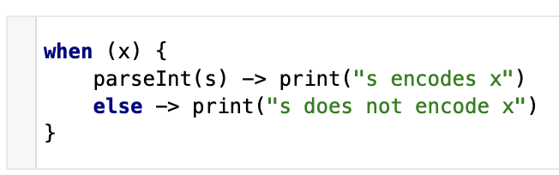
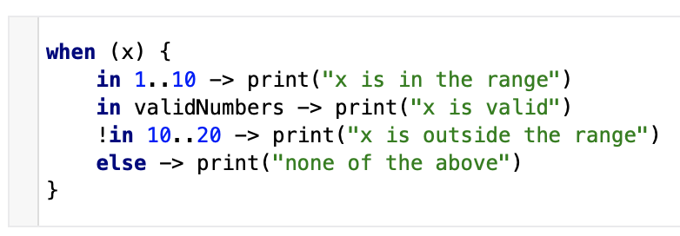
Control Flow – when
Branch conditions may be combined with a comma.
We can use arbitrary expressions (not only constants) as branch conditions.
We can also check a value for being in or !in a range or a collection.

Slide 19
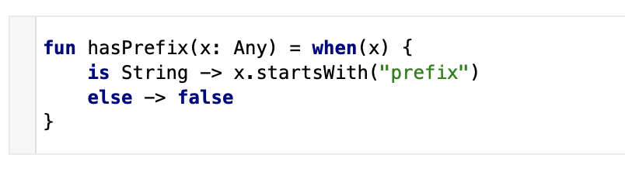
Control Flow – when
Another possibility is to check that a value is or !is of a particular type. Note that, due to smart casts, you can access the methods and properties of the type without any extra checks.

Slide 20
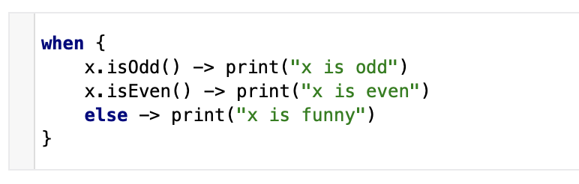
Control Flow – when
when can also be used as a replacement for an if-else if chain.
If no argument is supplied, the branch conditions are simply boolean expressions, and a branch is executed when its condition is true.

Slide 21
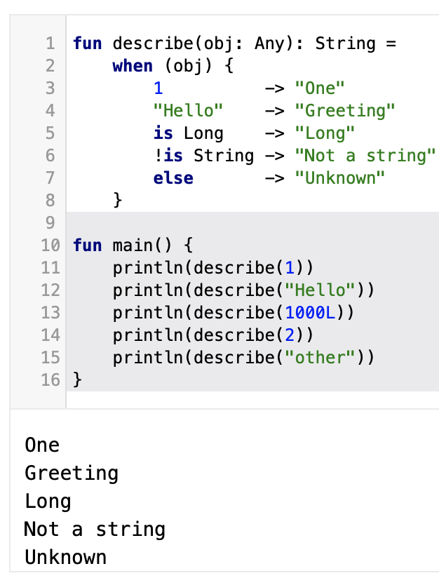
Control Flow – when

Slide 22
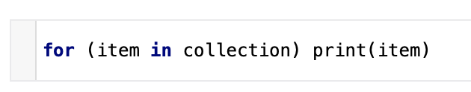
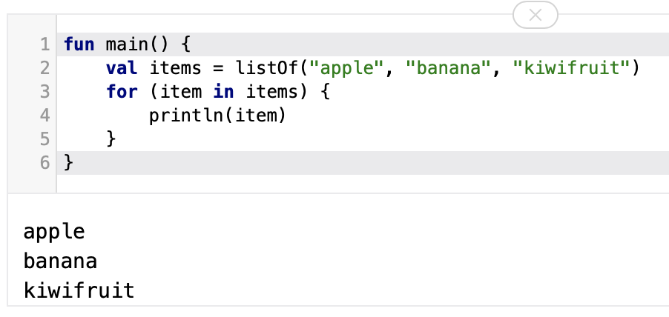
Control Flow – for
The for loop iterates through anything that provides an iterator. It is similar to the for-each loop in Java.

Slide 23
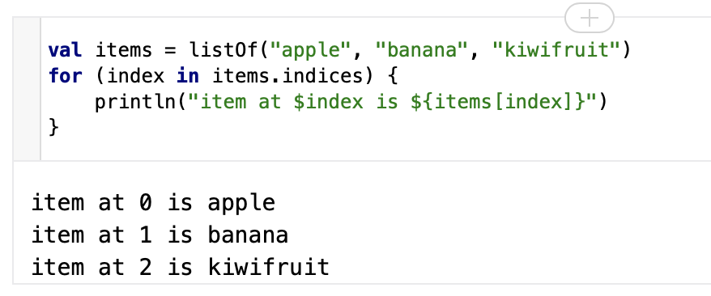
Control Flow – for
If you want to iterate through an array or a list with an index, you can do it this way:

Slide 24
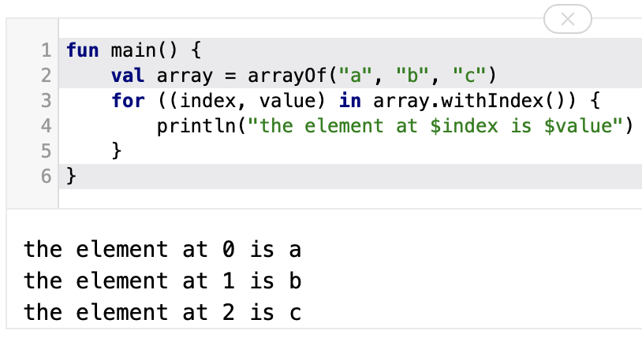
Control Flow – for
Alternatively, you can use the withIndex library function:

Slide 25
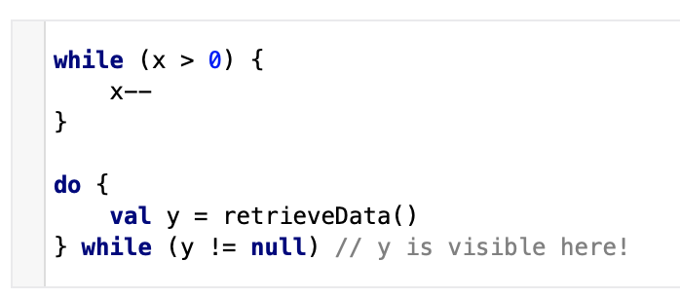
Control Flow – while
The while and do-while work as usual:
Note: Kotlin also supports traditional break and continue operators in loops.

Slide 26
References
Sources: http://kotlinlang.org/docs/reference/basic-syntax.html
http://petersommerhoff.com/dev/kotlin/kotlin-for-java-devs/
https://www.programiz.com/kotlin-programming
https://medium.com/@napperley/kotlin-tutorial-5-basic-collections-3f114996692b

Slide 27


