Slide 1




Mobile Application Development
Produced
by
Dave Drohan (david.drohan@setu.ie)
Department of Computing & Mathematics
South East Technological University Waterford, Ireland
Updated & Delivered
by
Gongzhe Qiao (003969@nuist.edu.cn)
Department of Computer Science
Nanjing University of Information Science and Technology Nanjing, China
nuist.edu.cn
setu.ie

Slide 2

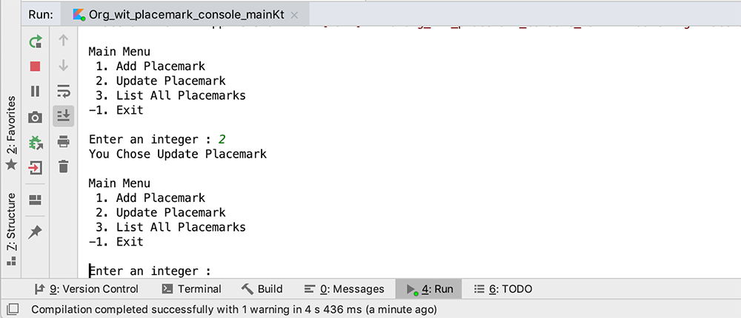
Placemark-Console Version 1.0

Slide 3
Features Covered (from Part 1)
Basic Types
Local Variables (val & var)
Functions
Control Flow (if, when, for, while)
Strings & String Templates
Ranges (and the in operator)
Type Checks & Casts
Null Safety
Comments

Slide 4
Features Covered (from Part 2)
Writing Classes (properties and fields)
Data Classes (just for data)
Collections: Arrays and Collections
Collections: in operator and lambdas
Arguments (default and named)

Slide 5
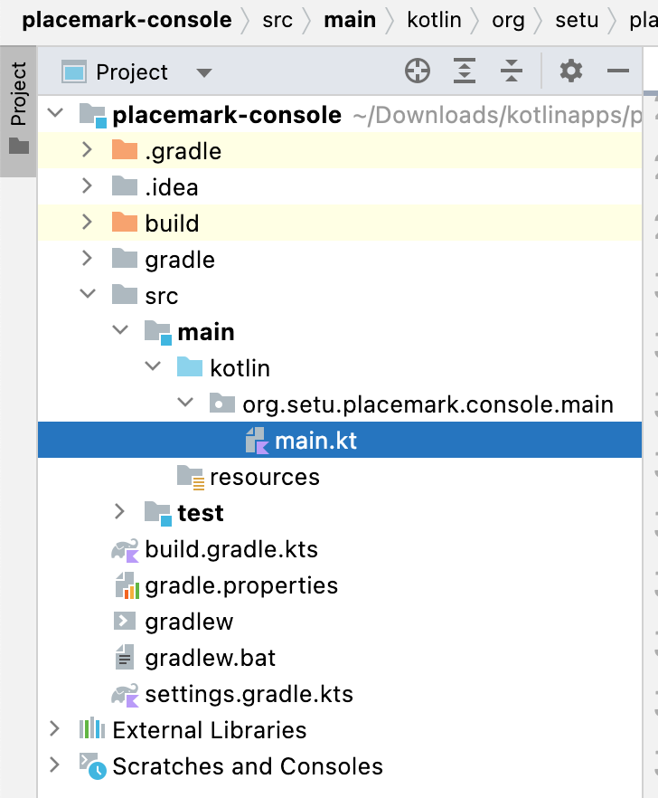
Project Structure
Fairly basic at the moment
1 package
1 Kotlin source FILE

Slide 6
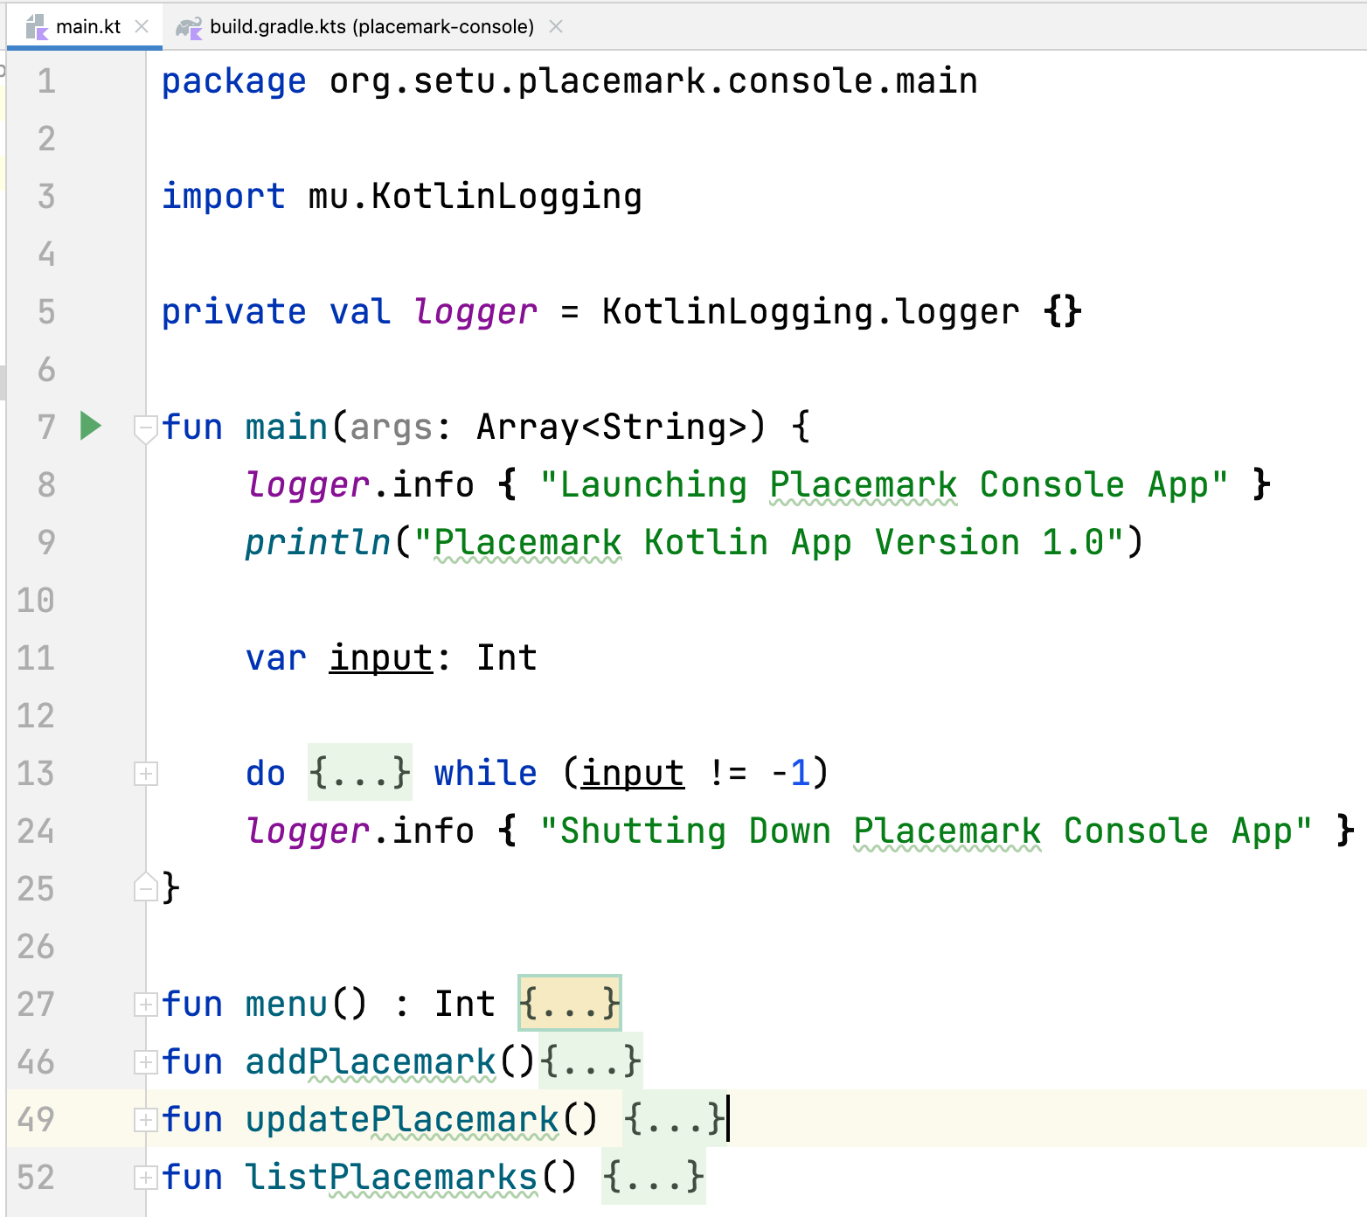
main.kt
Fairly basic at the moment
1 package
1 Kotlin source FILE
Limited Features

Slide 7
Basic Types & Variables
Placemark-Console Version 1.0

Slide 8
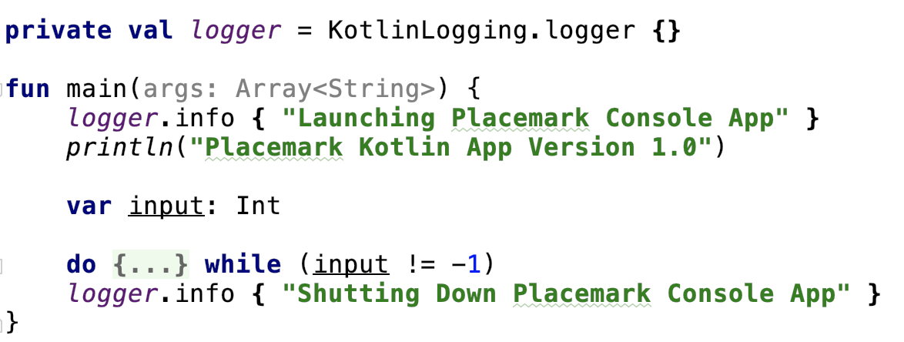
Basic Types in Placemark
var Int declaration called input
can be changed

Slide 9
Basic Types in Placemark
val declaration called logger with type inferred
cannot be changed after assignment

Slide 10
Functions & Control Flow
Placemark-Console Version 1.0

Slide 11
Functions in Placemark
fun main, the ‘main’ function in our application
Takes a single parameter args, of type String Array (not actually used)

Slide 12
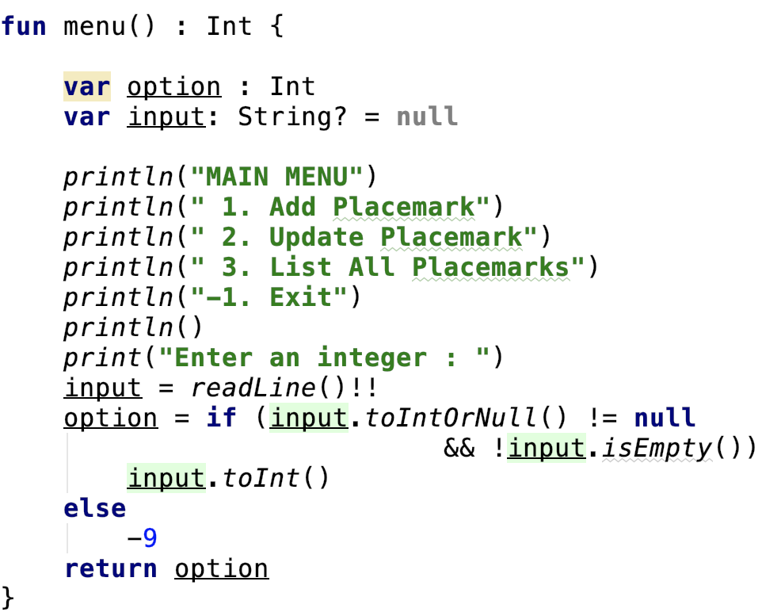
Functions in Placemark
fun menu, the ‘menu’ displayed to the user
also declares 2 var variables to be used within the function

Slide 13
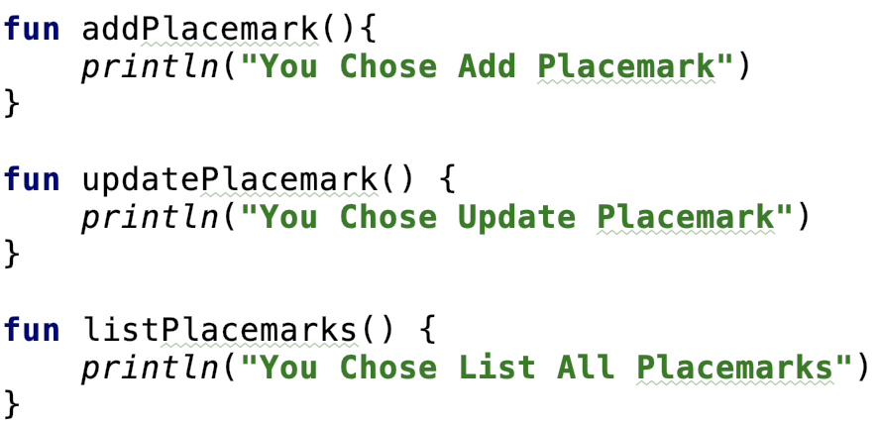
Functions in Placemark
the functions called based on the users choice
very basic at the moment, we will refactor these functions in future versions of Placemark.

Slide 14
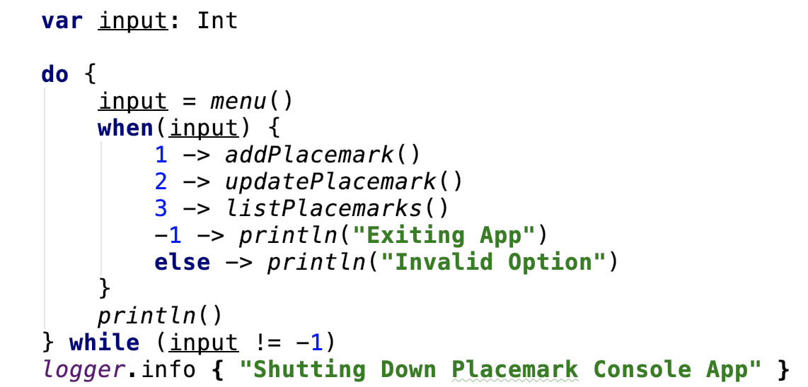
Control Flow in Placemark
do-while loop to call our functions based on user input
Using when & lambdas to keep our code clean and concise.
‘Exits’ on -1

Slide 15
Strings & Null Safety
Placemark-Console Version 1.0

Slide 16
Strings & Null Safety in Placemark
var variable input is declared as a String and nullable
We need the ? to assign a null value
Allows us to check for accidental empty values
Some basic validation on input

Slide 17
References
Sources: http://kotlinlang.org/docs/reference/basic-syntax.html
http://petersommerhoff.com/dev/kotlin/kotlin-for-java-devs/
https://www.programiz.com/kotlin-programming
https://medium.com/@napperley/kotlin-tutorial-5-basic-collections-3f114996692b

Slide 18


