Slide 1




Mobile Application Development
Produced
by
Dave Drohan (david.drohan@setu.ie)
Department of Computing & Mathematics
South East Technological University Waterford, Ireland
Updated & Delivered
by
Gongzhe Qiao (003969@nuist.edu.cn)
Department of Computer Science
Nanjing University of Information Science and Technology Nanjing, China
nuist.edu.cn
setu.ie

Slide 2

Introducing Kotlin Syntax - Part 1.3

Slide 3
Agenda
Basic Types
Local Variables (val & var)
Functions
Control Flow (if, when, for, while)
Strings & String Templates
Ranges (and the in operator)
Type Checks & Casts
Null Safety
Comments

Slide 4
Agenda
Basic Types
Local Variables (val & var)
Functions
Control Flow (if, when, for, while)
Strings & String Templates
Ranges (and the in operator)
Type Checks & Casts
Null Safety
Comments

Slide 5
Strings and String Templates
Escaped strings, raw strings, literals, templates

Slide 6
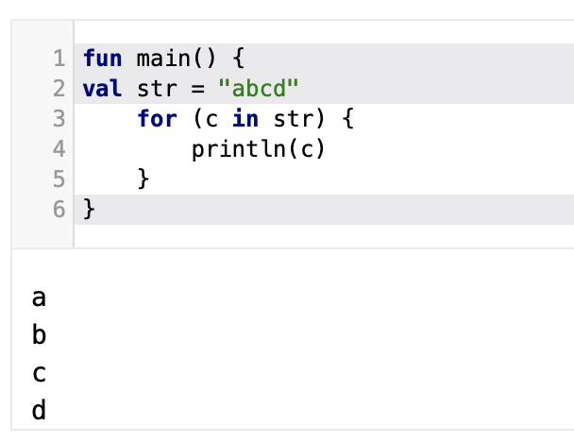
Strings
Strings are represented by the type String. Strings are immutable. Elements of a string are characters that can be accessed by the indexing operation: s[i]. A string can be iterated over with a for-loop:

Slide 7
String Literals
Kotlin has two types of string literals: escaped strings that may have escaped characters in them
and raw strings that can contain newlines and arbitrary text.

Slide 8

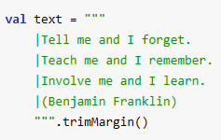
String Literals
Kotlin has two types of string literals: escaped strings that may have escaped characters in them
and raw strings that can contain newlines and arbitrary text.
An escaped string is very much like a Java string
A raw string is delimited by a triple quote (“””), contains no escaping and can contain new lines and any other characters.

Slide 9
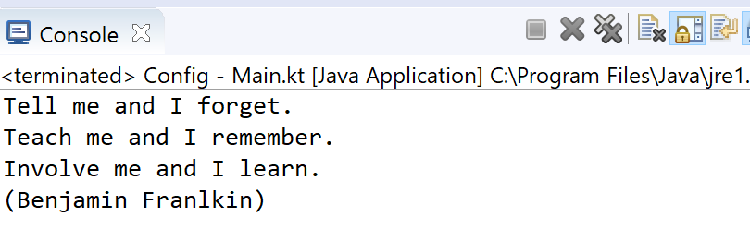
String Literals
You can remove leading whitespace with trimMargin()

Slide 10
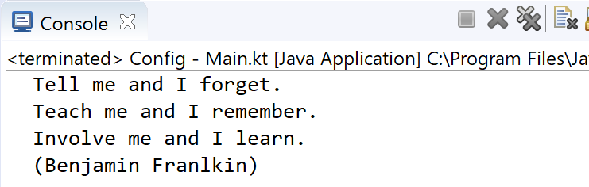
String Literals
By default | is used as margin prefix, but you can choose another character and pass it as a parameter like trimMargin(">").
val text = """
> Tell me and I forget.
> Teach me and I remember.
> Involve me and I learn.
> (Benjamin Franlkin)
""".trimMargin(">")
print(text)
Note the impact of the two spaces we put between > and the text

Slide 11

String Templates
Strings may contain template expressions, i.e. pieces of code that are evaluated and whose results are concatenated into the string.
A template expression starts with a dollar sign ($) and consists of either a simple name:
or an arbitrary expression in curly braces:

Slide 12
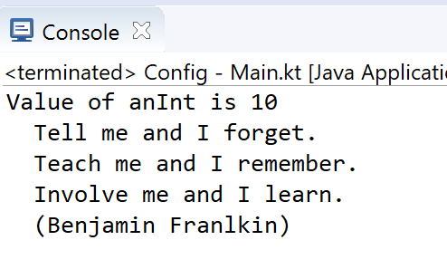
String Templates
Templates are supported both inside raw strings and inside escaped strings.
val anInt = 10
val aString = "Value of anInt is ${anInt}\n"
val text = """
> Tell me and I forget.
> Teach me and I remember.
> Involve me and I learn.
> (Benjamin Franlkin)
""".trimMargin(">")
print(aString)
print(text)

Slide 13
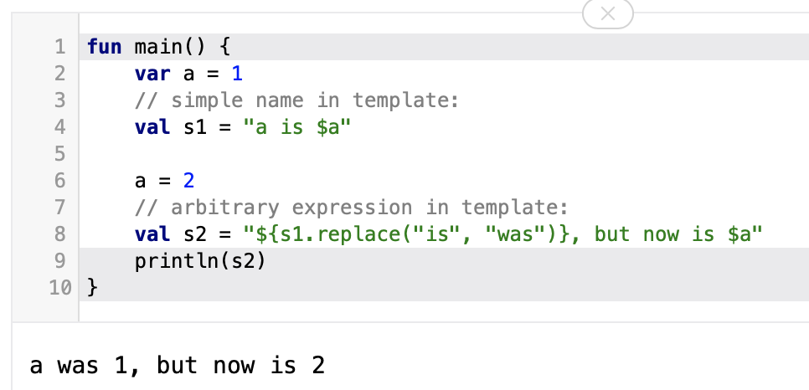
String Templates
s1
“a is 1”

Slide 14
Ranges
The in operator

Slide 15
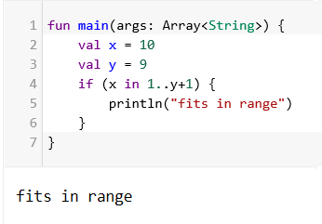
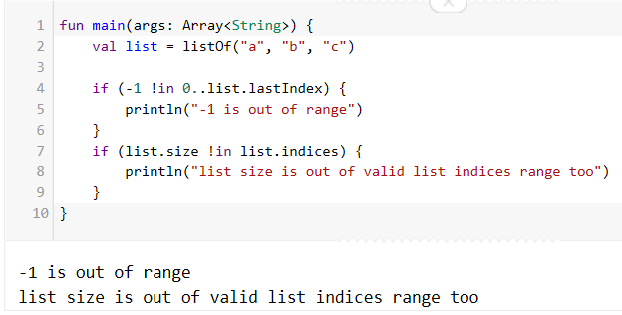
Range
Check if a number is within a range using in operator:
Check if a number is out of range:

Slide 16
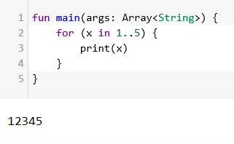
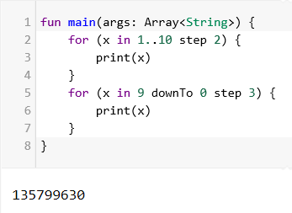
Range
Iterating over a range:
Iterating over a progression:

Slide 17
Type Checks & Casts

Slide 18
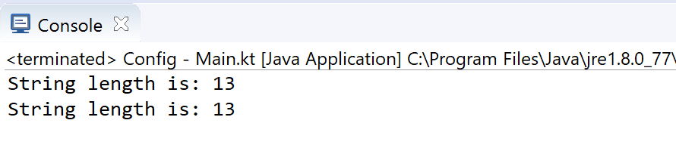
is and !is operators
fun main(args: Array<String>) {
val aString = "I am a String"
if (aString is String) {
println("String length is: ${aString.length}")
}
if (aString !is String) { // same as !(aString is String)
print("Not a String")
}
else {
println("String length is: ${aString.length}")
}
}

Slide 19
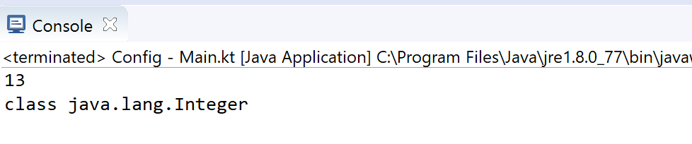
Smart Casts (an example using if)
fun main(args: Array<String>) {
demo ("I am a String")
demo (12)
}
fun demo(x: Any) {
if (x is String) {
println(x.length) // x is automatically cast to String
}
else{
println(x.javaClass)
}
}

Slide 20
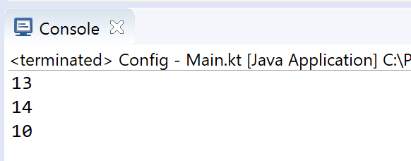
Smart Casts (an example using when)
fun main(args: Array<String>) {
demo (12)
demo ("I am a String")
demo (intArrayOf(1,2,3,4))
}
fun demo(x: Any) {
when (x) {
is Int -> println(x + 1)
is String -> println(x.length + 1)
is IntArray -> println(x.sum())
}
}

Slide 21
References
Sources: http://kotlinlang.org/docs/reference/basic-syntax.html
http://petersommerhoff.com/dev/kotlin/kotlin-for-java-devs/
https://www.programiz.com/kotlin-programming
https://medium.com/@napperley/kotlin-tutorial-5-basic-collections-3f114996692b

Slide 22


