Slide 1




Mobile Application Development
Produced
by
Dave Drohan (david.drohan@setu.ie)
Department of Computing & Mathematics
South East Technological University Waterford, Ireland
Updated & Delivered
by
Gongzhe Qiao (003969@nuist.edu.cn)
Department of Computer Science
Nanjing University of Information Science and Technology Nanjing, China
nuist.edu.cn
setu.ie

Slide 2

Introducing Kotlin Syntax - Part 1.4

Slide 3
Agenda
Basic Types
Local Variables (val & var)
Functions
Control Flow (if, when, for, while)
Strings & String Templates
Ranges (and the in operator)
Type Checks & Casts
Null Safety
Comments

Slide 4
Agenda
Basic Types
Local Variables (val & var)
Functions
Control Flow (if, when, for, while)
Strings & String Templates
Ranges (and the in operator)
Type Checks & Casts
Null Safety
Comments

Slide 5
Null
Using nullable values and checking for null

Slide 6
Null Safety
In Kotlin, the type system distinguishes between references that can hold null (nullable references) and those that cannot (non-null references)
The Kotlin compiler makes sure you don’t, by accident, operate on a variable that is null.

Slide 7
Null Safety – a non-null reference
A regular variable of type String can not hold null
var a: String = "abc"
a = null // syntax error
Calling a method / accessing a property on variable a, is guaranteed not to cause an NullPointerException (NPE)
val l = a.length

Slide 8
Null Safety – a nullable reference
To allow nulls, we can declare a variable as a nullable string, written String?
var b: String? = "abc"
b = null // ok
val l = b.length // syntax error: as // variable ‘b’
// can be null
However, there are many ways around this….

Slide 9
Null Safety – a nullable reference
To allow nulls, we can declare a variable as a nullable string, written String?
var b: String? = "abc"
b = null // ok
Option 1: you can explicitly check if b is null, and handle the two options separately:
val l = if (b != null) b.length else -1

Slide 10
Null Safety – a nullable reference
To allow nulls, we can declare a variable as a nullable string, written String?
var b: String? = "abc"
b = null // ok
Option 2: you can use the safe call operator ?. This returns b.length if b is not null, and null otherwise
b?.length

Slide 11
Null Safety – a nullable reference
To allow nulls, we can declare a variable as a nullable string, written String?
var b: String? = "abc"
b = null // ok
Option 3: you can use the !! Operator. This forces a call to our method and will return a non-null value of b or throw an NPE if b is null. Use sparingly!
val l = b!!.length

Slide 12
Null Safety – The Elvis Operator, ?:
When we have a nullable reference b, we can say:
"if b is not null, use it, otherwise use some non-null value x"
val l: Int = if(b != null) b.length else -1
Notes:
If we revisit Option 1 again and look at what we did, using a standard if/else expression

Slide 13
Null Safety – The Elvis Operator, ?:
When we have a nullable reference b, we can say:
"if b is not null, use it, otherwise use some non-null value x"
val l: Int = if(b != null) b.length else -1
Along with the complete if-expression, this can be expressed with the Elvis operator, written ?:
val l = b?.length ?: -1
If the expression to the left of ?: is not null, the Elvis operator returns it, otherwise it returns the expression to the right.

Slide 14
Nullable – nullable returns
A reference must be explicitly marked as nullable (i.e. ?) when null value is possible.
fun parseInt(str: String): Int? {
//...
}
Return null if the return value does not hold an integer:

Slide 15
Comments
Single line, block, KDoc

Slide 16
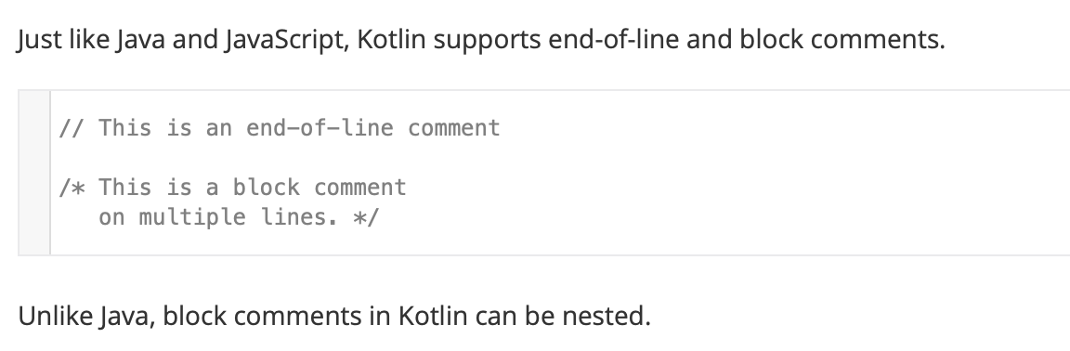
Comments – single line and block comments

Slide 17
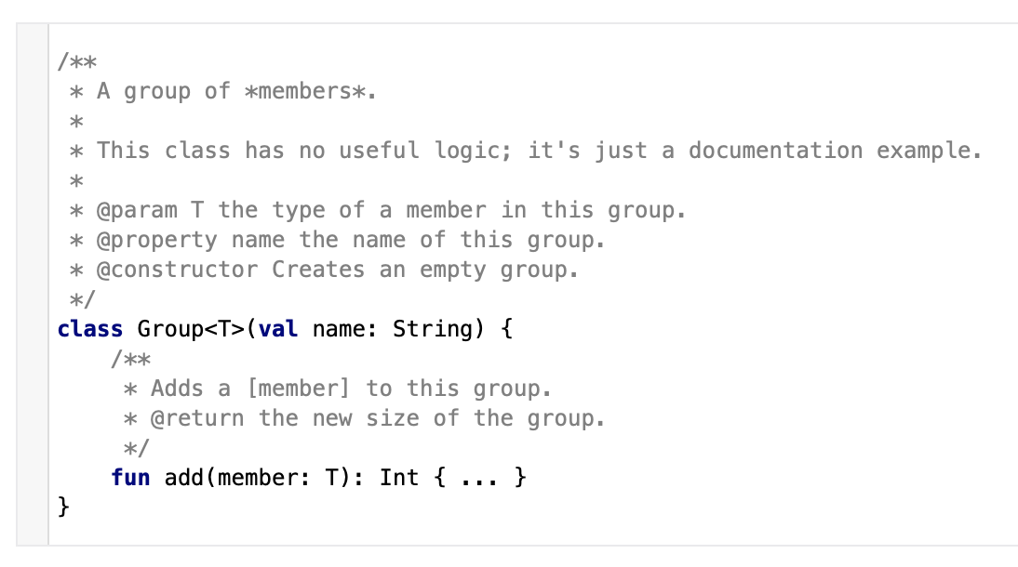
Comments – KDoc (equivalent to JavaDoc)

Slide 18
Comments – KDoc
Block tags | Currently supported KDoc block tags
@param <name> | Documents a value parameter of a function or a type parameter of a class, property or function.
@return | Documents the return value of a function.
@constructor | Documents the primary constructor of a class.
@receiver | Documents the receiver of an extension function.
@property <name> | Documents the property of a class which has the specified name.
@throws <class>, @exception <class> | Documents an exception which can be thrown by a method.
@sample <identifier> | Embeds the body of the function with the specified qualified name into the documentation for the current element, in order to show an example of how the element could be used.
@see <identifier> | Adds a link to the specified class or method to the See Also block of the documentation.
@author | Specifies the author of the element being documented.
@since | Specifies the version of the software in which the element being documented was introduced.
@suppress | Excludes the element from the generated documentation. Can be used for elements which are not part of the official API of a module but still have to be visible externally.
For more info: http://kotlinlang.org/docs/reference/kotlin-doc.html

Slide 19
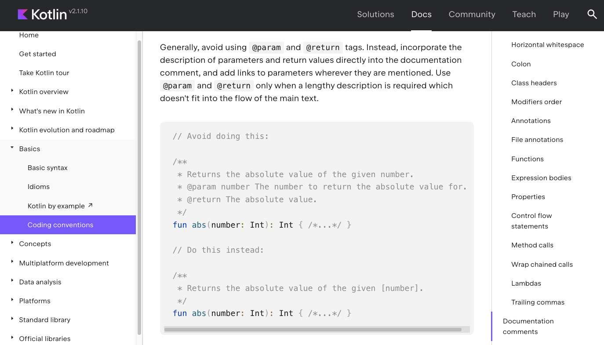
However …
For more info: https://kotlinlang.org/docs/coding-conventions.html#documentation-comments

Slide 20
References
Sources: http://kotlinlang.org/docs/reference/basic-syntax.html
http://petersommerhoff.com/dev/kotlin/kotlin-for-java-devs/
https://www.programiz.com/kotlin-programming
https://medium.com/@napperley/kotlin-tutorial-5-basic-collections-3f114996692b

Slide 21


