Slide 1




Mobile Application Development
Produced
by
Dave Drohan (david.drohan@setu.ie)
Department of Computing & Mathematics
South East Technological University Waterford, Ireland
Updated & Delivered
by
Gongzhe Qiao (003969@nuist.edu.cn)
Department of Computer Science
Nanjing University of Information Science and Technology Nanjing, China
nuist.edu.cn
setu.ie

Slide 2

Introducing Kotlin Syntax - Part 2.1

Slide 3
Agenda from Part 1
Basic Types
Local Variables (val & var)
Functions
Control Flow (if, when, for, while)
Strings & String Templates
Ranges (and the in operator)
Type Checks & Casts
Null Safety
Comments

Slide 4
Agenda for Part 2
Writing Classes (properties and fields)
Data Classes (just for data)
Collections: Arrays and Collections
Collections: in operator and lambdas
Arguments (default and named)

Slide 5
Agenda for Part 2
Writing Classes (properties and fields)
Data Classes (just for data)
Collections: Arrays and Collections
Collections: in operator and lambdas
Arguments (default and named)

Slide 6
Writing Classes
Properties & Fields

Slide 7
Writing Classes – properties
In Kotlin, classes don’t have explicit fields; they have properties.
var properties are mutable.
val properties cannot be changed.

Slide 8
Writing Classes – constructors
A class in Kotlin can have a primary constructor and one or more secondary constructors.
The primary constructor is part of the class header and it goes after the class name:
class Person constructor(firstName: String) {
}
class Person(firstName: String, lastName: String) {
}
class Person(val firstName: String, val lastName: String) {
}
Notes:
If the primary constructor does not have any annotations or visibility modifiers, the constructor keyword can be omitted

Slide 9
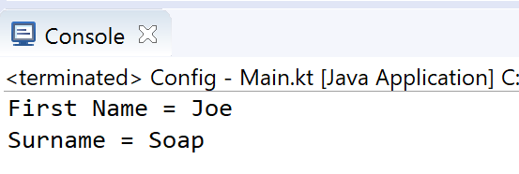
Writing Classes – primary constructors
class Person(val firstName: String, val lastName: String) {
}
fun main(args: Array<String>) {
val person = Person("Joe", "Soap")
println("First Name = ${person.firstName}")
println("Surname = ${person.lastName}")
}
Notes:
If the primary constructor does not have any annotations or visibility modifiers, the constructor keyword can be omitted

Slide 10
Writing Classes – primary constructors
The primary constructor cannot contain any code - initialisation code is placed in the init block.
The use of _ prefixing constructor variables is standard.
class Person( _firstName: String = "UNKNOWN FIRSTNAME", _lastName: String = "UNKNOWN LASTNAME") {
val firstName = _firstName
val lastName = _lastName
// initializer block
init {
println("First Name = $firstName")
println("Last Name = $lastName\n")
}
}

Slide 11
Writing Classes – primary constructors
class Person( _firstName: String = "UNKNOWN FIRSTNAME",
_lastName: String = "UNKNOWN LASTNAME") {
val firstName = _firstName
val lastName = _lastName
// initializer block
init {
println("First Name = $firstName")
println("Last Name = $lastName\n")
}
}
fun main(args: Array<String>) {
println("person1 is instantiated")
val person1 = Person("Joe", "Soap")
println("person2 is instantiated")
val person2 = Person("Jack")
println("person3 is instantiated")
val person3 = Person()
}
Notes:
If the primary constructor does not have any annotations or visibility modifiers, the constructor keyword can be omitted

Slide 12
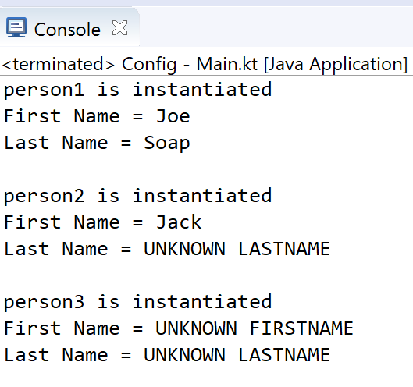
Writing Classes – primary constructors
class Person( _firstName: String = "UNKNOWN FIRSTNAME",
_lastName: String = "UNKNOWN LASTNAME") {
val firstName = _firstName
val lastName = _lastName
// initializer block
init {
println("First Name = $firstName")
println("Last Name = $lastName\n")
}
}
fun main(args: Array<String>) {
println("person1 is instantiated")
val person1 = Person("Joe", "Soap")
println("person2 is instantiated")
val person2 = Person("Jack")
println("person3 is instantiated")
val person3 = Person()
}
Note: varied parameters allowed in primary constructor as values are defaulted (i.e. optional parameters)
Notes:
If the primary constructor does not have any annotations or visibility modifiers, the constructor keyword can be omitted

Slide 13
Writing Classes – secondary constructors
The secondary constructor is prefixed with the keyword constructor. They are not very common in Kotlin.
http://kotlinlang.org/docs/reference/classes.html
class Person {
constructor(parent: Person) {
parent.children.add(this)
}
}
Notes:
https://www.programiz.com/kotlin-programming/constructors

Slide 14
Writing Classes – getters and setters
In Kotlin, getters (val and var) and setters (var) are optional and are auto-generated if you do not create them in your program.
Is equivalent to
class Person {
var name: String = "defaultValue"
}
class Person {
var name: String = "defaultValue"
// getter
get() = field
// setter
set(value) {
field = value
}
}
Notes:
https://www.programiz.com/kotlin-programming/constructors
Note:- The getters and setters are only created for mutable properties (var) and for immutable properties only getter is created.

Slide 15
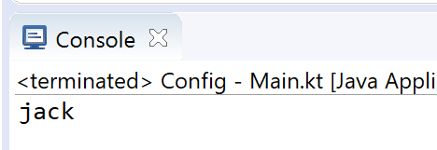
Writing Classes – getters and setters
When you instantiate object of the Person class and initialize the name property, it is passed to the setters parameter value and sets field to value.
class Person {
var name: String = "defaultValue"
// getter
get() = field
// setter
set(value) {
field = value
}
}
fun main(args: Array<String>) {
val person = Person()
person.name = "jack"
print(person.name)
}
Notes:
https://www.programiz.com/kotlin-programming/constructors

Slide 16
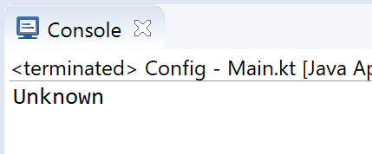
Writing Classes – getters and setters
When you want to add validation to your setter…
fun main(args: Array<String>) {
val person = Person()
person.name = ""
print(person.name)
}
class Person {
var name: String = "defaultValue"
get() = field
set(value) {
field = if (value.equals(""))
"Unknown"
else
value
}
}

Slide 17
Writing Classes – getters and setters
If we add another property…
class Person {
var name: String = "defaultValue"
get() = field
set(value) {
field = if (value.equals(""))
"Unknown"
else
value
}
var id: Int = 10001
get() = field
set(value) {
field = value
}
}

Slide 18
Writing Classes – field & value
You might have noticed two strange identifiers in all the getter and setter methods - field and value.
We use value as the name of the setter parameter. This is the default convention in Kotlin but you’re free to use any other name if you want.
The value parameter contains the value that a property is assigned to. For example, when you write person.name = "jack", the value parameter contains the assigned value “jack”.
(Using) field helps you refer to the property inside the getter and setter methods. This is required because if you use the property directly inside the getter or setter then you’ll run into a recursive call which will generate a StackOverflowError.

Slide 19
Data Classes
Just for data

Slide 20
Data Classes
We frequently create classes whose main purpose is to hold data. In such a class some standard functionality and utility functions are often mechanically derivable from the data. In Kotlin, this is called a data class and is marked as data:
The compiler automatically generates methods such as equals(), hashCode(), toString(), copy() from the primary constructor.
data class Person(var firstName: String,
var lastName: String) {
}
Notes:
https://www.programiz.com/kotlin-programming/data-class

Slide 21
Data Classes - Requirements
The primary constructor must have at least one parameter
The parameters of the primary constructor must be marked as either var or val
The class cannot be open, abstract, inner or sealed
The class may extend other classes or implement interfaces
data class Person(var firstName: String,
var lastName: String) {
}
Notes:
https://www.programiz.com/kotlin-programming/data-class

Slide 22
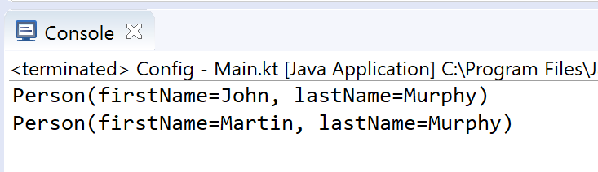
Data Classes – copy and toString Example
data class Person(var firstName: String,
var lastName: String) {
}
fun main(args: Array<String>) {
val person1 = Person("John", "Murphy")
// using copy function to create an object
val person2 = person1.copy(firstName="Martin")
println(person1)
println(person2.toString())
}
Notes:
https://www.programiz.com/kotlin-programming/data-class

Slide 23
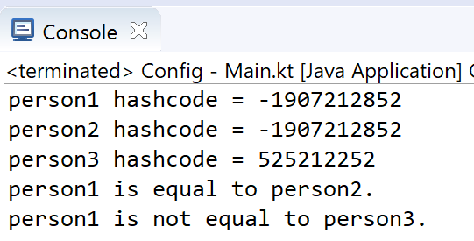
Data Classes – copy, equals and hashCode Example
fun main(args: Array<String>) {
val person1 = Person("John", "Murphy")
val person2 = person1.copy()
val person3 = person1.copy(firstName = "Martin")
println("person1 hashcode = ${person1.hashCode()}")
println("person2 hashcode = ${person2.hashCode()}")
println("person3 hashcode = ${person3.hashCode()}")
if (person1.equals(person2))
println("person1 is equal to person2.")
else
println("person1 is not equal to person2.")
if (person1.equals(person3))
println("person1 is equal to person3.")
else
println("person1 is not equal to person3.")
}
Notes:
https://www.programiz.com/kotlin-programming/data-class

Slide 24
Some additional sources for exploration:
Inheritance | https://www.programiz.com/kotlin-programming/inheritance
Interfaces | https://www.programiz.com/kotlin-programming/interfaces
Collections | https://kotlinlang.org/api/latest/jvm/stdlib/kotlin.collections/index.html
Try examples online | https://try.kotlinlang.org/#/Examples/Hello,%20world!/Simplest%20version/Simplest%20version.kt
Encapsulation & Polymorphism | https://medium.com/@napperley/kotlin-tutorial-12-encapsulation-and-polymorphism-6e5a150f25e1
Spek (testing) | https://objectpartners.com/2016/02/23/an-introduction-to-kotlin/ https://github.com/mike-plummer/KotlinCalendar

Slide 25
References
Sources: http://kotlinlang.org/docs/reference/basic-syntax.html
http://petersommerhoff.com/dev/kotlin/kotlin-for-java-devs/
https://www.programiz.com/kotlin-programming
https://www.baeldung.com/kotlin-lambda-expressions
https://www.programiz.com/kotlin-programming/lambdas
https://medium.com/@napperley/kotlin-tutorial-5-basic-collections-3f114996692b

Slide 26


