Slide 1




Mobile Application Development
Produced
by
Dave Drohan (david.drohan@setu.ie)
Department of Computing & Mathematics
South East Technological University Waterford, Ireland
Updated & Delivered
by
Gongzhe Qiao (003969@nuist.edu.cn)
Department of Computer Science
Nanjing University of Information Science and Technology Nanjing, China
nuist.edu.cn
setu.ie

Slide 2

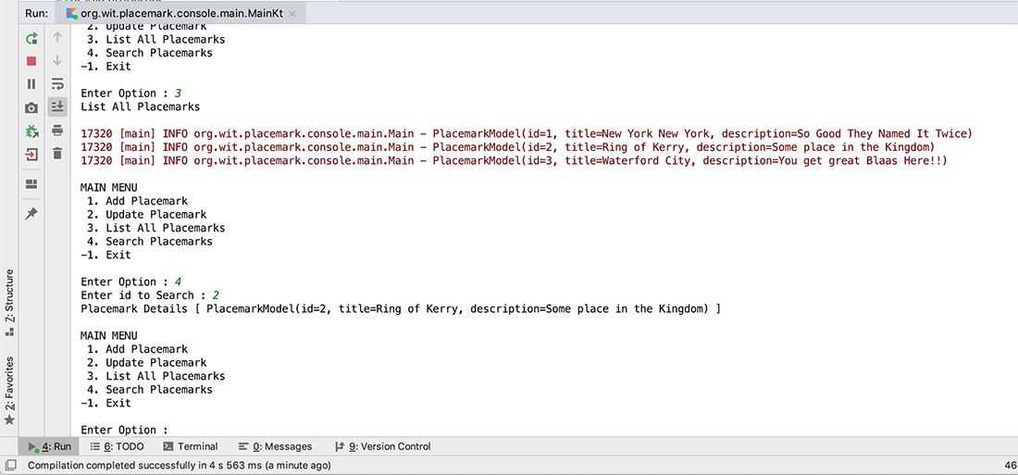
Placemark-Console Version 2.0

Slide 3
Features Covered (from Part 1)
Basic Types
Local Variables (val & var)
Functions
Control Flow (if, when, for, while)
Strings & String Templates
Ranges (and the in operator)
Type Checks & Casts
Null Safety
Comments

Slide 4
Features Covered (from Part 2)
Writing Classes (properties and fields)
Data Classes (just for data)
Collections: Arrays and Collections
Collections: in operator and lambdas
Arguments (default and named)

Slide 5
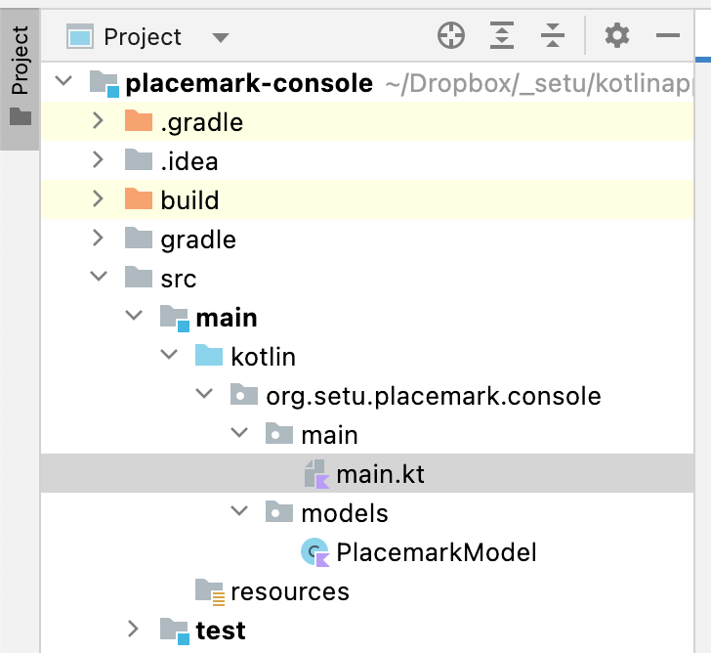
Project Structure
Still Fairly basic
Now 2 packages

Slide 6
Project Structure
Still Fairly basic
Now 2 packages
Model Introduced

Slide 7
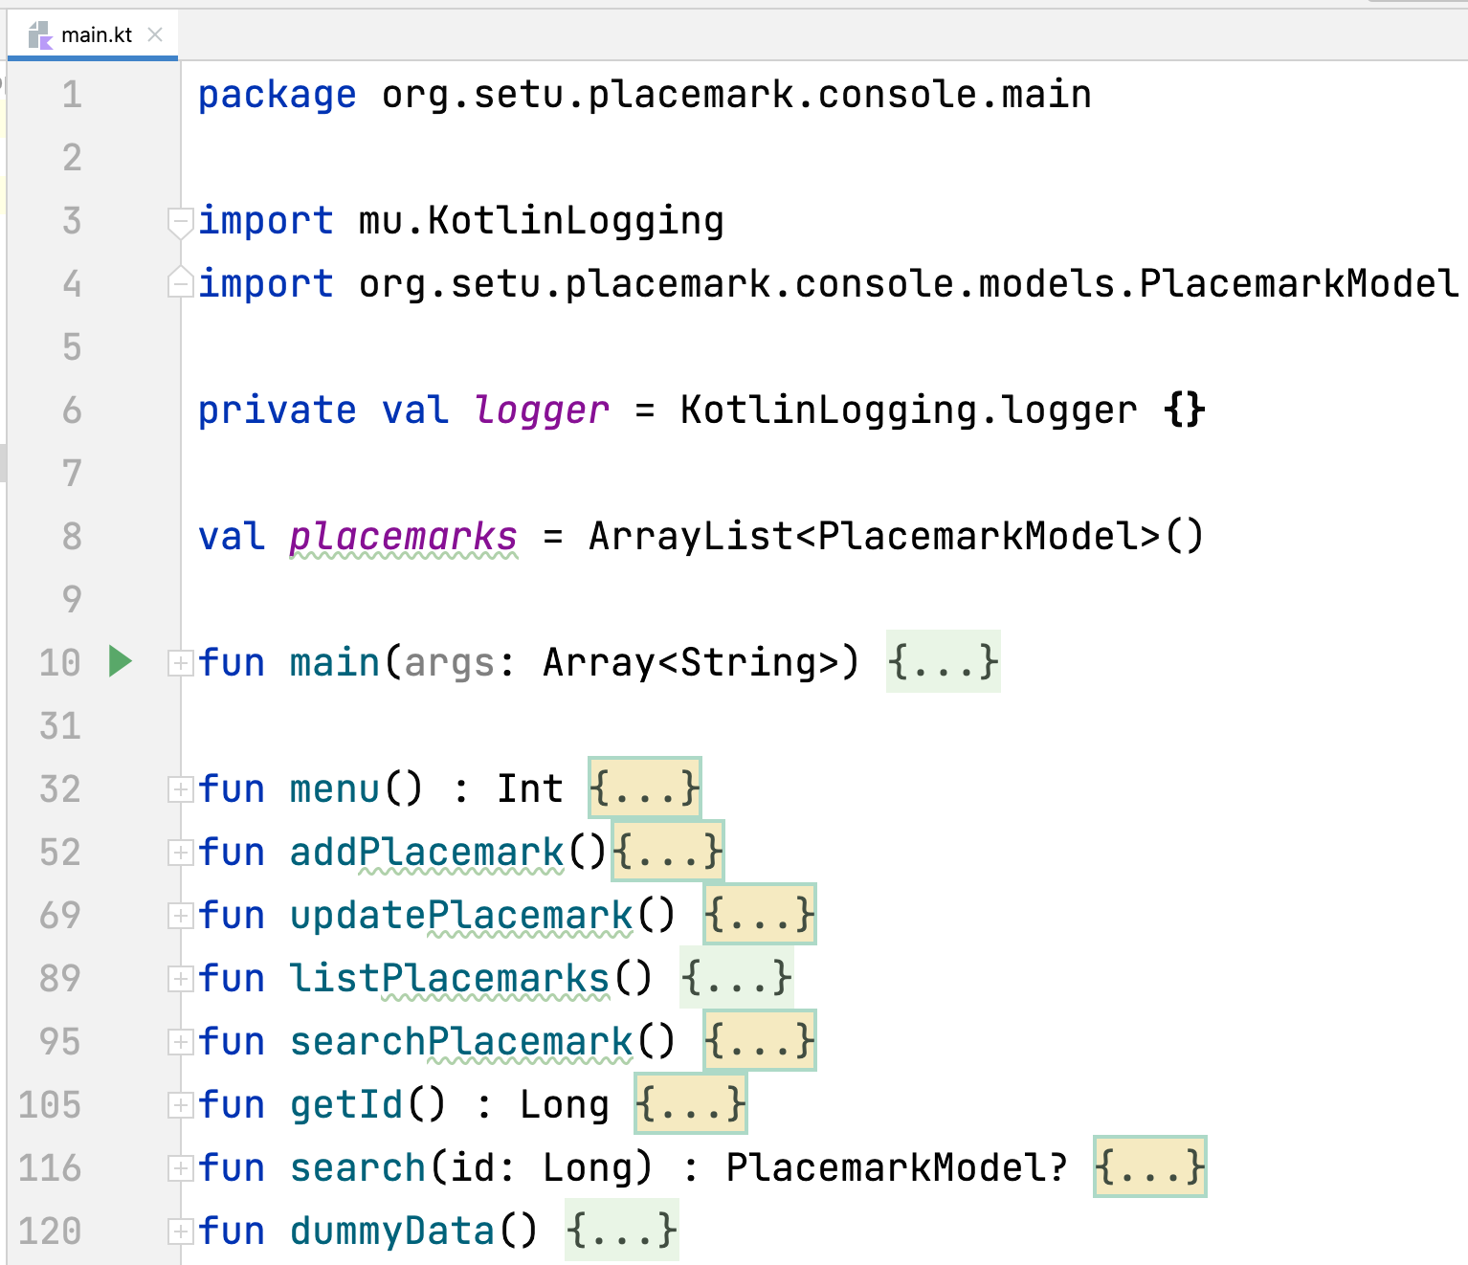
main.kt
Some basic CRUD
Package main
1 Kotlin source FILE
More Features

Slide 8
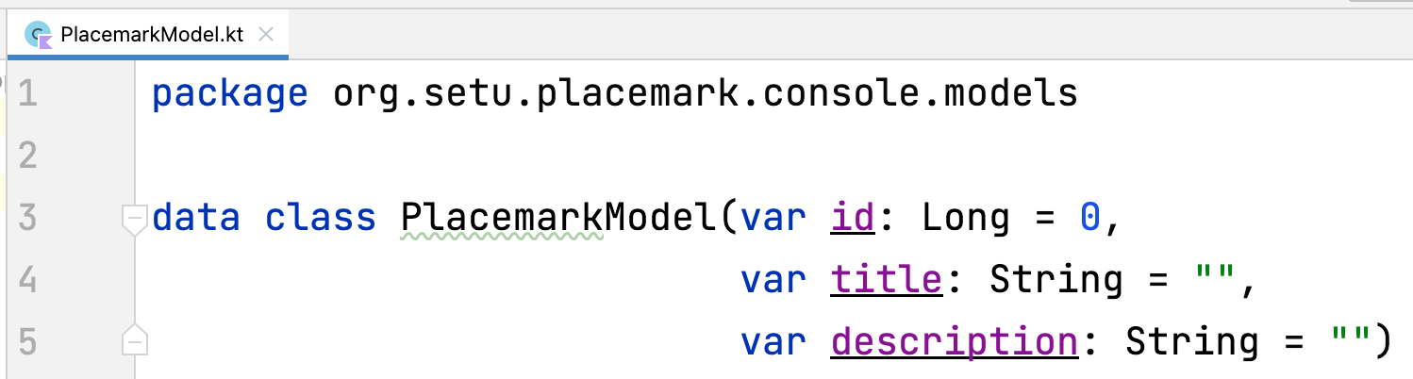
PlacemarkModel.kt
Basic data class
Package models
Default Arguments

Slide 9
Data Classes
Placemark-Console Version 2.0

Slide 10
Data Classes & Arguments in Placemark
note data class declaration
optimized for storing only data
We will use this class for modelling a Placemark object

Slide 11
Data Classes & Arguments in Placemark
3 arguments, named, with default values
Objects created like so
and

Slide 12
Functions & Control Flow
Placemark-Console Version 2.0

Slide 13
Functions in Placemark
more functions in our app to implement CRUD features
we’ll look at a few here

Slide 14
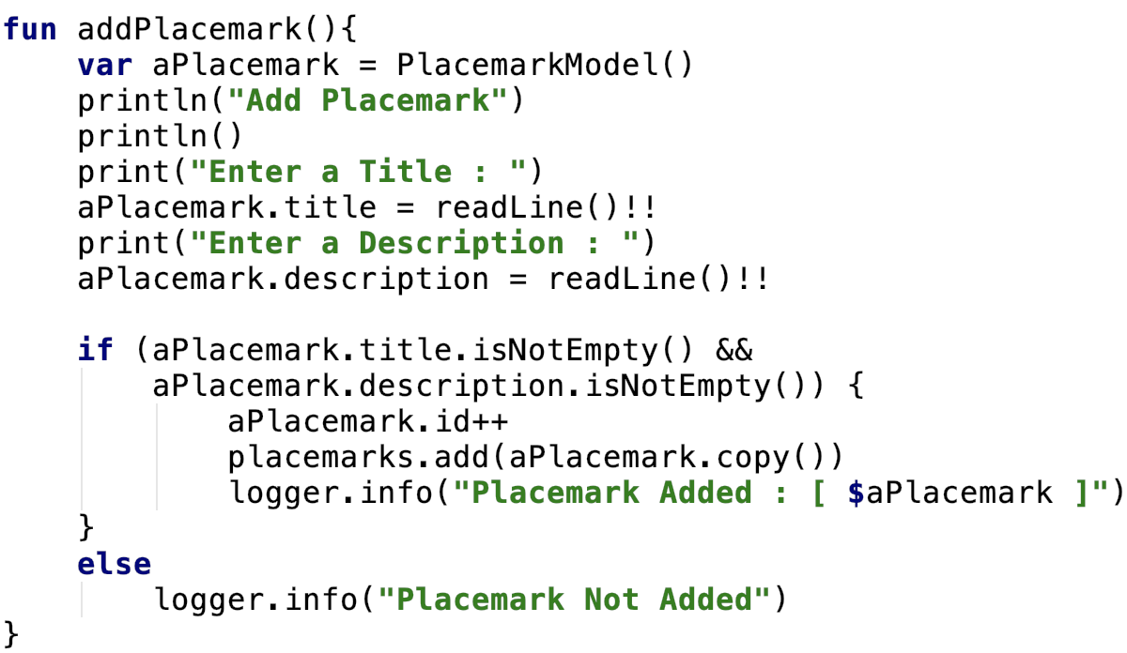
Function addPlacemark( ) (CREATE)
getting Placemark info
adding to our placemarks collection (more later)

Slide 15
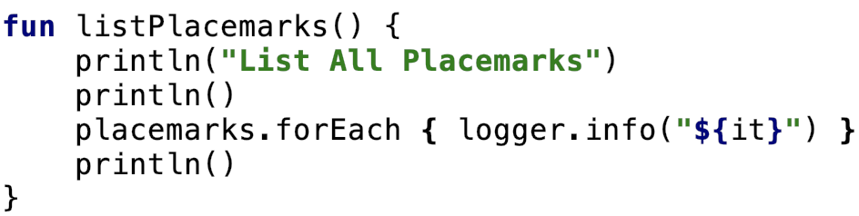
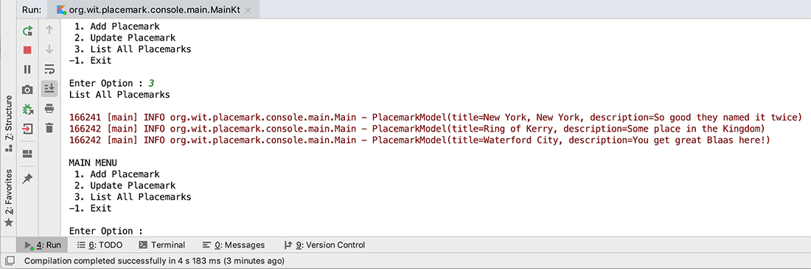
Function listPlacemarks( ) (READ)
displaying Placemarks
result

Slide 16
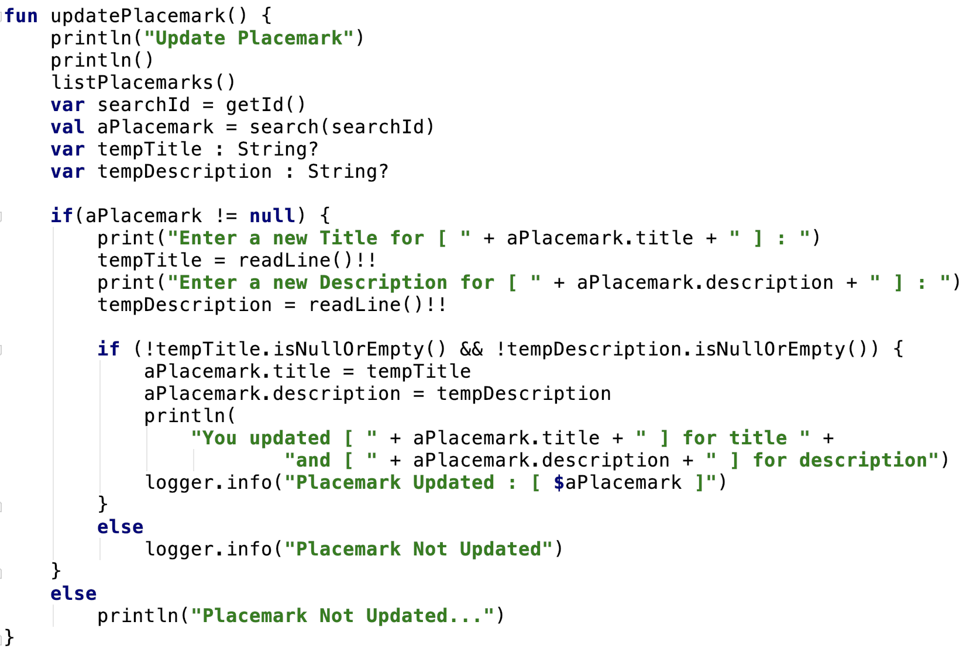
Function updatePlacemark( ) (UPDATE)
finding a Placemark
updating
note we don’t reference the collection – all done via reference aPlacemark

Slide 17
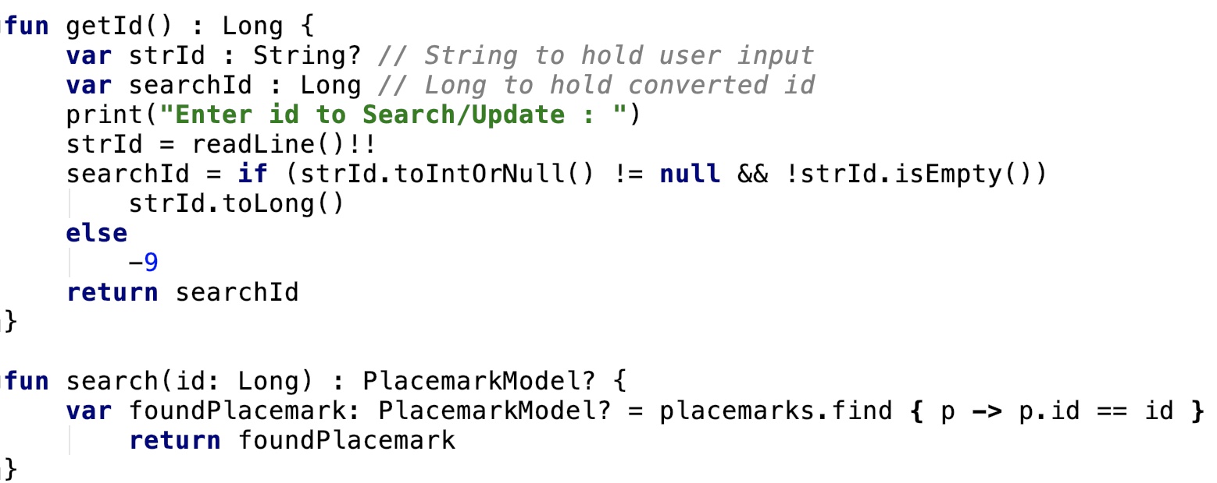
Helper Functions
getting a valid ‘id’
Searching for a specific Placemark
note we use the collections method find

Slide 18
Arrays & Collections
Placemark-Console Version 2.0

Slide 19

Arrays & Collections in Placemark
val variable placemarks is declared as a ArrayList of PlacemarkModel objects
we can add to this collection like so
or
Note the use of .copy() (ensures a copy is stored, not actual object to avoid unexpected changes to collection data)

Slide 20
Lambdas
Placemark-Console Version 2.0

Slide 21
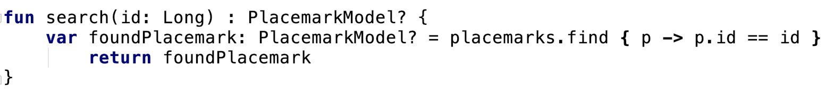
Lambdas in Placemark
Here the Collections find function is a ‘Higher Order’ function which means we can assign it as a parameter and pass anonymous functions to it, and use lambda expressions

Slide 22
References
Sources: http://kotlinlang.org/docs/reference/basic-syntax.html
http://petersommerhoff.com/dev/kotlin/kotlin-for-java-devs/
https://www.programiz.com/kotlin-programming
https://medium.com/@napperley/kotlin-tutorial-5-basic-collections-3f114996692b

Slide 23


