Slide 1




Mobile Application Development
Produced
by
Dave Drohan (david.drohan@setu.ie)
Department of Computing & Mathematics
South East Technological University Waterford, Ireland
Updated & Delivered
by
Gongzhe Qiao (003969@nuist.edu.cn)
Department of Computer Science
Nanjing University of Information Science and Technology Nanjing, China
nuist.edu.cn
setu.ie

Slide 2

Introducing Kotlin Syntax - Part 2.2

Slide 3
Agenda for Part 2
Writing Classes (properties and fields)
Data Classes (just for data)
Collections: Arrays and Collections
Collections: in operator and lambdas
Arguments (default and named)

Slide 4
Agenda for Part 2
Writing Classes (properties and fields)
Data Classes (just for data)
Collections: Arrays and Collections
Collections: in operator and lambdas
Arguments (default and named)

Slide 5
Collections
Arrays and Collections

Slide 6
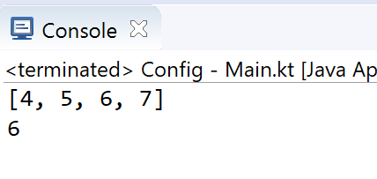
Arrays (using arrayOf)
Arrays in Kotlin can be created using arrayOf() or the Array() constructor.
fun main(args: Array<String>) {
val myArray = arrayOf(4, 5, 6, 7)
println(myArray.asList())
print(myArray[2])
}

Slide 7
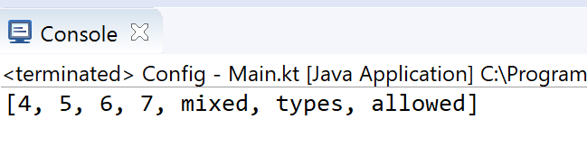
Arrays (using arrayOf)
You can create an array of mixed types (different from Java)
fun main(args: Array<String>) {
val myArray = arrayOf(4, 5, 6, 7, "mixed", “types", "allowed")
print(myArray.asList())
}
fun main(args: Array<String>) {
val intArray1 = intArrayOf(4, 5, 6, 7)
val intArray2 = arrayOf<Int>(4, 5, 6, 7)
val charArray = charArrayOf('a', 'b', 'c', 'd’)
val booleanArray = booleanArrayOf(true, false, true)
val mixedArray1 = intArrayOf(4, 5, 6, 7, "will","not","compile")
val mixedArray2 = arrayOf<Int>(4, 5, 6, 7,"will","not","compile")
}

Slide 8
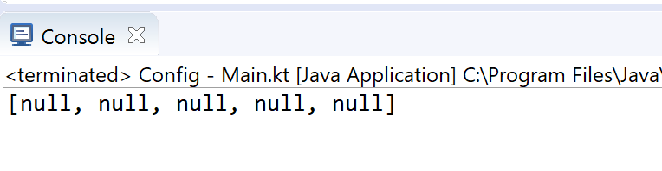
Arrays (using arrayOfNulls)
Or an array of nulls, in this case, to hold Ints
fun main(args: Array<String>) {
val nullArray = arrayOfNulls<Int>(5);
println (nullArray.asList())
}

Slide 9
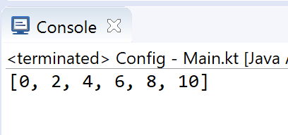
Arrays (using constructor)
The Array() constructor requires a size and a lambda function.
fun main(args: Array<String>) {
val intArray = Array(6, { i -> i * 2 })
print (intArray.asList())
}
Value to be inserted into the index
Index of the array element

Slide 10
Collections
Unlike many languages, Kotlin distinguishes between mutable and immutable collections (lists, sets, maps, etc).
Precise control over exactly when collections can be edited is useful for eliminating bugs, and for designing good APIs.
Notes:
Similar to Kotlin distinguishing between val and var it does the same for collections – so worth knowing which is which

Slide 11
Collections – mutable Vs immutable
The Kotlin List<out T> type is an interface that provides read-only operations like size, get and so on.
Like in Java, it inherits from Collection<T> and that in turn inherits from Iterable<T>.
Methods that change the list are added by the MutableList<T> interface.
This pattern holds also for Set<out T>/MutableSet<T> and Map<K, out V>/MutableMap<K, V>.
Notes:
The OUT modifier ensures that objects of type T can only be consumed (read-only) there’s also another modifier IN, that enforces write-only

Slide 12
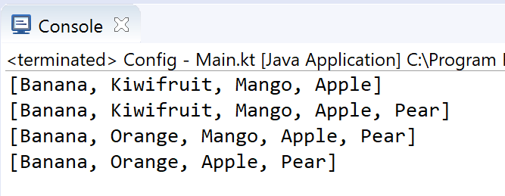
Collections – mutable List
fun main(args: Array<String>) {
// Create a mutable list (MutableList).
val fruit = mutableListOf("Banana", "Kiwifruit", "Mango", "Apple")
println(fruit)
// Add a element to the list.
fruit.add("Pear")
println(fruit)
// Change an element in the list.
fruit[1] = "Orange"
println(fruit)
// Remove a existing element from the list.
fruit.removeAt(2)
println(fruit)
}

Slide 13
Collections – immutable List – example 1
fun main(args: Array<String>) {
val numbers: MutableList<Int> = mutableListOf(1, 2, 3)
val readOnlyView: List<Int> = numbers
println(numbers) // prints "[1, 2, 3]"
numbers.add(4)
println(readOnlyView) // prints "[1, 2, 3, 4]"
readOnlyView.clear() // -> does not compile
}

Slide 14
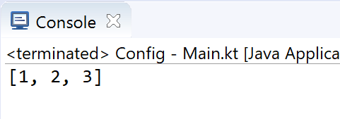
Collections – immutable List – example 2
class Person( _firstName: String = "UNKNOWN",
_lastName: String = "UNKNOWN") {
private val _items = mutableListOf<String>("1", "2", "3")
val items: List<String> get() = _items.toList()
}
custom function get() ‘linking’ _items with items
items returns a snapshot of a collection at a particular point in time (that's guaranteed to not change) as toList() just duplicates _items.
fun main(args: Array<String>) {
val person = Person()
println(person.items)
//person.items.clear() //doesn't compile
}
Notes:
Custom function get() ‘links’ _items with items so every time you access items you actually get _items

Slide 15
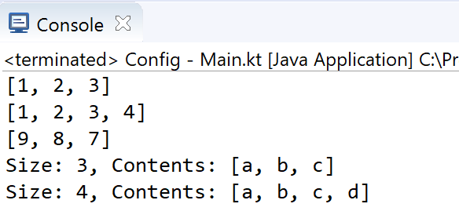
Collections – Set and hashSet
Ordered
(implement LinkedHashSet)
fun main(args: Array<String>) {
// mutatble set
val mutableSet : MutableSet<Int> = mutableSetOf(1,2,3)
println(mutableSet)
mutableSet.add(4)
println(mutableSet)
// immutatble set
val immutableSet : Set<Int> = setOf(9,8,7)
println(immutableSet)
//immutableSet.add(6) //won't compile
//note: ignores duplicate items
val strings = hashSetOf("a", "b", "c", "c")
println("Size: ${strings.size}, Contents: " + strings)
strings.add("d")
println("Size: ${strings.size}, Contents: " + strings)
}
Not ordered
Notes:
Remember, NO DUPLICATES in a Set

Slide 16
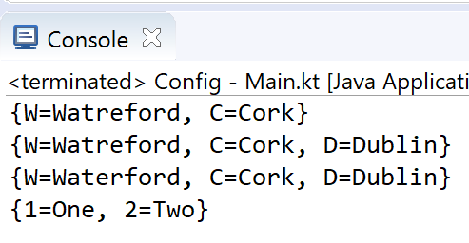
Collections – Map and hashMap
fun main(args: Array<String>) {
// mutatble map
val mutableMap = mutableMapOf("W" to "Watreford", "C" to "Cork")
println(mutableMap)
mutableMap.put("D", "Dublin")
println(mutableMap)
mutableMap["W"] = "Waterford"
println(mutableMap)
// immutatble map
val immutableMap : Map<Int, String> = mapOf(1 to "One", 2 to "Two")
println(immutableMap)
//immutableMap.put(3, "Three") //won't compile
}

Slide 17
Some additional sources for exploration:
Inheritance | https://www.programiz.com/kotlin-programming/inheritance
Interfaces | https://www.programiz.com/kotlin-programming/interfaces
Collections | https://kotlinlang.org/api/latest/jvm/stdlib/kotlin.collections/index.html
Try examples online | https://try.kotlinlang.org/#/Examples/Hello,%20world!/Simplest%20version/Simplest%20version.kt
Encapsulation & Polymorphism | https://medium.com/@napperley/kotlin-tutorial-12-encapsulation-and-polymorphism-6e5a150f25e1
Spek (testing) | https://objectpartners.com/2016/02/23/an-introduction-to-kotlin/ https://github.com/mike-plummer/KotlinCalendar

Slide 18
References
Sources: http://kotlinlang.org/docs/reference/basic-syntax.html
http://petersommerhoff.com/dev/kotlin/kotlin-for-java-devs/
https://www.programiz.com/kotlin-programming
https://www.baeldung.com/kotlin-lambda-expressions
https://www.programiz.com/kotlin-programming/lambdas
https://medium.com/@napperley/kotlin-tutorial-5-basic-collections-3f114996692b

Slide 19


