Slide 1




Mobile Application Development
Produced
by
Dave Drohan (david.drohan@setu.ie)
Department of Computing & Mathematics
South East Technological University Waterford, Ireland
Updated & Delivered
by
Gongzhe Qiao (003969@nuist.edu.cn)
Department of Computer Science
Nanjing University of Information Science and Technology Nanjing, China
nuist.edu.cn
setu.ie

Slide 2

Introducing Kotlin Syntax - Part 2.3

Slide 3
Agenda for Part 2
Writing Classes (properties and fields)
Data Classes (just for data)
Collections: Arrays and Collections
Collections: in operator and lambdas
Arguments (default and named)

Slide 4
Agenda for Part 2
Writing Classes (properties and fields)
Data Classes (just for data)
Collections: Arrays and Collections
Collections: in operator and lambdas
Arguments (default and named)

Slide 5
Collections
The in operator and using lambdas

Slide 6
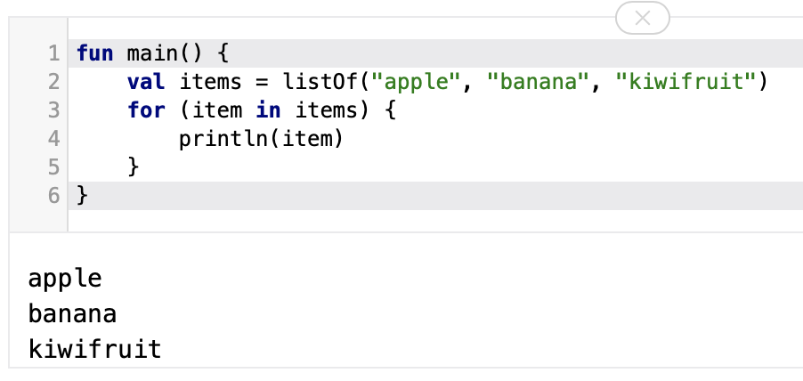
Collections – iterating using the in operator

Slide 7
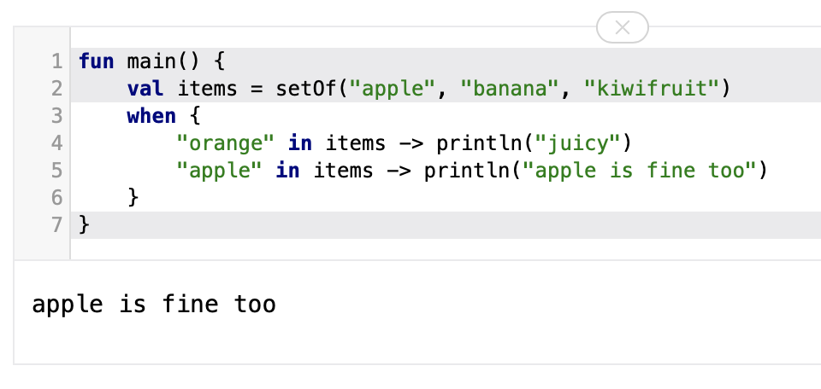
Collections – checking if collection contains an object

Slide 8
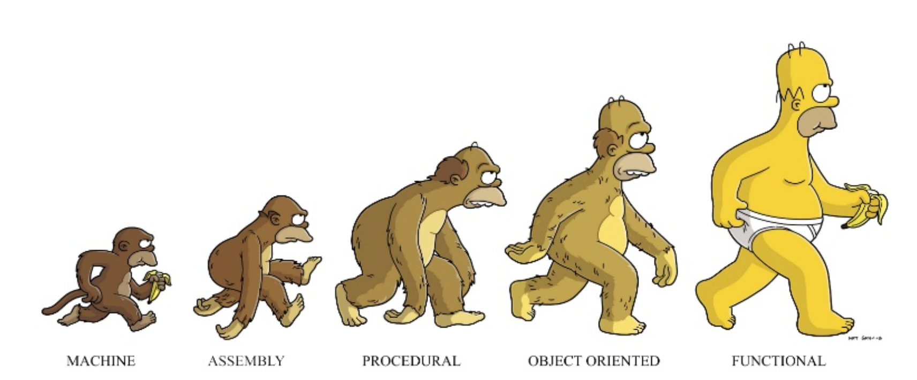
Kotlin…. functional programming is prevalent!
Notes:
https://pt.slideshare.net/arnaudgiuliani/kotlin-smarter-development-for-the-jvm Amusing Graphic ☺ showing the Evolution of the different types of Programming

Slide 9
Quick Overview – Functional Programming
In a nutshell, its a style of programming where you focus on transforming data through the use of small expressions that ideally don’t contain side effects.
In other words, when you call “myfun(a, b)”, it will always return the same result. This is achieved by immutable data typical of a functional language.
With the functional approach, we are expressing what we want done, not how to do it.

Slide 10
Quick Overview – Functional Programming
The main characteristics of functional programming languages are :
Designed on the concept of mathematical functions that use conditional expressions and recursion to perform computation.
Supports higher-order functions and lazy evaluation features.
Doesn’t support flow Controls like loop statements and conditional statements like If-Else and Switch/When Statements. They directly use the functions and functional calls.
Like OOP, functional programming languages support popular concepts such as Abstraction, Encapsulation, Inheritance, and Polymorphism.

Slide 11
Quick Overview – lambdas
Lambdas aren’t unique to Kotlin and have been around for many years in many other languages (very similar to Java)
Lambda expressions (or lambda functions) are essentially blocks of code (anonymous functions) that can be assigned to variables, passed as an argument to methods, or returned from a function call, in languages that support higher-order functions.

Slide 12
Quick Overview – lambdas
To define a Lambda (expression) we say something like
Note : The only part of a lambda which isn’t optional is the codeBody.
The arguementList can be skipped (omitted) when defining at most one argument and the Type can often be inferred.
We don’t always need a variable either - lambda can be passed directly as a function argument.
The type of the last command within a lambda block is the return type.
val lambdaName : Type = { arguementList -> codeBody }

Slide 13
Quick Overview – lambdas
Here, a lambda expression is assigned to variable greeting. The expression doesn't accept any parameters and doesn't return any value in this program.
When you run the program, the output will be:
fun main(args: Array<String>) {
val greeting = { println("Hello!")}
// invoking function
greeting()
}
Hello!

Slide 14
Quick Overview – lambdas
Here, we have a lambda expression that accepts two integers as parameters, and returns the product of those two integers.
When you run the program, the output will be:
fun main(args: Array<String>) {
val product = { a: Int, b: Int -> a * b }
val result = product(9, 3)
println(result)
}
27

Slide 15
Quick Overview – lambdas
In the previous example, the lambda expression is:
Note again, a lambda expression is enclosed inside curly braces.
arguementList
{ a: Int, b: Int -> a * b }
codeBody

Slide 16
Collections – lambdas
Lambdas are frequently used while working with collections.
There are several built-in functions available (next few slides) in standard-library that take lambdas to make tasks easier.
If the lambda expression accepts only one parameter/argument (a list of objects perhaps? (next slide)) you can refer to the argument by using the keyword “it”.
It is an implicit variable and can be omitted when it refers to a particular object in a single list argument.

Slide 17
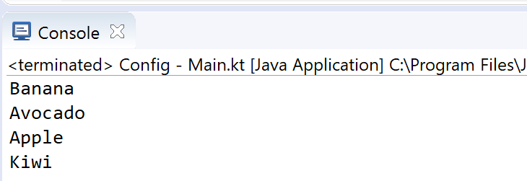
Collections – lambdas
Using lambda expressions to filter and map collections
it -> is optional here
fun main(args: Array<String>) {
val fruits = listOf ("Banana", "Avocado", "Apple", "Kiwi")
fruits.forEach { it -> println(it) }
}
No need for function brackets (. . . )
Notes:
You can see how you code is reduces considerably when you start using lambda expressions

Slide 18
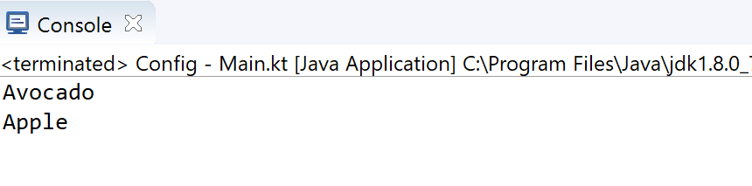
Collections – lambdas
Using lambda expressions to filter and map collections
fun main(args: Array<String>) {
val fruits = listOf ("Banana", "Avocado", "Apple", "Kiwi")
fruits.filter { it.startsWith("A") }
.forEach { println(it) }
}

Slide 19
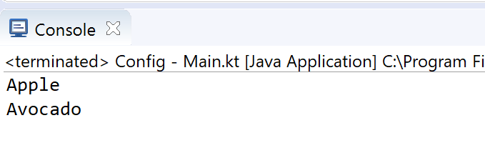
Collections – lambdas
Using lambda expressions to filter and map collections
fun main(args: Array<String>) {
val fruits = listOf ("Banana", "Avocado", "Apple", "Kiwi")
fruits.filter { it.startsWith("A") }
.sortedBy { it }
.forEach { println(it) }
}

Slide 20
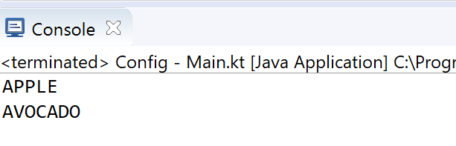
Collections – lambdas
Using lambda expressions to filter and map collections
fun main(args: Array<String>) {
val fruits = listOf ("Banana", "Avocado", "Apple", "Kiwi")
fruits.filter { it.startsWith("A") }
.sortedBy { it }
.map { it.uppercase() }
.forEach { println(it) }
}

Slide 21
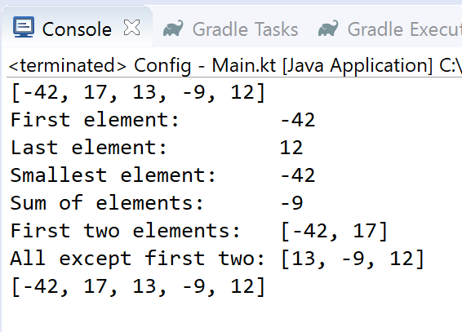
Collections – sample functions
fun main(args: Array<String>) {
val numbers = listOf(-42, 17, 13, -9, 12)
println(numbers)
println("First element: " + numbers.first())
println("Last element: " + numbers.last())
println("Smallest element: " + numbers.min())
println("Sum of elements: " + numbers.foldRight(0, { a, b -> a + b }))
println("First two elements: " + numbers.take(2))
println("All except first two: " + numbers.drop(2))
println(numbers)
}

Slide 22
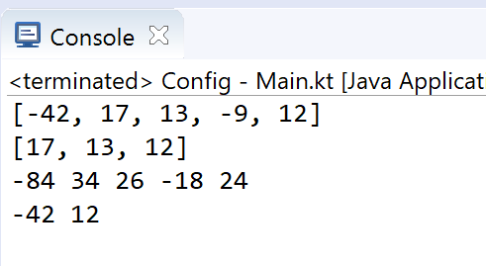
Collections – sample functions
fun main(args: Array<String>) {
val numbers = listOf(-42, 17, 13, -9, 12)
println(numbers)
// New list only containing non-negative numbers
val nonNegative = numbers.filter { it >= 0 }
println(nonNegative)
// Double each element
numbers.forEach { print("${it * 2} ") }
println();
// Output Even elements only
numbers.filter {it % 2 == 0}
.forEach {print ("$it " )}
println();
}

Slide 23
Sets and Lambdas
fun main(args: Array<String>) {
val numbers = setOf(-42, 17, 13, -9, 12)
println(numbers)
// New list only containing non-negative numbers
val nonNegative = numbers.filter { it >= 0 }
println(nonNegative)
// Double each element
numbers.forEach { print("${it * 2} ") }
println();
// Output Even elements only
numbers.filter {it % 2 == 0}
.forEach {print ("$it " )}
println();
}

Slide 24
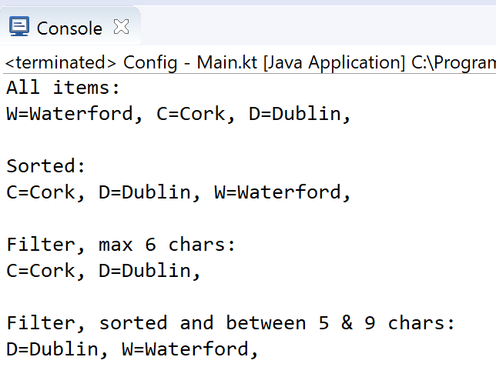
Maps and Lambdas
fun main(args: Array<String>) {
val counties = mapOf(
Pair("W","Waterford"),
Pair("C","Cork"),
Pair ("D","Dublin") )
println("All items:");
counties.forEach {print(it); print (", ")}
println("\n\nSorted:");
counties.toSortedMap()
.forEach {print(it); print (", ")}
println("\n\nFilter, max 6 chars:");
counties.filter {it.value.length <= 6 }
.forEach {print(it); print (", ")}
println("\n\nFilter, sorted and between 5 & 9 chars:");
counties.filterValues {it.length >= 5 && it.length <=9}
.toSortedMap()
.forEach {print(it); print (", ")}
}

Slide 25
Arguments
default and named

Slide 26
Default Arguments (optional)
In Java, you often have to duplicate code in order to define different variants of a method or constructor (i.e. overloading).
Kotlin simplifies this by using default values for arguments (i.e. makes them optional arguments).
Notes:
No need for multiple constructors/methods/functions with different numbers of parameters in Kotlin – one function with optional arguments

Slide 27
Default Arguments (optional)
Primary Constructor
class NutritionFacts( val foodName: String,
val calories: Int,
val protein: Int = 0,
val carbohydrates: Int = 0,
val fat: Int = 0,
val description: String = "" )
{
}
Optional
Parameters
Some possible constructor calls
val pizza = NutritionFacts("Pizza", 442, 12, 27, 24,
"Deep Pan Pizza")
val pasta = NutritionFacts("Pasta", 371, 14, 25, 11)
val soup = NutritionFacts("Soup", 210)

Slide 28
Named Arguments
class NutritionFacts( val foodName: String,
val calories: Int,
val protein: Int = 0,
val carbohydrates: Int = 0,
val fat: Int = 0,
val description: String = "" )
{
}
Naming arguments make your code more readable
Some possible constructor calls
val pasta = NutritionFacts("Pasta", 371, 14, 25, 11)
val burger = NutritionFacts("Hamburger", calories = 541, fat = 33,
protein = 14)
val rice = NutritionFacts("Rice", 312, carbohydrates = 23,
description = “Grains")
Notes:
You don’t have to maintain the order the parameters are defined in, when you explicitly name them

Slide 29
Some additional sources for exploration:
Inheritance | https://www.programiz.com/kotlin-programming/inheritance
Interfaces | https://www.programiz.com/kotlin-programming/interfaces
Collections | https://kotlinlang.org/api/latest/jvm/stdlib/kotlin.collections/index.html
Try examples online | https://try.kotlinlang.org/#/Examples/Hello,%20world!/Simplest%20version/Simplest%20version.kt
Encapsulation & Polymorphism | https://medium.com/@napperley/kotlin-tutorial-12-encapsulation-and-polymorphism-6e5a150f25e1
Spek (testing) | https://objectpartners.com/2016/02/23/an-introduction-to-kotlin/ https://github.com/mike-plummer/KotlinCalendar

Slide 30
References
Sources: http://kotlinlang.org/docs/reference/basic-syntax.html
http://petersommerhoff.com/dev/kotlin/kotlin-for-java-devs/
https://www.programiz.com/kotlin-programming
https://www.baeldung.com/kotlin-lambda-expressions
https://www.programiz.com/kotlin-programming/lambdas
https://medium.com/@napperley/kotlin-tutorial-5-basic-collections-3f114996692b

Slide 31


