Slide 1




Mobile Application Development
Produced
by
Dave Drohan (david.drohan@setu.ie)
Department of Computing & Mathematics
South East Technological University Waterford, Ireland
Updated & Delivered
by
Gongzhe Qiao (003969@nuist.edu.cn)
Department of Computer Science
Nanjing University of Information Science and Technology Nanjing, China
nuist.edu.cn
setu.ie

Slide 2

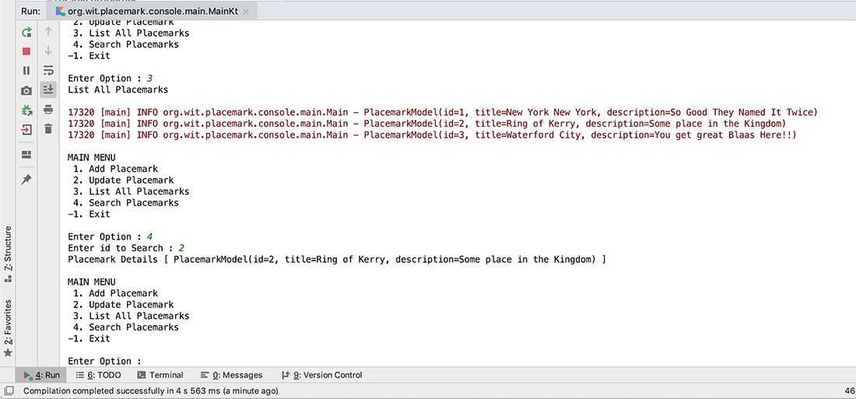
Placemark-Console Version 3.0

Slide 3
Features Covered (from Part 1)
Basic Types
Local Variables (val & var)
Functions
Control Flow (if, when, for, while)
Strings & String Templates
Ranges (and the in operator)
Type Checks & Casts
Null Safety
Comments

Slide 4
Features Covered (from Part 2)
Writing Classes (properties and fields)
Data Classes (just for data)
Collections: Arrays and Collections
Collections: in operator and lambdas
Arguments (default and named)

Slide 5
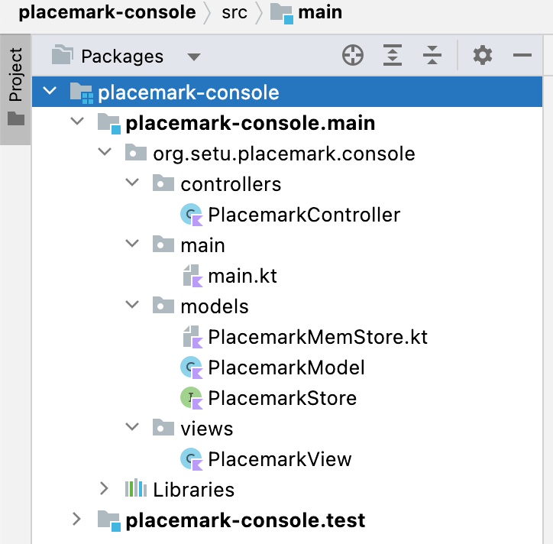
Project Structure
Now more complex
Multiple packages

Slide 6
Project Structure
Now more complex
Multiple packages
MVC Pattern

Slide 7
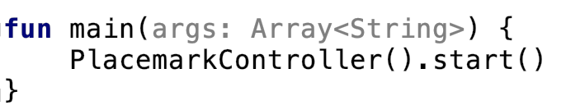
main.kt
Codebase in main file substantially Reduced
fun main
Single line of code

Slide 8
Classes & Interfaces
Placemark-Console Version 3.0

Slide 9
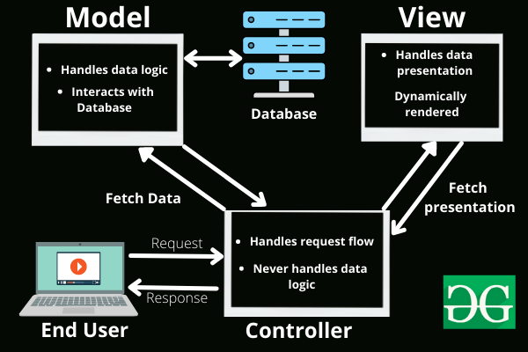
Classes & Interfaces in Placemark
Version 3.0 refactors the app to make use of the MVC (Model-View-Controller) Design Pattern
Allows for SoC (Separation of Concerns)
A number of new Classes & Interfaces introduced to improve overall design
https://www.geeksforgeeks.org/mvc-framework-introduction/

Slide 10
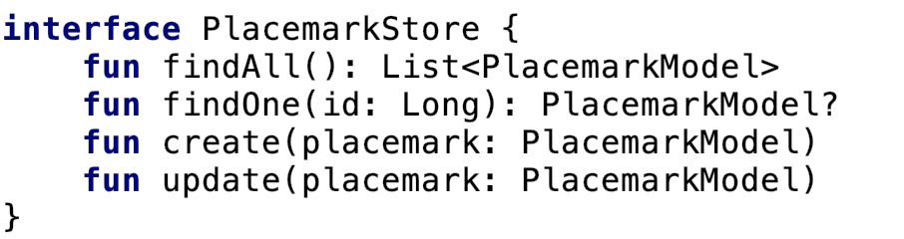
Interface PlacemarkStore
4 functions, responsible for defining how our implementation classes will behave (for the moment)
Classes that implement this interface must implement these functions

Slide 11
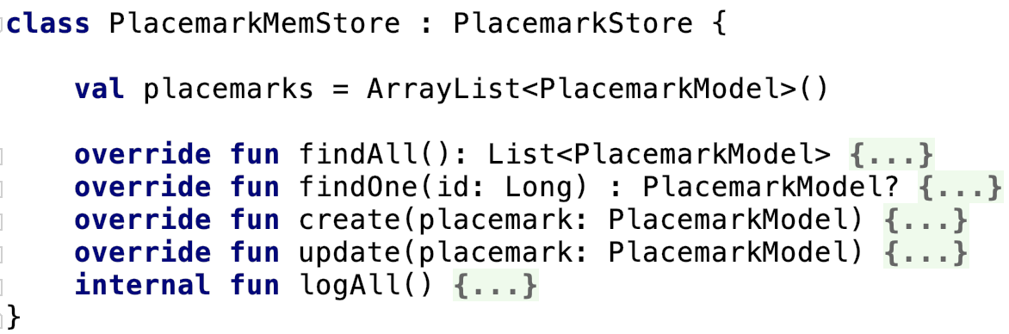
Class PlacemarkMemStore
This class implements PlacemarkStore – note modifier override to signify the function is an implementation of the function defined in interface
We also have an internal function (just ‘local’ to this class)

Slide 12
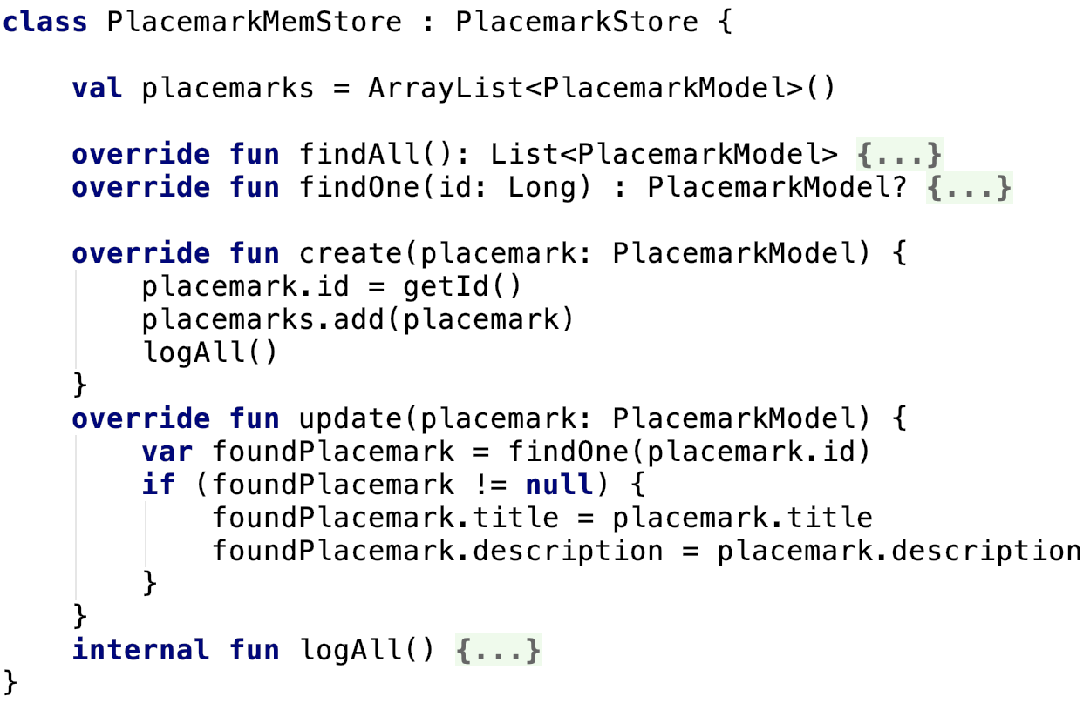
Class PlacemarkMemStore
Here we see the ‘inner workings’ of our implemented functions (create & update)

Slide 13
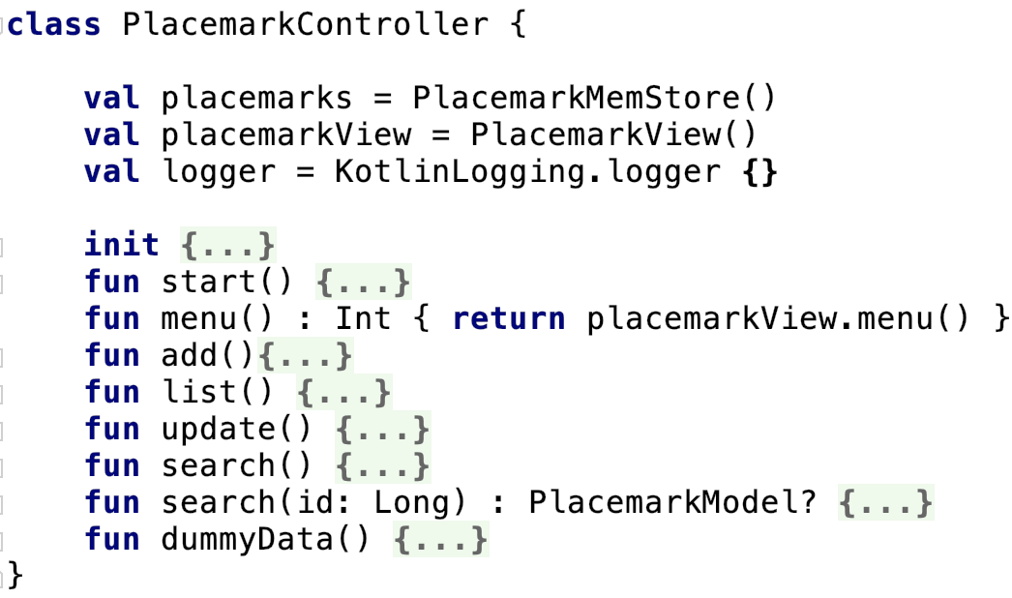
Class PlacemarkController
Main purpose to act as ‘link’ between Model and View
No interaction with user - ‘controls’ the flow of data between the user and storage

Slide 14
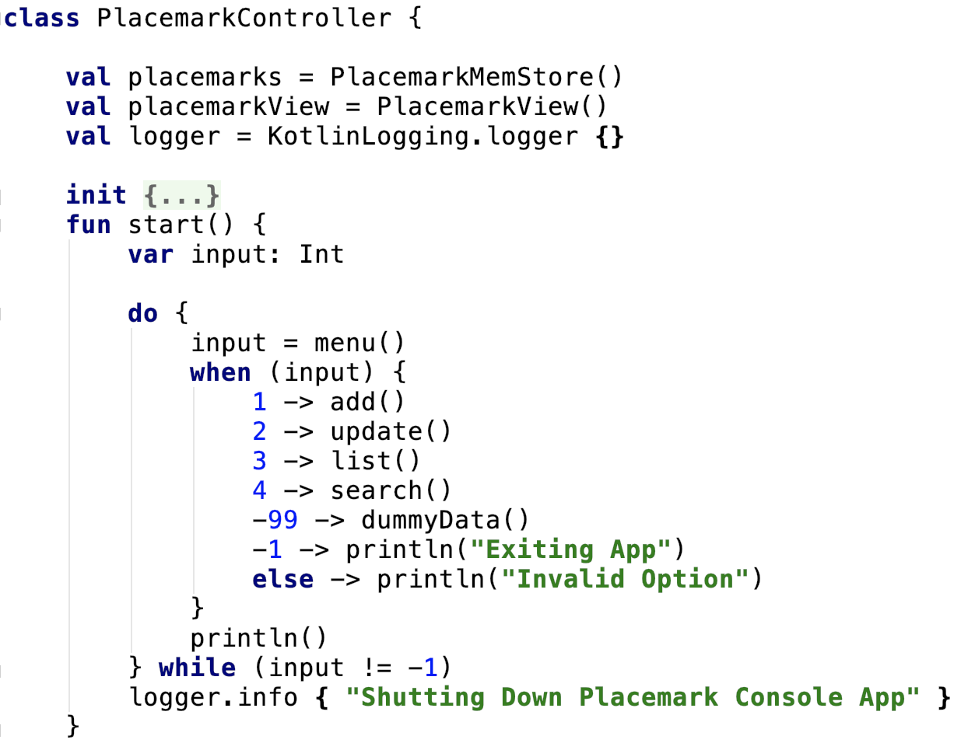
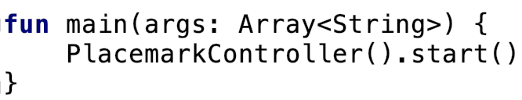
Class PlacemarkController – start()
Initial point of entry in application
Triggers CRUD features based on user options from ‘View’

Slide 15
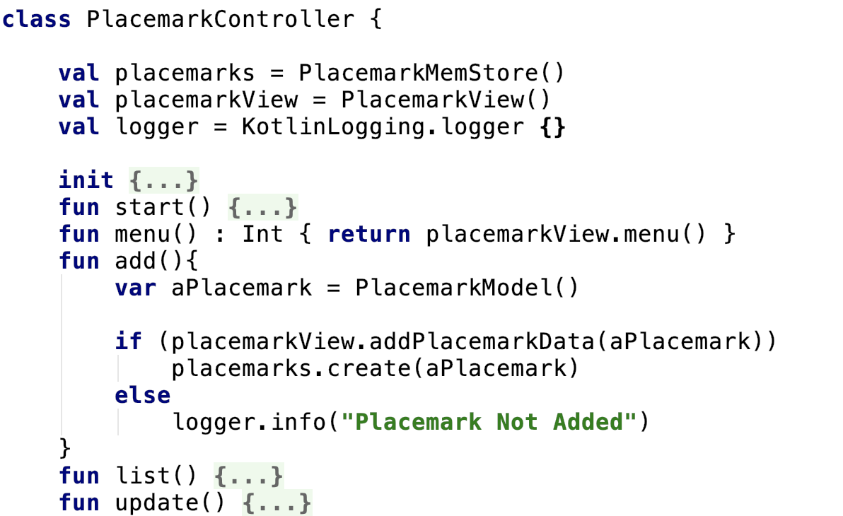
Class PlacemarkController – add()
Interacting with both Model and View to add a Placemark
The remaining functions operate in a similar fashion

Slide 16
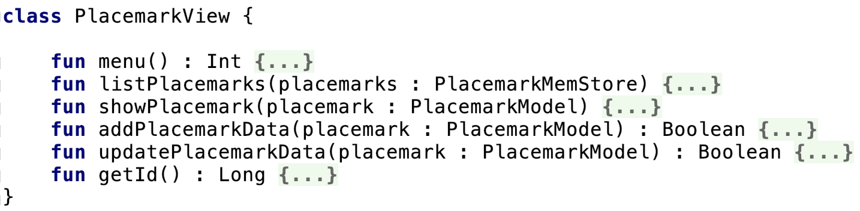
Class PlacemarkView
‘User Facing’ class to present console UI for the application
Responsible for displaying user menu, Placemarks, getting Placemark data etc.

Slide 17
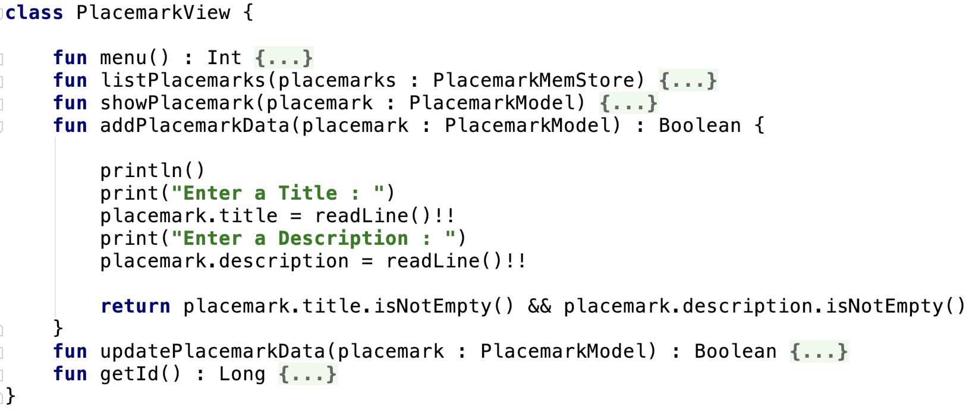
Class PlacemarkView – addPlacemarkData()
Getting User Data

Slide 18
Arrays & Collections
Placemark-Console Version 3.0

Slide 19
Arrays & Collections in Placemark
val variable placemarks is declared as a ArrayList of PlacemarkModel objects inside PlacemarkMemStore
we can add to this collection manually like so

Slide 20
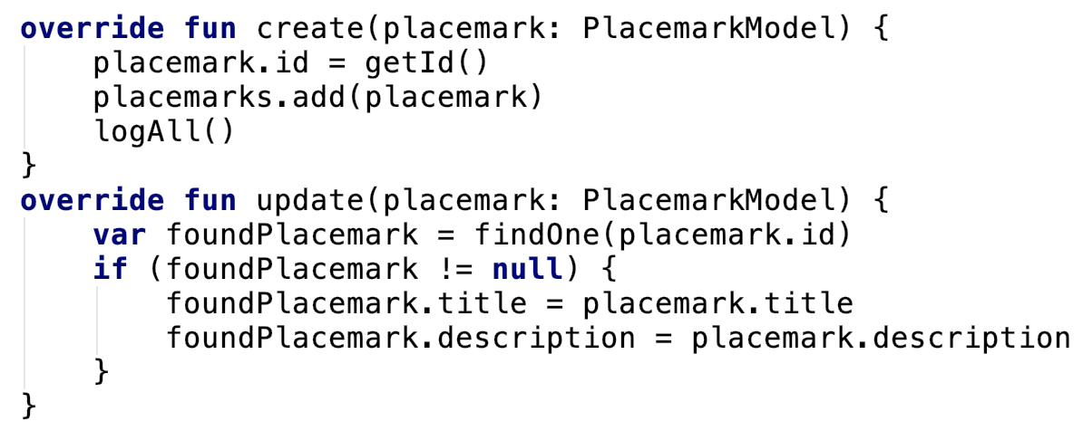
Arrays & Collections in Placemark
We can also carry out CRUD operations using PlacemarkMemStore functions

Slide 21
Lambdas
Placemark-Console Version 3.0

Slide 22
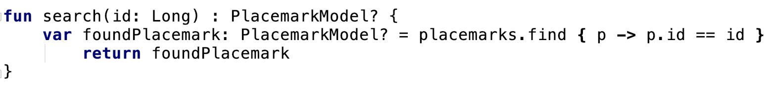
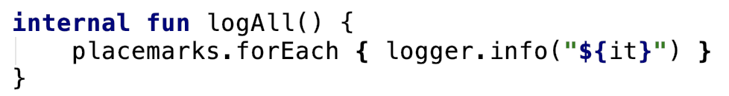
Lambdas in Placemark
Here the Collections find function is a ‘Higher Order’ function which means we can assign it as a parameter and pass anonymous functions to it, and use lambda expressions
Another Higher Order Function – forEach (note use of it)

Slide 23
References
Sources: http://kotlinlang.org/docs/reference/basic-syntax.html
http://petersommerhoff.com/dev/kotlin/kotlin-for-java-devs/
https://www.programiz.com/kotlin-programming
https://medium.com/@napperley/kotlin-tutorial-5-basic-collections-3f114996692b

Slide 24


