Slide 1

Programming Fundamentals 1 Course Outline & Essential Information

Slide 2
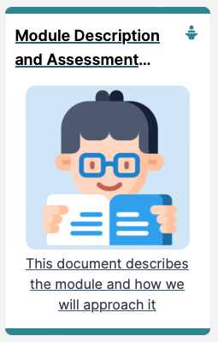
Course Outline &
Essential Information
Introducing Programming Fundamentals 1

Slide 3
Outline
Lecturer Details
How to Contact me
Learning Technologies
Course Purpose
Course Structure and
Course Document

Slide 4
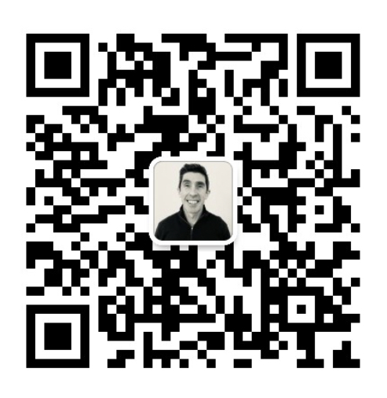
Lecturer Details
David (Dave) Drohan (BSc, MSc)
Lecturer in Department of Computing and Mathematics (in SETU)
Programme Leader, BSc (Hons) in Software Engineering
david.drohan@setu.ie
WeChat ID: dave-drohan-setu

Slide 5
Lecturer Details – Module Areas
Object Oriented Programming
Data Structures
Systems Analysis & Design
GUI Development
Web App Development
Mobile App Development (Android)
Programming Fundamentals 1 ☺

Slide 6
How to Contact me
The best way to reach me will be via Slack so please join the Programming Fundamentals 1 Slack workspace (via tutors site or direct link)
If you need to contact me directly, please DM rather than using public channels
or if you prefer, email me at david.drohan@setu.ie
or via WeChat at dave-drohan-setu

Slide 7
Learning Technologies
Moodle - our learning management system (used all over SETU), where you can find links to the notes, and where online exams are curated. The link to this course will be available soon. Most weeks you will be given a list of activities to have done before the class and a list of activities to have done before the next week. (need to be enrolled first though…)
Zoom - If, for some reason, we need to use Zoom for remote working, we will generally send the Zoom link via the Slack channel.

Slide 8
Learning Technologies
Slack - Slack is a messaging app for companies with organised spaces called channels – a different one for everything that we’re working on. We will use Slack for all our day-to-day communication for the module.
Tutors - This static website will hold all the notes, labs and links to videos (if we need them). This site is organised by topic, as opposed to Moodle which is organised by week (by linking to, among other things, the relevant tutors topic). (can be accessed immediately with a Github account)

Slide 9
Learning Technologies
Slack
https://pf1-nuist-2024.slack.com/
Tutors
https://tutors.dev/course/prog-fund-1-nuist-2024

Slide 10

Course Purpose
Introduce Java & Programming Fundamentals 1 through Case Studies and targeted practical labs on a week by week basis

Slide 11
Course Purpose
Introduce Java & Programming Fundamentals 1 through Case Studies and targeted practical labs on a week by week basis
Assumptions:
NO level of Java or closely related language expected
Every topic explores specific Java features in parallel to the labs

Slide 12
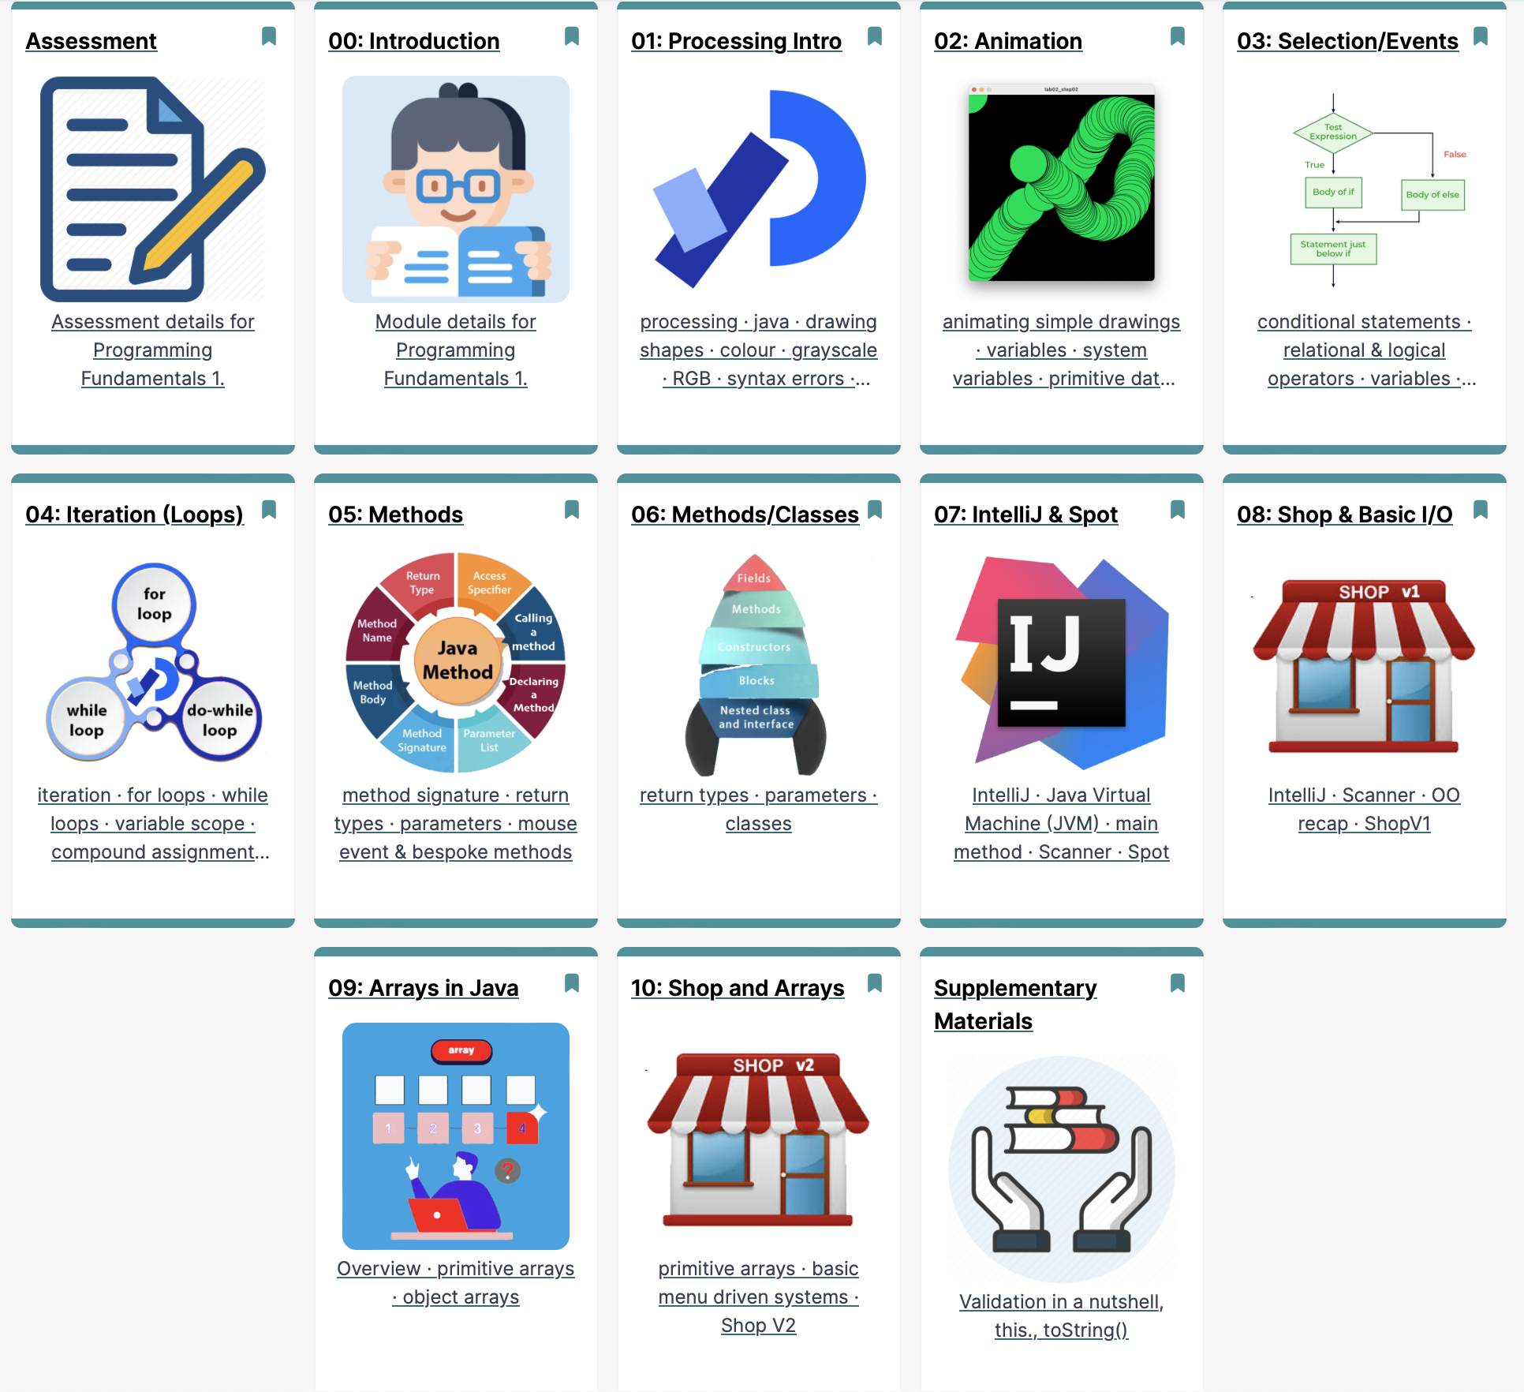
Course Structure

Slide 13
Course Structure MCQ 1

Slide 14
Course Structure MCQ 2

Slide 15
Course Structure Team Project

Slide 16
Assessment
100% Continuous Assessment Module (15%,45%,40%)
1 Team Based Assignment, Teams of 3 – Due week 15 and 2 Multiple Choice Question (MCQ) Exams, Weeks 4 & 8
Demos Week 13 (TBC)
Project Ideas MUST be unique AND all your own original work (mostly!)
1st come 1st served approach to Project Titles
10% +2% per day deduction for every day late
We’ll talk about the Assignments in more detail later on

Slide 17
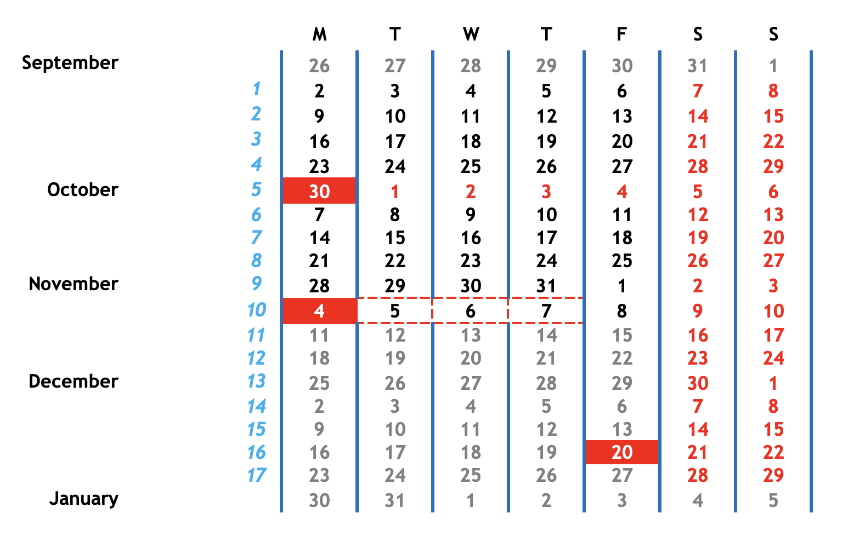
Assessment Schedule

Slide 18
Assessment Schedule
MCQ Exam 1

Slide 19
Assessment Schedule
Teams Submitted

Slide 20
Assessment Schedule
MCQ Exam 2

Slide 21
Assessment Schedule
Team Project Specification

Slide 22
Assessment Schedule
Team Project Submission

Slide 23
Assessment Schedule
MCQ Exam 1
MCQ Exam 2
Teams Submitted
Team Project Specification
Team Project Submission

Slide 24

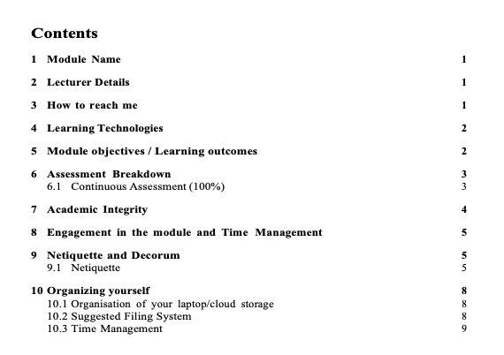
Course Document

Slide 25

Questions? 问题

Slide 26
Questions are Good – so ASK! 问题很好，所以提问
☺

Slide 27
如果你不能用英语提问，可以找一个能帮你提问的人 ☺

Slide 28


谢谢

