Slide 1
Programming Fundamentals 1

Slide 2
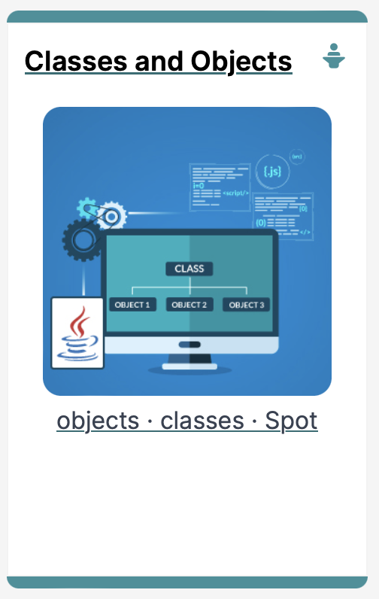
Introduction to Processing
Classes and Objects

Slide 3
Agenda
Classes & Objects
Properties & Methods
The Dot Operator
Creating your first class – Spot
Constructors
Default
Parameters
Overloading

Slide 4

Classes and Objects

Slide 5
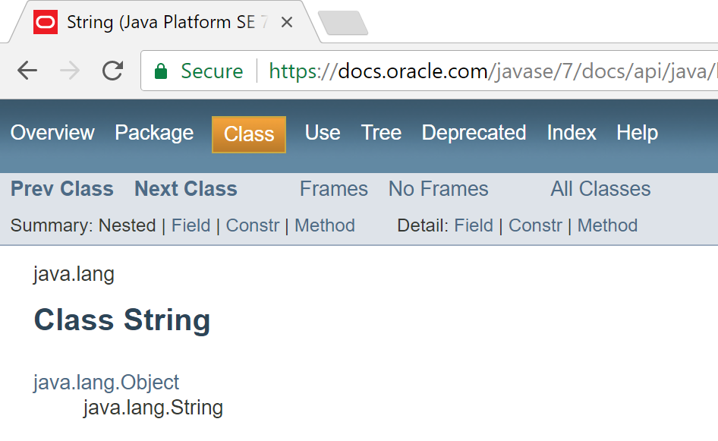
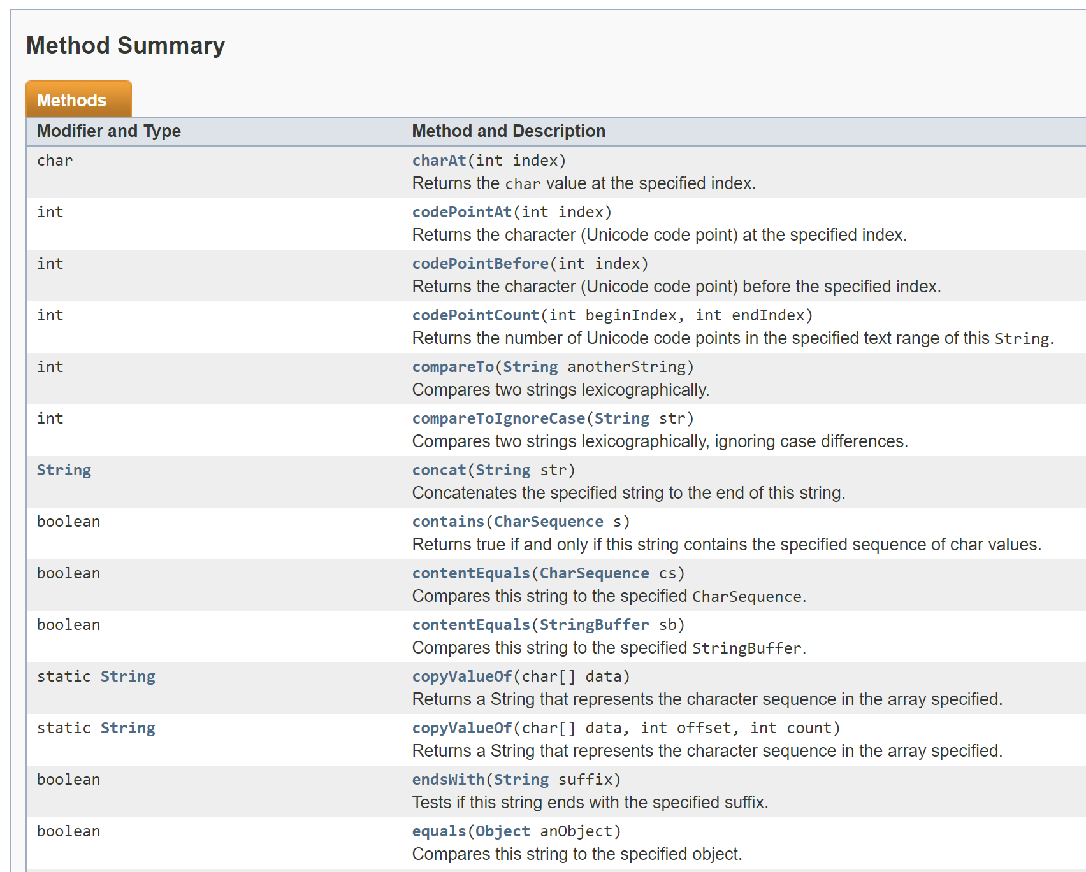
Classes and Objects
A class
defines a group of related methods (functions) and fields (variables / properties).

Slide 6
Classes and Objects
An object
is a single instance of a class
i.e. an object is created (instantiated) from a class.
String is the Class
String a;
&FFCC
a is the Object, which contains “Hello”
&FFCC
“Hello”

Slide 7
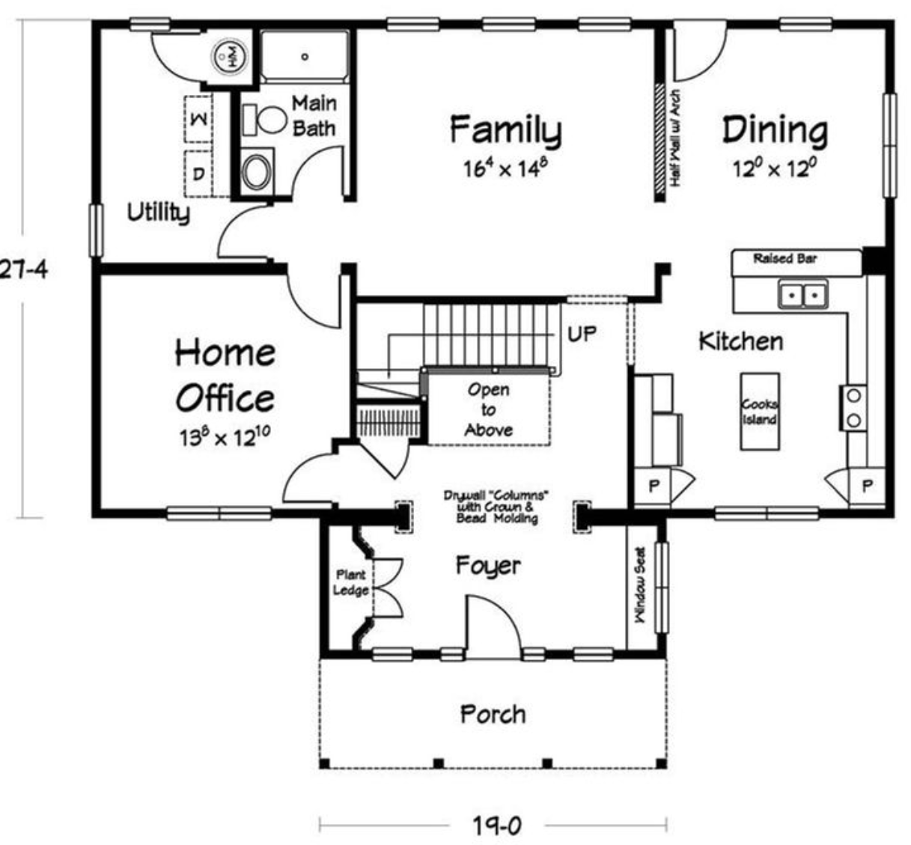
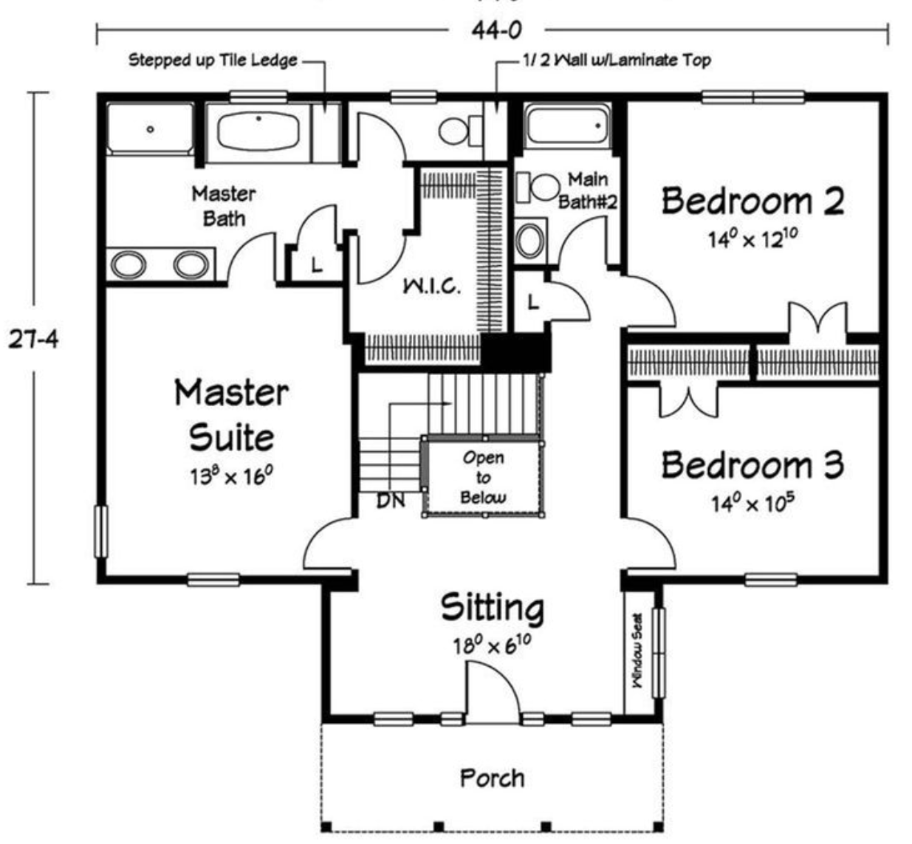
Classes and Objects – Building Analogy
A class is like a blueprint for a building.

Slide 8
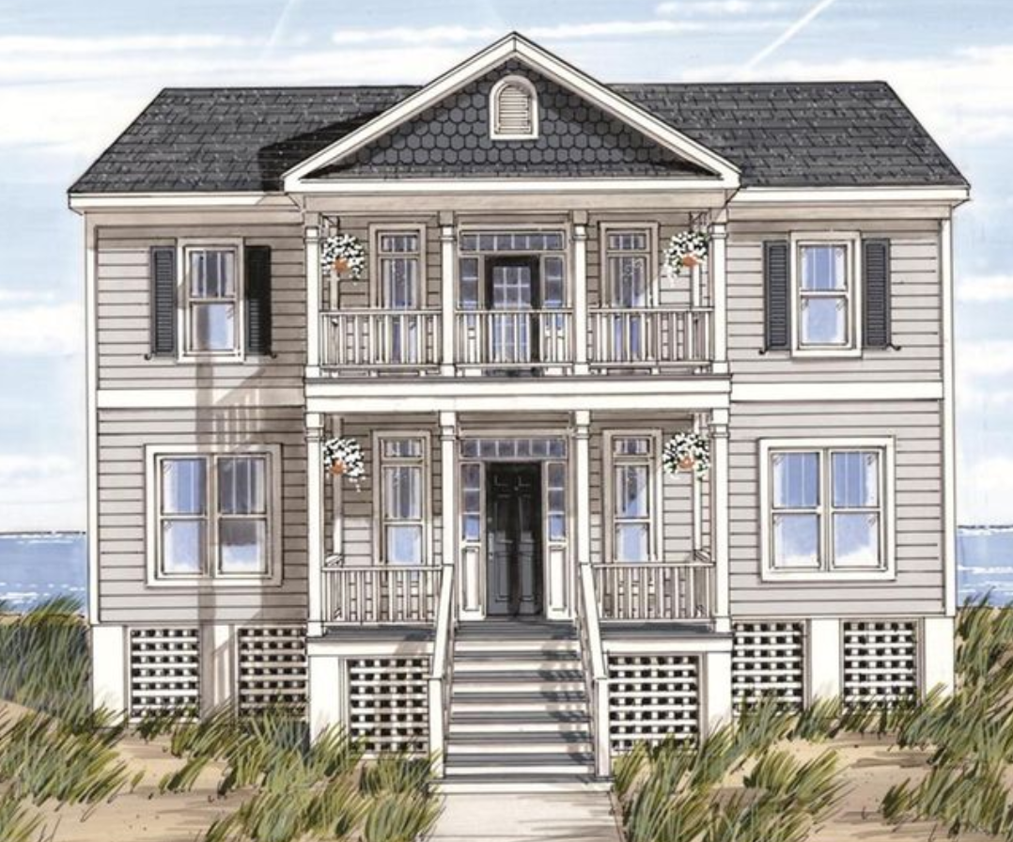
Classes and Objects – Building Analogy
An object is a building constructed from that blueprint.

Slide 9
Classes and Objects – Building Analogy
You can build lots of (buildings) objects from a single blueprint.
Notes:
http://momchuri.com/blueprint-house-plans/best-25-house-blueprints-ideas-on-pinterest-floor-plans-blueprint-small-b2b36c37890dbaeb4ef896380f4312f5-minecraft-building-h/

Slide 10
Classes and Objects – Many Objects
Many objects can be constructed from a single class definition.
Each object must have a unique name within the program.

Slide 11
Properties & Methods

Slide 12
Methods (functions) & Fields (variables/properties)
Objects are typically related to real-world artefacts.
In object-oriented programming (e.g. Java), you model an object by grouping together related methods (functions) and fields (variables).

Slide 13

Object example: Apple
Object Name | Apple
Fields (variables, properties) | colour weight
Methods (functions) | grow() fall() rot()

Slide 14

Object example: Butterfly
Object Name | Butterfly
Fields (variables, properties) | species gender
Methods (functions) | grow() flapWings() land()
Notes:
https://butterflyplace-ma.com/

Slide 15

Object example: Radio
Object Name | Radio
Fields (variables, properties) | frequency volume
Methods (functions) | turnOn() tune() setVolume()
Notes:
http://saltandlightministriesgh.org/radio-ministry/

Slide 16
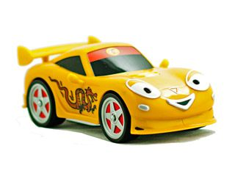
Object example: Car
Object Name | Car
Fields (variables, properties) | make model colour year
Methods (functions) | accelerate() brake() turn()
Notes:
https://www.pinterest.com/pin/24206916723490233/

Slide 17
Returning to the Apple Example
Object Name | Apple
Fields (variables, properties) | colour weight
Methods (functions) | grow() fall() rot()

Slide 18
Returning to the Apple Example
Object Type
Object Name | Apple
Fields (variables, properties) | colour weight
Methods (functions) | grow() fall() rot()

Slide 19
Returning to the Apple Example
Object Name | Apple
Fields (variables, properties) | colour weight
Methods (functions) | grow() fall() rot()
Properties / Attributes

Slide 20
Returning to the Apple Example
Object Name | Apple
Fields (variables, properties) | colour weight
Methods (functions) | grow() fall() rot()
Behaviours

Slide 21

Apple Class
To make a “blue print” of an Apple:
The grow() method
might have inputs for temperature and moisture.
can increase the weight field of the apple based on these inputs.
Apple
colour weight
grow() fall() rot()

Slide 22
Apple Class
To make a “blue print” of an Apple:
The fall() method
can continually check the weight and cause the apple to fall to the ground when the weight goes above a threshold.
Apple
colour weight
grow() fall() rot()

Slide 23
Apple Class
To make a “blue print” of an Apple:
The rot() method could then take over,
beginning to decrease the value of the weight field
and change the colour fields.
Apple
colour weight
grow() fall() rot()

Slide 24
Apple Object(s)
We saw earlier that:
An object
is created (instantiated) from a class.
A class
can have many objects created from it.
Each object
must have a unique name within the program.

Slide 25
Apple Object(s)
Apple
colour weight
grow() fall() rot()
gala
colour
red
weight
6.2
fugi
colour
yellow
weight
8.4
Class
Two objects. Each has a unique name and it’s own copy (values) of the fields.

Slide 26
Object State
There are two objects of type Apple.
Each has a unique name:
gala fugi
Each object has a different object state:
each object has it’s own copy of the fields (colour and weight) in memory and has it’s own data stored in these fields.
gala
colour
red
weight
6.2
fugi
colour
yellow
weight
8.4

Slide 27
The Dot Operator

Slide 28
Using an Object’s fields and methods
The fields and methods of an object are accessed with the dot operator i.e. external calls.
object.property
object.method
gala.colour | Gives access to the colour value in the gala object.
fugi.colour | Gives access to the colour value in the fugi object.
FIELDS
gala.grow() | Runs the grow() method inside the gala object.
fugi.fall() | Runs the fall() method inside the fugi object.
METHODS
Notes:
CAVEAT: As we progress through the module, we will show you a better way to access the fields of a class.

Slide 29
Creating your first Class - Spot

Slide 30
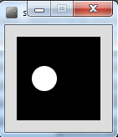
Creating your first class
We are going to start with sample code that draws a white spot on a black background.
We will refactor this code by:
writing a class
that will draw and format this spot.

Slide 31
Sample Code
float xCoord = 33.0;
float yCoord = 50.0;
float diameter = 30.0;
void setup(){
size (100,100);
noStroke();
}
void draw(){
background(0);
ellipse(xCoord, yCoord, diameter, diameter);
}

Slide 32
Creating your first class
A class creates a unique data type.
When creating a class, think carefully about what you want the code to do:
What are the attributes?
What are the behaviours?
First, we will start by: listing the attributes (fields/variables/properties) and figure out what data type they should be.

Slide 33
Identifying the fields (attributes, properties)
Q: What fields do we need to model the spot?
Note: fields are the attributes/properties of the object we are modelling.
float xCoord = 33.0;
float yCoord = 50.0;
float diameter = 30.0;
void setup(){
size (100,100);
noStroke();
}
void draw(){
background(0);
ellipse(xCoord, yCoord, diameter, diameter);
}

Slide 34
Identifying the fields (attributes, properties)
A: The required fields (attributes) are:
float xCoord (x-coordinate of spot)
float yCoord (y-coordinate of spot)
float diameter (diameter of the spot)
float xCoord = 33.0;
float yCoord = 50.0;
float diameter = 30.0;
void setup(){
size (100,100);
noStroke();
}
void draw(){
background(0);
ellipse(xCoord, yCoord, diameter, diameter);
}

Slide 35
Giving our new class a name
The name of a class should be carefully considered and should match its purpose
The name can be any word or words
It should begin with a capital letter
It should not be pluralised
For our first class, we could use names like:
Spot
Dot
Circle, etc.
We will call our first class, Spot.

Slide 36
Spot Class – Version 1.0
Spot sp;
void setup(){
size (100,100);
noStroke();
sp = new Spot();
sp.xCoord = 33;
sp.yCoord = 50;
sp.diameter = 30;
}
void draw(){
background(0);
ellipse(sp.xCoord, sp.yCoord, sp.diameter, sp.diameter);
}
class Spot
{
float xCoord, yCoord;
float diameter;
}

Slide 37
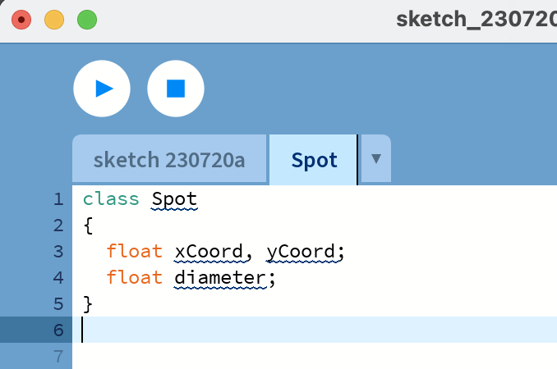
Spot Class – Version 1.0
Defining the class
class Spot
{
float xCoord, yCoord;
float diameter;
}
Declaring the fields in the class
In the PDE, place this code in a new tab, called Spot

Slide 38
Spot Class – Version 1.0
Declaring an object sp, of type Spot.
Spot sp;
void setup(){
size (100,100);
noStroke();
sp = new Spot();
sp.xCoord = 33;
sp.yCoord = 50;
sp.diameter = 30;
}
void draw(){
background(0);
ellipse(sp.xCoord, sp.yCoord, sp.diameter, sp.diameter);
}
class Spot
{
float xCoord, yCoord;
float diameter;
}

Slide 39
Spot Class – Version 1.0
Declaring an object sp, of type Spot.
Spot sp;
void setup(){
size (100,100);
noStroke();
sp = new Spot();
sp.xCoord = 33;
sp.yCoord = 50;
sp.diameter = 30;
}
void draw(){
background(0);
ellipse(sp.xCoord, sp.yCoord, sp.diameter, sp.diameter);
}
Calling the Spot() constructor to build the sp object in memory.
class Spot
{
float xCoord, yCoord;
float diameter;
}

Slide 40
Spot Class – Version 1.0
Declaring an object sp, of type Spot.
Spot sp;
void setup(){
size (100,100);
noStroke();
sp = new Spot();
sp.xCoord = 33;
sp.yCoord = 50;
sp.diameter = 30;
}
void draw(){
background(0);
ellipse(sp.xCoord, sp.yCoord, sp.diameter, sp.diameter);
}
Calling the Spot() constructor to build the sp object in memory.
class Spot
{
float xCoord, yCoord;
float diameter;
}
Initialising the fields in the sp object with a starting value.

Slide 41
Spot Class – Version 1.0
Declaring an object sp, of type Spot.
Spot sp;
void setup(){
size (100,100);
noStroke();
sp = new Spot();
sp.xCoord = 33;
sp.yCoord = 50;
sp.diameter = 30;
}
void draw(){
background(0);
ellipse(sp.xCoord, sp.yCoord, sp.diameter, sp.diameter);
}
Calling the Spot() constructor to build the sp object in memory.
class Spot
{
float xCoord, yCoord;
float diameter;
}
Initialising the fields in the sp object with a starting value.
Calling the ellipse method, using the fields in the sp object as arguments.

Slide 42
Constructors

Slide 43
Constructors
Spot sp;
sp = new Spot();
sp
sp
new calls the constructor to allocate the object in memory and initialise it’s fields
null
&FFCC
sp
Declares an sp object variable initialised to null by default
&FFCC
xCoord
0.0
yCoord
0.0
diameter
0.0

Slide 44
Constructors
Spot sp;
sp = new Spot();
The sp object is constructed with the keyword new.
Spot() is the default constructor that is called to build the sp object in memory.
Spot()
{
}
A CONSTRUCTOR is a method that has the same name as the class but has no return type.

Slide 45
Default Constructor
class Spot
{
float xCoord;
float yCoord;
float diameter;
//Default Constructor
Spot()
{
}
}
The default constructor has an empty parameter list.

Slide 46
Default Constructor
class Spot
{
float xCoord;
float yCoord;
float diameter;
//Default Constructor
Spot()
{
}
}
If you don’t include a constructor in your class, the compiler inserts a default one for you in the background (i.e. you won’t see it in your code).

Slide 47
Default Constructor
class Spot
{
float xCoord;
float yCoord;
float diameter;
//Default Constructor
Spot()
{
}
}
Here, the Spot() default constructor simply constructs the object.

Slide 48
Default Constructor
class Spot
{
float xCoord;
float yCoord;
float diameter;
//Default Constructor
Spot()
{
}
}
sp
sp
xCoord
0.0
yCoord
0.0
diameter
0.0
The constructor stores initial values in the fields.

Slide 49
Writing our first constructor
We now know that constructors store initial values in the fields of the object:
They often receive external parameter values for this.
Spot sp;
void setup(){
size (100,100);
noStroke();
sp = new Spot();
sp.xCoord = 33;
sp.yCoord = 50;
sp.diameter = 30;
}
void draw(){
background(0);
ellipse(sp.xCoord, sp.yCoord, sp.diameter, sp.diameter);
}

Slide 50
Writing our first constructor
In this code, we initialized:
xCoord
yCoord
diameter
after calling the Spot() constructor.
Spot sp;
void setup(){
size (100,100);
noStroke();
sp = new Spot();
sp.xCoord = 33;
sp.yCoord = 50;
sp.diameter = 30;
}
void draw(){
background(0);
ellipse(sp.xCoord, sp.yCoord, sp.diameter, sp.diameter);
}

Slide 51
Writing our first constructor
We want to write a new constructor that will take three parameters
xPos
yPos
diamtr
These values will be used to initialise the
xCoord,
yCoord
Diameter
variables.
Spot sp;
void setup(){
size (100,100);
noStroke();
sp = new Spot();
sp.xCoord = 33;
sp.yCoord = 50;
sp.diameter = 30;
}
void draw(){
background(0);
ellipse(sp.xCoord, sp.yCoord, sp.diameter, sp.diameter);
}

Slide 52
Writing our first constructor
We want to write a new constructor that will take three parameters
xPos
yPos
diamtr
These values will be used to initialise the
xCoord,
yCoord
Diameter
variables.
class Spot
{
float xCoord, yCoord;
float diameter;
Spot(float xPos, float yPos, float diamtr)
{
xCoord = xPos;
yCoord = yPos;
diameter = diamtr;
}
}

Slide 53
Spot Class – Version 2.0
Spot sp;
void setup()
{
size (100,100);
noStroke();
sp = new Spot(33, 50, 30);
}
void draw()
{
background(0);
ellipse(sp.xCoord, sp.yCoord,
sp.diameter, sp.diameter);
}
class Spot
{
float xCoord, yCoord;
float diameter;
Spot(float xPos, float yPos, float diamtr)
{
xCoord = xPos;
yCoord = yPos;
diameter = diamtr;
}
}

Slide 54
Overloading Constructors
We can have as many constructors as our design requires, ONCE they have unique parameter lists.
We are overloading our constructors in Version 3.0…

Slide 55
Spot Class – Version 3.0
Spot sp;
void setup()
{
size (100,100);
noStroke();
sp = new Spot(33, 50, 30);
}
void draw()
{
background(0);
ellipse(sp.xCoord, sp.yCoord,
sp.diameter, sp.diameter);
}
class Spot{
float xCoord, yCoord;
float diameter;
Spot(){
}
Spot(float xPos, float yPos, float diamtr){
xCoord = xPos;
yCoord = yPos;
diameter = diamtr;
}
}

Slide 56
Spot Class – Version 3.0
class Spot{
float xCoord, yCoord;
float diameter;
Spot(){
}
Spot(float xPos, float yPos, float diamtr){
xCoord = xPos;
yCoord = yPos;
diameter = diamtr;
}
}
Default Constructor with NO parameters

Slide 57
Spot Class – Version 3.0
class Spot{
float xCoord, yCoord;
float diameter;
Spot(){
}
Spot(float xPos, float yPos, float diamtr){
xCoord = xPos;
yCoord = yPos;
diameter = diamtr;
}
}
A second Constructor with a (float, float, float) parameter list.

Slide 58

Questions?

Slide 59
References
Reas, C. & Fry, B. (2014) Processing – A Programming Handbook for Visual Designers and Artists, 2nd Edition, MIT Press, London.

Slide 60



