Slide 1
Programming Fundamentals 1

Slide 2
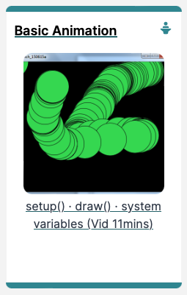
Introduction to Processing
Basics of Animation

Slide 3
Agenda
The setup() function
The draw() function
System Variables in Processing

Slide 4


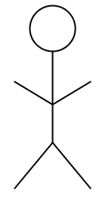
So far, all of our animations have been static.
Recap
Notes:
The drawing doesn’t change when you click on it with the mouse, drag the mouse, press a key on the keyboard, etc. It doesn’t change when time lapses, etc. It doesn’t react to “events”. It is not “listening” to our mouse / keyboard. It is not reacting to time lapsing, etc. When our drawings change based on some “event”, we call these animated drawings.

Slide 5

The setup() function

Slide 6
void setup()
setup() is called by Processing once (when the program starts). It should not be called again.
setup() can set the screen size and background colour.
There can only be one setup() function for each sketch.
https://processing.org/reference/setup_.html
Notes:
You don’t call the setup method….processing does it for you.
It is typically used to set up the canvas e.g. size and background colour, but a lot of other things can be done in setup….we will discuss these in future lectures, but will concentrate on size and background for the moment.

Slide 7
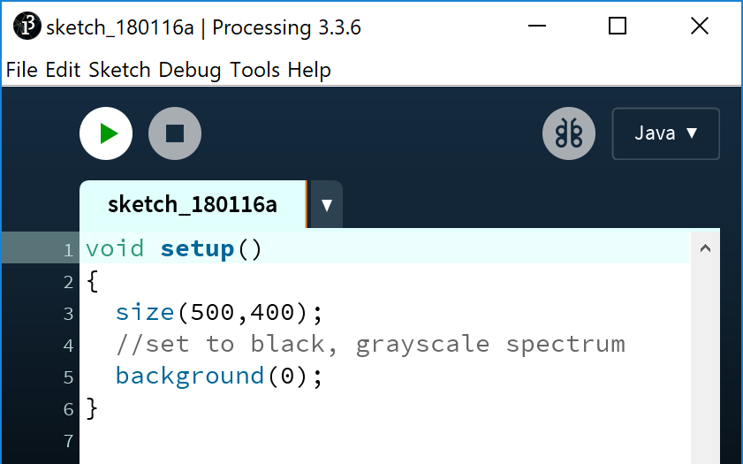
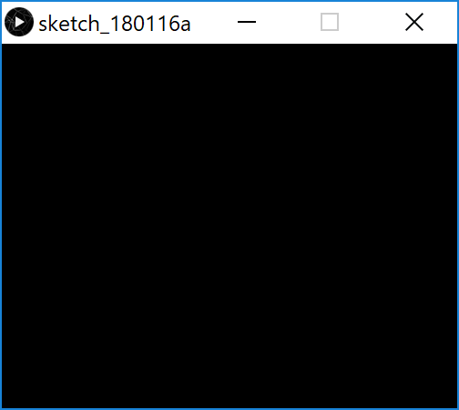
void setup() – defining a method
Notes:
//draw attention to curly braces…i.e. method body…all code is enclosed in it and belongs to the method setup.
// Draw attention to “void” and parenthesis.
//note that we will cover these in future lectures and to just write the method signature as is.

Slide 8
void setup() – defining a method
Notes:
//draw attention to curly braces…i.e. method body…all code is enclosed in it and belongs to the method setup.
// Draw attention to “void” and parenthesis.
//note that we will cover these in future lectures and to just write the method signature as is.

Slide 9
void setup() – defining a method
Notes:
//draw attention to curly braces…i.e. method body…all code is enclosed in it and belongs to the method setup.
// Draw attention to “void” and parenthesis.
//note that we will cover these in future lectures and to just write the method signature as is.

Slide 10
void setup() – defining a method
Notes:
//draw attention to curly braces…i.e. method body…all code is enclosed in it and belongs to the method setup.
// Draw attention to “void” and parenthesis.
//note that we will cover these in future lectures and to just write the method signature as is.

Slide 11
void setup() – defining a method
Notes:
//draw attention to curly braces…i.e. method body…all code is enclosed in it and belongs to the method setup.
// Draw attention to “void” and parenthesis.
//note that we will cover these in future lectures and to just write the method signature as is.

Slide 12
The draw() function

Slide 13
void draw()
You should never call the draw() function. (Just write it)
Processing automatically calls it straight after the setup() call.
draw() continuously executes the code contained inside it.
(60 times a second by default)
There can only be one draw() function for each sketch.
https://processing.org/reference/draw_.html

Slide 14
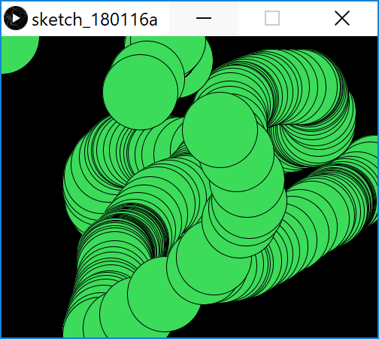
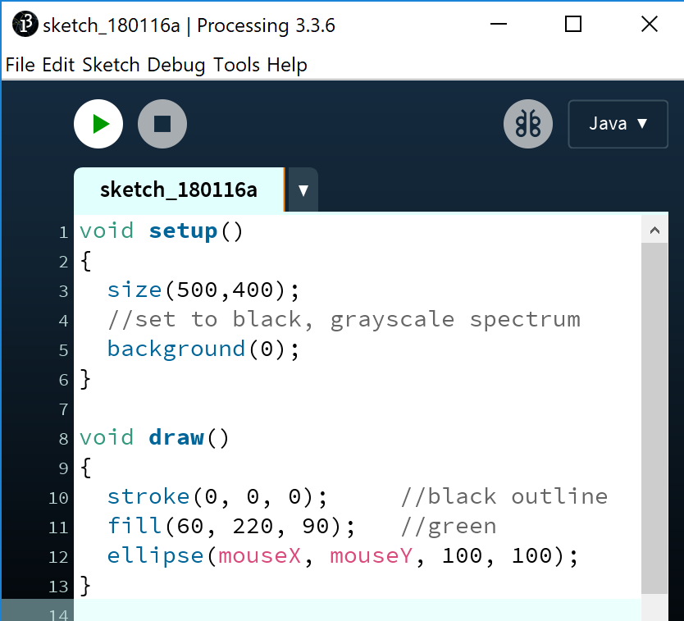
void draw()
mouseX = x co-ordinate of mouse pointer
mouseY = y co-ordinate of mouse pointer
System Variables
Notes:
//The background function is only called once, so the background is only “painted” over when the sketch is drawn.
//A circle is drawn each time draw() is called.
//The circle is drawn at the current location of mouseX and mouseY, so as the mouse is moved, you get multiple circles.
void setup()
{
size(500,400);
//set to black, grayscale spectrum
background(0);
}
void draw()
{
stroke(0, 0, 0); //black outline
fill(60, 220, 90); //green
ellipse(mouseX, mouseY, 100, 100);
}

Slide 15
void draw()
Q: Why many circles?
mouseX = x co-ordinate of mouse pointer
mouseY = y co-ordinate of mouse pointer
System Variables
Notes:
//The background function is only called once, so the background is only “painted” over when the sketch is drawn.
//A circle is drawn each time draw() is called.
//The circle is drawn at the current location of mouseX and mouseY, so as the mouse is moved, you get multiple circles.
void setup()
{
size(500,400);
//set to black, grayscale spectrum
background(0);
}
void draw()
{
stroke(0, 0, 0); //black outline
fill(60, 220, 90); //green
ellipse(mouseX, mouseY, 100, 100);
}

Slide 16
void draw()
Q: Why many circles?
A: background(0) is in the setup function.
mouseX = x co-ordinate of mouse pointer
mouseY = y co-ordinate of mouse pointer
System Variables
Notes:
//The background function is only called once, so the background is only “painted” over when the sketch is drawn.
//A circle is drawn each time draw() is called.
//The circle is drawn at the current location of mouseX and mouseY, so as the mouse is moved, you get multiple circles.
void setup()
{
size(500,400);
//set to black, grayscale spectrum
background(0);
}
void draw()
{
stroke(0, 0, 0); //black outline
fill(60, 220, 90); //green
ellipse(mouseX, mouseY, 100, 100);
}

Slide 17
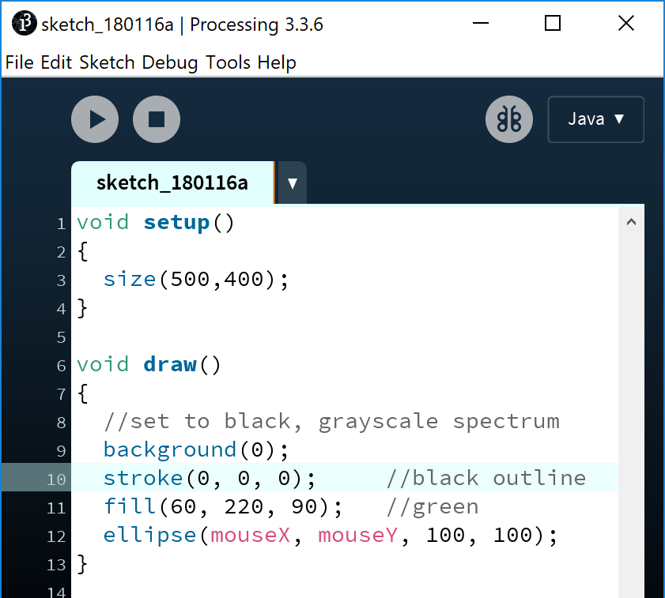
void draw()
Q: What happens when we move background(0) into the draw function?
Notes:
void setup()
{
size(500,400);
background(0);
}
void draw()
{
stroke(0, 0, 0);
fill(60, 220, 90);
ellipse(mouseX, mouseY, 100, 100);
}

Slide 18
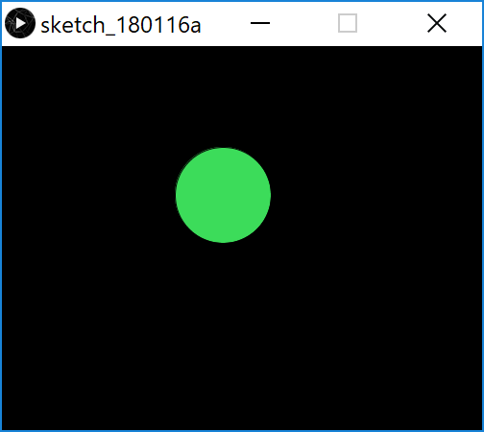
void draw()
Q: What happens when we move background(0) into the draw function?
A: Before each circle is drawn, the background is painted black, so it clears the previous circle.
Notes:
void setup()
{
size(500,400);
background(0);
}
void draw()
{
stroke(0, 0, 0);
fill(60, 220, 90);
ellipse(mouseX, mouseY, 100, 100);
}

Slide 19
System Variables in Processing

Slide 20
System Variables in Processing
Some examples of system variables in Processing:
mouseX (x co-ordinate of the mouse pointer on the display window)
mouseY (y co-ordinate of the mouse pointer on the display window)
width (width of the display window)
height (height of the display window)
We don’t have to define/create these; just use them
Notes:
}

Slide 21
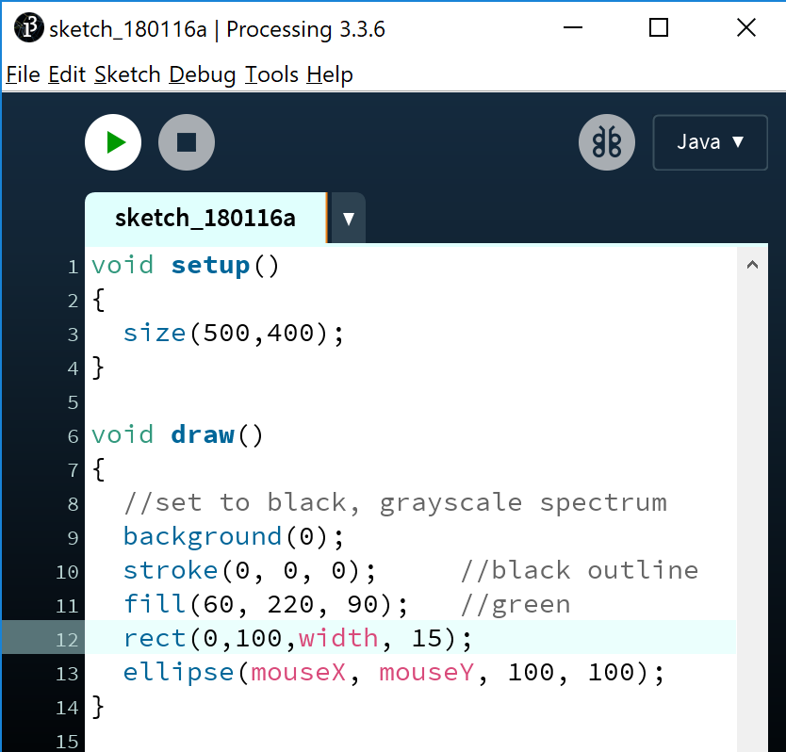
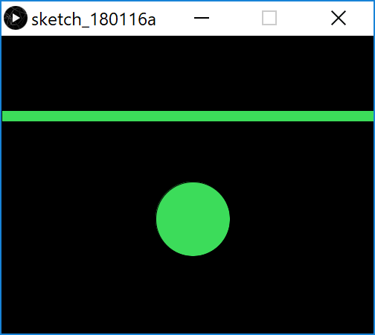
System Variables in Processing
Using the width system variable in the rect function to draw a thick line.
Notes:
Note that the line drawn doesn’t move with the mouse, as the mouseX and mouseY are not part of it.
void setup()
{
size(500,400);
}
void draw()
{
//set to black, grayscale spectrum
background(0);
stroke(0, 0, 0); //black outline
fill(60, 220, 90); //green
rect(0,100,width, 15);
ellipse(mouseX, mouseY, 100, 100);
}

Slide 22
System Variables in Processing
Q: What would happen to our animation if we swapped the mouseX and mouseY variables in the ellipse function with each other?
Notes:
Answer: You will be trying this in labs…as you move your mouse right on the x axis, the circle will move down on the y axis and vice versa.
void setup()
{
size(500,400);
}
void draw()
{
//set to black, grayscale spectrum
background(0);
stroke(0, 0, 0); //black outline
fill(60, 220, 90); //green
rect(0,100,width, 15);
ellipse(mouseX, mouseY, 100, 100);
}

Slide 23
System Variables in Processing
Q: What would happen to our animation if we swapped the mouseX and mouseY variables in the ellipse function with each other?
A: As you move your mouse right on the x axis, the circle will move down on the y axis and vice versa.
Notes:
Answer: You will be trying this in labs…as you move your mouse right on the x axis, the circle will move down on the y axis and vice versa.
void setup()
{
size(500,400);
}
void draw()
{
//set to black, grayscale spectrum
background(0);
stroke(0, 0, 0); //black outline
fill(60, 220, 90); //green
rect(0,100,width, 15);
ellipse(mouseX, mouseY, 100, 100);
}

Slide 24

Questions?

Slide 25



